Slide 1
DWSD Update for District One
Gary Brown, Director, Detroit Water & Sewerage Department
April 24, 2021

Slide 2
DWSD Update for District One
Water and Sewer Rates
Response to COVID-19
Customer Affordability Programs
Long-Term Affordability
Construction Projects

Slide 3
Water and Sewer Rates
No General Fund dollars (tax revenue) support Detroit’s water and sewer systems
Services supported through the water, sewer and drainage rates
Revenue support for affordability plans are from outside resources (i.e., CARES Act)
Mostly fixed costs driven by infrastructure requirements
OLD DWSD before GLWA
Operating Both Detroit and Regional System
NEW DWSD as of January 2016
Serving Only Detroit
437%
Total rate increase the 20 years prior to the bifurcation with GLWA
9%
Average annual rate increase in that timeframe
3%
Average rate increase since the bifurcation with GLWA
3%
Rate increase for FY2021
$2.29 increase per month for a residential household of three with average usage

Slide 4
COVID-19 Response
Moratorium on residential shutoffs extended through the end of 2022 while we work on a long-term affordability plan
$14 Million in direct bill assistance to 40,000 residential accounts to help pay down past due balances
$10 Million for a Emergency Plumbing Repair Program in partnership with Wayne Metro
Plumbing repairs to restore water under the COVID-19 Water Restart Plan announced March 9, 2020
1,300 occupied houses had water restored that were previously interrupted for nonpayment
$6 Million for private sewer line replacement and major home plumbing repairs at 600 houses
More than 100 lead service lines replaced
Engage the Community Health Corps (CHC) when residents in abject poverty need wrap-around services
Plumbing repairs can reduce monthly water and sewer bills by 23%
on average

Slide 5
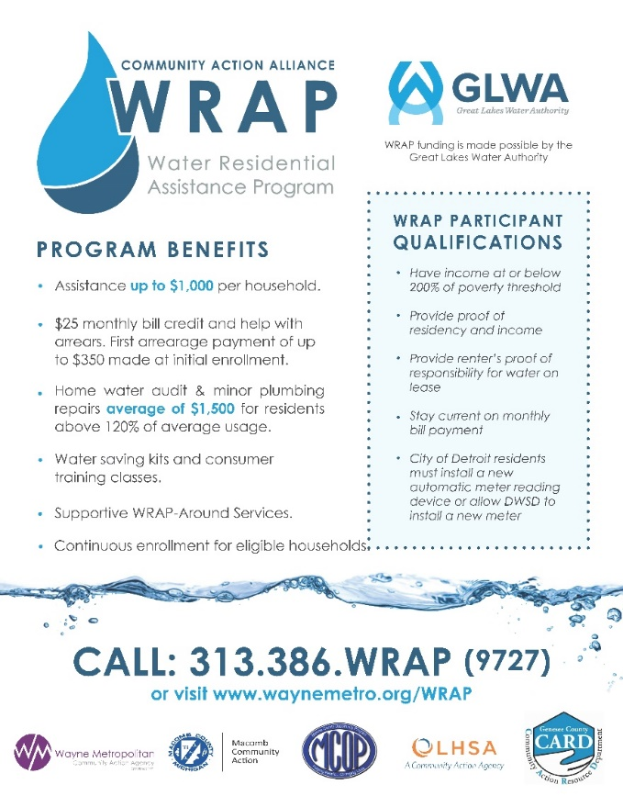
Customer Affordability Programs
10/30/50 Plan available to all DWSD customers
Water Residential Affordability Program (WRAP)
A compassionate, robust income-based affordability program – national interest
Eligible households at or below 200% of the federal poverty level (i.e., $52,400 for a family of four)
Plumbing repairs average of $1,500, per household
Tenants are now eligible for minor home plumbing repairs
Annual monthly bill credit and arrearage credit is $1,000
Two-year program for most households -- seniors, Veterans and persons living with disabilities receive $25 monthly bill credit indefinitely
Households have a monthly bill reduction of 19%, on average, resulting from the minor home plumbing repairs
More than 20,000 households have benefited since March 2016
Annual GLWA allocation of $6.5M, of which nearly $3M earmarked for Detroit

Slide 6
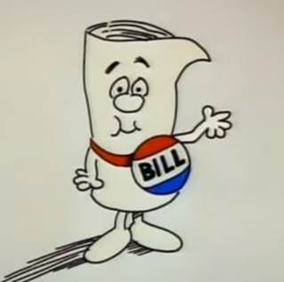
Long-Term Affordability Dependent on State and Federal Funding
Income-based rate not viable in Detroit – 30% of customers would have to bear most of the costs
State and federal legislation/funding necessary to support reducing water bills for low-income residents
American Rescue Plan provides additional dollars for two existing ratepayer programs
$4.5B for FY21-FY22 for Low-Income Home Energy Assistance Program (LIHEAP)
$500M for Low-Income Household Drinking Water and Wastewater Emergency Assistance Program
New program provides funds to assist low-income households that are paying a high proportion of their income for drinking water and wastewater services during the COVID-19 Pandemic
Detroit | Philadelphia | Baltimore | Chicago
Total Population (U.S. Census)
680,000 | 1,600,000 | 620,000 | 8,800,000
Percentage of Households At or Below 200% of Federal Poverty Level*
73% | 58% | 53% | 15%
Percentage of Households At or Below the Federal Poverty Level*
46% | 34% | 29% | 9%
DWSD is committed to aggressive public outreach and marketing of these programs

Slide 7
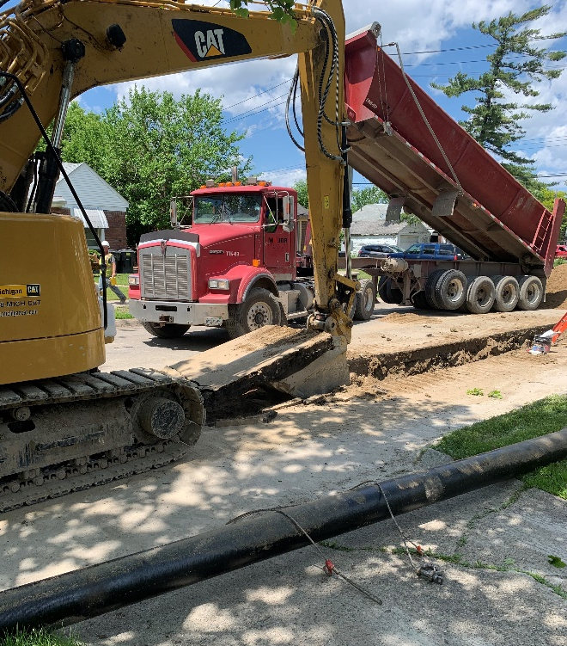
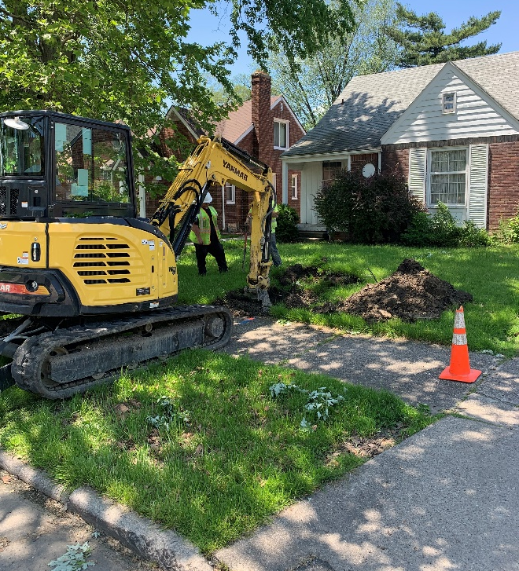
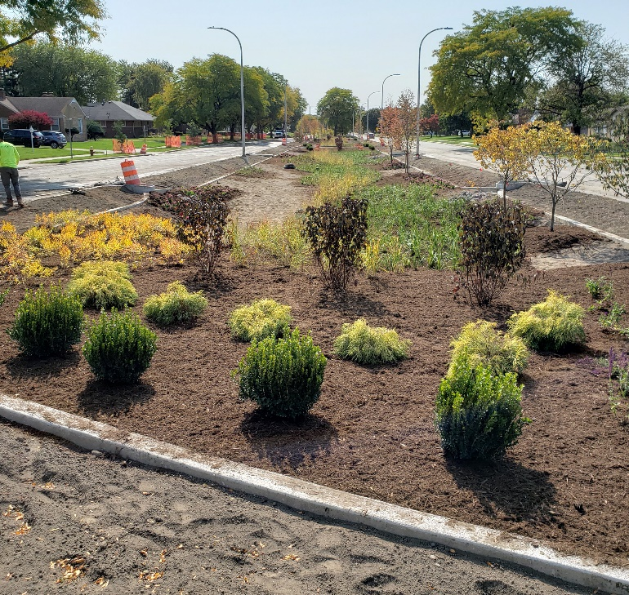
DWSD Capital Improvement Program Update
DWSD has invested $200M in capital improvement projects since 2019
Water main, hydrant and lead service line replacement
Sewer lining and replacement
Green Stormwater Infrastructure installations
Condition assessments and other data are used to determine necessary upgrades
DWSD and our contractors have:
Replaced 66 miles of water main and more than 1,155 lead service lines
Replaced or lined 50 miles of sewer collection piping
Installed 11 bioretention gardens
DWSD crews also performing preventative maintenance tasks

Slide 8
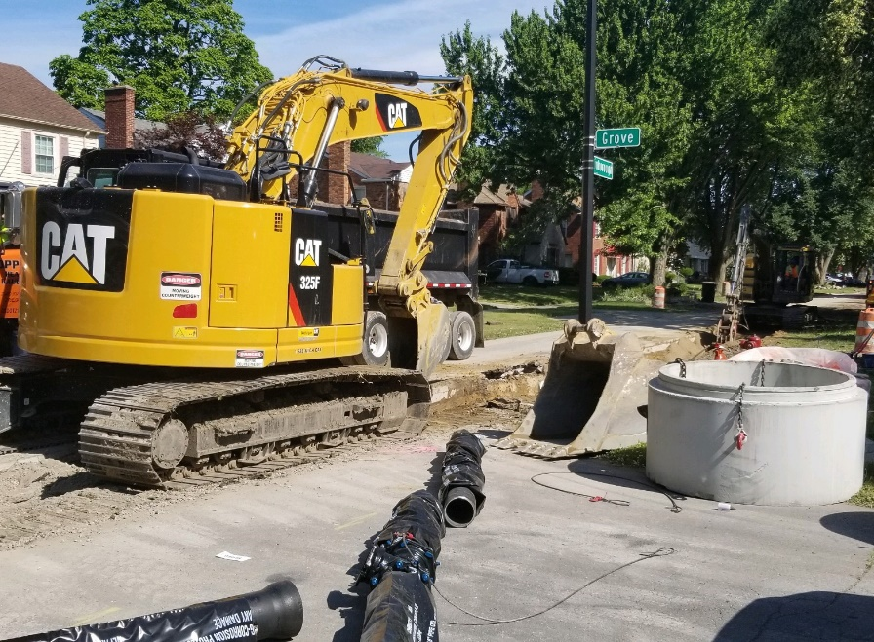
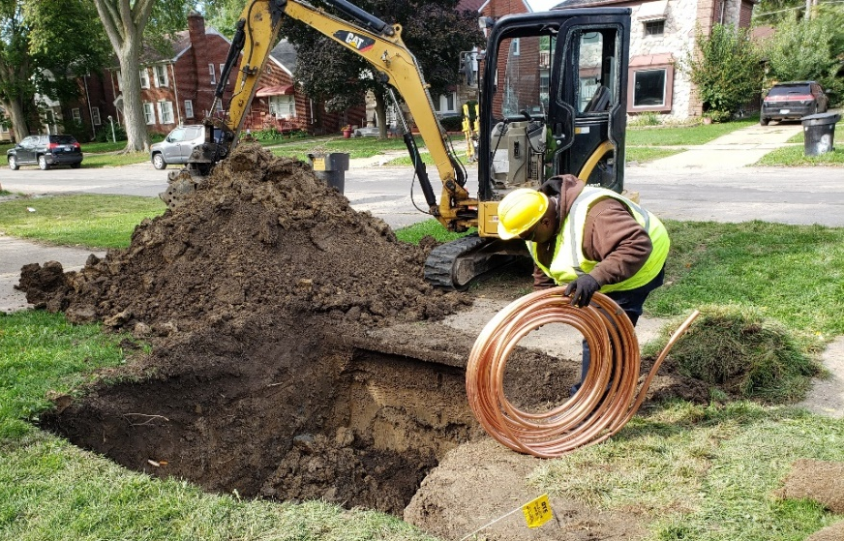
DWSD Construction in District One
North Rosedale Park Water and Sewer Upgrades in progress
Charles Wright Academy Green Stormwater Infrastructure Project starts this month
Sewer Connection Repairs and Lining in Minock Park this summer
Other Areas with Water System Upgrades
Schoolcraft from Asbury Park to Grand River (near completion)
Southfield Service Drive between Pembroke and Seven Mile (start date TBD in 2021)
Water Upgrades coming to six neighborhoods starts this summer
Evergreen-Lasher
McNichols
Miller Grove
Minock Park
Riverdale
Rosedale Park

Slide 9
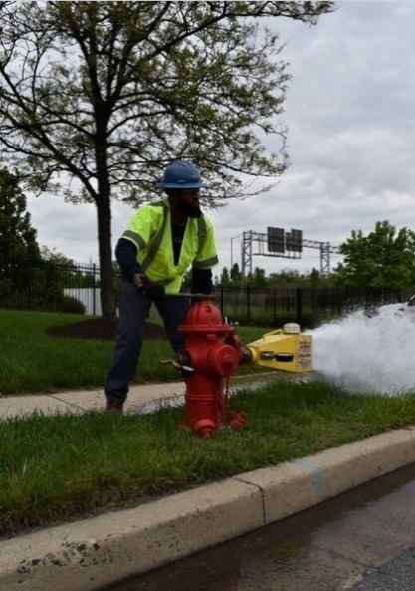
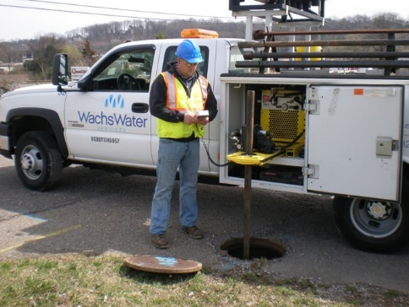
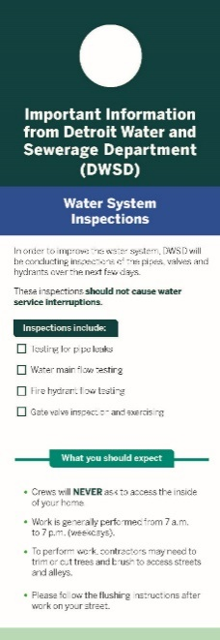
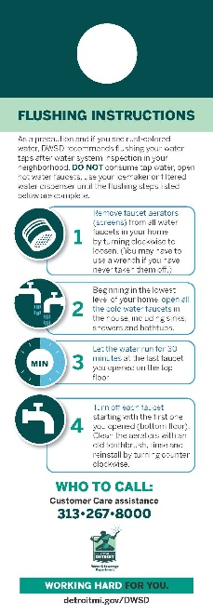
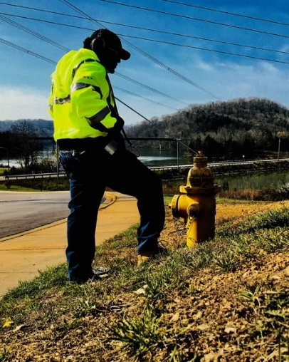
DWSD Water System Assessments in 39 Neighborhoods including District One
This summer, DWSD and Wachs Water Services, will perform water main condition assessments
The project will consist of maintenance inspections and data collection
Assessments includes water main leak detection and hydrant flushing which should not cause water service interruptions to residents
Leaks will be recorded and a DWSD Service Request will be created for DWSD Field Services to investigate immediately
Residents will receive door hanger notifications and other communication prior to work in their neighborhood
Work will generally be performed 7 a.m. to 7 p.m. on weekdays
Assessments will indicate what needs to be repaired or replaced – not all water mains will need to be replaced

Slide 10
Questions?

Slide 11
Gary Brown, Director
DWSD-publicaffairs@detroitmi.gov

