Slide 1
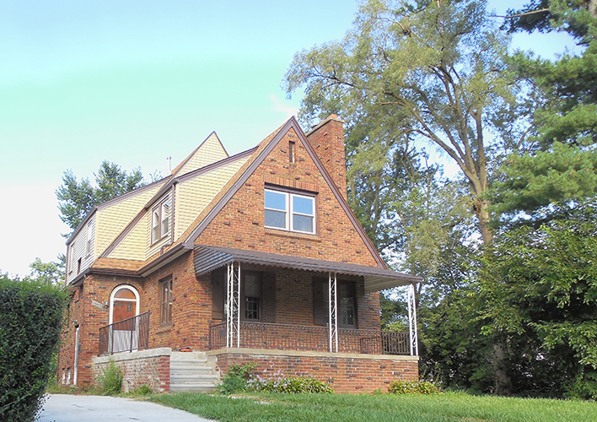
Brilliant Detroit
Brightmoor House
15509 Heyden St.
Detroit, MI 48223

Slide 2
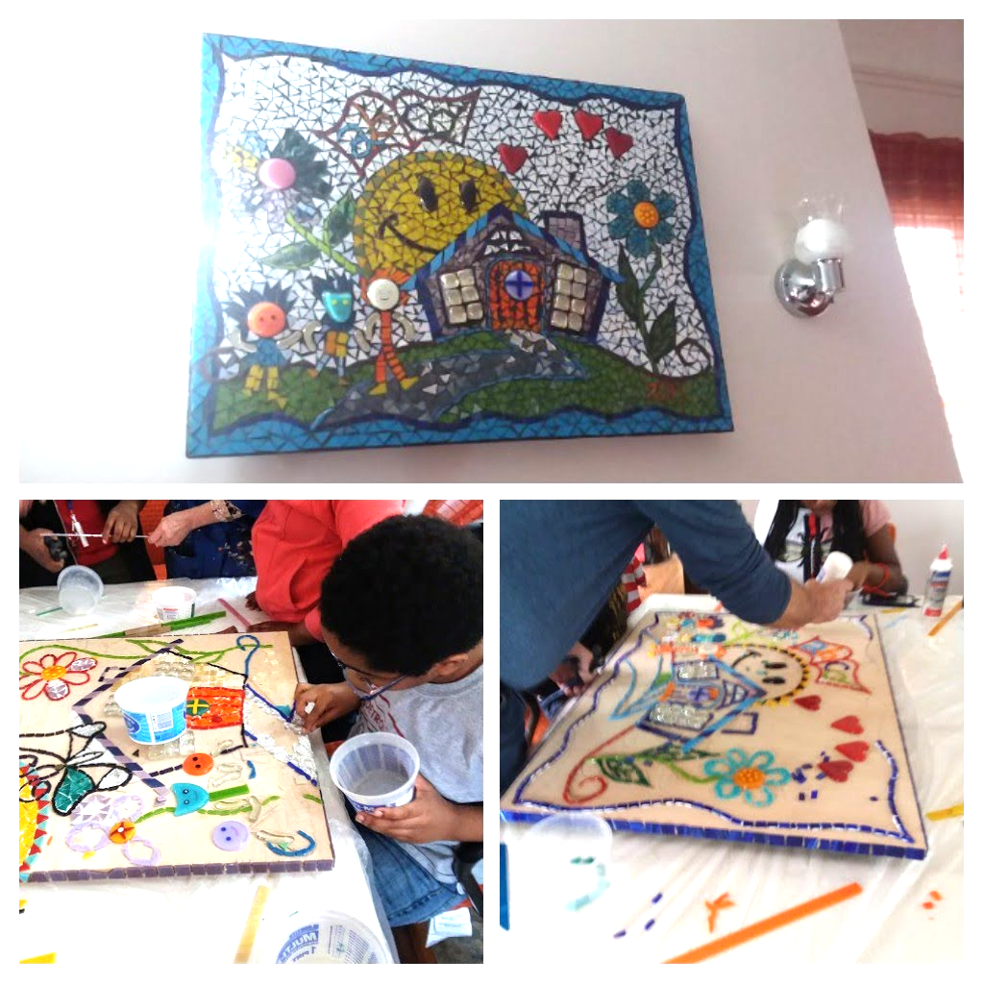
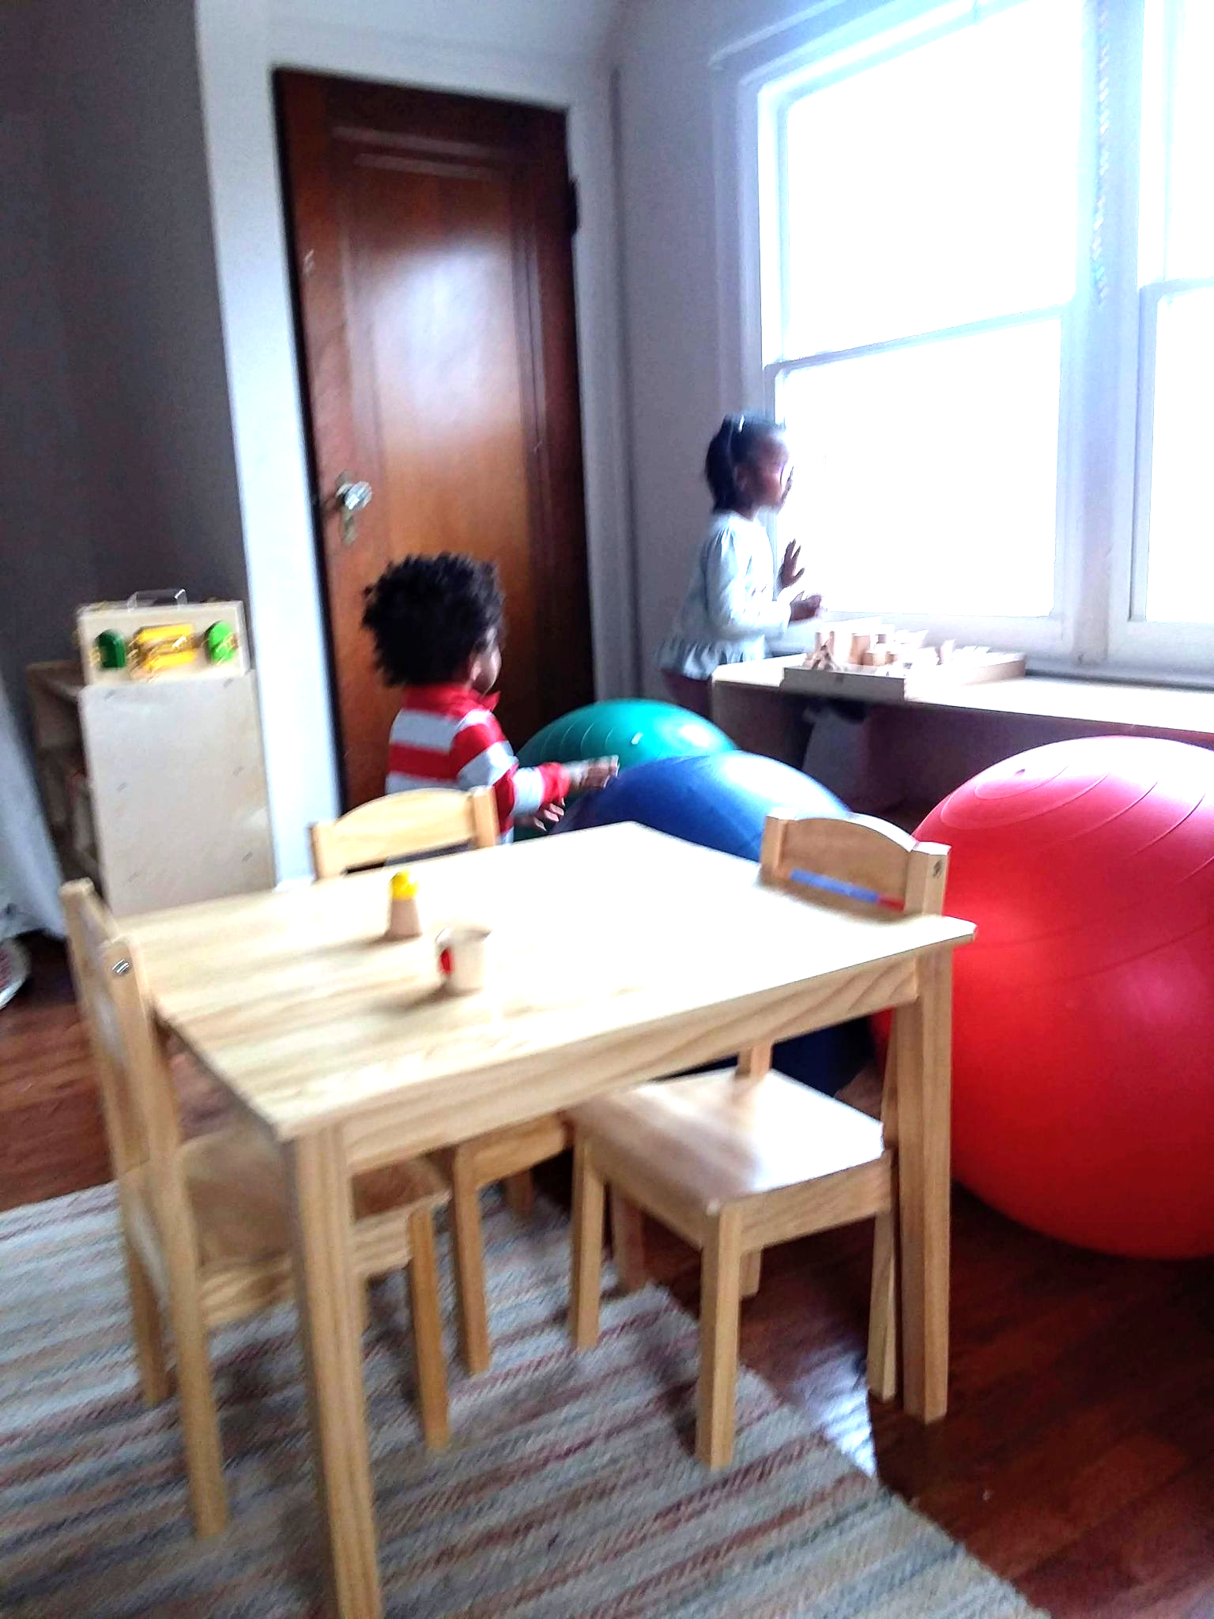
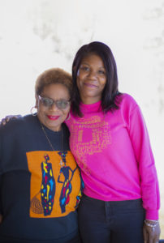
Samara’s Brilliant Journey
Rekisha Odom (Right, pictured with Advisory Board Member Ora Williams), was the Manager at the time I began attending the BDB house. She made me feel welcomed from the moment I came through the door and quickly became like a sister.
April 10, 2019 would be my first experience at the Brilliant Detroit Brightmoor House. The activity was a community mosaic, which I later learned was a special tradition they have where the community comes together to create a piece of art that hangs in their site. While my oldest son Gabriel worked with the volunteers, my youngest son (Jacob), my niece (Wynter) and I explored the rest of the house. My youngest son Jacob quickly took to the Toddler Room.

Slide 3
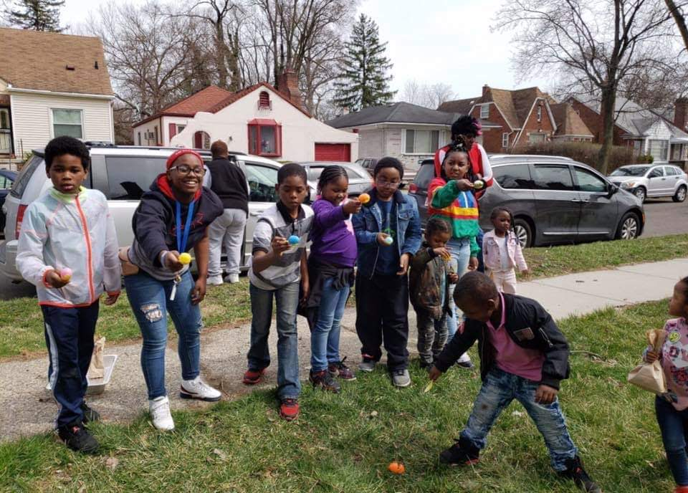
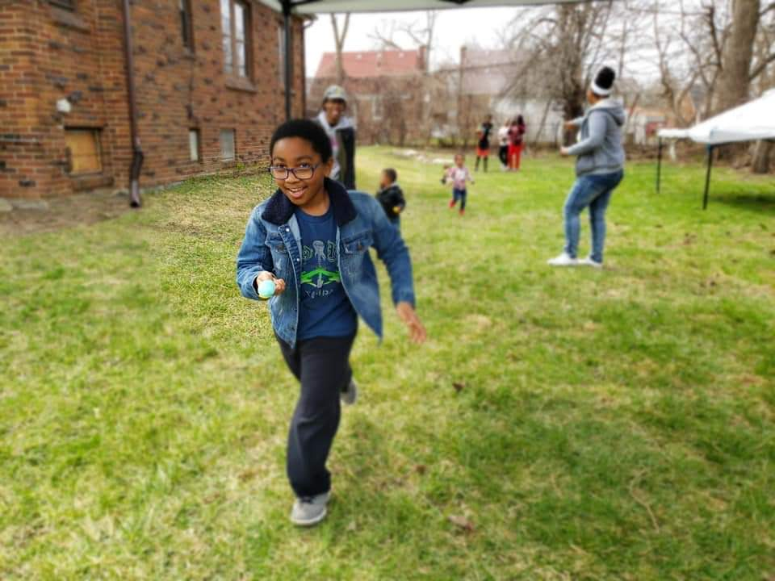
The children got to use the large side yard to hunt for eggs, have and egg relay, and free dance (just one of the many examples of how the house used creative ways to get the kids involved in physical activities and promotes a healthy lifestyle. Afterwards they calmed down by listening to stories because reading is integrated into the majority of their activities, while they dyed and decorated eggs and enjoyed healthy snacks. While the children played, I helped to put together goodie bags for the kids to take home and my husband led the raffle.
Easter at the Brilliant Detroit Brightmoor House

Slide 4
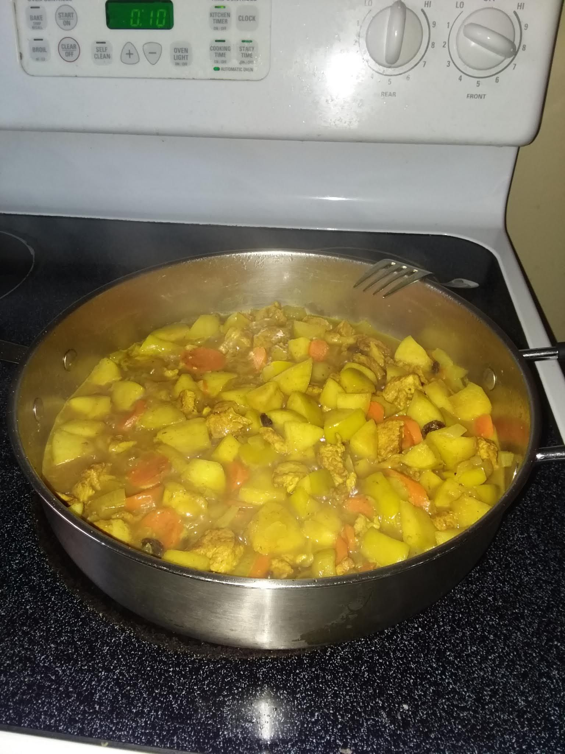
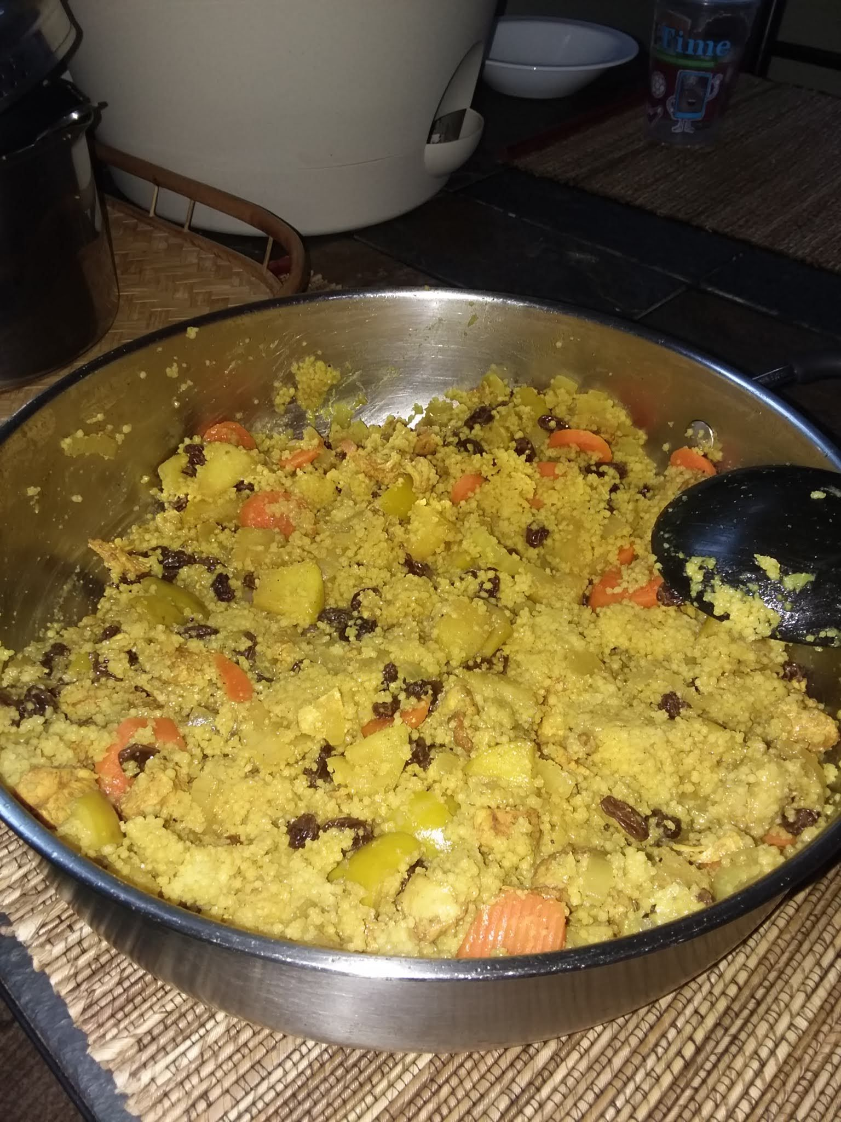
One of the many classes I’ve taken at the BDB house, included where we learned about making healthier food choices and saving money at the grocery store. Each week we worked together as a team to cook the meal. While we washed, chopped and prepared fresh vegetables, prepped lean proteins and cooked whole grains, we shared stories about our lives and bonded.
At the end of each class we received groceries to take home to recreate the meal for our family. The pictured dish is Chicken and Couscous with Apple and Raisins.
Cooking Matters Classes

Slide 5
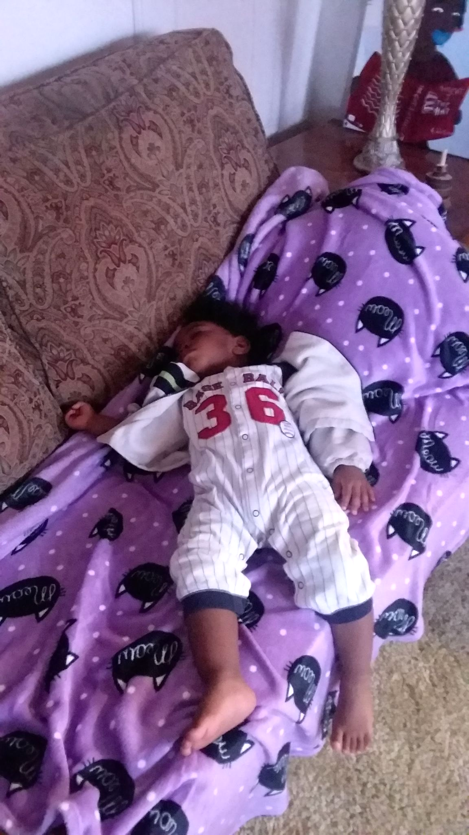
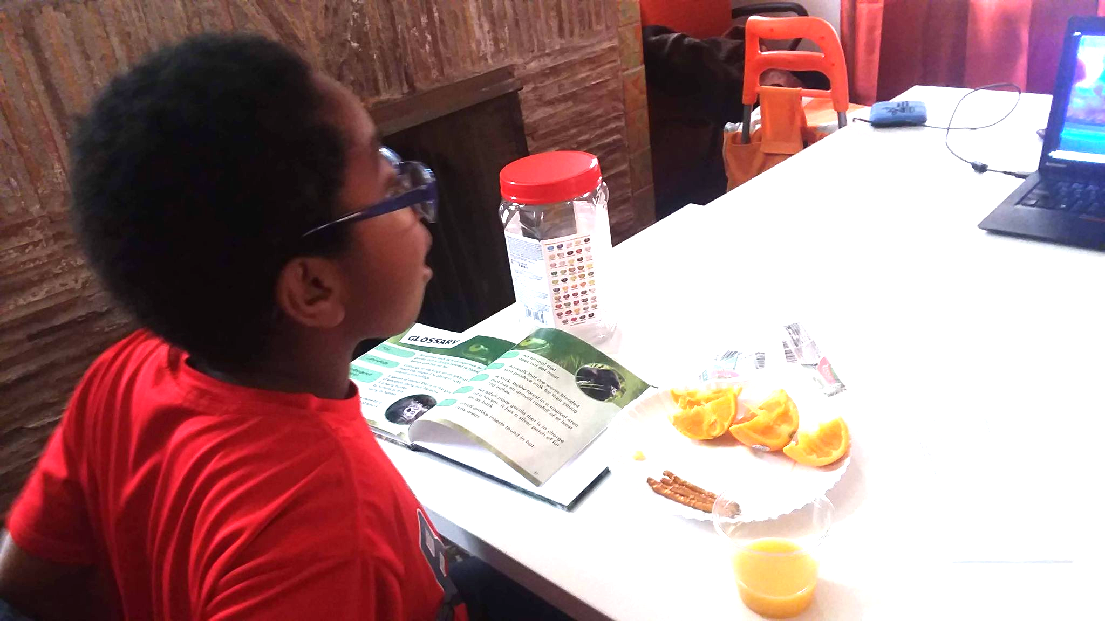
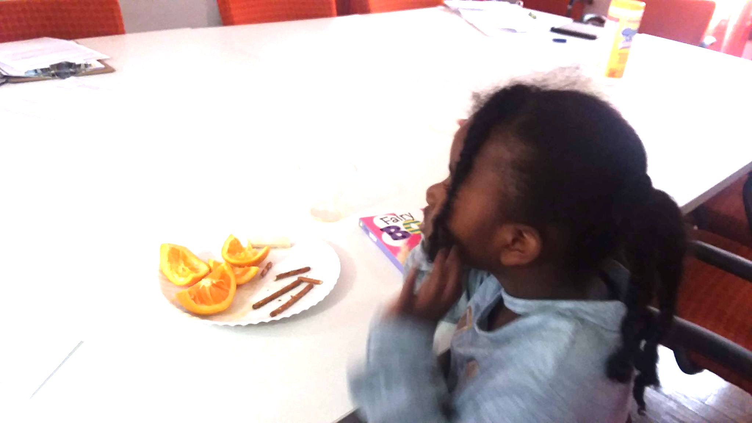
Even on days where there wasn’t anything special going on I would bring my children by to have a snack, read a book, take a nap on the comfy couch in the den or just have a change of scenery. Ms. Rekisha as we call her created an environment that was so welcoming and supportive that we loved coming as often as we could.
Home Away from Home

Slide 6
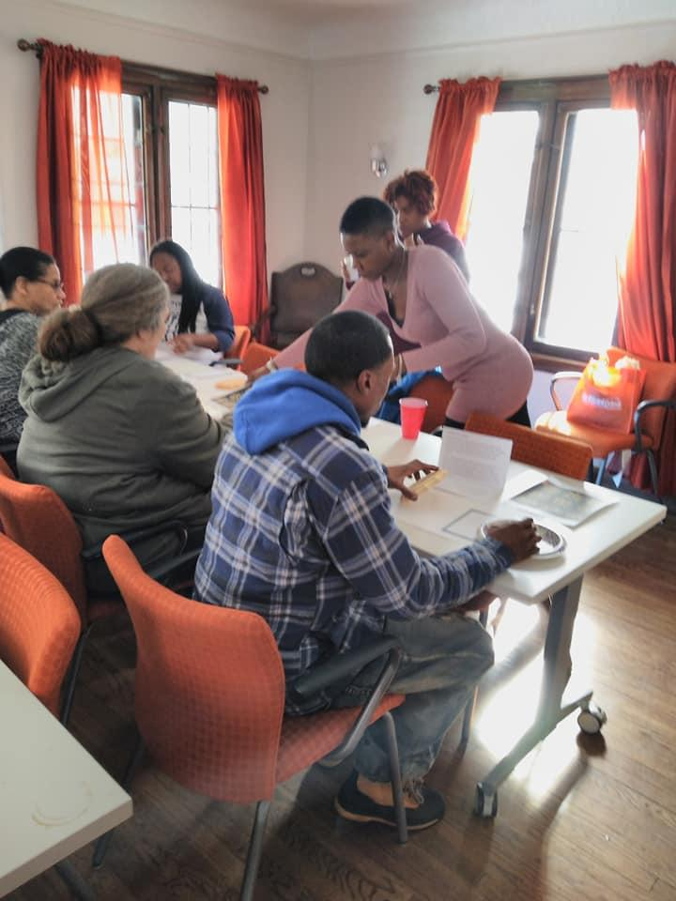
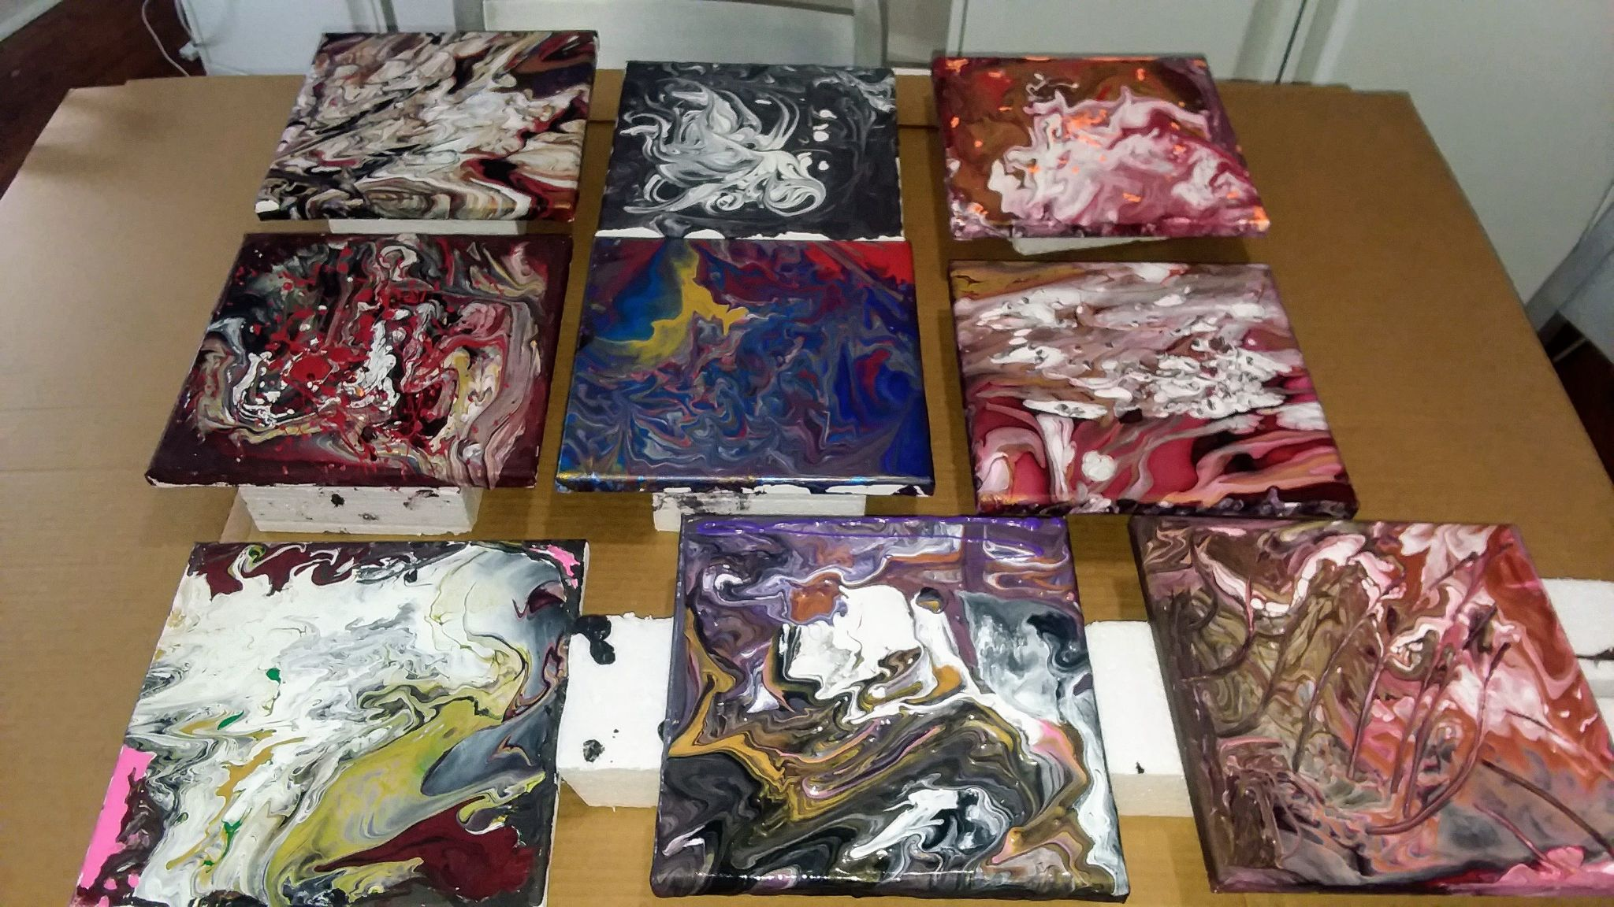
The BDB house had a weekly art therapy class where we came together to express ourselves through our art. We drank coffee/tea and chatted about our hopes and dreams and shared what was going on in the neighbor.
This class gave me an opportunity to connect with and learn from the seniors in the community who were regular participants.
Art Therapy
Classes

Slide 7
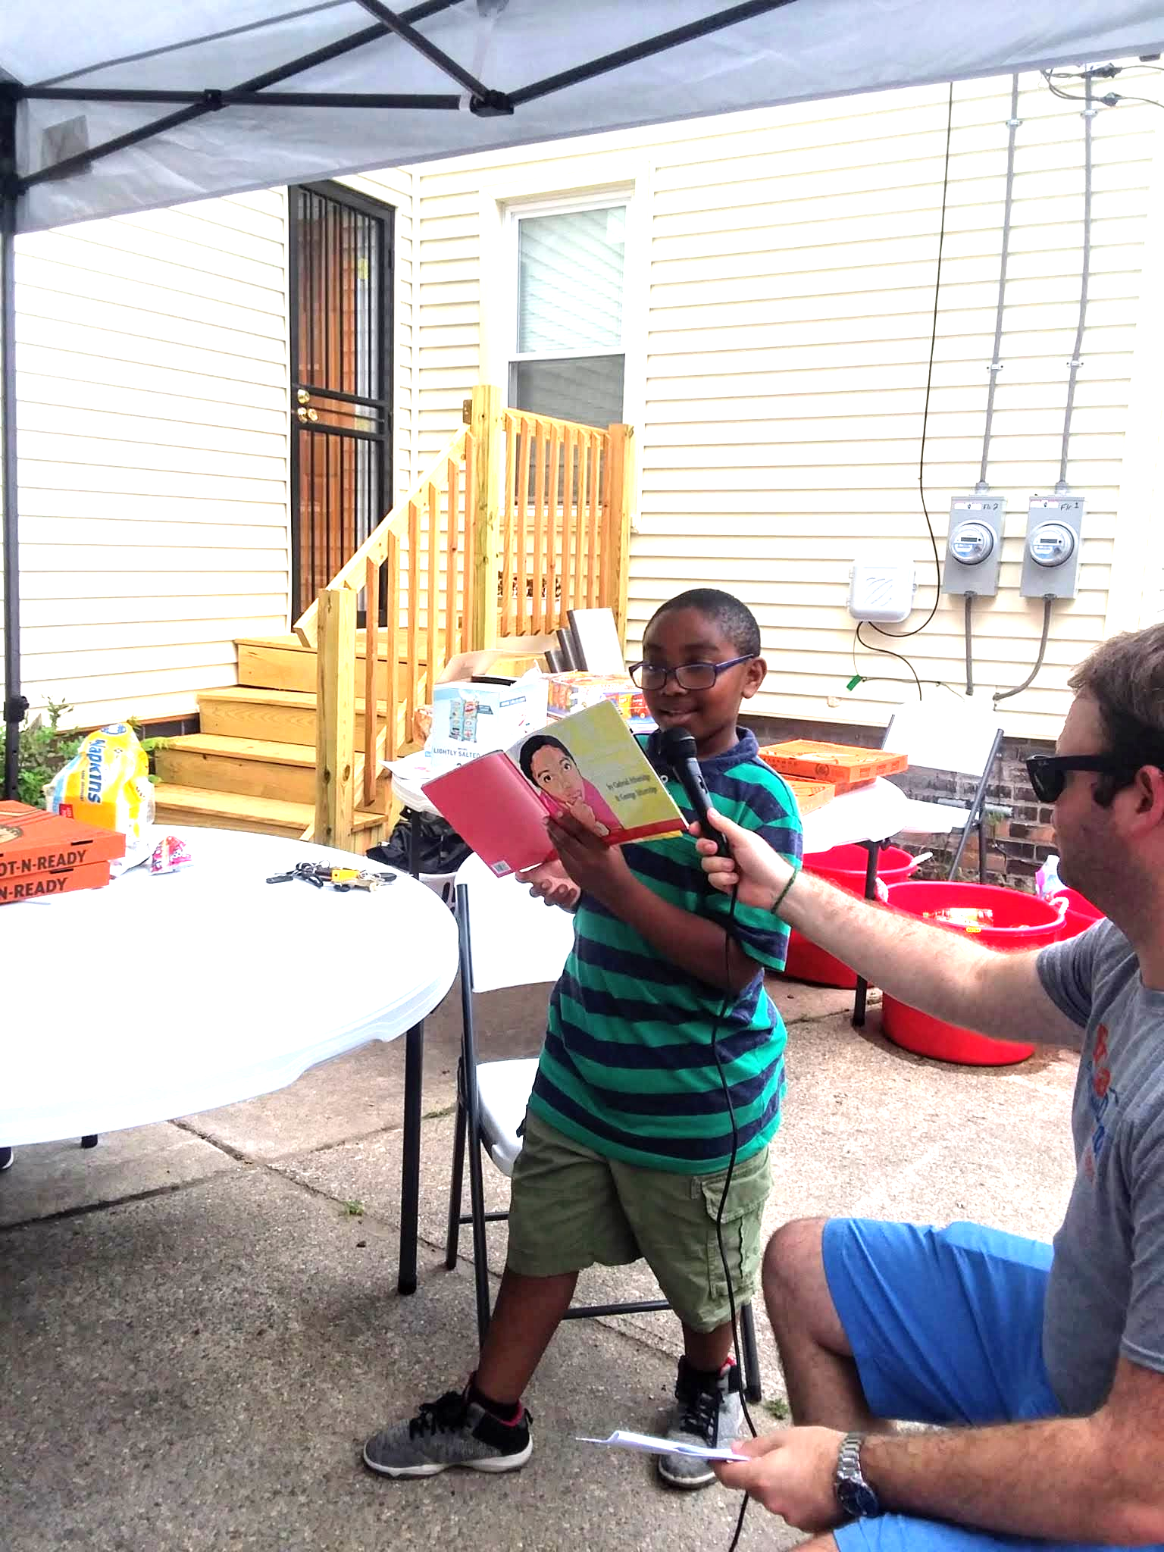
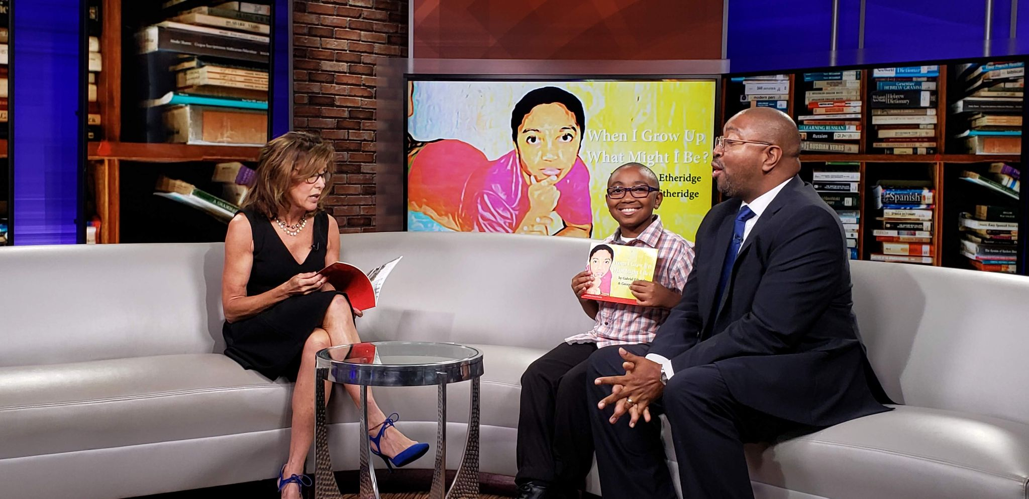
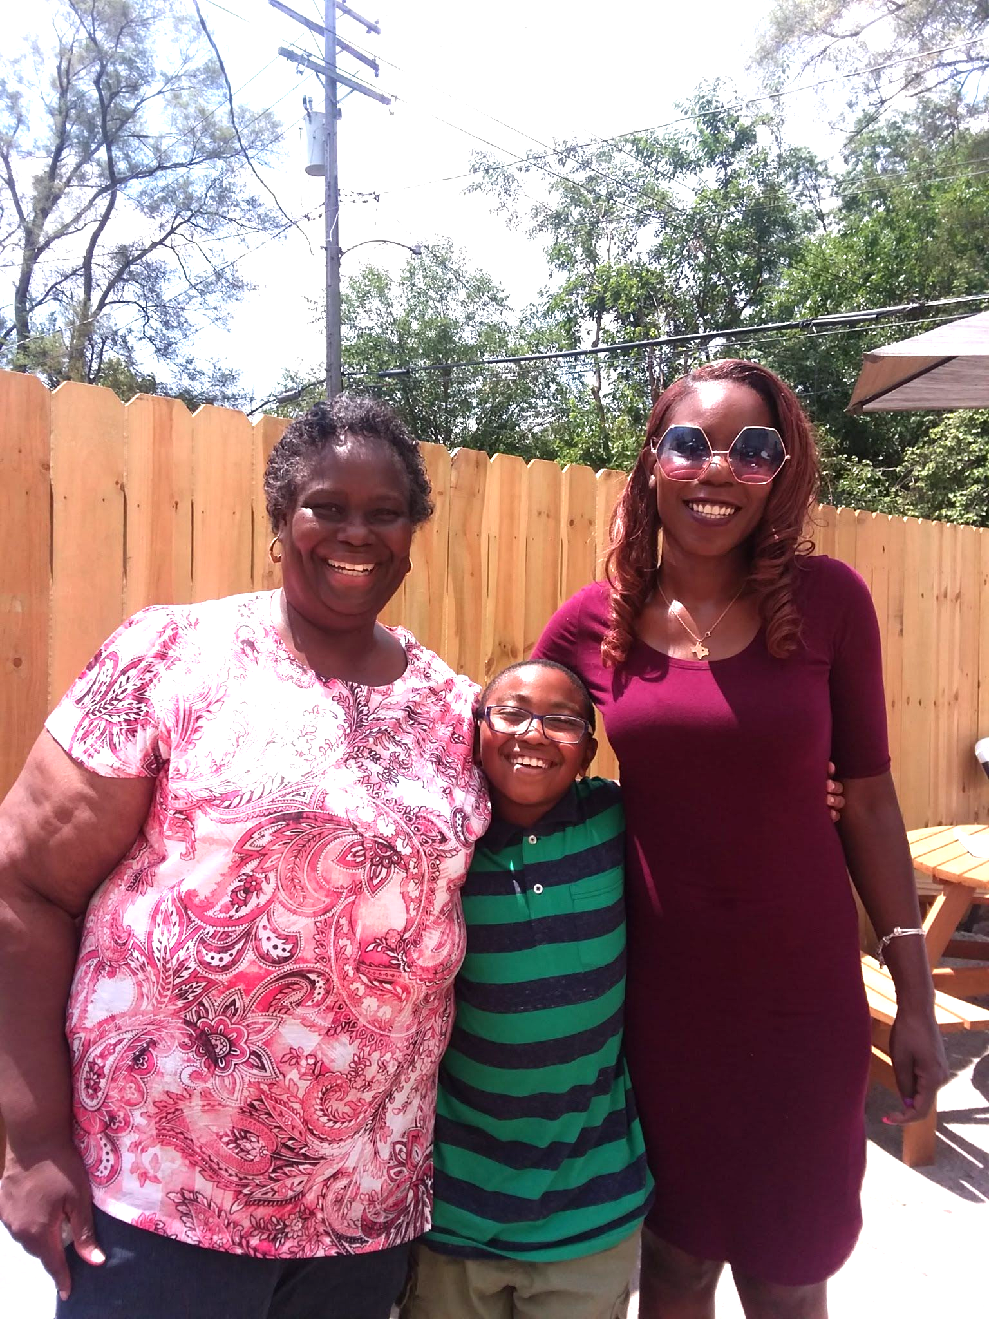
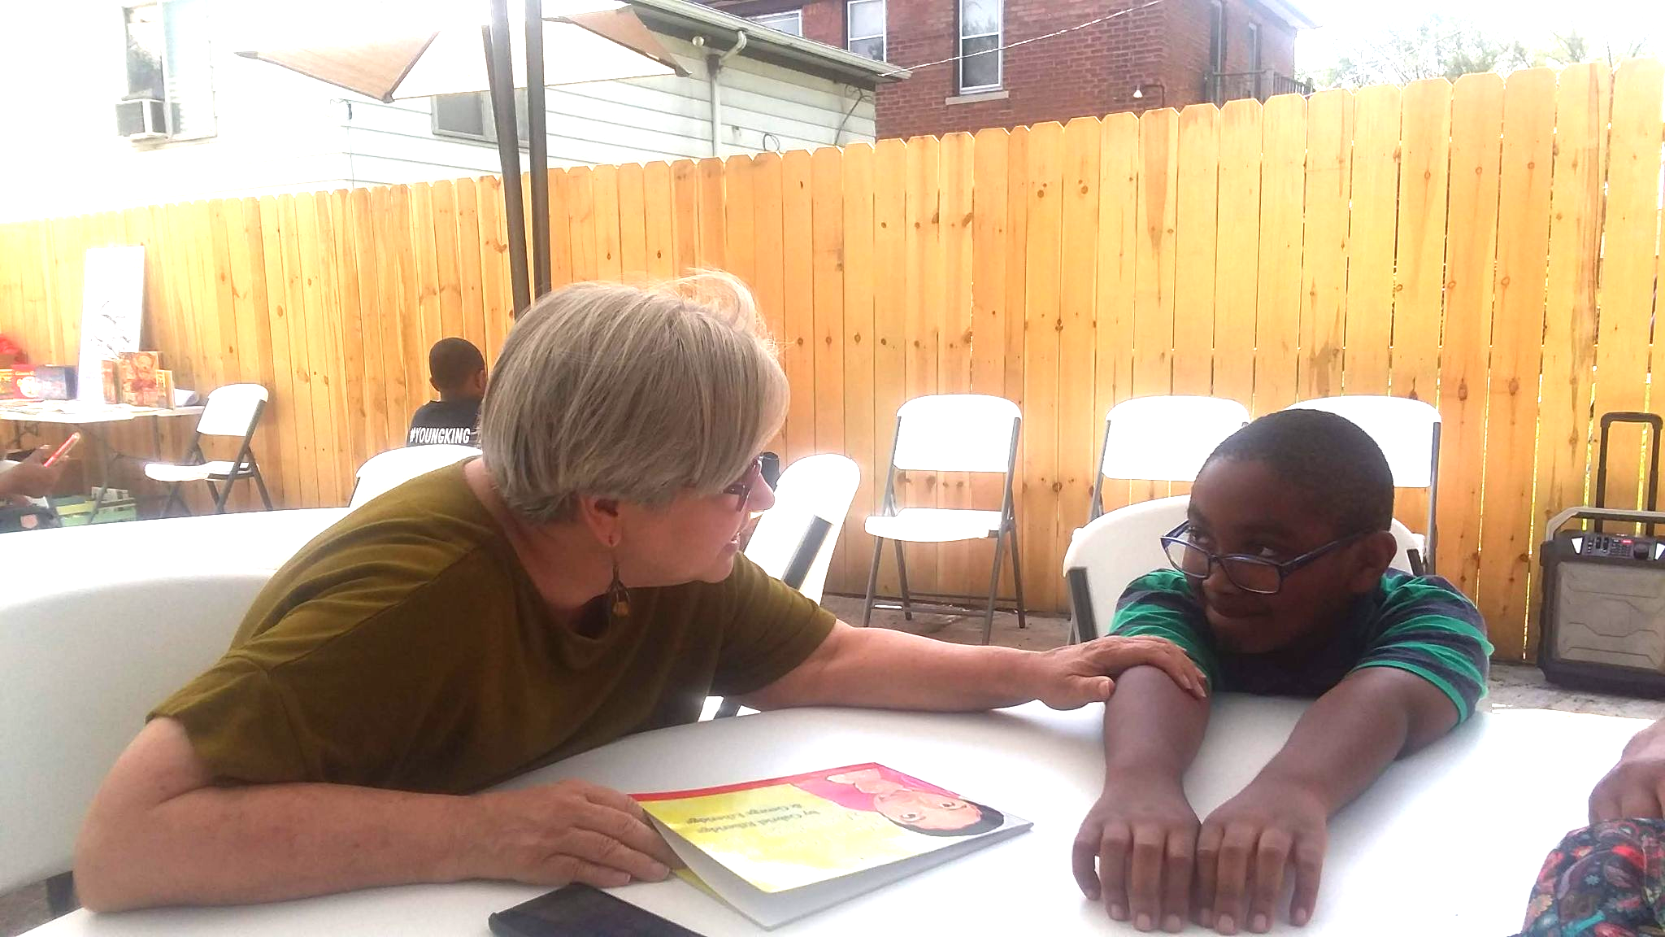
Here’s an example of how Brilliant Detroit supported and uplifted my family. Through a casual conversations I had with Ms. Rakisha, she learned that my son had recently published a book. She was so excited to support him, that she purchased several copies to keep in the house and give to participants.
The support did not stop there, she then recommend that he read his story at the recently opened Fitzgerald house, which was having a special event showcasing community authors. It was through this event that he met Cindy, the Co-founder and CEO of the organization, who was so impressed with him that she recommended him for a news interview to share his story.
Family Support

Slide 8
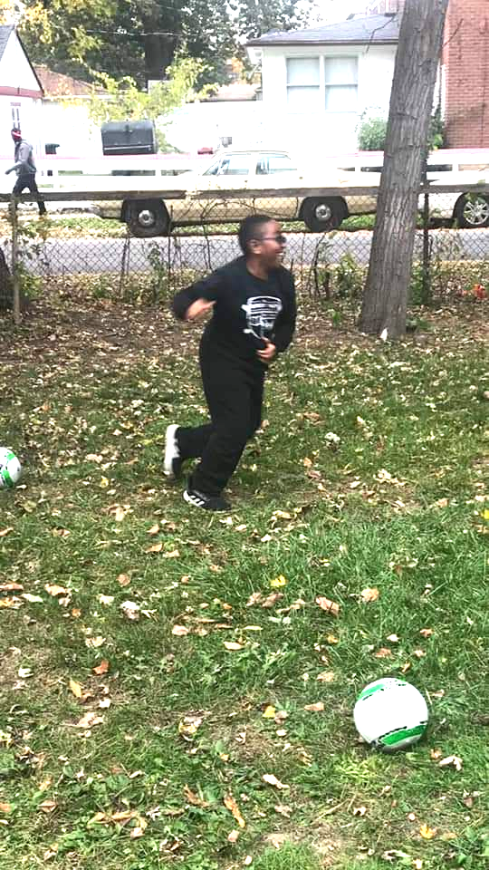
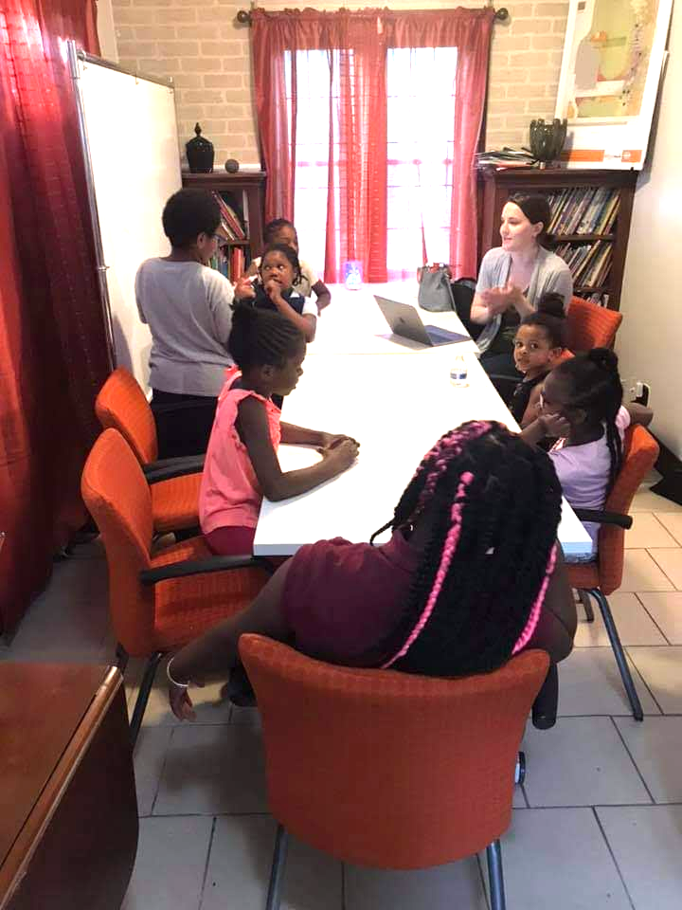
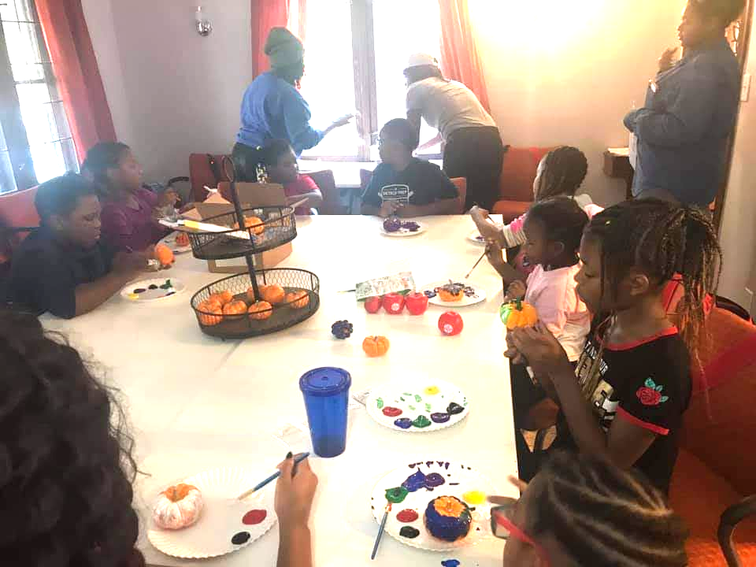
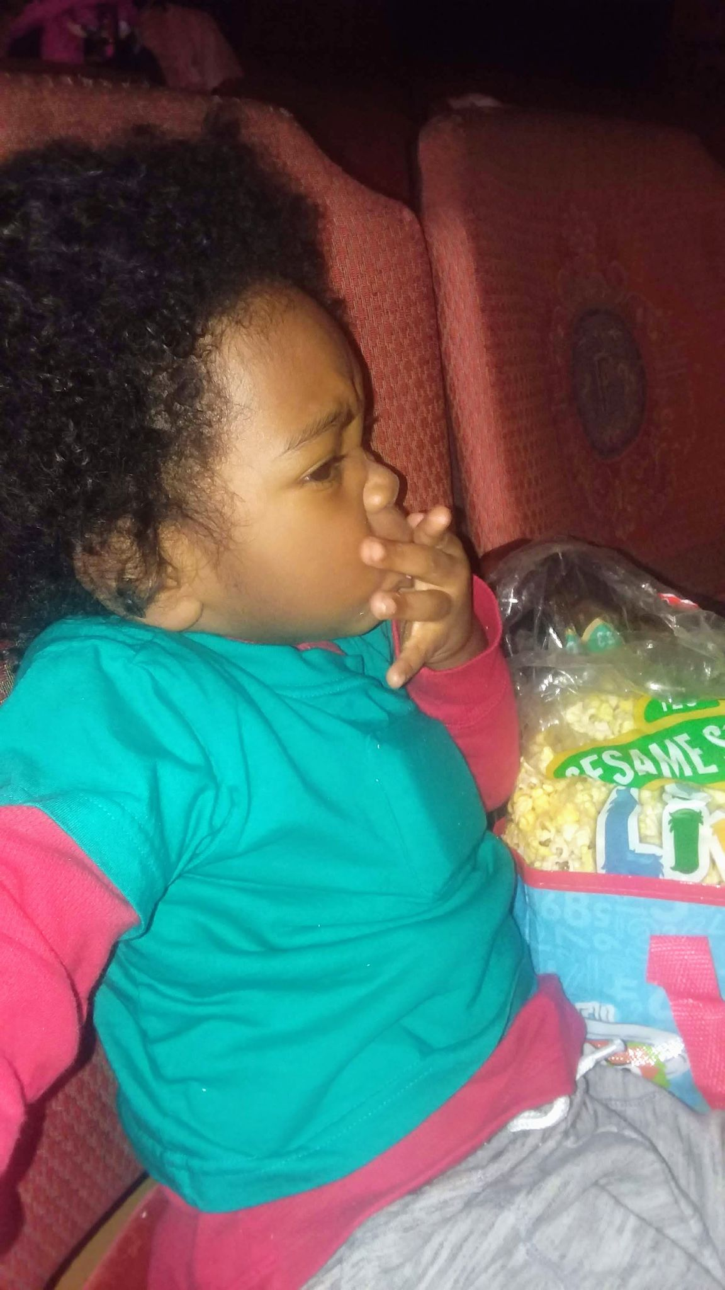
Social & Emotional Wellness Programming
One of the key areas of focus has been on social and emotional wellness. Having a toddler at home, has lead me to seek out opportunities to help me effectively communicate with him and guide him through what he is feeling.
I have taken classes like BEES which stands for Building Early Emotional Skills and Pre-School University - PBS, which have given me tools and tips for working with my son. I have also taken the Anger Management class at Brilliant to work on dealing with my own stress and emotional health.
Pumpkin painting and scary stories for Halloween
Soccer drills in
the side yard
Snack & Learn Health & Nutrition Class
Kids learned to prepare their own healthy snacks and learned about taking care of their bodies
BD has partnered with the city of Detroit to facilitate the 313 Speaks program, a program that focuses on increasing language in children 0-3 here you see my youngest Jacob wearing his talking pedometer, which counts the number of words he hears in a day. This coupled with a parent and child playgroup helped me to become more aware of not only how many words he was exposed to in a typical day, but also how many conversational “turns” we had.

Slide 9
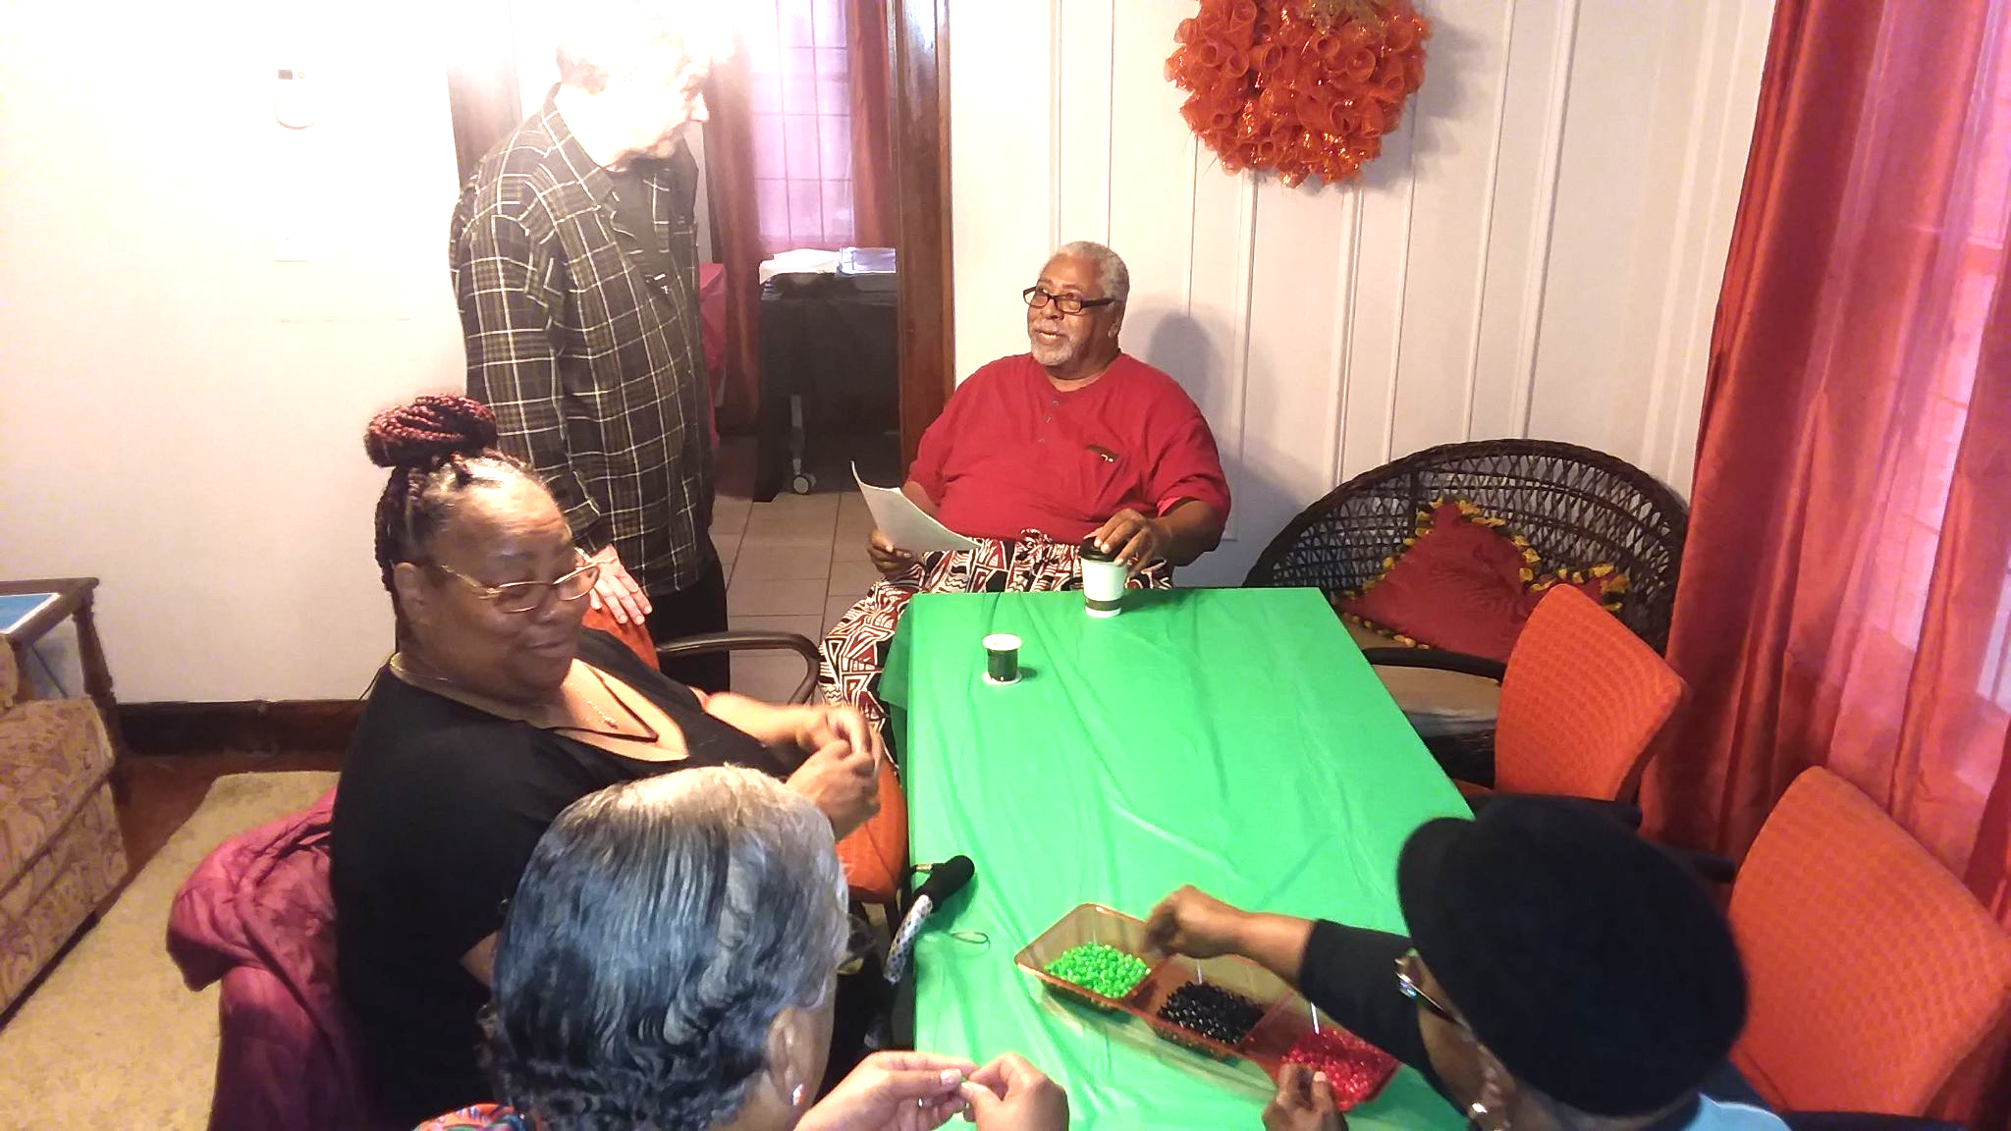
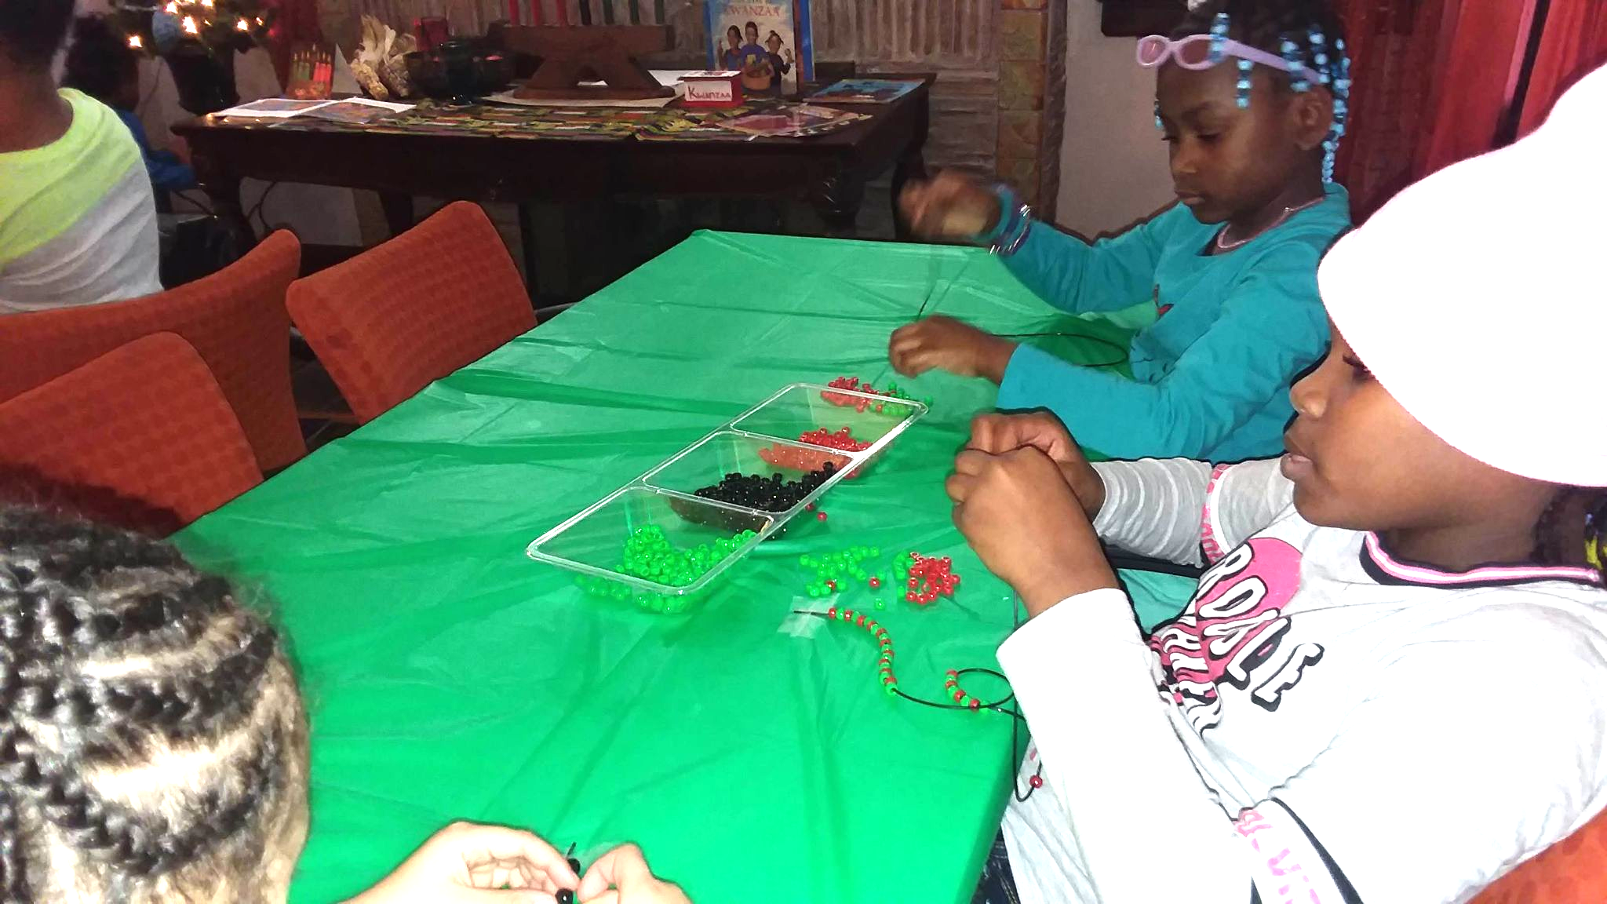
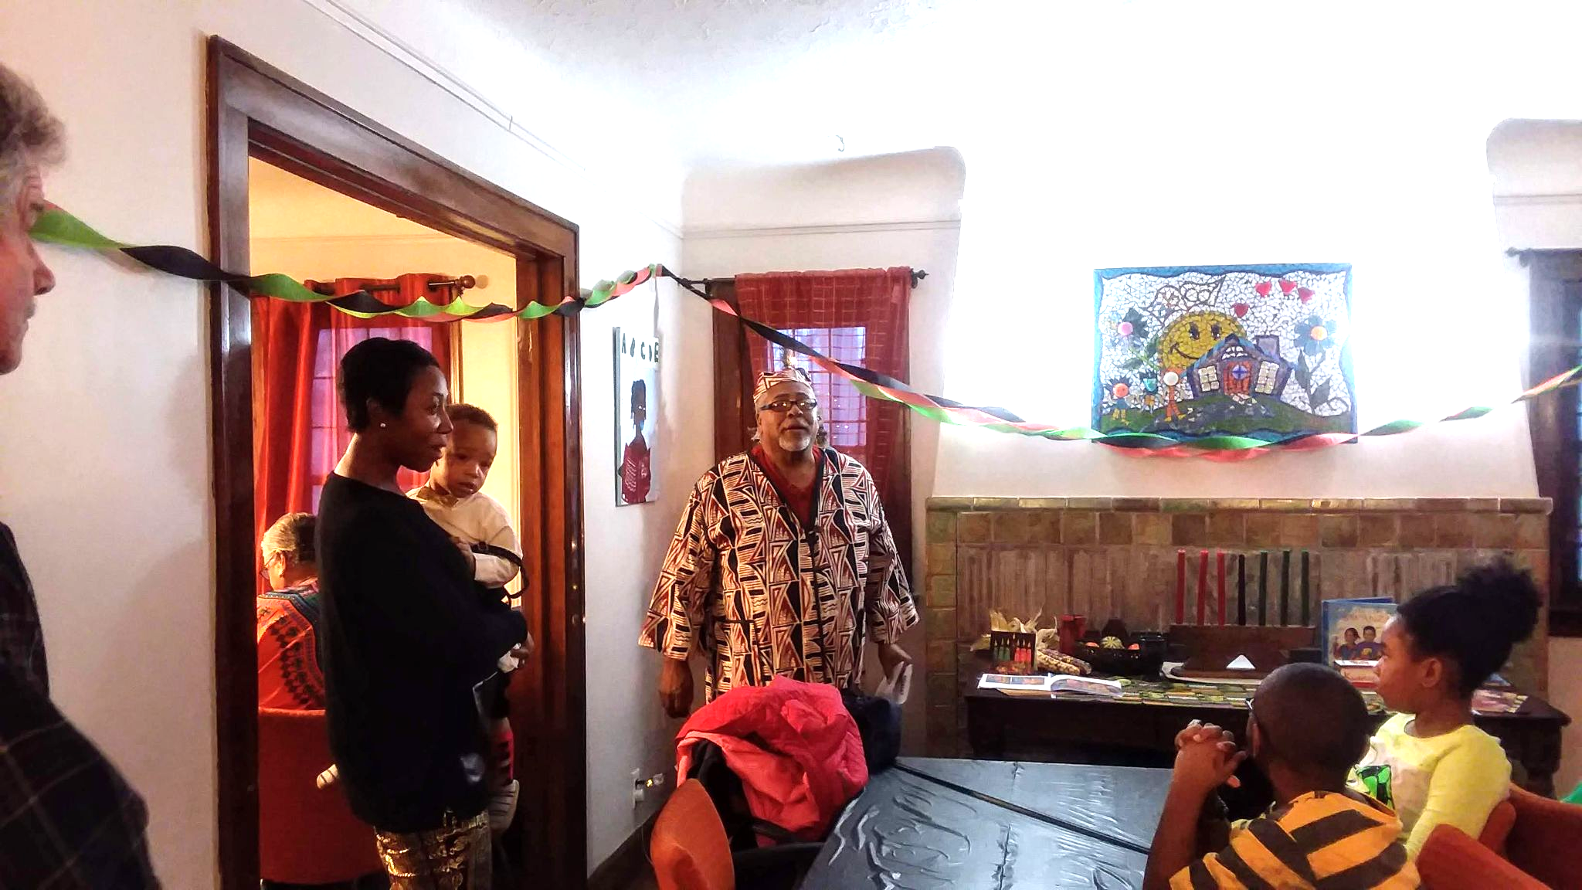
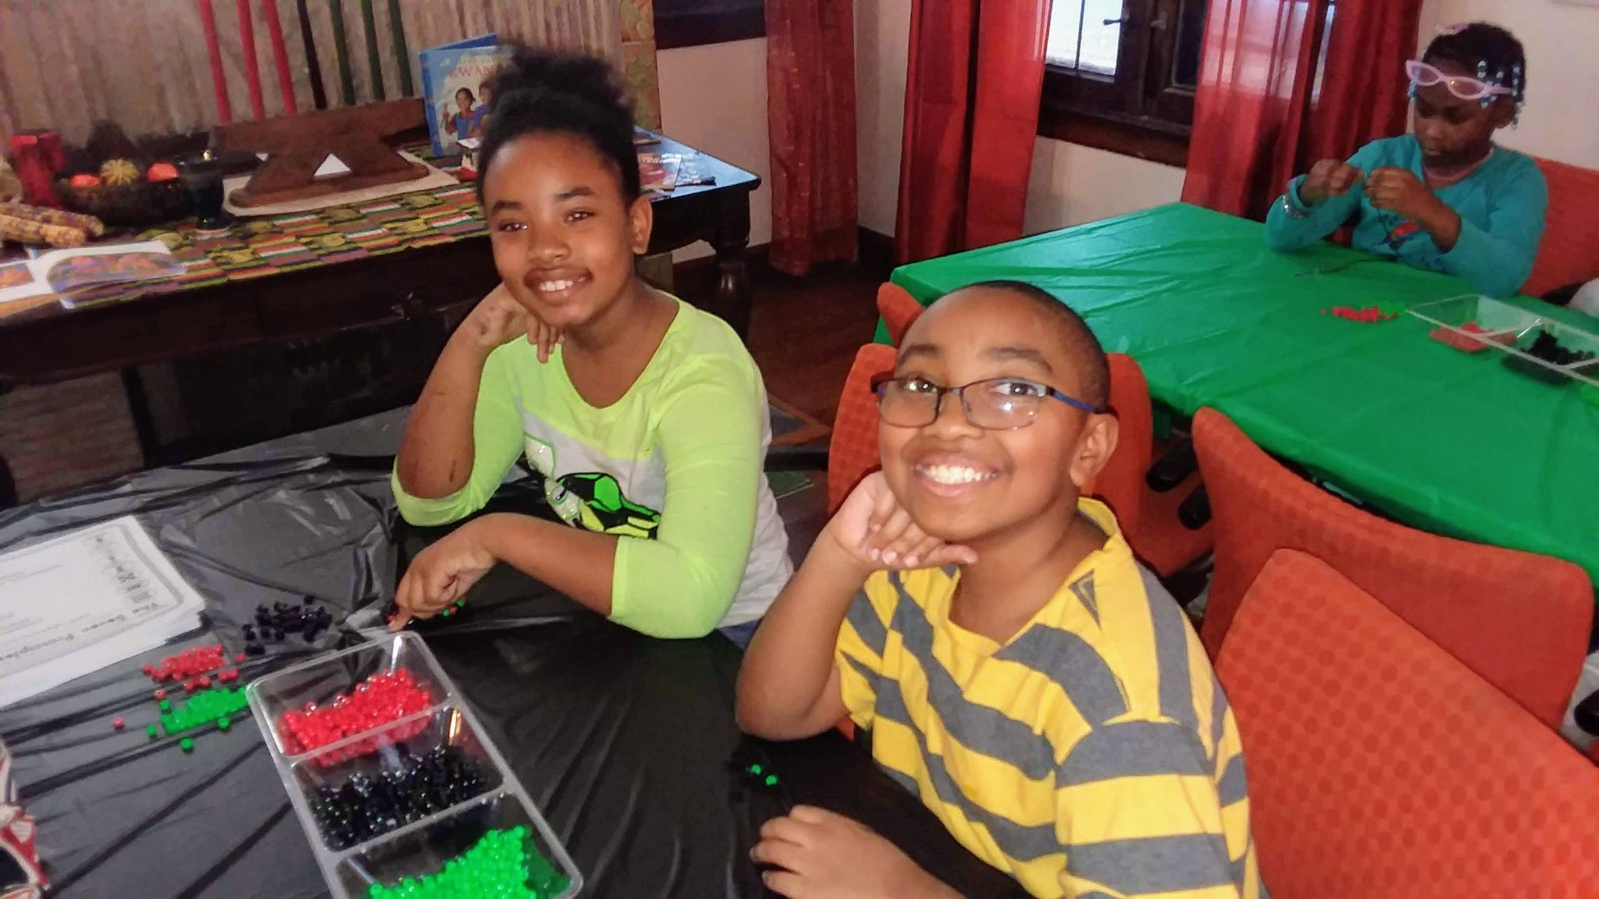
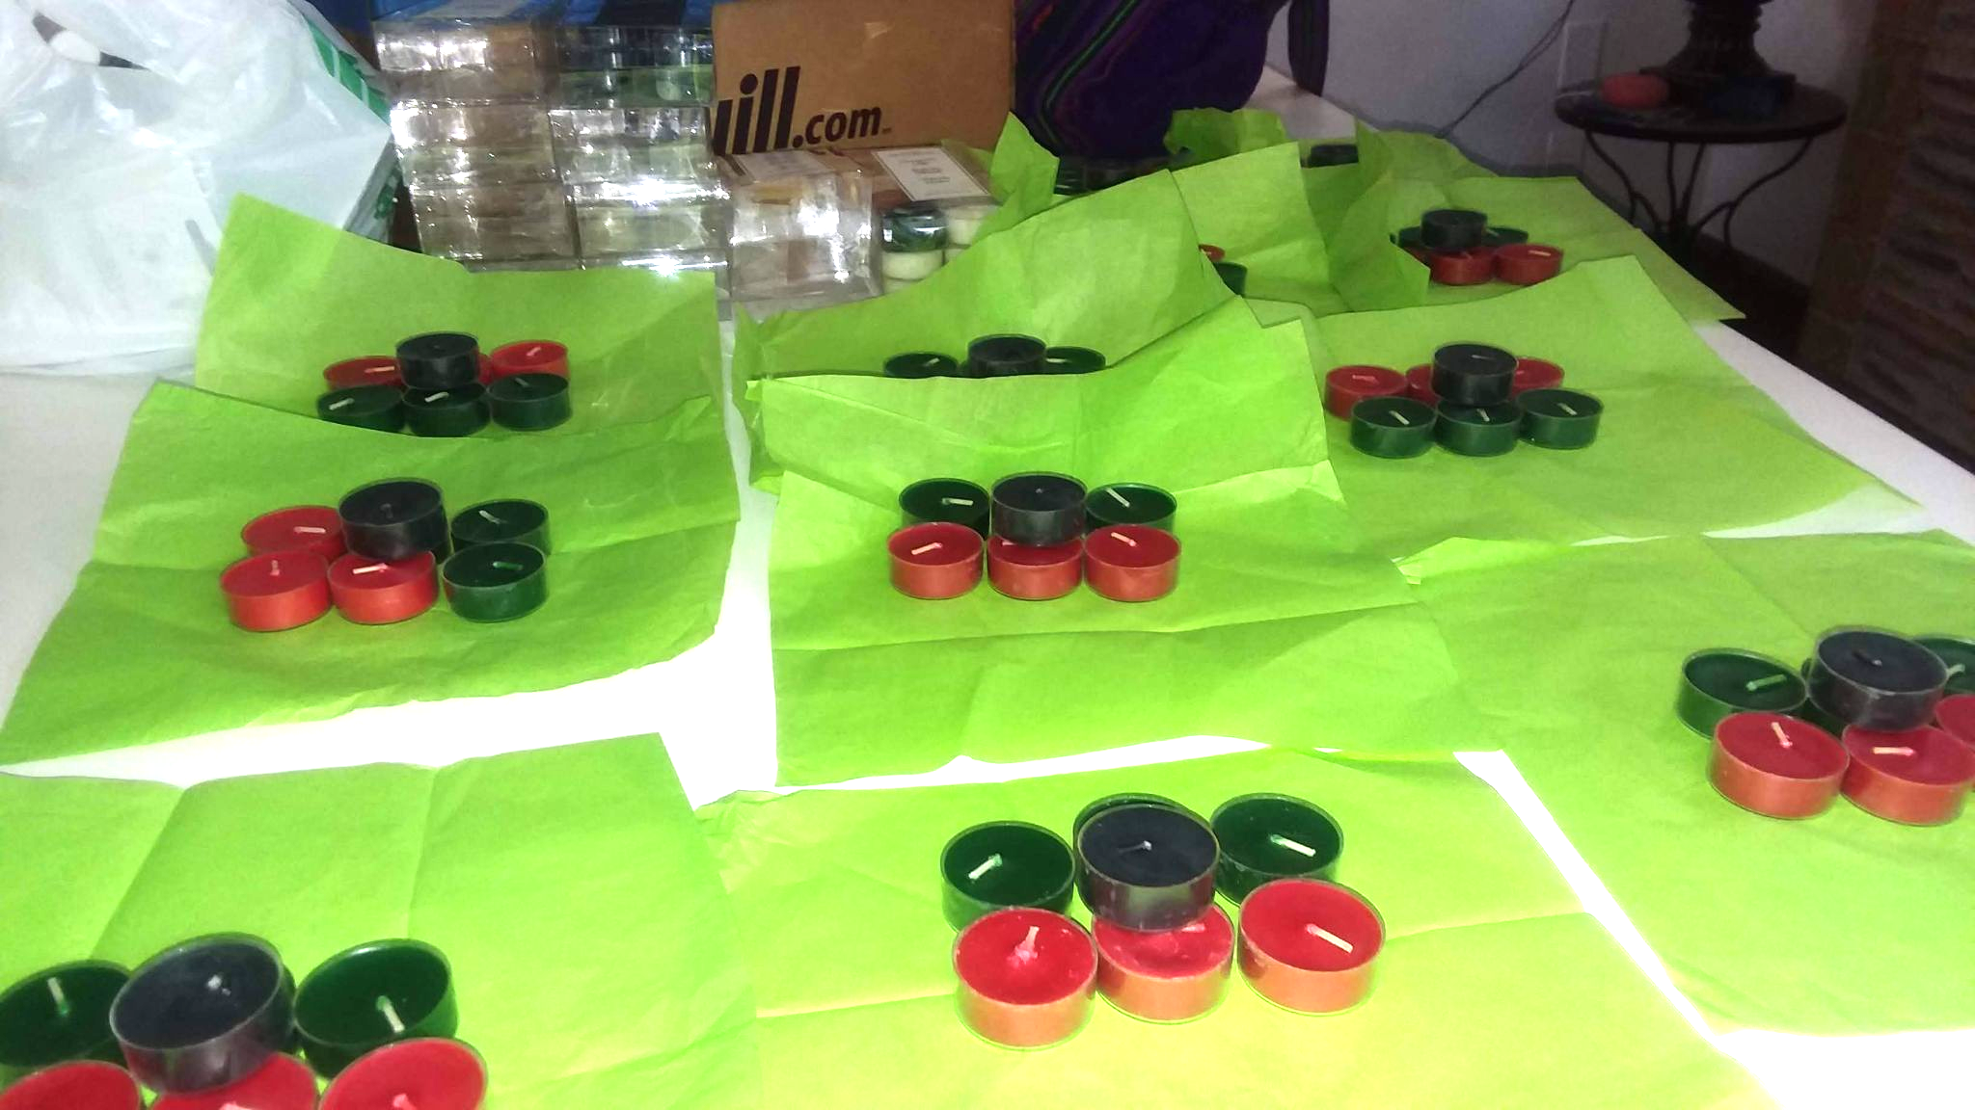
When Ms.Rachelle asked me to join the advisory team, we met monthly to give our feedback on programs and suggested ideas for events. Mr. Lionel and I came up with the idea to have a Kwanzaa celebration, so we worked together to plan the event. We planned a special dinner where families made crafts, received Kwanzaa kits with candles and special book , while Mr. Lionel and I took turns talking about the principals and the traditions of Kwanzaa.
With, For and By The Community

Slide 10
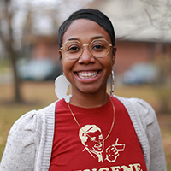
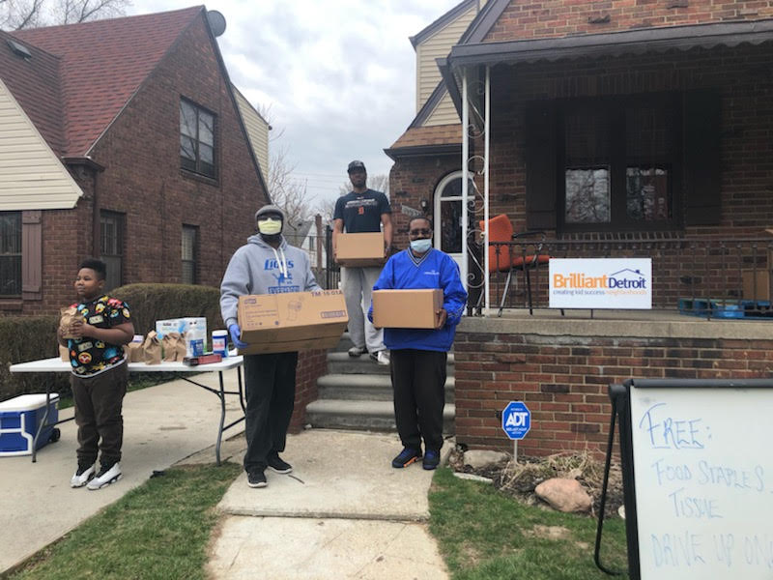
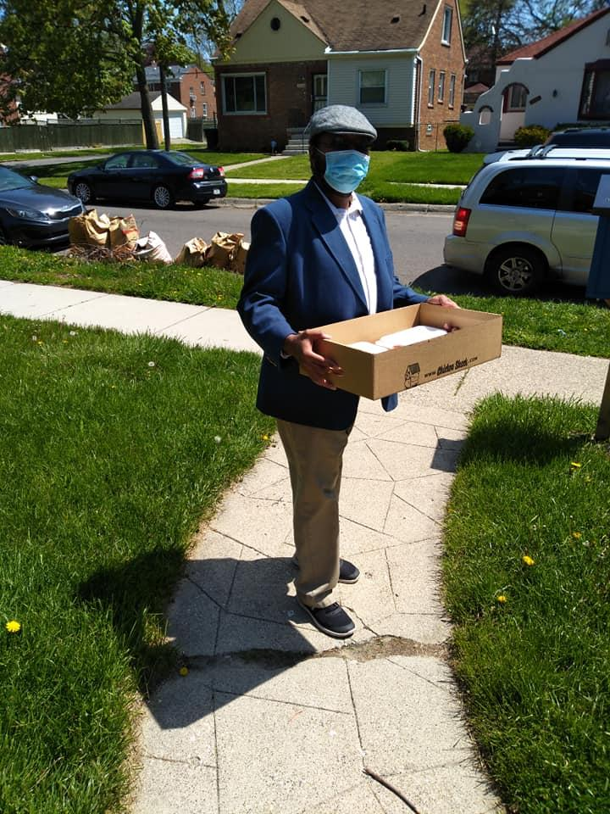
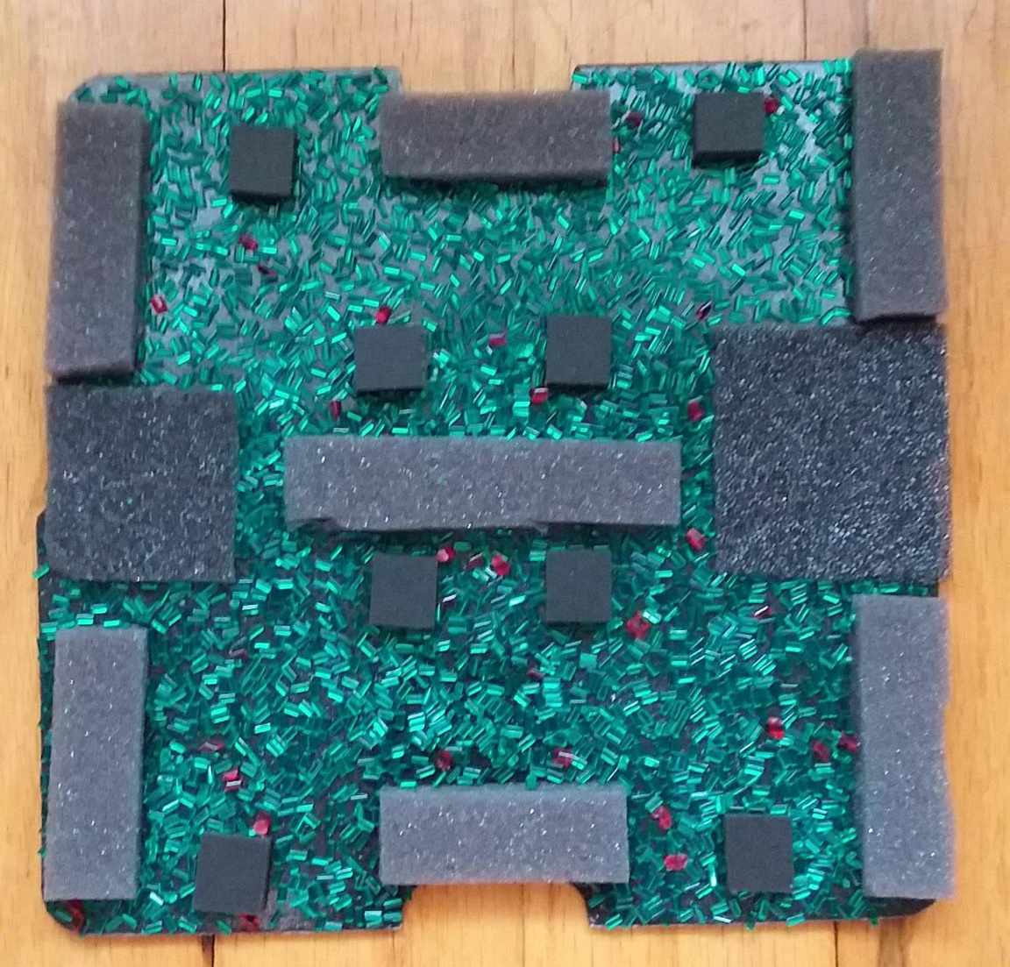
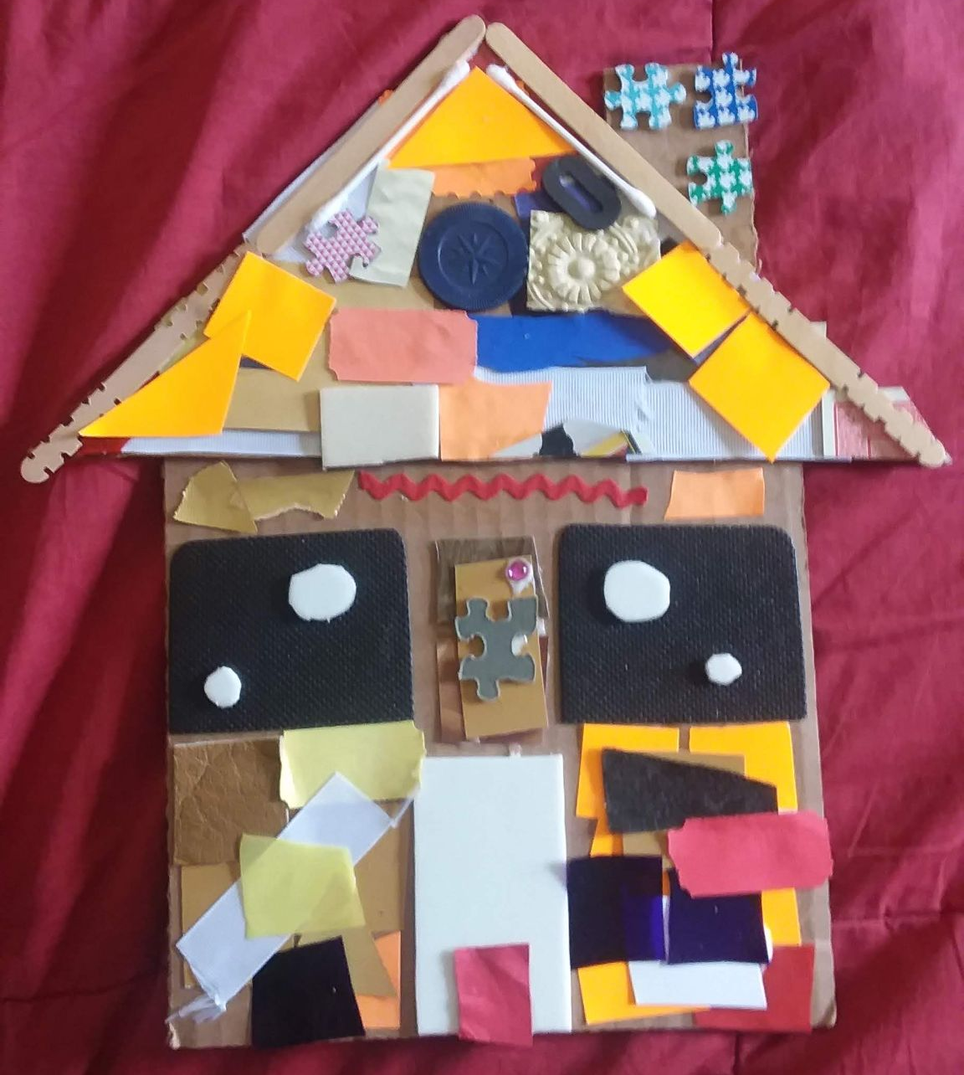
Even During the Pandemic...
Rachelle and her two boys were participants, just like my family when she became the Manager at the BDB house. She would cook delicious meals for us when we had advisory board meetings and she made sure there was always a pot of coffee and snacks available when we came over. She truly created a home-like feel at the BDB house. When the pandemic hit, Rachelle led the BDB house through the transition from in-person to virtual. Rachelle is a true example of what it means to care for the community you serve. During the pandemic she would call and check-in on us to make sure we had everything we needed, even taking time to listen to my fears or frustrations about the pandemic. She shared resources and continued to keep us engaged. I was honored when Rachelle recommend that I take over for her as the Manager of the BDB site.
Art that Gabriel created using the Arts and Scraps kits distributed during the weekly distribution that was still held during pandemic.
During quarantine, George would volunteer to help distribute food and other resources to BDB families

Slide 11
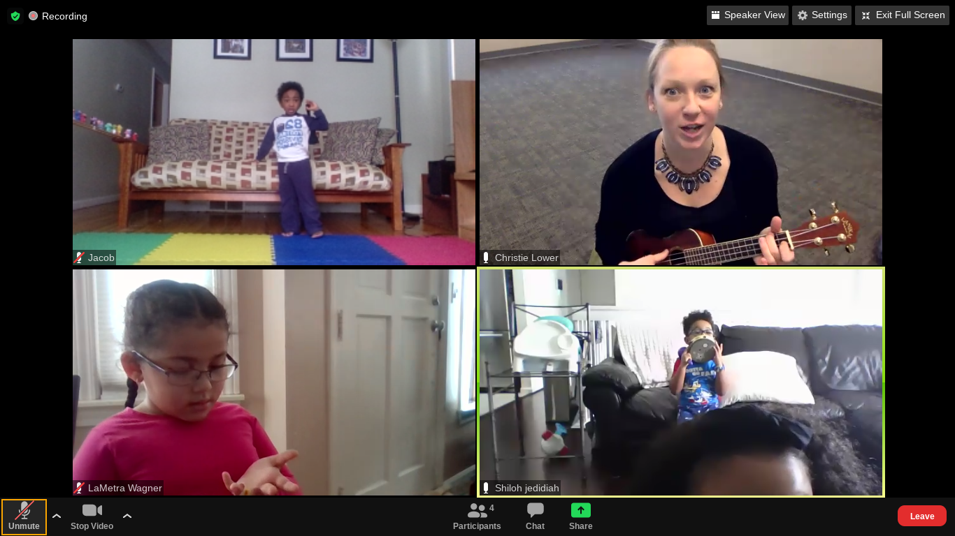
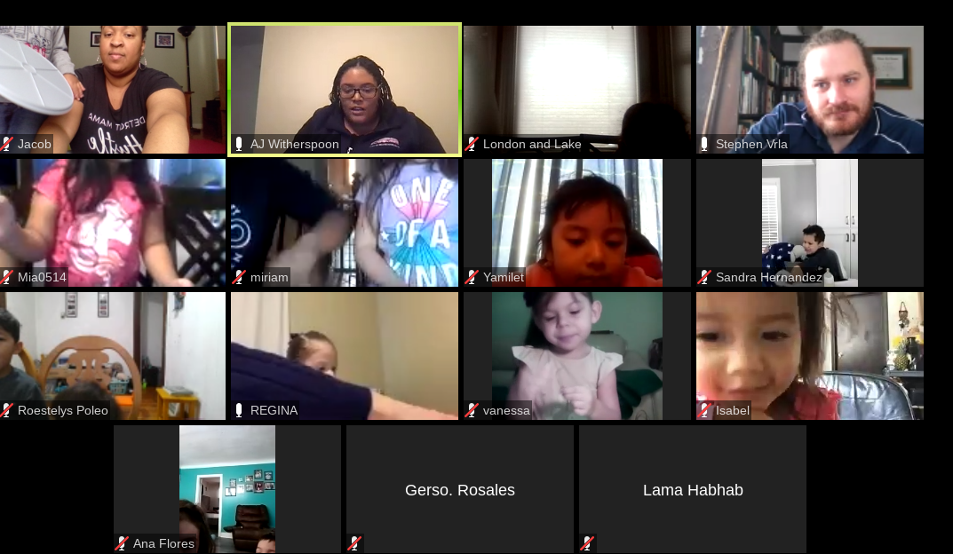
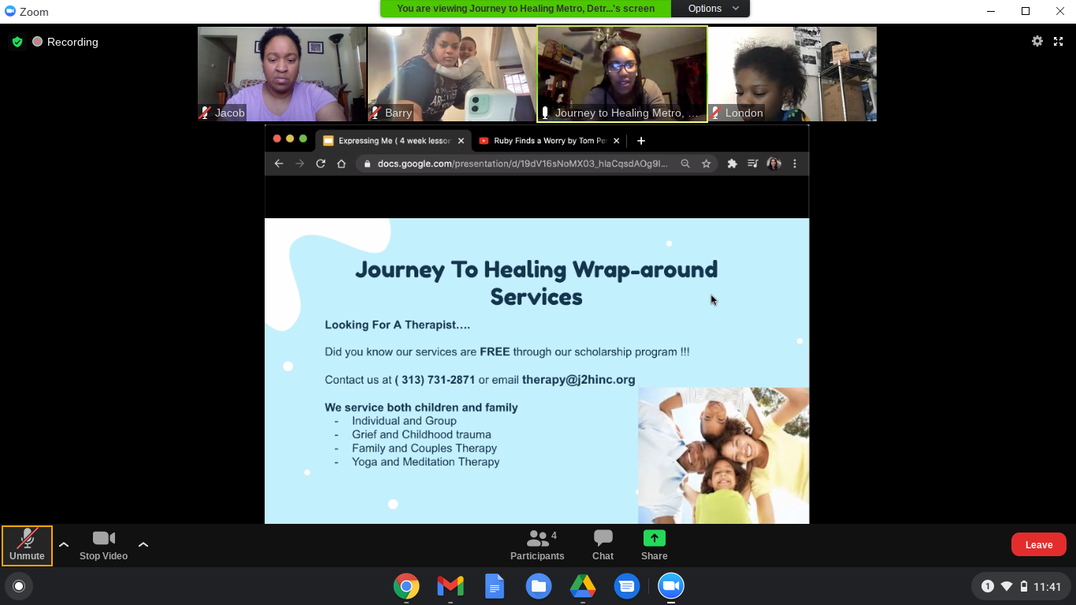
So as we continue to navigate through the pandemic, this is what BD programs look like now. Jacob is becoming a professional at Zoom as his schedule includes; Nature Tots, where he builds his science vocabulary, while learning about animals and animal habitats.
He continues to work on his Social and emotional skills through his Expressing Me Art class, he listens to stories and completes science experiments in Stories and STEM and he gets his wiggles out and sings songs in Toddler Music class.
Even During the Pandemic...

Slide 12
On February 22, 2021 I officially joined the Brilliant Detroit Brightmoor staff as the Community Engagement Manager at the Brightmoor Site. (I haven’t taken my official picture yet for the website) I am what Brilliant refers to as a transformed participant. I started as a participant, became engaged through volunteering and joining the advisory board and now as an employee, I’m able to serve the community, by uplifting and supporting our families as the team at BDB has done for my family.
It is my goal to continue to build relationships with my BDB families, listen and hear what is needed and act as an advocate to deliver the programs and services the community wants. I know that I have some big shoes to fill, because Rakisha and Rachelle tooks great care in creating a safe, warm and inviting space for the community. My teammate Jerry and I have been reaching out to past and present participants through calls, e-mails and our weekly distributions. We are working on engaging with our community partners to help spread the word about what we have to offer, which is always FREE to the community.
We hold weekly distributions, which includes, books, food (Gleaners), diapers/wipes, coats, clothes, shoes, PPE, sanitizing wipes and other items the community needs during this time. We have a monthly newsletter that goes out to our families and supporters that highlights our many programs and opportunities. We held a technology listening session to determine, the technological needs of our community and even have computers available to loan out to ensure families can stay connected during this time. I want to keep that spirit of community alive as we continue to navigate through the pandemic and on into the future.

