Slide 1
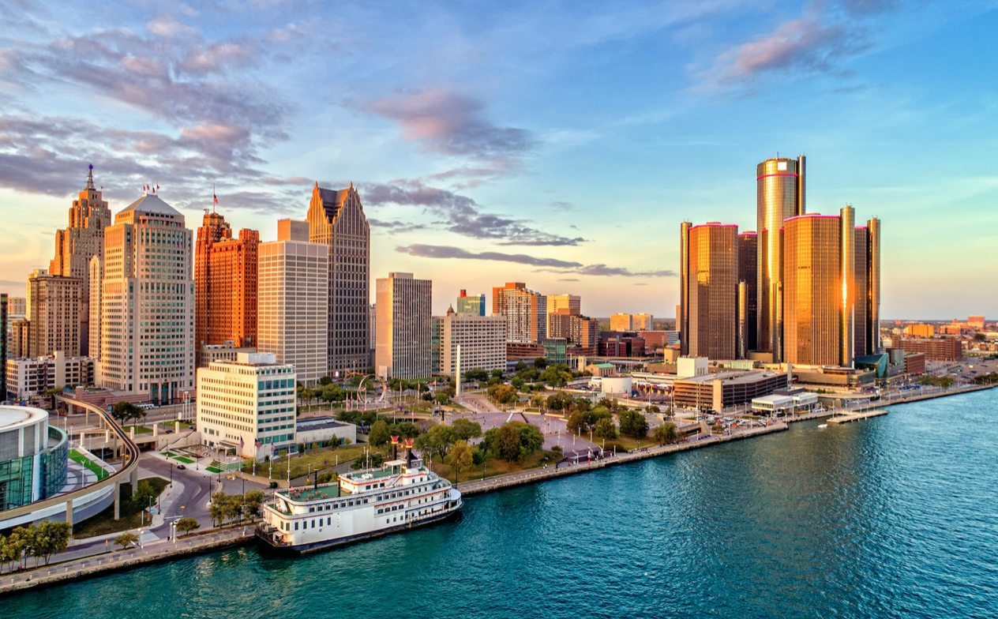
TAX INCENTIVES
Educational Outreach Series
City Council District 1
April 2021

Slide 2
TAX INCENTIVES
Known as “DEGC”
Created in 1978
Private, Non-Profit
Lead Economic Development Corporation to the City of Detroit
Retain existing Businesses (Retention and Expansion)
Attract New Companies
Assist with Real Estate and Development Activities
Support small Business Programs
example: Motor City Match, Motor City Restore

Slide 3
WHAT IS A TAX ABATEMENT?
A tax abatement is a subsidy that lowers the cost of owning real and personal property by reducing the taxes a company pays on it.
WHY DO PROJECTS USE TAX ABATEMENTS?
To make sure Detroit is competitive in attracting Jobs and to improve our neighborhood by assisting with Redevelopment of Blighted or contaminated properties.
When a company receives a property tax abatement, its taxes are reduced by a certain percentage for the amount of time approved by Agreement between the Applicant and the City. If the site is contaminated and the company receives a Brownfield to Clean up site, the Applicant is reimbursed for those cost that are eligible.
WHAT DOES THE COMPANY RECEIVE?
WHY ARE WE GIVING AWAY MONEY?
Tax abatements are not cash grants – there is no money exchanged. A business will not benefit from a tax abatement until the project is complete and taxes have increased.
Businesses are held accountable through:
Clawbacks (type of legal provision)
Job quality standards in development agreements
Citizen participation via Detroit’s Community Benefits Ordinance (CBO) approval process
WHO HOLDS THESE COMPANIES ACCOUNTABLE?

Slide 4
HOW DO ABATEMENTS WORK?
Major investment in a property results in an increase in property taxes *
WITHOUT AN ABATEMENT
New Taxes Paid
(based upon improved property value*)
$10,000 (yellow)
WITH AN ABATEMENT
Applicant continues to pay Current Taxes
$1,500 (teal)
Applicant pays a Partial Increase in Taxes
$2,000 (light green)
Only a portion of the new taxes are exempted with the approval of an abatement. $5,500 (peach)
Total New Taxes Paid
W/O ABATEMENT
= $10,000

Slide 5
HOW DO ABATEMENTS WORK?
Old Tax Payment
(Before Construction)
Est. Future Taxes | Based Upon Improved Value
(After Construction)
Est. Taxes Based Upon
New Property Value = $200,000
Taxes Based Upon
Old Property Value = $50,000
No Abatement Applied
Year
Year
Abated Tax Amount (SAVINGS)
Over 12 Year Term
New Tax Payment | with Abatement
(12 Year Term +)
Old Tax Payment
+
Slight INCREASE
Approved Abatement
=
Tax Savings Over Time
ABATEMENT
Year
Year

Slide 6
WHY ARE ABATEMENTS NEEDED?
Abatements help reduce the high
cost of investment
The City can use incentives to secure Community Benefits
Abatements partially reduce taxes and reduce a business’ expenses for a period time
Reduced expenses allow the business to offer affordable rents, provide increased wages and pay on their loan (funding the new investment)
Detroit is competing against properties in other communities where taxes are lower
Renovation of
Blighted and Vacant Structures
Job Creation + Employment
for Detroiters
Affordable
Rental Housing
New
Retail Space
Affordable
Homeownership

Slide 7
HOW DO I GET AN ABATEMENT?
Step 1: Apply for a District with the City of Detroit
A District does not provide the tax abatement. The district indicates that properties in the boundaries may be eligible for the abatement.
Step 2: Apply for Certificate
Step 3: Approval by the State Tax Commission (STC)
The State of Michigan STC makes the final approval of all certificates at monthly board meetings.
The Certificate grants the property an abatement. Only property owners who commit to specific investments into the property are eligible to request an exemption certificate.
Step 3: City of Detroit Department Review
Department review for: compliance with master plan, eligibility, blight violations, outstanding taxes
DEGC underwriting & fiscal impact analysis
Step 4: City Council Review
All abatements must be approved by City Council.

Slide 8
EVALUATING TAX INCENTIVE REQUESTS
DEGC reviews and evaluates each project against five (5) criteria.
A project must demonstrate that without the approval of the abatement, the project will not occur.
In economic development evaluation, we call this a “but for” analysis
All projects must demonstrate benefit.
Competitive Site Selection
Is a project in Detroit more expensive than another site under consideration?
“But For” Test
Net Fiscal Benefit
Increased revenue from job creation, company income taxes, and new taxes are greater than the cost of the investment
Is the abatement necessary to enable positive cash flow?
Can we reduce costs to attract new jobs for Detroiters?
Is the net benefit greater than the partial reduction in taxes?
Is the reduction in property tax expense needed to pay for the debt?
What is the minimum time the abatement is needed before the project has sufficient cash flow?

Slide 9
COMMONLY USED INCENTIVES
Commercial Rehabilitation Act – PA 210
Commercial Facilities Exemption – PA 255
Obsolete Property Rehabilitation – PA 146
Industrial Facilities Exemption – PA 198
New Personal Property – PA 328
Next Michigan Development Renaissance Zone

Slide 10
OBSOLETE PROPERTY REHABILITATION ACT
Incentivizes redevelopment of buildings that are contaminated, blighted, or functionally obsolete
Abatement Utilized
Obsolete Property Rehabilitation Act (OPRA)
Blighted property rehabilitated for mixed-use
Retail/commercial ground level and 4 apartment units above

Slide 11
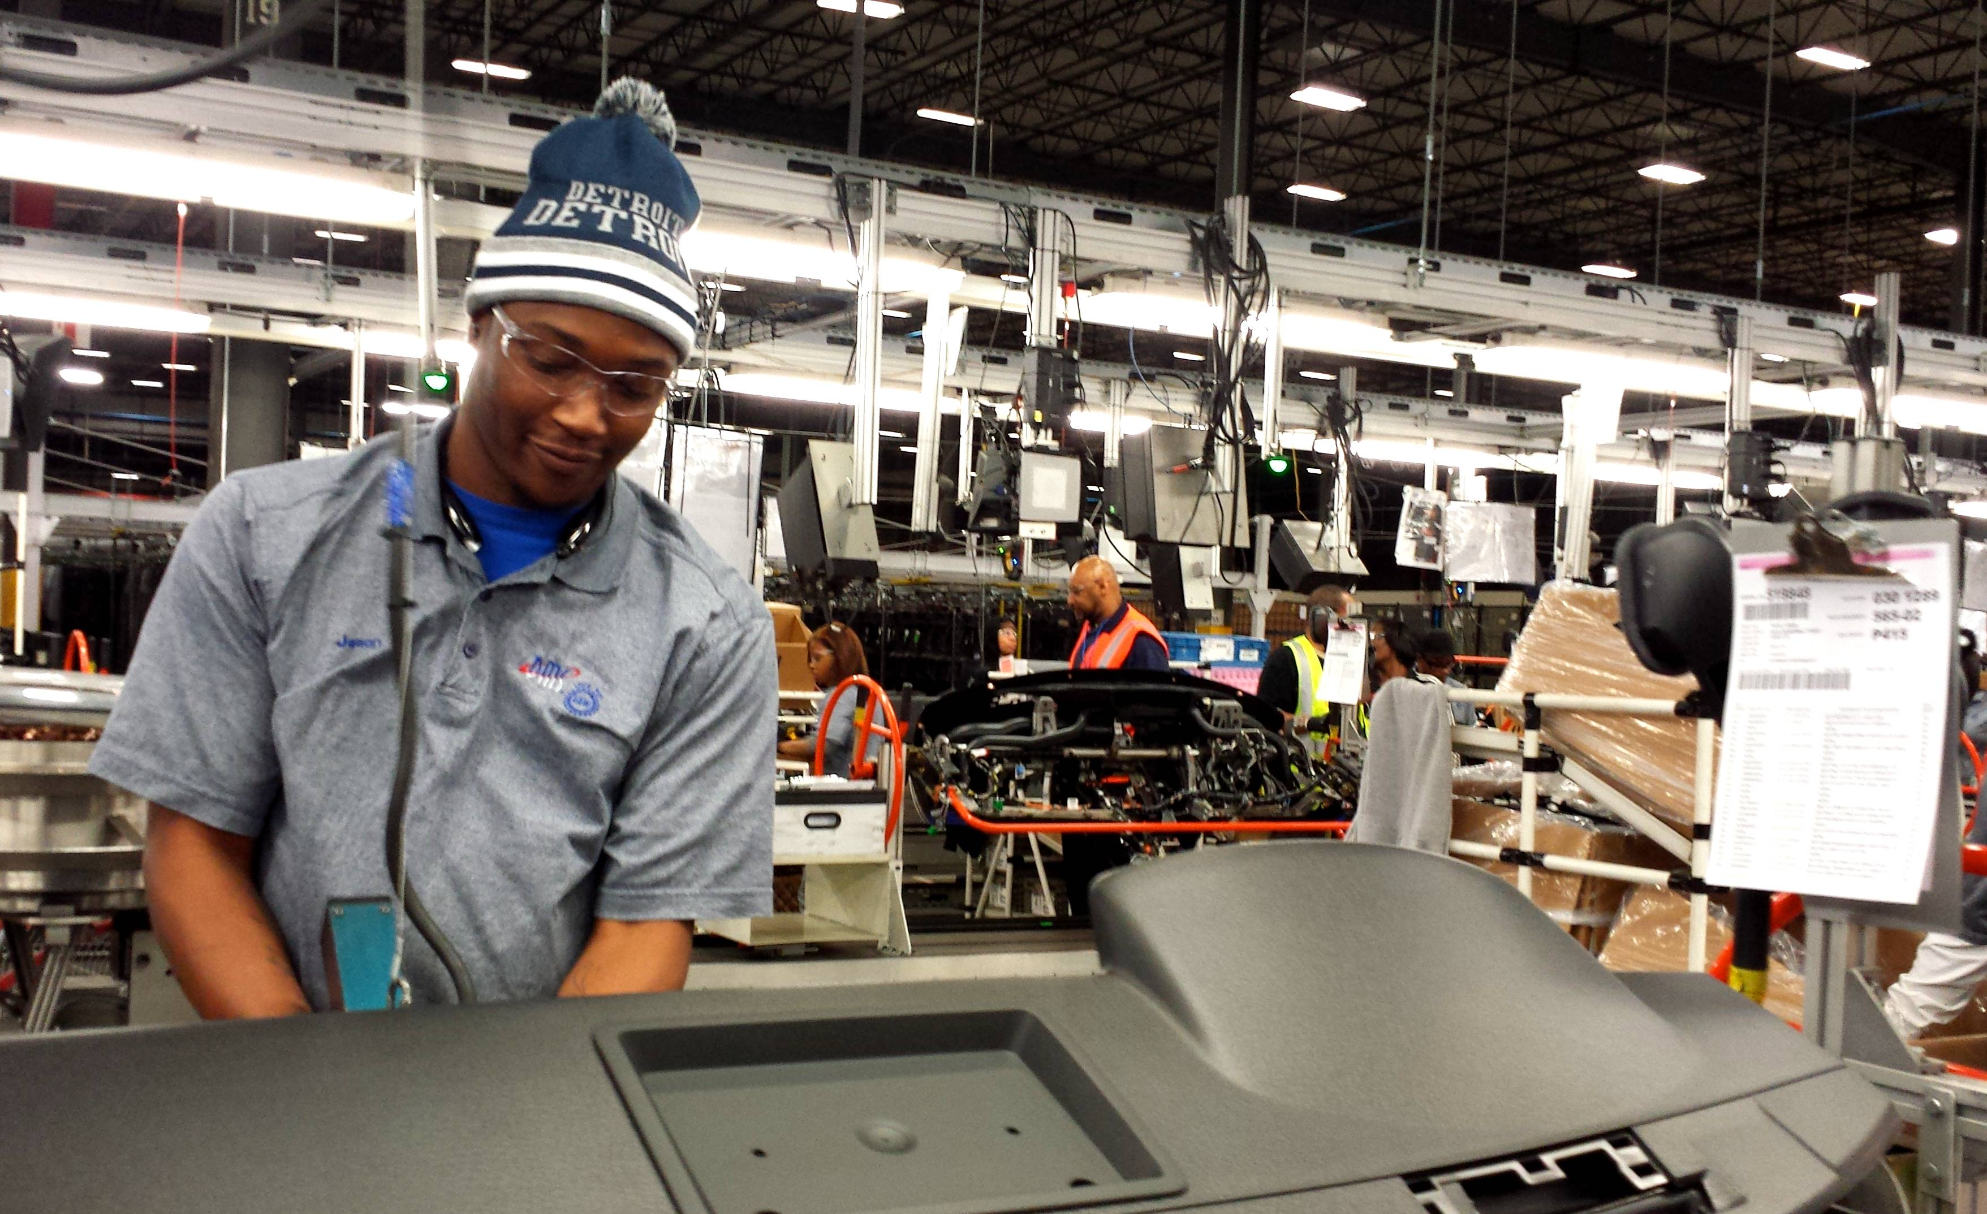
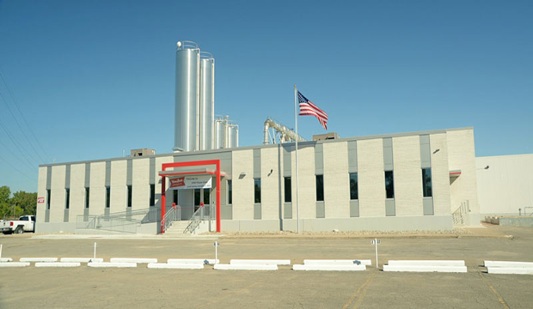
Incentivizes rehabilitation of manufacturing and industrial property
Industrial Facilities Exemption
Incentivizes rehabilitation of manufacturing and industrial property
Abatement Utilized
Industrial Facilities Exemption – PA 198
Attraction of New Company
Created more than 600 Jobs
Abatement Utilized
Industrial Facilities Exemption – PA 198
Retained existing 60 year old company
Eliminated blighted building in the neighborhood

Slide 12
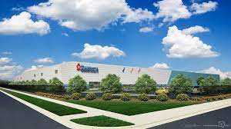
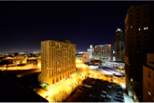
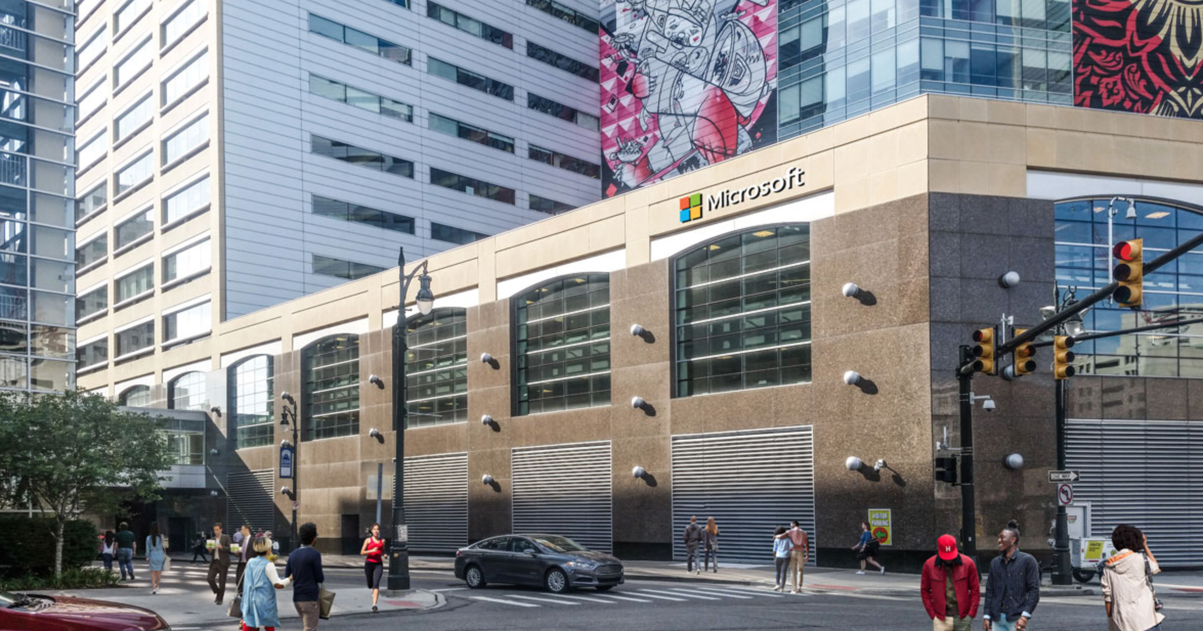
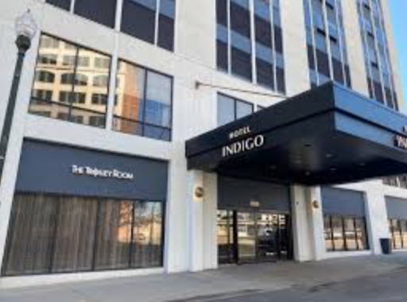
OTHER ABATEMENT TYPES
Next Michigan Development Act
Spurs business development in targeted areas
Example Project: Dakkota
Specific to companies utilizing (2) or more methods of transportation to move products
Neighborhood Enterprise Zone Act (NEZ)
NEZ Districts were zoned in the mid-2000s to offer tax incentives to homeowners completing home renovations, as well as stabilizing annual property taxes
Example Project: Town Residences
New Personal Property Exemption
Incentivizes installation of new personal property
Example Project: Microsoft
Commercial Facilities Exemption
Incentivizes redevelopment of commercial mixed-used property in a qualified downtown revitalization district
Example Project: Holiday Inn

Slide 13
COMMON MISCONCEPTIONS
Concern
Fact Check
My taxes will go up
An individual’s property taxes are prevented from increasing by more than the rate of inflation by State Law.
Abatements take money away from schools
The State of Michigan is required to make School Districts whole. The State ensures Detroit Public School district receives a minimum amount of funding per student.
Abatements take dollars from the City’s general funds that would otherwise be spent on services and give that money to wealthy people.
Abatements are not a cash grant. The project must be completed and the taxes must increase for a project to receive any benefit.
Companies get tax abatements without demonstrating a need or benefit to the City
DEGC completes an exhaustive analysis to determine the need and minimum amount of incentives necessary. This analysis is further verified by the Council’s legislative policy staff.
All recipients of tax abatements must sign a contract with the City of Detroit. The contract allows the City to pull back the incentive or other legal remedies if the investment or job creation does not occur as promised.
Companies receive abatements with no accountability or oversight

Slide 14
EXAMPLE PROJECT
3401 Cass Avenue
City Council District 6
Incentive Facilitated: OPRA

Slide 15
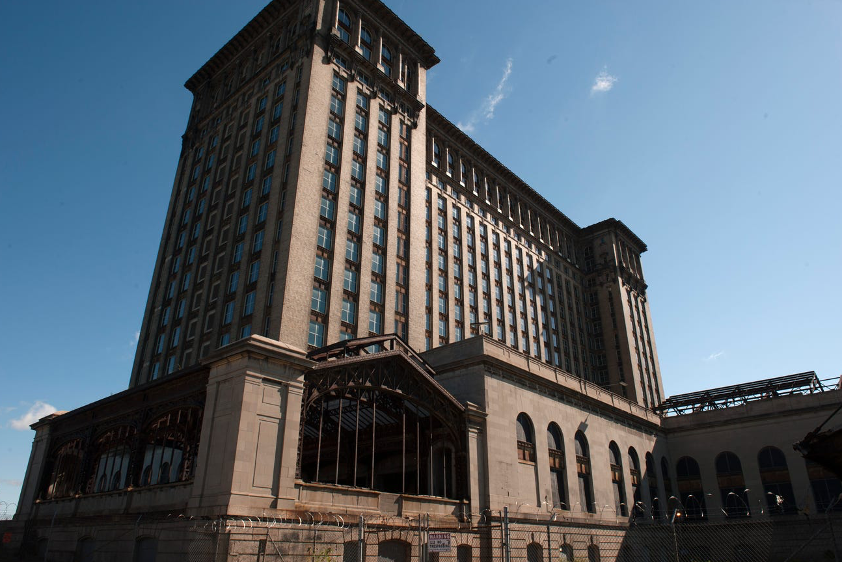
Obsolete Property Rehabilitation Act
The Obsolete Property Rehabilitation Tax Abatement (OPRA) is an incentive used to encourage the redevelopment of commercial or commercial mixed used buildings that are contaminated, blighted, or functionally obsolete.
Considered obsolete, the City of Detroit approved an OPRA for Michigan Central Station in 2018.

Slide 16
Iconic Downtown Property
3401 Cass | CITY COUNCIL DISTRICT 6
OPRA
12 Years
$1.3M
Total Investment
$621,081
Net Benefit
$84,500
Property Value
Before Construction
$404,800
Property Value
After Construction
55
Jobs

Slide 17
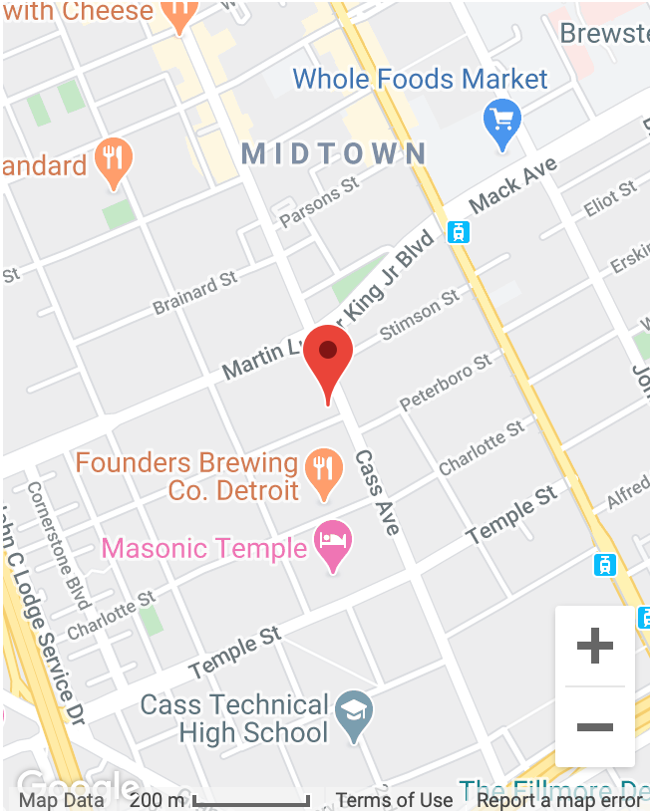
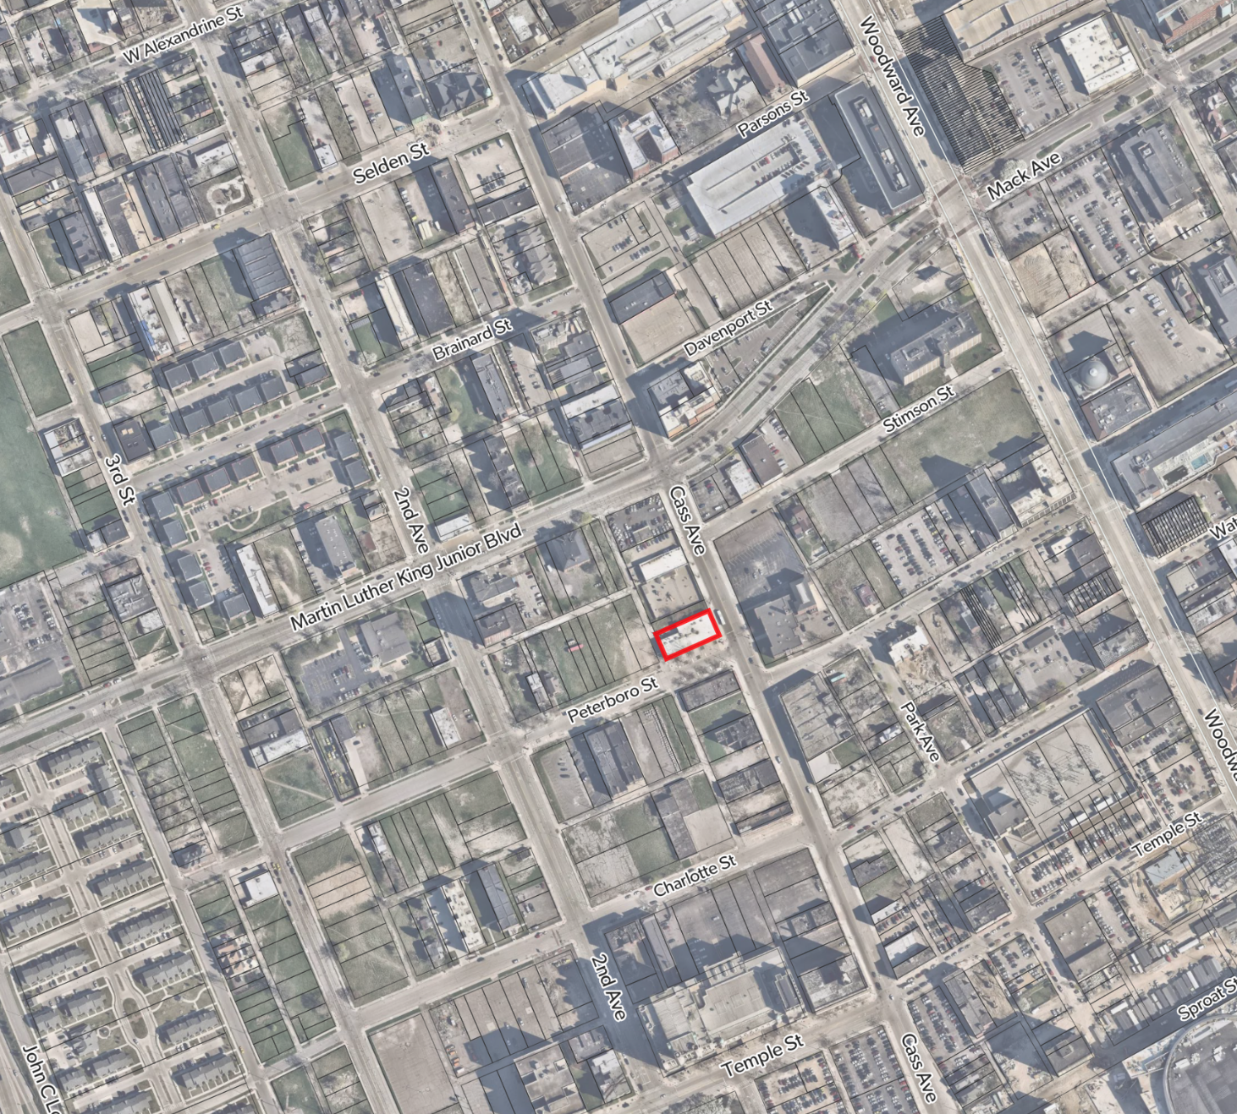
SITE LOCATION
3401 Cass | CITY COUNCIL DISTRICT 6

Slide 18
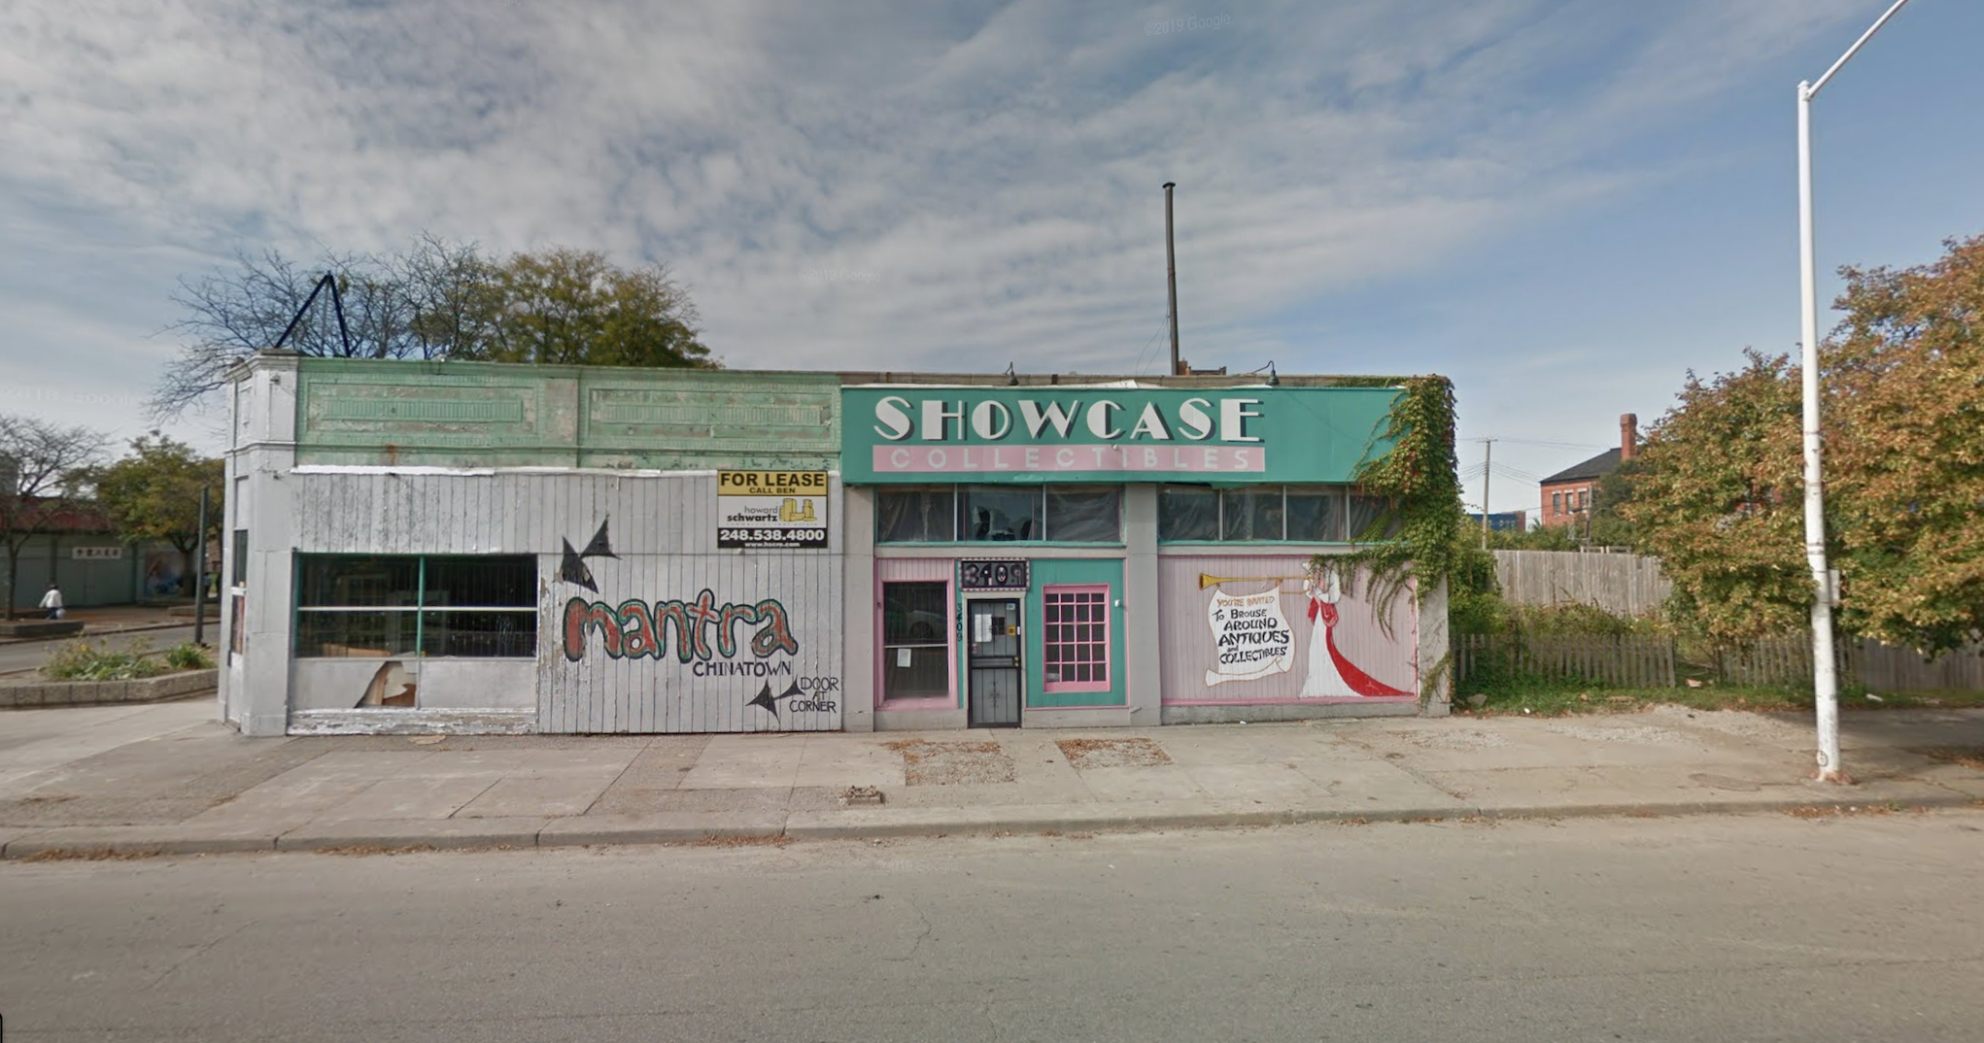
EXISTING CONDITION
3401 Cass | CITY COUNCIL DISTRICT 6

Slide 19
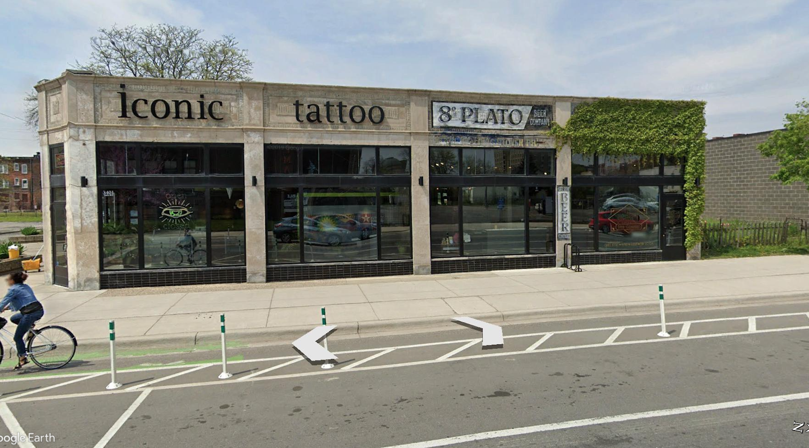
CURRENT CONDITION
3401 Cass | CITY COUNCIL DISTRICT 6
INSERT MAP
Visit the website

Slide 20
THANK YOU
For more information, please contact the Abatement Review Team at DEGC.

