Slide 1
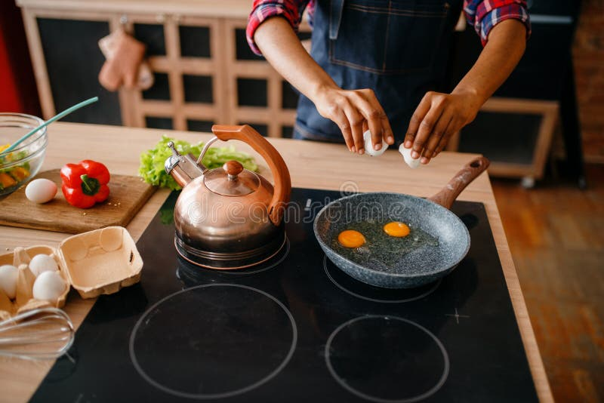
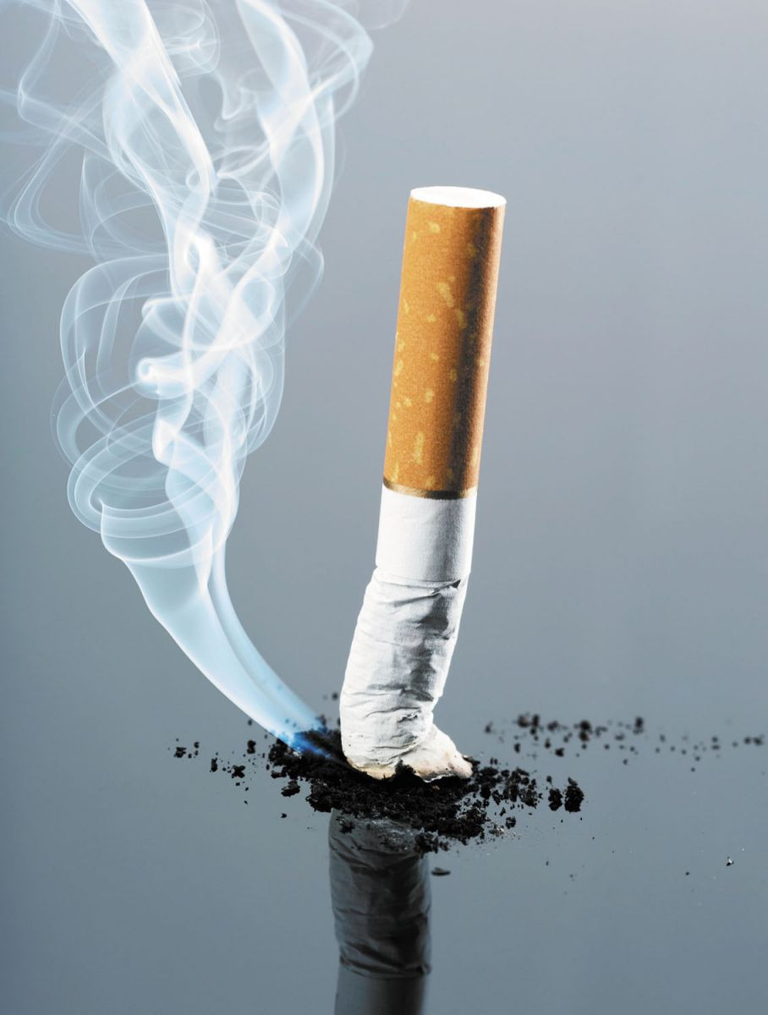
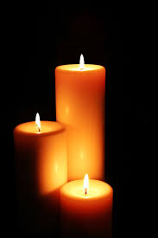
DFD Safety Series: Cooking, Smoking & Candle Safety
Welcome & Thank You for Joining us for the DFD Safety Series!
Theresa Halsell, Captain
https://detroitmi.gov/departments/detroit-fire-department
2025

Slide 2
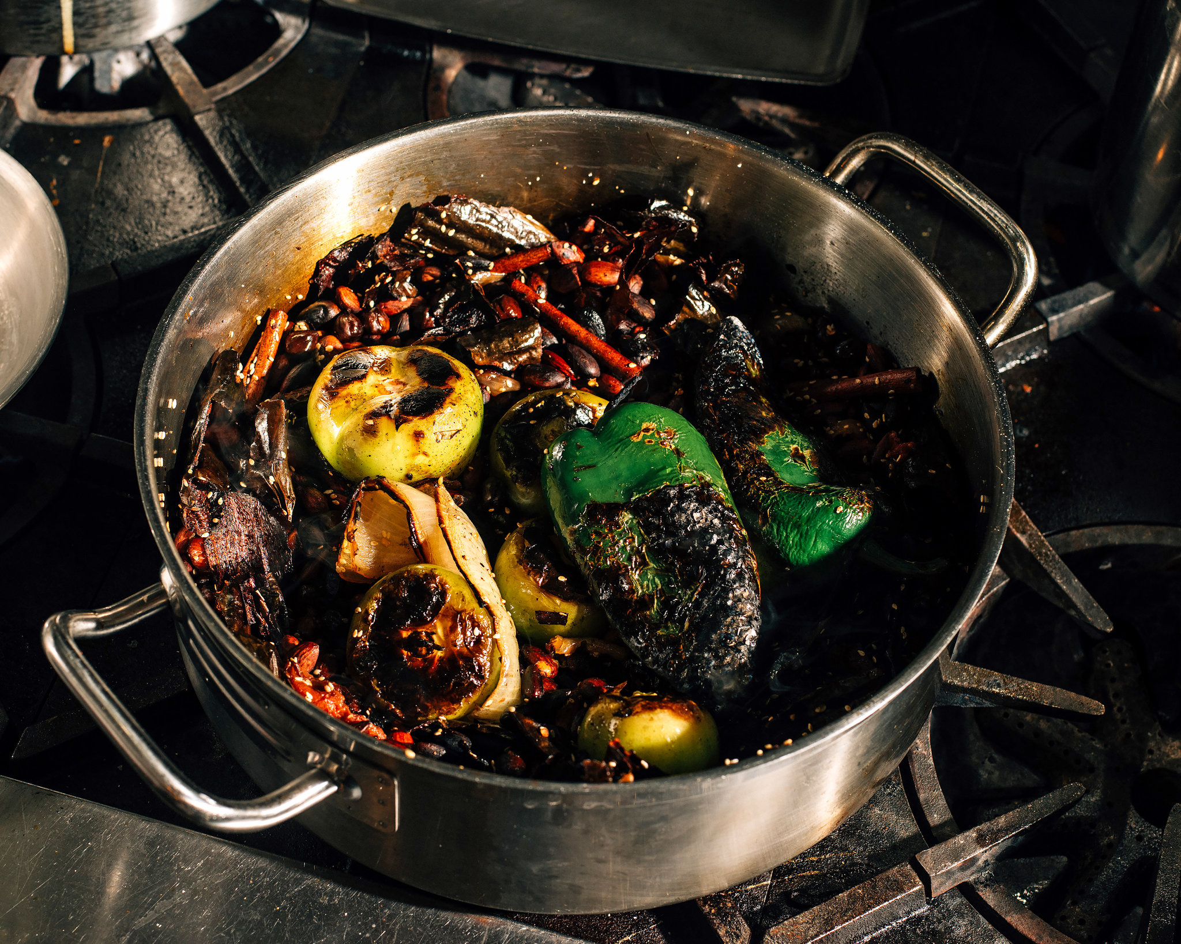
DFD Safety Series: Cooking, Smoking & Candle Safety
Cooking is . . .
Routine Activity
Leading cause of reported Home Fires and Home Fire Injuries
Second leading cause of Home Fire Deaths

Slide 3
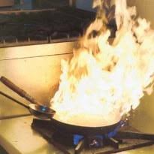
DFD Safety Series: Cooking, Smoking & Candle Safety
Key national findings
Cooking caused an average of 158,400 reported home structure fires per year
The leading factor contributing to cooking fires and casualties …unattended cooking
Cooking caused an average of an average of 470 civilian deaths and 4,150 civilian injuries annually
Clothing was the item first ignited in less than 1% but are 7% of deaths (33 deaths)
Electric ranges … higher risk of cooking fires and associated losses than those with gas ranges
Ranges or cooktops were involved in 53% of the reported home cooking fires

Slide 4
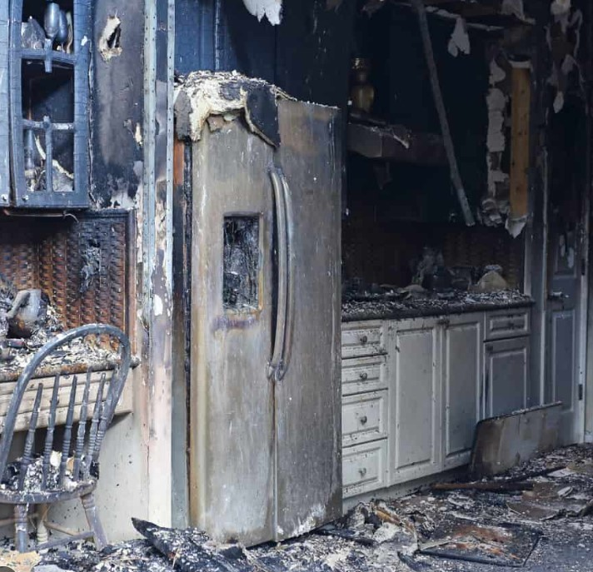
DFD Safety Series: Cooking, Smoking & Candle Safety
More than 25% of the people killed by cooking fires were asleep
More than half of reported injuries occurred when people tried to control the fire themselves

Slide 5
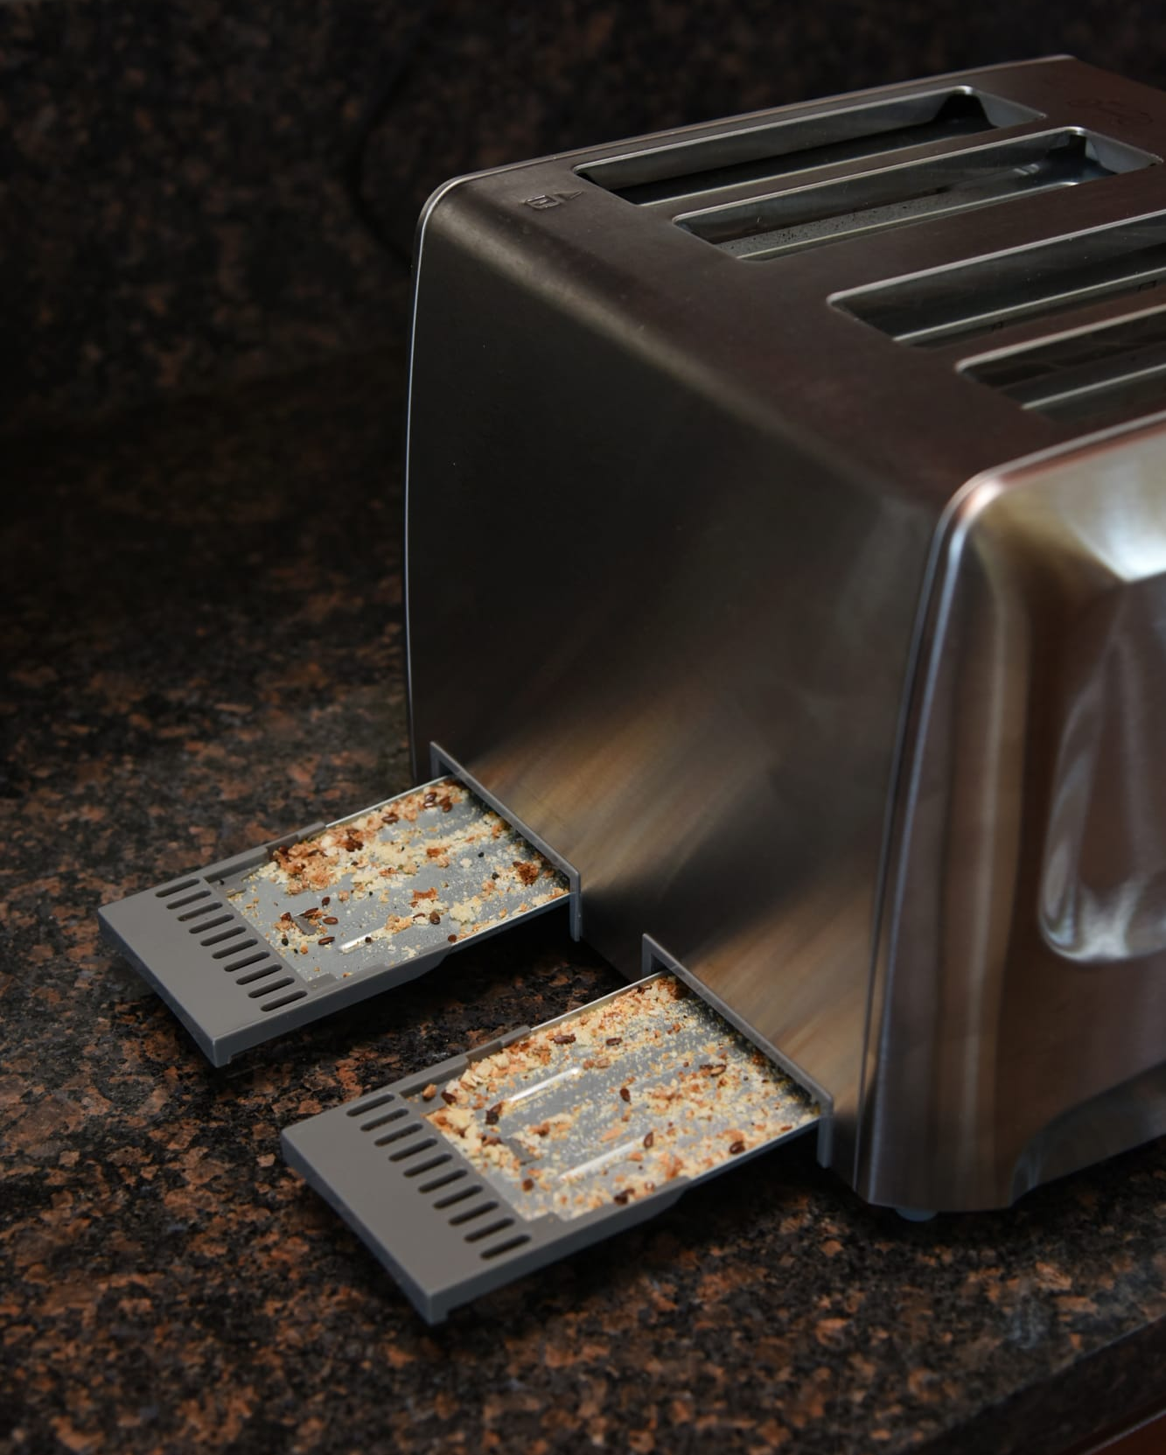
DFD Safety Series: Cooking, Smoking & Candle Safety
DETROIT-SPECIFIC DATA
In 2024, nearly 22% of all structure fires were cooking fires
Almost 14% of those were caused by improper use of cooking appliances
Cooking is the second leading cause of fires in Detroit, behind only electrical fires

Slide 6
DFD Safety Series: Cooking, Smoking & Candle Safety
Cooking Safety Tips:
Be on alert!
Stay in the kitchen
Check food regularly and use a timer
Keep anything that can catch fire away from your stovetop
Stovetop fire: sliding a lid over the pan and turning off the burner and leave the pan covered until it is completely cooled
Oven fire: turn off the heat and keep the door closed
Fire extinguishers or anything white and powdery
Remember …when in doubt get the heck OUT!!
If a Fire Happens:

Slide 7
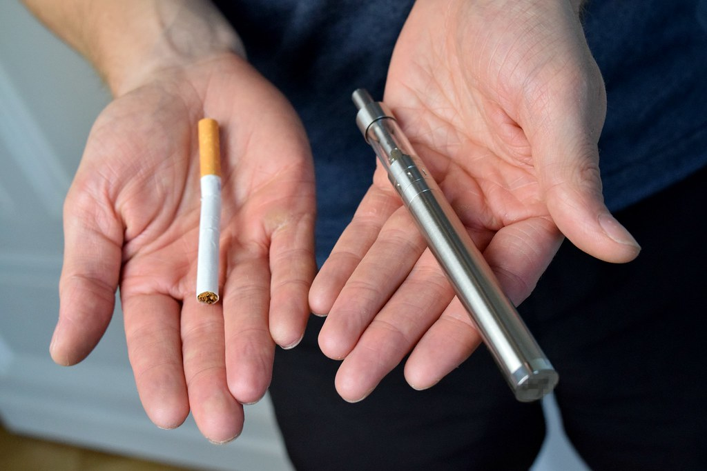
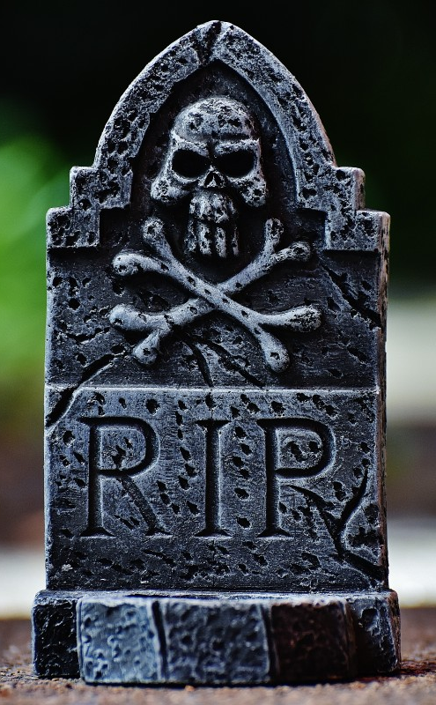
DFD Safety Series: Cooking, Smoking & Candle Safety
Smoking-related
fires are . . .
Leading cause of Home Fire Deaths
100% preventable
The risk of dying in a home structure fire caused by smoking materials rises with age

Slide 8
DFD Safety Series: Cooking, Smoking & Candle Safety
Key findings
Relaxation, sleep and carelessness are leading factors making smoking #1
Fires have occurred while e-cigarettes were being used or transported
Most deaths result
from fires that started in living rooms, family rooms, dens or in bedrooms
Fires have occurred while e-cigarettes battery was being charged
Medical oxygen can cause materials to ignite more easily and make fires burn at a
faster rate
Fires have occurred when e-cigarettes Battery failures have led to small explosions

Slide 9
DFD Safety Series: Cooking, Smoking & Candle Safety
Smoking Safety Tips:
Be on alert, smoke outside!
If you smoke, use only fire-safe cigarettes
Use a deep, sturdy ashtray placed away from combustibles
Make sure smoking materials are out! Douse in water or sand
Do not discard cigarettes in vegetation or anything easily ignited
Never smoke and never allow anyone to smoke where medical oxygen is used
Fire extinguishers or when in doubt…get the heck OUT!!!!
25% of those killed from smoking fires are not the smoker whose cigarette started the fire

Slide 10
DFD Safety Series: Cooking, Smoking & Candle Safety
Candles. . .
Look Pretty and smell good
Used in religious services, in places of worship or at home
Loved on our birthday cakes
Caused 4% of reported home fires, 3% of home fire deaths, 6% of home fire injuries, and 4% of the direct property damage in home fires

Slide 11
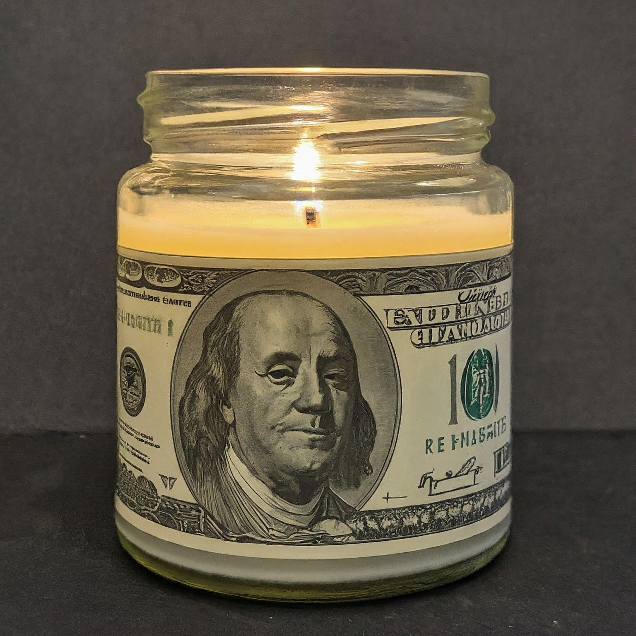
DFD Safety Series: Cooking, Smoking & Candle Safety
Key national findings
December is the peak month for home candle fires
3 out of 5 candle fires start when things that can burn are too close to the candle
More than 1/3 of home candle fires started in the bedroom
Candle price ranges from $1.25 for a votive to $35 for a large pillar or jar candle
5,910 home structure fires started by candles
Average of 74 civilian deaths per year
558 civilian injuries per year
$257 million in property damage

Slide 12
DFD Safety Series: Cooking, Smoking & Candle Safety
Candle Safety Tips:
Use sturdy candle holders
Candles need at least 1 foot around clear to be used safely
Never use a candle if oxygen is used in the home
Don’t burn a candle all the way down
Blow out all candles before going to sleep!
During a power outage, never use candles
Think about using flameless candles in your home
Make a “Power thru it all Kit”
Fire extinguishers or anything white and powdery
Remember …when in doubt…
get the heck OUT!!!!

Slide 13

DFD Safety Series: Cooking, Smoking & Candle Safety
When to call 911:
If you see smoke or flames in your home, get out and call 911. Fire can spread fast – property can be replaced, but people can’t!
DFD is here for you – our response times are some of the best in the country. We’ll be there when you need us!
In Summary:
Stay safe. Be safe!
Remember …when in doubt…get the heck OUT!!!!

Slide 14
DFD Safety Series: Cooking, Smoking & Candle Safety
Thank you for joining us today for the
DFD Safety Series.
Please reach out if you have any questions!
Captain Theresa Halsell
Community Relations Division
Communityrelations@detroitmi.gov
313-596-2959

Slide 15

DFD Safety Series: Cooking, Smoking & Candle Safety
Thank you for joining us today for the
DFD Safety Series.
Please reach out if you have any questions!
Captain Theresa Halsell
Community Relations Division
Communityrelations@detroitmi.gov
313-596-2959

