Slide 1
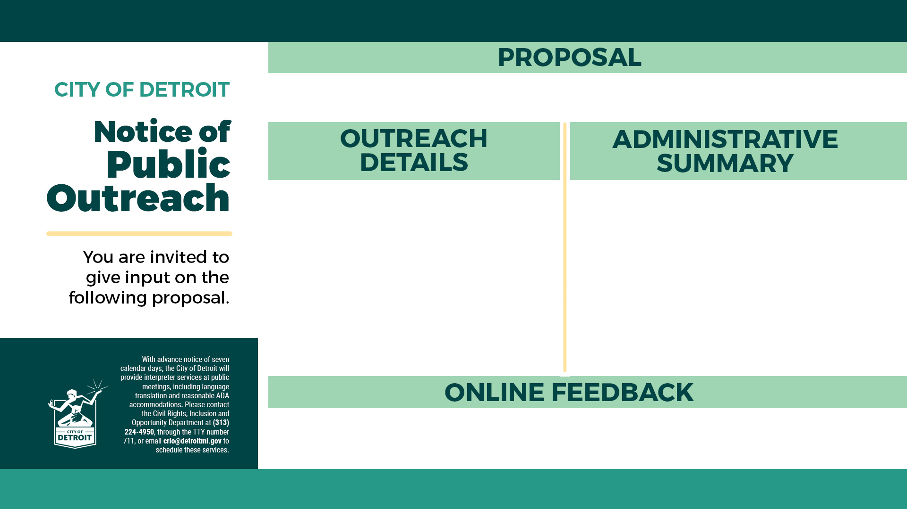
2023 Sidewalk Repair Program (Class D Proposal)
The city of Detroit is now taking applications from neighborhood block clubs requesting replacement of sidewalks in their community. Thanks to an additional $20 million in budget surplus funds approved by Detroit City Council, the city will spend a total of $25 million. Repairs would be primarily for sidewalks that have been damaged by city trees located between the curb and sidewalk. Priority will be given to replacing broken sidewalks that are near schools, churches and parks as well as:
Identified by neighborhood block clubs
Adjacent to city road resurfacing projects
Requested by elderly and disabled residents
Along a city commercial corridor
Part of an existing backlog of requests from prior years
  Weekly DONcast Meeting
  Monday, March 20, 2023, at 5:00 p.m. http://cityofdetroit.zoom.us/j/3631409738
  Weekly DONcast Meeting
  Monday, April 3, 2023, at 5:00 p.m. http://cityofdetroit.zoom.us/j/3631409738
Additional questions and comments can be directed to completestreets@detroitmi.gov

