Slide 1
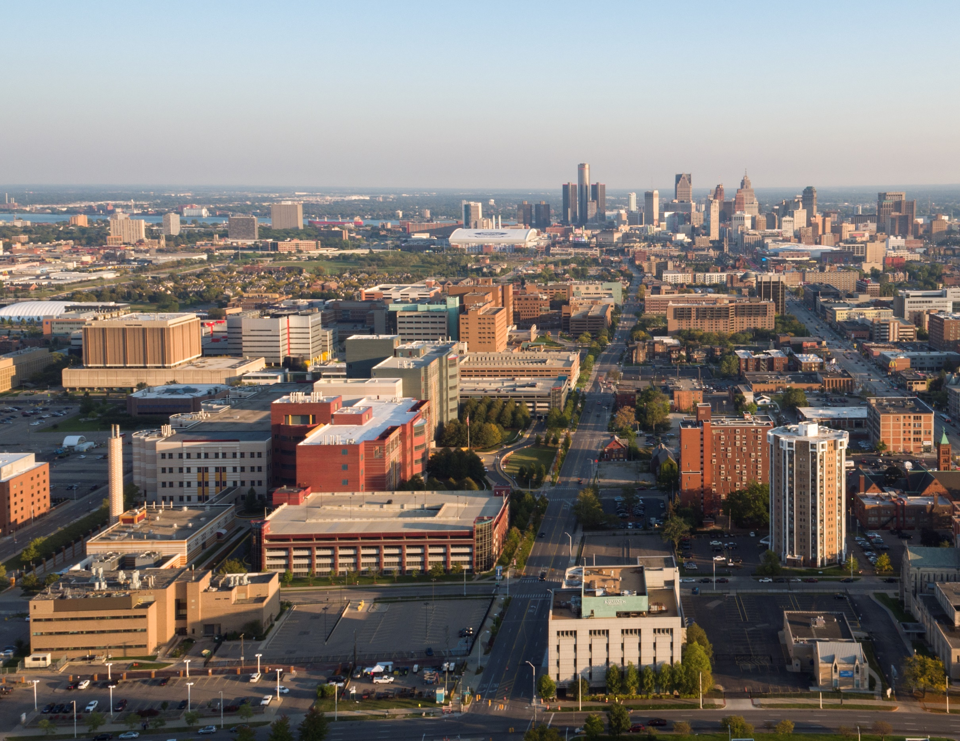


2025-2029
5-year consolidated annual action plan & NRSA

Slide 2
5-YEAR CONSOLIDATED PLAN & ANNUAL ACTION PLAN
Housing and Revitalization Department
Warren Duncan, Director of HUD Reporting & Compliance

Slide 3
What is the Consolidated Plan?
Document prepared to submit to HUD
  Identify community development needs
  Set goals
  How grant funds are spent
Notes:
(HUD’s Definition):The Consolidated Plan is designed to help states and local jurisdictions to assess their affordable housing, community development needs, market conditions and to make data-driven, place-based investment decisions when using entitlement grant funds.
Also, the overall Con Plan goal is improving the quality of life in the low-and moderate-income areas of the city, including identifying and prioritizing the City’s housing and community development needs, by setting five year goals for the use of the entitlement grants in the plan.

Slide 4
What is an Annual Action Plan?
Annual goals and objectives of the Con Plan
Acts as the City’s application to HUD to receive our annual allocation of HUD Grant funds.

Slide 5




What are HUD Grant Funds?
Community Development Block Grant (CDBG)
HOME Investment Partnership(HOME)
Housing Opportunities for Persons with AIDS (HOPWA)
Emergency Solutions Grant (ESG)
Notes:
CDBG: (Ex. Home Repair, Job Training programs)
HOME: (Ex. Rehab multi-family affordable housing – apartments)
ESG: (Ex. Emergency Shelters for the homeless, Homeless Prevention programs)
HOPWA: (Ex. Tenant-Based Rental Assistance for families affected by the Aids Virus)

Slide 6
Con & Annual Action Plan
Five Year Plan
2025-2029
2025 is submitted with Con Plan
2025
2026
2027
2028
2029
Notes:
Use this visual to go over how the Con Plan and Annual Action Plan work together.
(Contains specific implementing actions to carry out five year strategies, goals and objectives)
Goals
Primarily focused on low-to moderate-income households and communities
Development of decent and affordable housing
Create suitable living environments and promote quality of life
Expand economic opportunities

Slide 7
FY 24-25 HUD Formula Allocations
$32,759,210
$5,928,131
CDBG
HOME
$2,990,945
$3,593,290
ESG
HOPWA
Notes:
CDBG: (Ex. Home Repair, Job Training programs)
HOME: (Ex. Rehab multi-family affordable housing – apartments)
ESG: (Ex. Emergency Shelters for the homeless, Homeless Prevention programs)
HOPWA: (Ex. Tenant-Based Rental Assistance for families affected by the Aids Virus)

Slide 8

Citizen Participation
Notes:
HRD submits the Consolidated Plan + the Year 1 Annual Action Plan in July 2025
One component of the submission is Citizen’s Participation. We will need your help!

Slide 9
Citizen Participation
Citizens will have an opportunity to complete a survey via online, handouts or using QR codes to receive feedback on what is going on in your community.
Citizens have an opportunity to give comments on the draft of the Con Plan
This will assist the city in establishing our goals and priorities for the use of funds over the next 5-years.
Notes:
Participation includes sharing what your priorities are through surveys and sharing your comments on the draft of the Con Plan. Your engagement helps us establish what our goals our over the next few years.
This kind of outreach will begin in January 2025

Slide 10
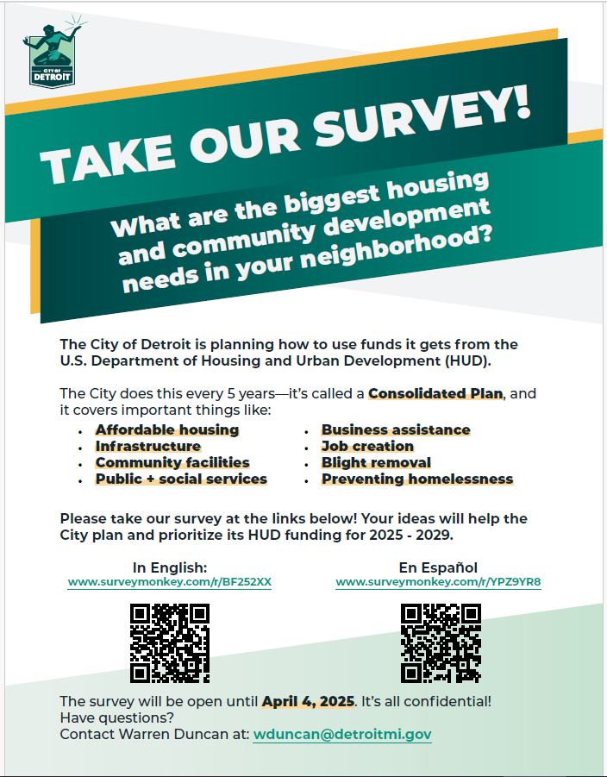
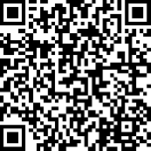
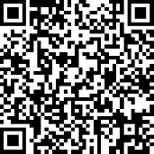
Scan the QR Code and take the survey!
English
EspaÑol

Slide 11

Intro to Neighborhood Revitalization Strategy Areas (NRSA’s)

Slide 12
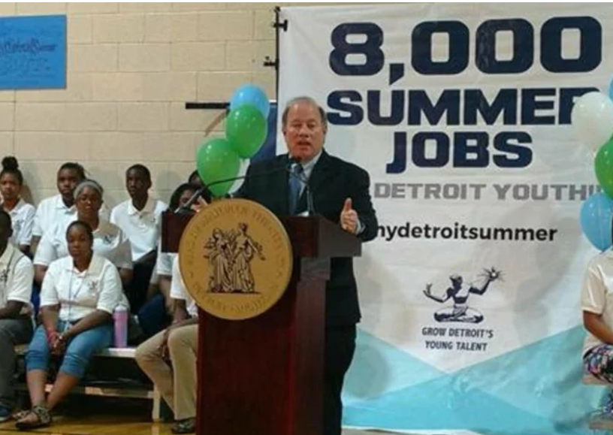
Background
    Since 2014, the City has used $11.6MM in Community Development Block Grant (CDBG) dollars to partially fund Grow Detroit's Young Talent, leveraging millions of other federal, state and local dollars and employing over 8,000 Detroit youth annually.

Slide 13
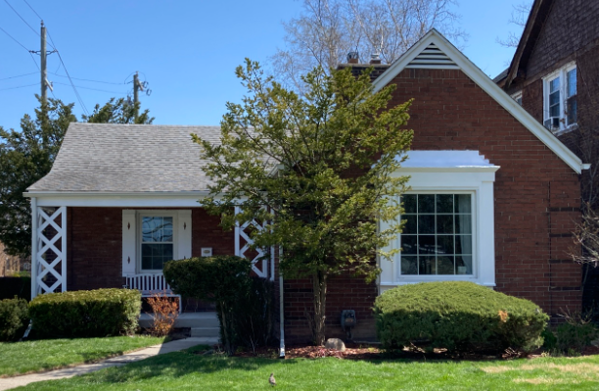
Background
    In 2014, the City funded the 0% Home Repair Loan Program, addressing funding needs for over 700 Detroit Homeowners seeking essential repairs on their homes, and leveraging over $10MM in private funding.

Slide 14

What is a Neighborhood Revitalization Strategy Area?
A tool provided by the U.S. Department of Housing and Urban Development (HUD) for CDBG grantees
5-year plan that targets the use of our CDBG dollars in specific areas, with the goal of leveraging other funding and resources
As a result, HUD grants flexibilities with CDBG rules
Without our NRSA’s, these programs would not be possible

Slide 15



What kind of tool is a NRSA?
No additional funding is provided from HUD, however NRSA’s offer more flexibility in the regulations for CDBG, specifically for housing, public service and economic activities.

Slide 16



NRSA Benefits
Housing - CDBG requires that all households must be at or below 80% of the area median income (low-to-moderate income). However, the NRSA tool allows flexibility in how we calculate this. This allows for more flexibility to expand mixed-income housing opportunities.
Non-NRSA
NRSA
Public Services – CDBG does not allow more than 15% to be spent on Public Services (if Neighborhood Opportunity Fund). However, the NRSA tool allows for grantees to exceed that 15% if the services are provided within the NRSA and are implemented by a Community Based Development Organization (CBDO – as defined by HUD).
Economic Development – CDBG requires that the income for persons who fill jobs be collected, it also requires that the financial benefits be tracked. However, the NRSA eliminates the need to collect income information, and expands the amount of assistance that can be provided.

Slide 17
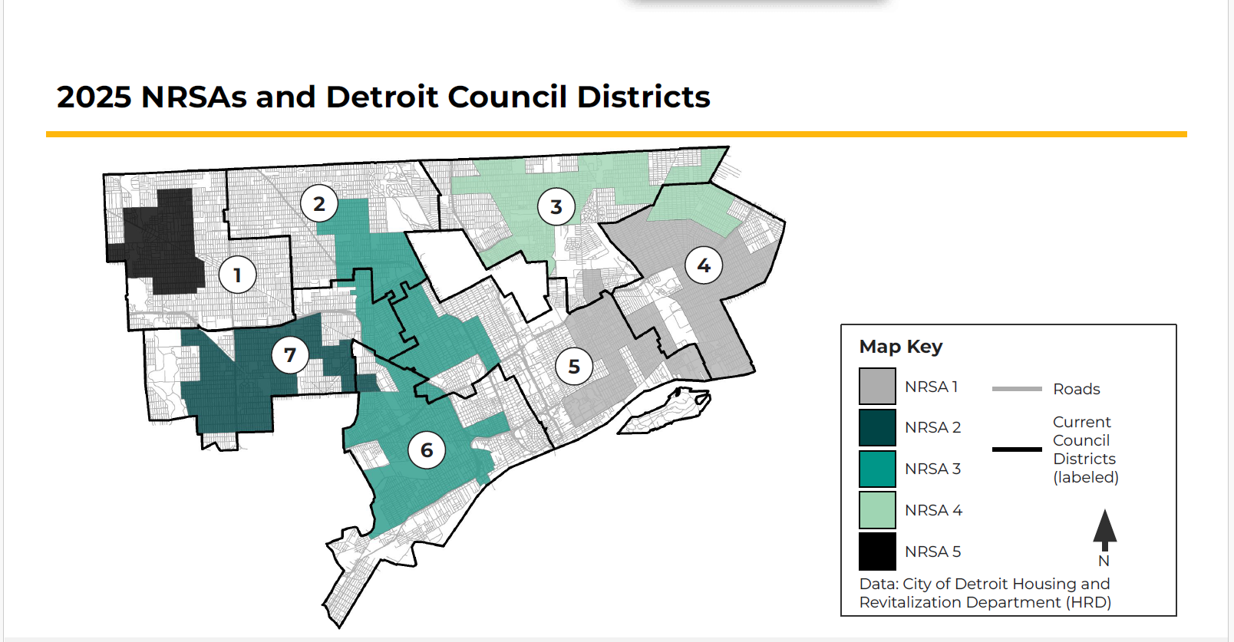
Proposed 2025-2029
City of Detroit
NRSA Boundaries
Has connecting borders (usually determined by census tracts)
70% of the population within those borders are low-to-moderate income
The area is primarily residential (usually more than 60% residential).

Slide 18

Why is this information important?
The City must submit a renewal application to HUD with its Consolidated Plan in 2025
  This will include updated boundaries of the NRSA’s based on updated data
Outreach is happening now!

Slide 19

How can you help?
Participation of stakeholders, particularly those living in proposed NRSA areas, are needed to support the strategy
  Take the survey!
  Attend meetings
  Review the Draft
    Provide written comments via email
  Share with neighbors and friends in the City

Slide 20

Thank You!
Questions?

Slide 21
Additional Resources

Slide 22
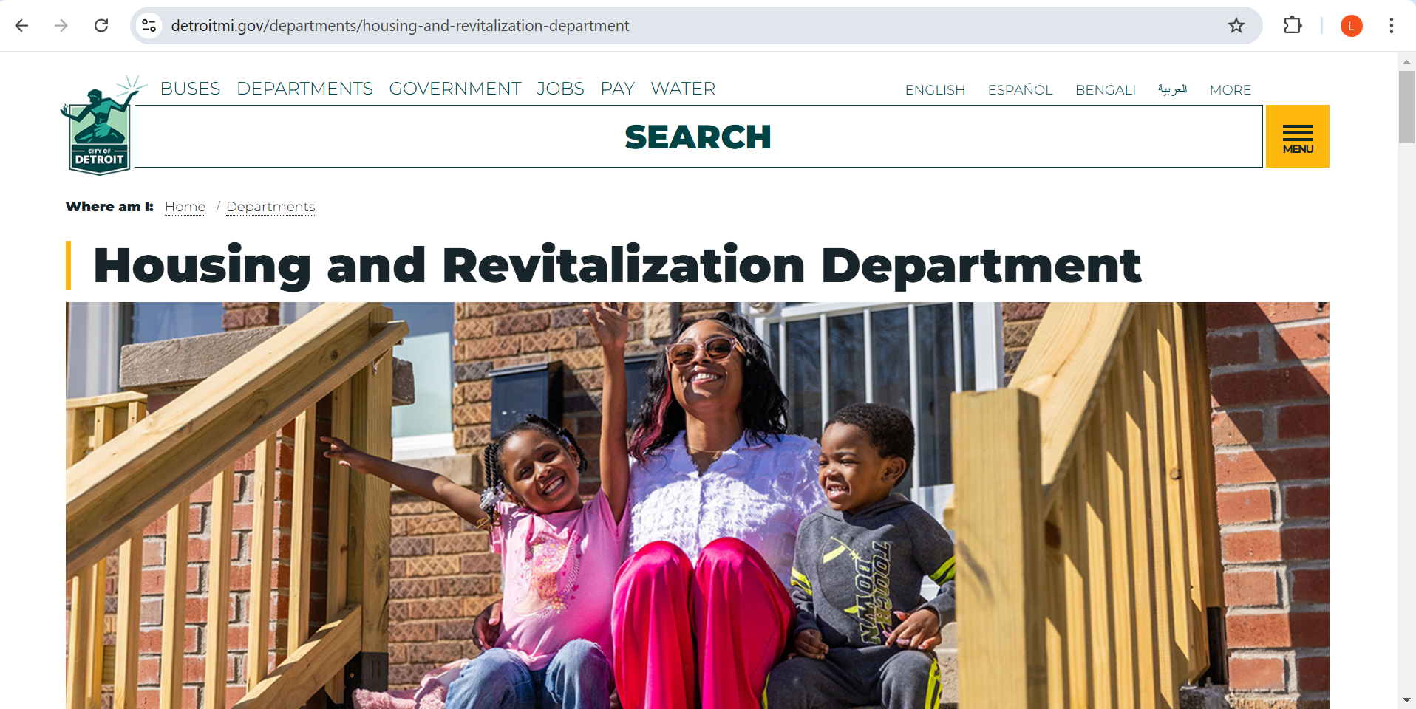
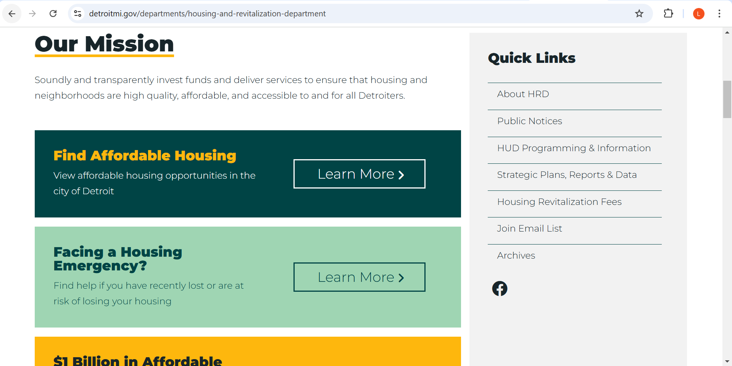
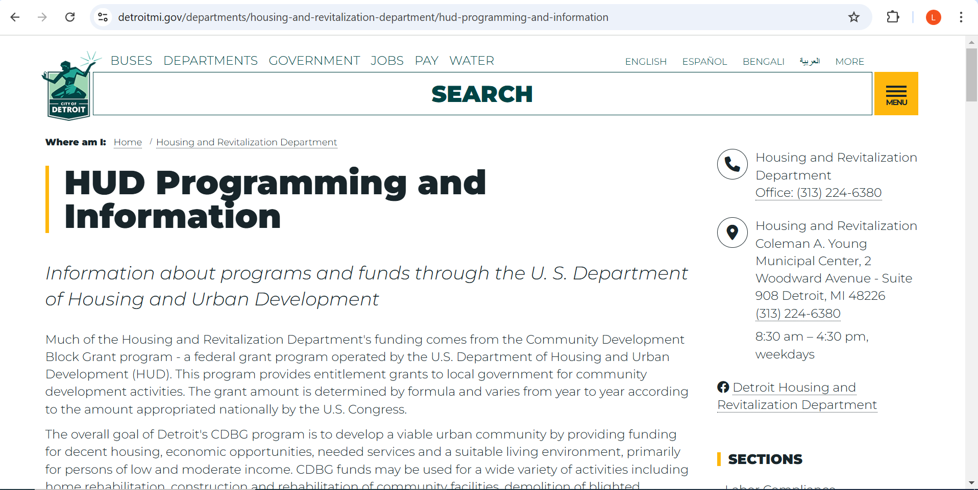
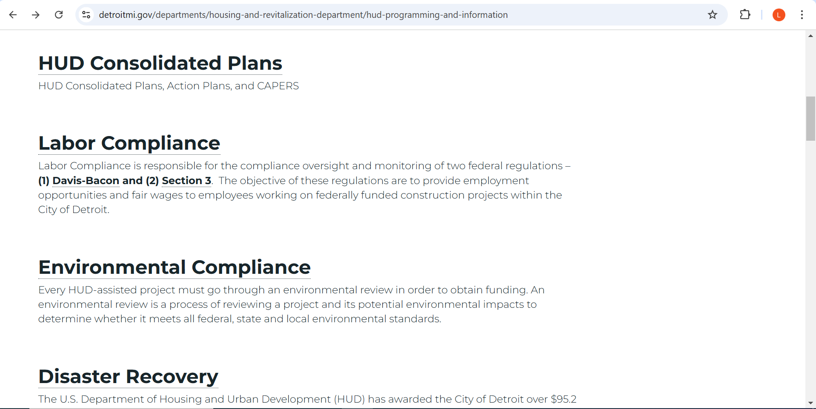
HRD Webpage
2
1
4
3
Notes:
www.detroitmi.gov/hrd
Search: Consolidated Plan

Slide 23
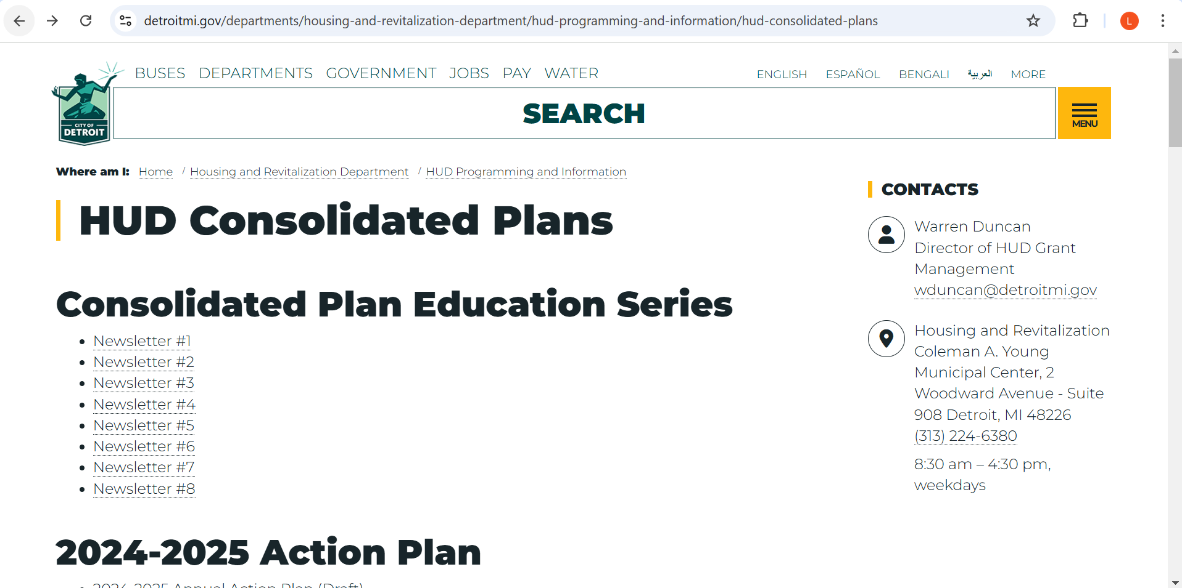
HRD Webpage

Slide 24
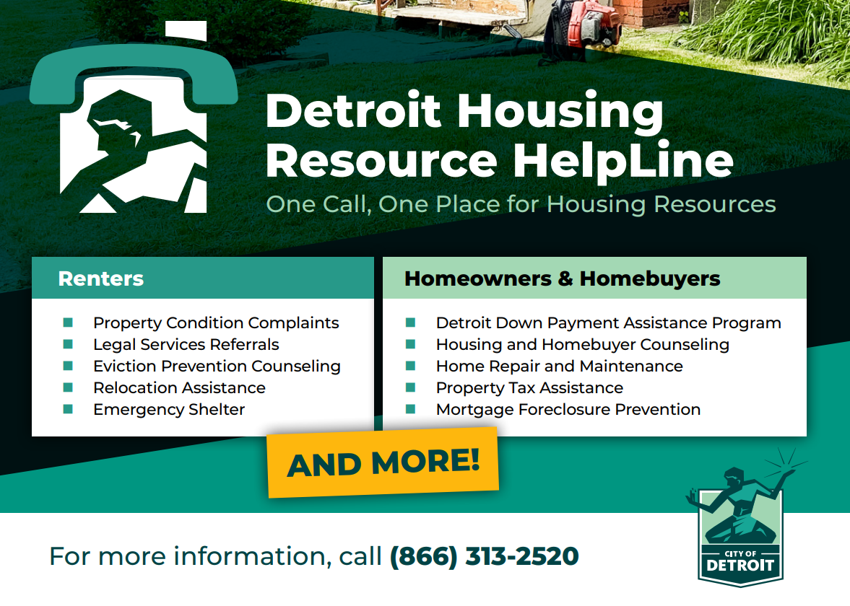
Detroit Housing Resource HelpLine​
866-313-2520 Monday-Friday 8am-6pm, Saturday 9am-12pm

Slide 25

COMMUNITY RESOURCES
Coordinated Assessment Model (CAM) – 313-305-0311
website: camdetroit.org
Detroit Housing Resource Help Line – 866-313-2520
CDBG Home Repair related question contact: Anna Pinter email: pintera@detroimi.gov

Slide 26
Public Participation
Question and Answer
Comments (Conplancomments@detroitmi.gov)

Slide 27
Citizen Participation Survey
Survey In English:
www.surveymonkey.com/r/BF252XX
Encuesta En EspaÑol
www.surveymonkey.com/r/YPZ9YR8
Notes:
Participation includes sharing what your priorities are through surveys and sharing your comments on the draft of the Con Plan. Your engagement helps us establish what our goals our over the next few years.
This kind of outreach will begin in January 2025

Slide 28
2025-29 Con/Plan Annual Action Plan – Citizen Participation
Citizen Comments
Citizens will have an opportunity to comment at the end of the presentation. Citizen comments are received by the following methods:
During our Public Hearings or these (Public hearings will be announced in the spring ‘25)
In Writing at: Housing &
Revitalization Department, Grants
Management section, 2 Woodward
Ave, Ste. 908, Detroit MI, 48226
3. Via Email at:
ConPlancomments@detroitmi.gov
4. Via Telephone: 1-313-224-6380, Hours:
Monday to Friday from 8:30am-4:30pm
5. Department of Neighborhood District
Manager or City Council person
HRD website
www.detroitmi.gov/hrd
Copy of draft – 2025-29 ConPlans/Action Plan (past ConPlan/ Action Plans)
-Copy of presentations
- All ConPlan/Action Plan Notices

