Slide 1
Disaster Recovery
March 2025
CDBG-DR Action Plan Public Hearing
Notes:
Introduce yourself and why you are here
Recognize Colleagues from DWSD, DPW, HRD
Background on more intense rain storms and more frequent in recent years
When we found out we received rare large sum of funding to address these issues, we wanted to address flooding concerns in Detroit, and identify projects that would have a great impact and reduce flooding. This money wont address our larger infrastructure needs (well in the billions), but there are ways we believe we can make a large impact. Today we are proposing to use the funds for…(introduce the projects).

Slide 2



Introduction to CDBG-DR
We are here
Congress (sometimes) appropriates CDBG-DR funding towards Presidentially Declared Disasters (12/21/24)
HUD determines award amounts and awards the CDBG-DR funding to grantees with eligible disasters.
Awards published in the Federal Register Notice (1/16/25)
The City of Detroit has 90 days to submit an Action Plan to HUD proposing the use of the CDBG-DR funds.
HUD has 45 days to review upon submission.
City of Detroit, through its Housing and Revitalization Department, implements the approved Action Plan

Slide 3
Disaster Response Timeline
Immediate Response
FEMA and other agencies begin immediate response efforts including rescue, safety, shelter and other actions focused on triage.
Initial Recovery
The federal government begins assessing the damage in conjunction with state and local governments, as well as entities such as insurance companies.
Long-Term Recovery
Development Block Grant – Disaster Recovery (CDBG-DR) funds are appropriated to help communities with presidentially declared disasters recover from those disasters. Recovery is defined as restoring housing, infrastructure and economy to pre-disaster conditions.

Slide 4
HUD ‘Unmet Needs’ Calculation & Award
Damaged assessed (in dollars $$) by FEMA and translated
-Disaster response funding awarded (residents/city) i.e. FEMA Public Assistance, Individual Assistance, SBA Loans
= Total ‘Unmet Need’
HUD determined our unmet need for the August 2023 disaster to be $346,864,000
CDBG-DR-funded activities and programs must respond to disaster-related impacts that are not fully addressed by other funding sources
Unmet Needs
Other Funding Sources
Insurance
Notes:
Looked at total damage assess by FEMA; Total impact of the storm in $$.
Subtracted funding we already received. Like FEMA public assistance $$ individual assistance SBA loans,
The difference between the damaged assessed and relief already provided. And the balance is the unmet need.
We believe that was the driver in why this award amount was larger. City did not receive FEMA public assistance for the 2023 disaster.

Slide 5
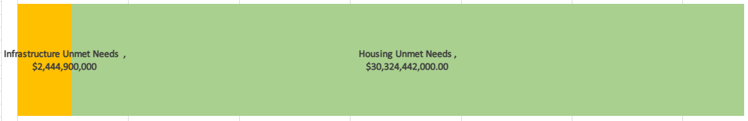
Action Plan ‘Unmet Needs’
Action Plan Identified Unmet Needs - $32,769,342,000.00
Based on local data and pre-existing conditions exacerbated by the disaster. Includes mitigation projects.
*Economic Development unmet needs are unknown at this time, however if and when data becomes available, this information will be updated in the Action Plan and proposed uses of the funds will be evaluated and updated as applicable.
Notes:
Data can be found in the Action Plan

Slide 6

CDBG-DR Eligible Uses
Eligible Activities
Infrastructure
Economic Development
National Objective
Housing
Low-to-moderate income households at or below 80% AMI
“Tie-Back” to the Disaster
Duplication of Benefits
Slum & Blight
Urgent Need
Notes:
Slum & Blight – we don’t believe our disaster impact will qualify for this NO
Urgent need – the timeline to use this NO is coming to an end soon
We have chosen to use LMI
Tie back must be direct or indirect
Example – direct a tornado hits and your roof is blown off. We replace the roof.
Indirect – PSRP – while the infrastructure itself did not cause the flooding, the condition of the laterals exacerbated the basement flooding we experienced.
Example – you received homeowners' insurance for the roof, then we can’t use CDBG DR, or the City received FEMA funds to repair all of the laterals in the city.
You must use all other sources before using the CDBG-DR funding.

Slide 7
Proposed Use of CDBG-DR
Infrastructure
Housing
Planning
Administration
$252,470,800
$75,050,000
$17,343,200
$2,000,000
$346,864,000
Notes:
After reviewing the unmet needs and regulations, we are proposing the following activities for CDBG-DR.
Even though the unmet need showed housing significantly larger than the unmet need for infrastructure, the proposed infrastructure activities protect housing from flooding events.

Slide 8
Proposed Activities - Budget
Program Category | Project | Budget
Housing
$75,050,000.00 | Affordable Housing | $34,050,000.00
 | Public Housing | $31,000,000.00
 | Homeownership Opportunities - Down Payment Assistance | $10,000,000.00
Infrastructure
$252,470,800.00 | Public Facility Rehab - Homeless Shelters | $7,227,800.00
 | Stormwater Improvement Projects | $25,000,000.00
 | Sewer Alley Repair Program | $175,000,000.00
 | Traffic Signal Connectivity and BackUp - Mitigation | $9,000,000.00
 | Public Facility Rehab - Homeless Shelters - Mitigation | $16,243,000.00
 | Jefferson Chalmers Stop Log Flood Mitigation Project - Mitigation | $20,000,000.00
Planning |  | $2,000,000.00
Administration |  | $17,343,200.00
Total |  | $346,864,000.00

Slide 9
Overview of Proposed
Flood Protection Infrastructure Improvements
Notes:
After reviewing the unmet needs and regulations, we are proposing the following activities for CDBG-DR.
Even though the unmet need showed housing significantly larger than the unmet need for infrastructure, the proposed infrastructure activities protect housing from flooding events.

Slide 10
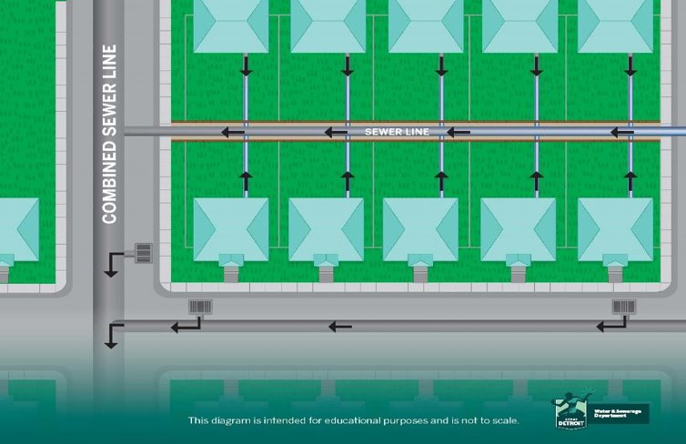
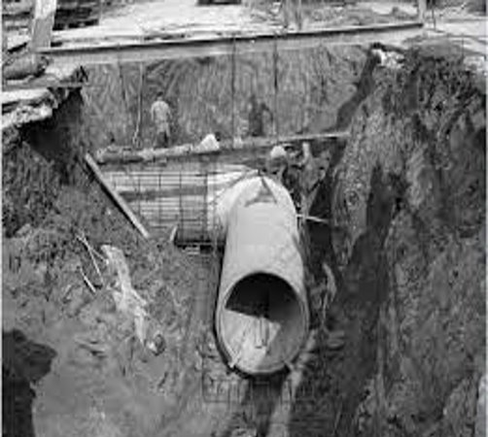
Infrastructure Programs
Sewer Alley Repair Program
Detroit has 1,800 miles of alley sewers
that connect homes to main sewer lines
Most were installed 70-90 years ago
Notes:
Insert introduction related to use of funds for PSRP, moving to area benefit to reduce paperwork for households (13 documents, only 5K residents versus $30K in 2021), achieve same results from the public side.
Area benefit versus household (individual benefit).
5,000 versus 17,000 residents because of tie-back and income eligibility requirements.

Slide 11
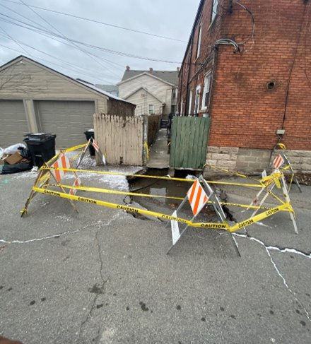
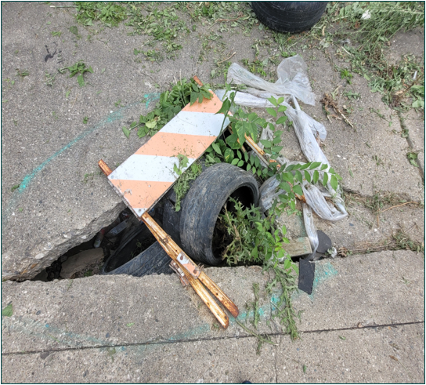
Infrastructure Programs
Sewer Alley Repair Program
After nearly a century of neglect, ​
these sewers can collapse and create sinkholes
Notes:
Sinkholes in the alleys

Slide 12
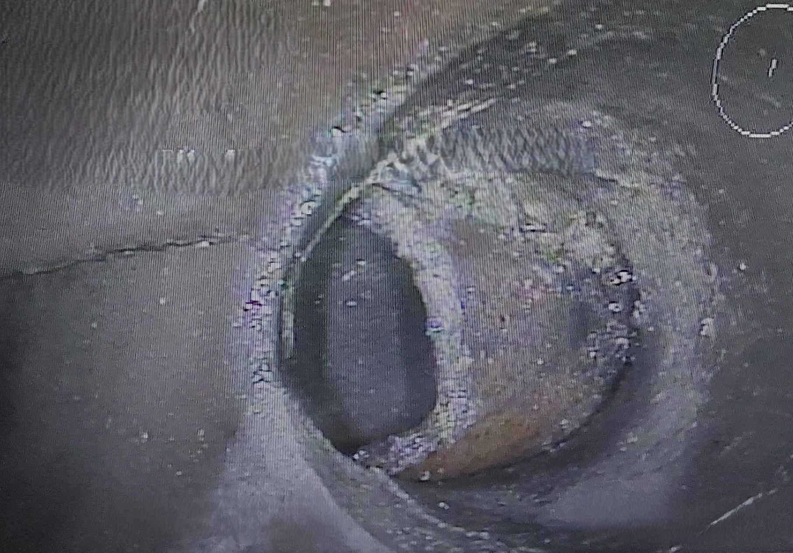
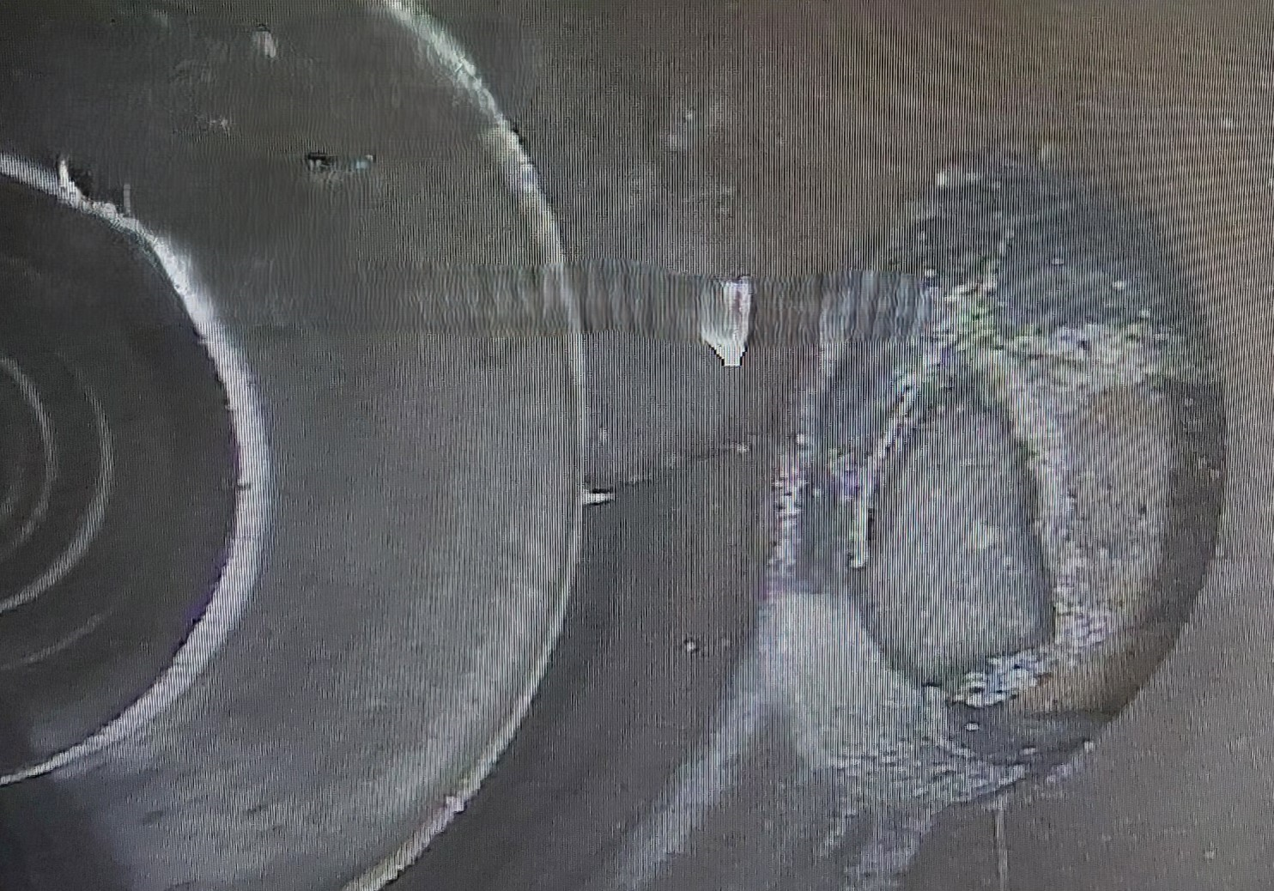
Infrastructure Programs
Sewer Alley Repair Program
Private sewer laterals in many cases have outlived their useful life and start collapsing or falling off from the public sewer, leading to basement backups and causing alley sinkholes.
DWSD estimates that with CDBG-DR, approximately 12,000 households will be served
Notes:
Every district will benefit from this program, DWSD has committed to working with City Council to understand the needs and identify projects in each district.

Slide 13
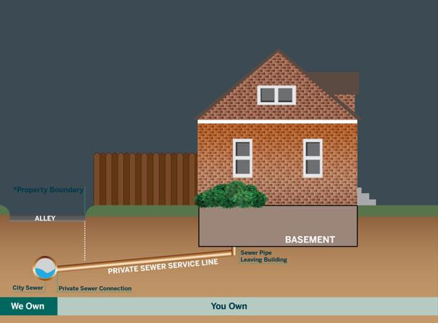
Infrastructure Programs
Sewer Alley Repair Program
The majority of private sewer connections in Detroit neighborhoods are in the alley, and a program to reconnect them to the public sewer can help reduce basement backups.

Slide 14
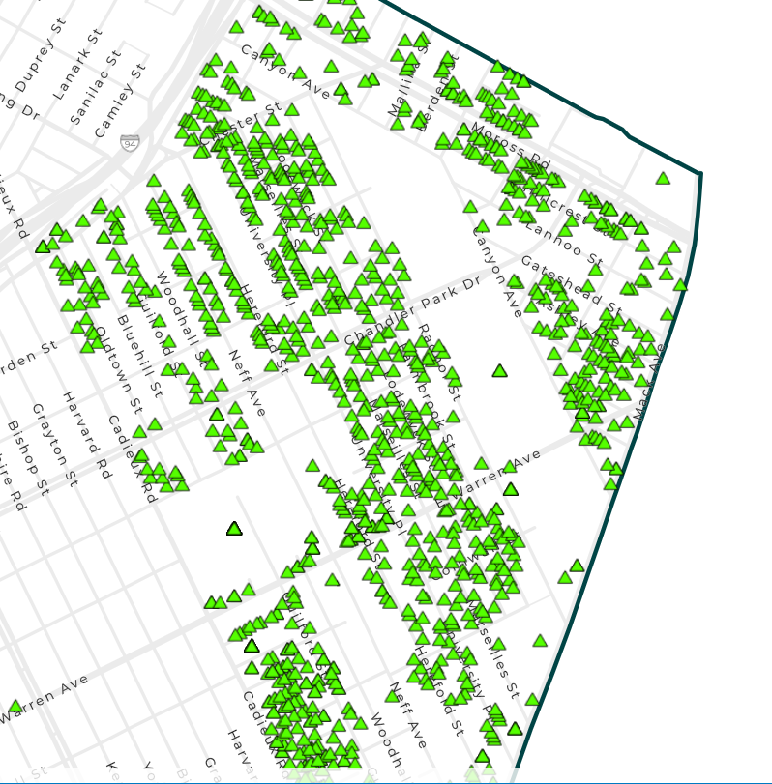
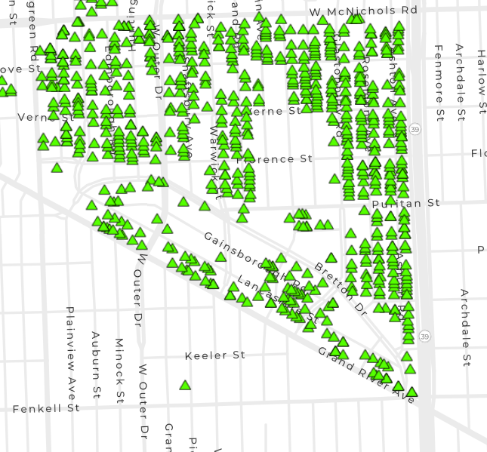
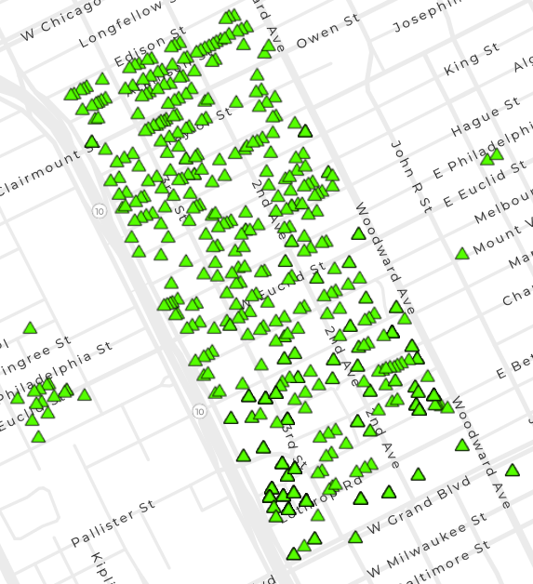
DWSD thoroughly inspected 3 neighborhoods:
each green triangle represents a home with a blockage
Cornerstone Village
N. Rosedale Park
North End
*These neighborhoods are being shown for example purposes only

Slide 15
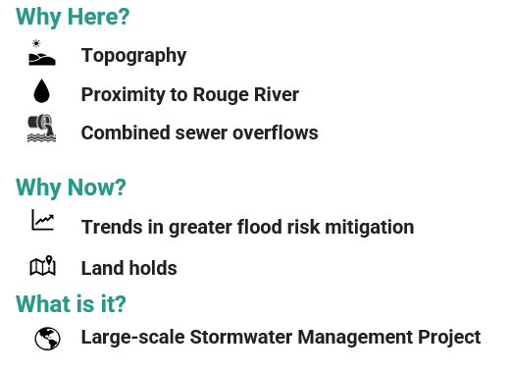
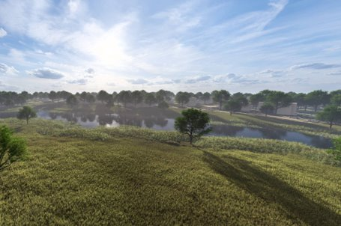
Infrastructure Programs
Stormwater Improvement Project
Large-scale GSI captures stormwater runoff from a much larger area and can benefit multiple tributaries along a river rather than just localized areas.
Rendering of Brightmoor Stormwater Feature
Notes:
GSI – Green Stormwater Infrastructure located in the Brightmoor neighborhood.

Slide 16
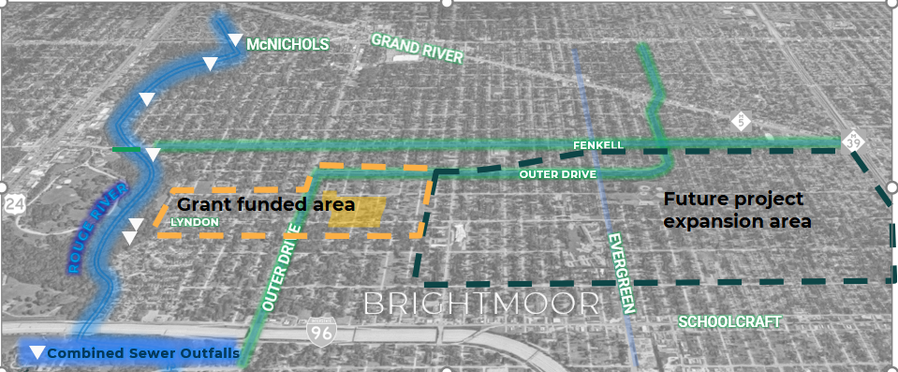
Infrastructure Programs
Stormwater Improvement Project

Slide 17
Background and Overview of Jefferson Chalmers Proposed Flood Mitigation Project

Slide 18
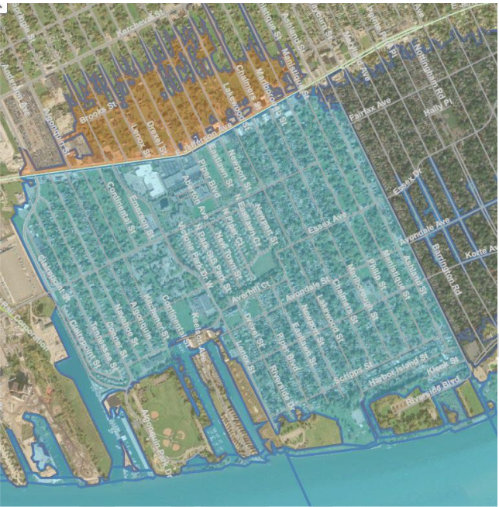
Infrastructure Programs
Stop Log Flood Mitigation Project
The city will install permanent fixtures for temporary stop logs to keep Detroit River flood water out of the sewer system with the intention of removing Jefferson Chalmers from the floodplain.
The installation of the three (3) stop log structures will be across Lakewood, Phillip and Fox Creek canals, and include earthwork in Mariners, Riverfront - Lakewood East, AB Ford and Maheras Gentry Parks, and site grading/ floodwall at KAM Marine/Bayview Yacht Club.
Privately repairing seawalls does not remove Jefferson Chalmers from the floodplain.
FEMA-accredited flood barrier protection rules likely apply – including maintenance plan and local municipality oversight. ( https://www.fema.gov/sites/default/files/documents/fema_meeting-criteria-accrediting.pdf )
Notes:
•There are 2,771 parcels in the floodplain – 366 are on the river or canals, and 2,405 are in the interior, with an estimated population of about 5,500.
This is different from the 2022 Army Corps Flood Plain Management study report which recommended 2 permanent canal closures and one stoplog installation. We are proposing three stoplog installations and no permanent canal closures with the DR funds.
The city will install permanent fixtures for temporary stop logs and other elements to keep Detroit River flood water out of the sewer system and adjacent properties and with the intention of removing Jefferson Chalmers from the floodplain.
( https://www.fema.gov/sites/default/files/documents/fema_meeting-criteria-accrediting.pdf )
We also cannot service seawalls owned by private owners because of the income requirements for CDBG-DR

Slide 19
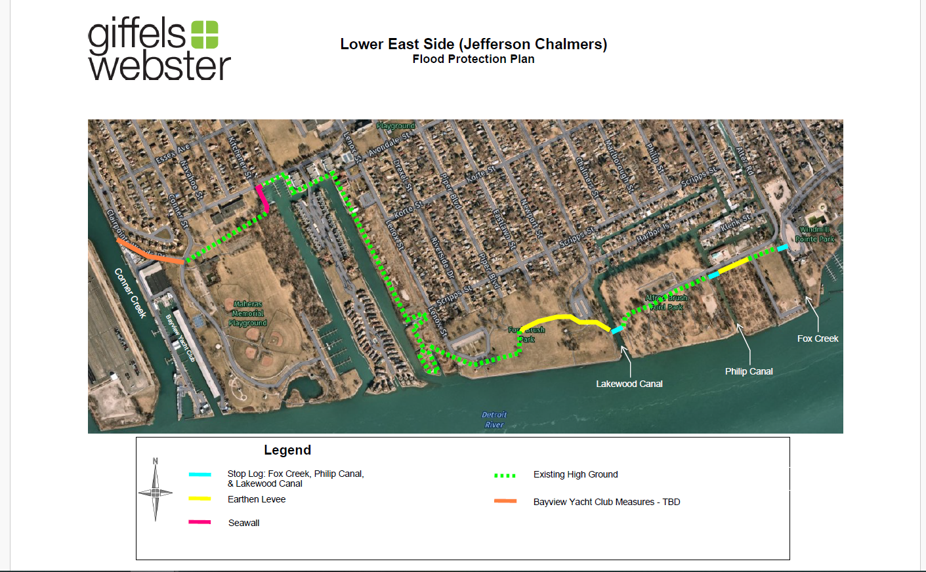
Infrastructure Programs
Stop Log Flood Mitigation Project
Notes:
* Close-up of expected work elements to resolve both the overland flooding and floodplain designation issues.
* Note that concept of temporary closure of the canals for flood control purposes is recognized by the US Army Corps of Engineers in their July 2022 Flood Risk * Reduction Study (BSEED page - https://detroitmi.gov/sites/detroitmi.localhost/files/2022-08/Jefferson%20Chalmers%20FPMS%20Study_July2022.pdf )
* At KAM Marine/Bayview YC- while "Floodwall" was denoted in the USACE document, we would prefer a re-grading/repaving solution rather than a closure device.
It is fully acknowledged by all parties that possible discharge of the Fox Creek combined sewer by GLWA into the Fox Creek open channel while stop logs are in place, is a subject that must be addressed with this proposed project. Additionally, possible stagnation of the canals while the stop logs are in place will also be addressed with this project.
ONLY when River elevation are approaching canal over topping elev (currently at ~575')

Slide 20
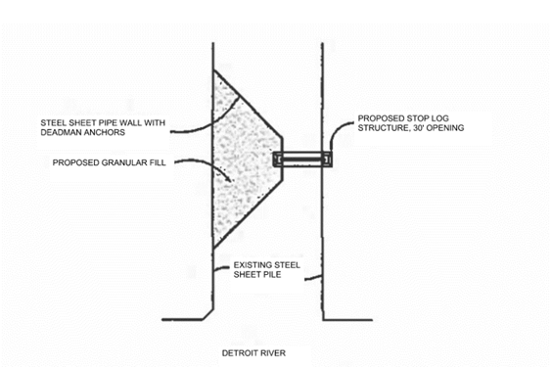
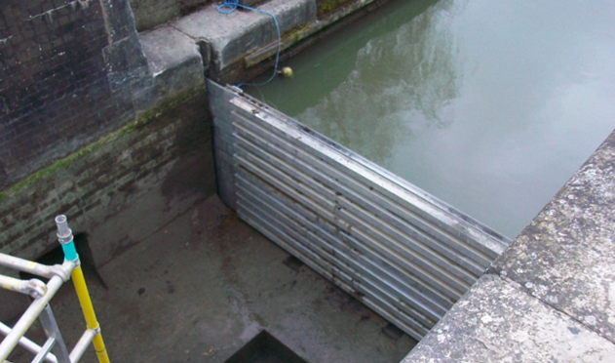
Infrastructure Programs
Stop Log Flood Mitigation Project
What could a stop log installation look like?
Based on current data, lake levels are expected to rise about every 10 years triggering the need for stop logs
Stop logs are currently expected to be in place for 4-6 months at a time every 10 years
Notes:
•Figures from Giffels
Stop logs could be steel, aluminum, or fiber-reinforced plastic (FRP)
•Requires crane and detailed plan for operation and maintenance (details TBD)
•Would close access to Detroit River ONLY when levels approach elevations where canal overtopping occurs (lowest currently is ~575')

Slide 21
Infrastructure Programs
Stop Log Flood Mitigation Project
These subjects will be addressed and resolved PRIOR TO construction as they will require regulatory approval by GLWA, EGLE and USACE:
  Fox Creek sewer discharge.
  Confirmation that no other sewer outlets to canals.
  Stagnation of Fox Creek canal, especially while the canals are temporarily closed.
  Historic hydrologic and hydraulics investigation.
  Maintenance and operation plan.

Slide 22
Infrastructure Programs
Stop Log Flood Mitigation Project
Why fund a Flooding/Floodplain project with DR?
  Funding is available NOW. 100% federal, no local match. Future costs will be higher, and funding sources are uncertain.
  The need for flood protection and floodplain designation relief exist currently and will persist until we act to rectify.
  Great Lakes levels will continue to fluctuate and there will be future canal overtopping events, and corresponding deployment of temporary protection measures.
  Relief from FEMA floodplain restrictions can occur sooner.
  No permanent canal closures are proposed with this project.
Notes:
NOW – because its available. Future funding is uncertain/speculative. 100% federal with no local match. Future prices will be more expensive, and city share will be proportionally higher.
2. Flooding = canal overtopping and entering sewer system, not necessarily like kayaking in the streets. Project will help canal-abutting parcels from becoming oversaturated (damage to basements, foundations, flatwork, etc.) AND protects the local and regional sewer system (not designed for "constant-ON" operation, and failures are not an option or easily/timely fixed)
Sandbags & Tiger Dams likely for next event.
Floodplain -
Flood Insurance Requirements For Homeowners – requires flood insurance in perpetuity for the house itself (even when selling to a new owner). If that insurance lapses, the home is no longer eligible for future federal assistance.
Step #3 of the Floodplain Management 8 Step Decision process requires the City to identify alternatives to building in a floodplain, requiring significant due diligence and making it almost impossible to justify using federal funds to invest in projects (especially housing).

Slide 23
Infrastructure Programs
Stop Log Flood Mitigation Project
Why fund a Flooding/Floodplain project with DR?
  Could potentially lower water bills
  Relief of flood insurance requirements
  Prevent further damage to the regional sewer system
    More likely to see basement backups
  Prevent property damage (i.e. foundation damage)
  Opens access to additional federal resources for residents
Notes:
NOW – because its available. Future funding is uncertain/speculative. 100% federal with no local match. Future prices will be more expensive, and city share will be proportionally higher.
2. Flooding = canal overtopping and entering sewer system, not necessarily like kayaking in the streets. Project will help canal-abutting parcels from becoming oversaturated (damage to basements, foundations, flatwork, etc.) AND protects the local and regional sewer system (not designed for "constant-ON" operation, and failures are not an option or easily/timely fixed)
Sandbags & Tiger Dams likely for next event.
Floodplain -
Flood Insurance Requirements For Homeowners – requires flood insurance in perpetuity for the house itself (even when selling to a new owner). If that insurance lapses, the home is no longer eligible for future federal assistance.
Step #3 of the Floodplain Management 8 Step Decision process requires the City to identify alternatives to building in a floodplain, requiring significant due diligence and making it almost impossible to justify using federal funds to invest in projects (especially housing). Rehabilitation requirements also change (building basements)

Slide 24
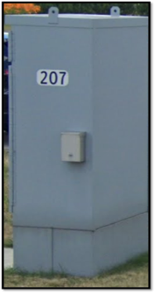
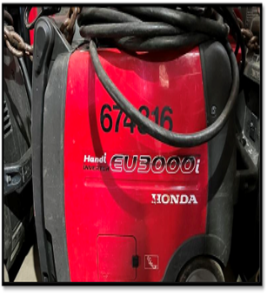
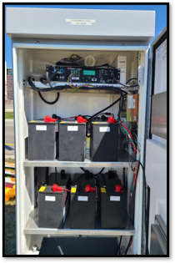
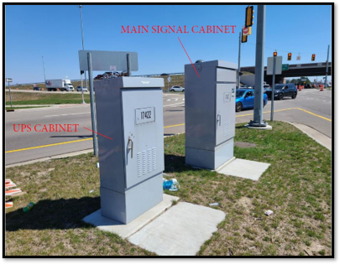
Infrastructure Programs
Traffic Signal Connectivity & Backup
In 2024, there were 2,400 reported signal malfunctions & 239 power outages. To mitigate future negative impact during storms, DPW proposes to:
Install generator connector switches to all of the 819 city jurisdiction traffic signals
Install UPS battery back-up at 40+ high traffic volume intersections in the city
Connect 230 currently unconnected traffic signals to the Traffic Management Center
Transfer Switch
Portable Generator
Notes:
Picture 1 - Generator Connector (Transfer) Switch would be permanently installed on the side of the traffic signal cabinet at all 819 signals​
Crews would quick connect portable generator during outage events​
Allows signal to work during outages until permanent power is restored
Picture 2 - Uninterruptible Power Supply (UPS) system keeps the signal running uninterrupted during power outages for up to 5 hours.​
DPW will install this system at 40+ high traffic volume intersections​
Provides buffer-time until generator can be brought on site

Slide 25
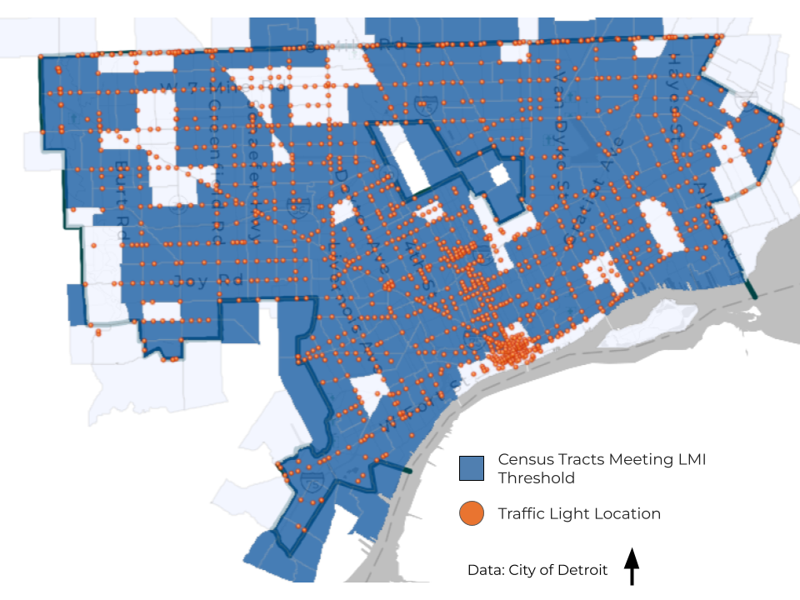
Infrastructure Programs
Traffic Signal Connectivity & Backup
589/819 signals are currently connected to Traffic Management Center (TMC)
This project would upgrade & connect remaining 230 signals to network
Ability to see and manage signal operations from TMC in real-time
Ability to receive real-time malfunction and outage alerts
Quicker response to malfunctions and outages
Notes:
TMC is currently relying on being told a light is out. This would allow them to see real time.

Slide 26
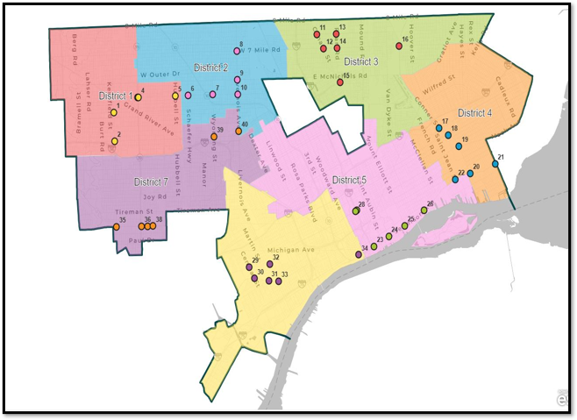
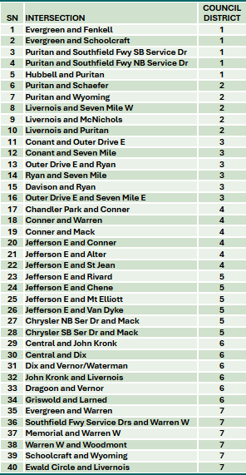
Infrastructure Programs
Traffic Signal Connectivity & Backup
Notes:
Map of where UPS battery back up systems are planned to be installed.

Slide 27
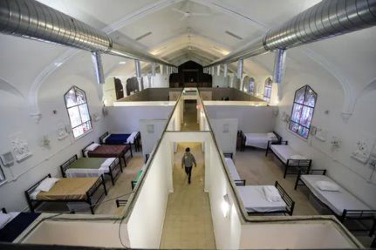
Infrastructure Programs
Public Facility Rehab – Homeless Shelters
Homeless Shelters in the City of Detroit can apply for rehabilitation assistance to help respond to and/or prevent future impacts from flooding and storms.
Shelters must be owned by a non-profit organization, open to the public and receive referrals from Detroit’s Coordinated Assessment Model (CAM).
Notes:
Homeless shelters have been impacted over the years by disasters, including flood events that have caused disruption in shelter services, including taking beds offline for multiple days. The rehabilitation will provide protection against future impacts.

Slide 28
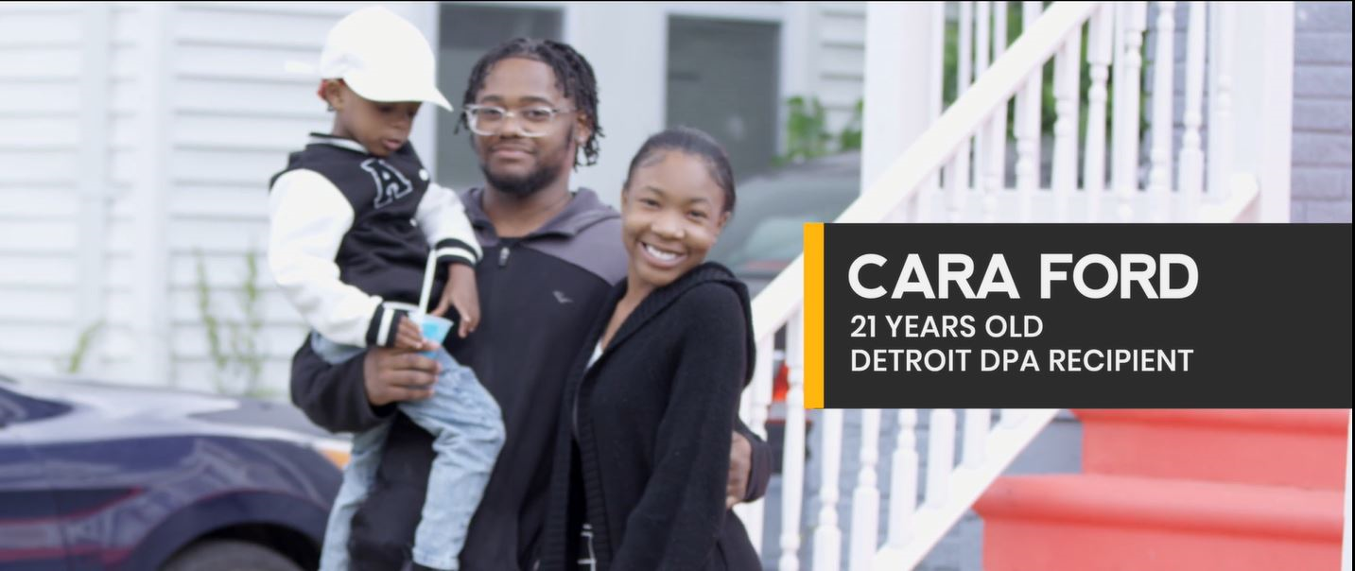
Housing Programs
Down Payment Assistance
Data shows unmet needs around the need for increased homeownership opportunities in the City, and this need is exacerbated by disasters
Up to $25,000 in down payment assistance provided to qualifying LMI households

Slide 29
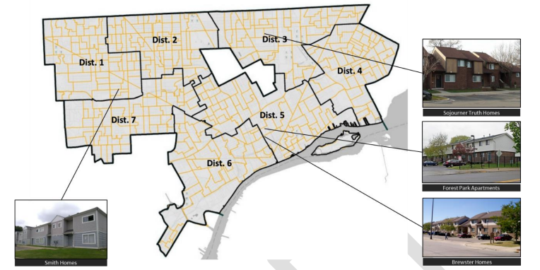
Housing Programs
Affordable Rental Housing & Public Housing
Housing unmet needs such as affordability for low-to-moderate income households, age of housing stock, and rising costs pre-date the disaster. The impact of the disaster exacerbated these conditions.
Increase affordable rental housing and public housing supply for LMI households between 30% AMI-80% AMI.
Affordable rental housing projects will be identified through a Notice of Funding Availability process overseen by HRD.
Identified DHC Public Housing projects include Brewster Homes, Smith Homes, Diggs Forest Park and Sojourner Truth.
Notes:
While the disaster led to many unforeseen circumstances for Detroit residents, the housing unmet needs predate the date of the disaster. While housing costs in Detroit are low compared to the surrounding region, housing affordability remains a major challenge due to the lower incomes of many Detroit households. Rents have grown by an average of 4.5% annually in Detroit since 2019. Median gross rent was $1,043 in Detroit in 2023, compared to $1,183 in the Metro Detroit area and $1,406 nationally. This rent growth outpaces growth in median income, making affordable housing options increasingly unattainable for the lower-income Detroit families. Around 60% of renters in Detroit are considered extremely low-income and earn $35,000 or less annually. In 2023, 39% (roughly 100,000) of Detroit households were cost burdened (meaning they paid more than 30% of their income on housing) at the time of the disaster (ACS 2023). Extremely low-income households are disproportionately impacted by rising housing costs, leaving fewer resources for other critical expenses such as food, transportation, and childcare. Consequently, disaster recovery expenses fell on homeowners and renters already experiencing economic hardships.
The scale of housing challenges related to the disaster were exacerbated by the age of the housing stock in Detroit. More than 58% of the housing stock in Detroit was built prior to 1950 and 92% was built prior to 1980. Housing units of this age were generally not built with disaster/weather related resiliency design considerations. Further, the infrastructure built/installed at the time of housing construction has aged and is prone to failure when stressed by extreme weather events. As this housing stock faces high incidences of deferred maintenance, investments are needed to prevent new vacancies and reduce unsafe living conditions for residents.

Slide 30
Proposed Activities - Budget
Program Category | Project | Budget
Housing
$75,050,000.00 | Affordable Housing | $34,050,000.00
 | Public Housing | $31,000,000.00
 | Homeownership Opportunities - Down Payment Assistance | $10,000,000.00
Infrastructure
$252,470,800.00 | Public Facility Rehab - Homeless Shelters | $7,227,800.00
 | Stormwater Improvement Projects | $25,000,000.00
 | Sewer Alley Repair Program | $175,000,000.00
 | Traffic Signal Connectivity and BackUp - Mitigation | $9,000,000.00
 | Public Facility Rehab - Homeless Shelters - Mitigation | $16,243,000.00
 | Jefferson Chalmers Stop Log Flood Mitigation Project - Mitigation | $20,000,000.00
Planning |  | $2,000,000.00
Administration |  | $17,343,200.00
Total |  | $346,864,000.00

Slide 31
Next Steps
Review the Action Plan and Provide Feedback on the Proposed Activities
  Public Comments will be received until Friday March 28th at 5:00PM
  Comments can be provided verbally during Public Hearings, or by emailing disasterrecovery@detroitmi.gov
Action Plan is submitted to HUD for review and approval (45 Days)
City receives a grant agreement from HUD and City Council accepts and appropriates the funding (estimated in May/June)

Slide 32
Thank you!
Public Comment

