Slide 1
Director’s Report
December 20, 2017

Slide 2
Table of Contents
Calendar Year-End Update from Director Gary Brown Page 3
Department Metrics To be provided January 17, 2018

Slide 3
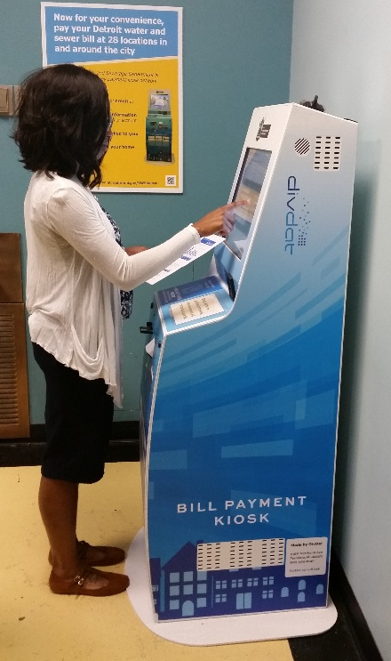
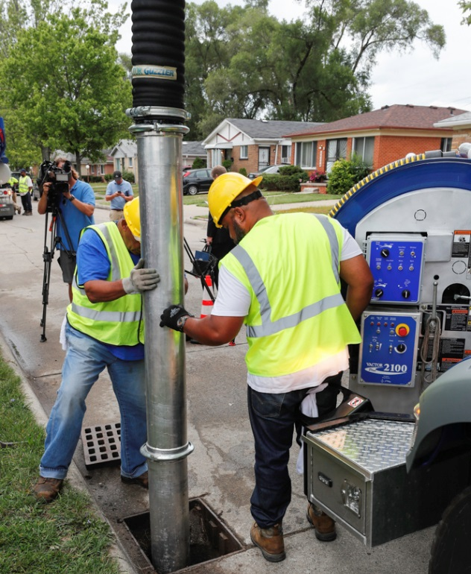
Calendar Year-End Director‘s Report: 2017
Key Improvements at DWSD*
The Detroit Water and Sewerage Department (DWSD) Customer Assistance Programs (CAP), and customer service improvements led to the 91 percent collection rate and the reduction of the number of households at-risk for a service interruption by 26 percent.
More than 7,500 households enrolled in WRAP, the Water Residential Assistance Program.
Forty payment kiosks launched in April 2017.
QLESS advance appointment scheduling made available in June 2017.
Customer Care Web Portal launched in August 2017.
The improvements also resulted in significantly less foot traffic in the Customer Care Centers compelling the department to end Saturday hours on December 16.
Addressing the most visible sewer asset in the neighborhoods – catch basins – through a inspection and cleaning program that launched in April 2017.
Field Services Technicians use tablets to track their work and indicate where the catch basins are located for asset inventory.
Several “good news” stories coordinated with local news media, including about the customer service improvements noted above, the catch basin inspection program, aggressive efforts toward delinquent commercial accounts, and green stormwater infrastructure projects.
A frequent DWSD customer complaint has been the long delays in restoring sidewalks, driveways and lawns after water main breaks and other water/sewer repairs; With Board of Water Commissioners approval, the Maintenance & Repair group this year launched a more aggressive approach to restoring property.
*This list does not include all the improvements during calendar year 2017.
DWSD Director’s Report: December 20, 2017
3

Slide 4
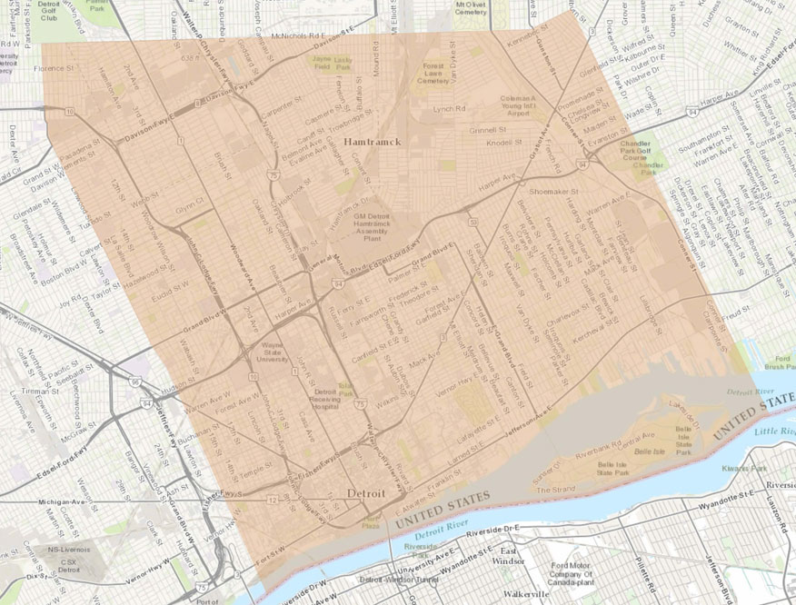
Calendar Year-End Director‘s Report: 2017
Three Lessons Learned at DWSD*
Following the boil water advisory in late February that affected a large portion of the city of Detroit, DWSD worked with the Mayor’s Office, the Department of Homeland Security and Emergency Management, and the Great Lakes Water Authority to create an emergency customer notification protocol for future crises that ensure stakeholders will be notified promptly.
The drainage charge impervious acreage transition was re-engineered due to affordability concerns by the customer base; DWSD will launch a comprehensive residential outreach and faith-based strategy that is coupled with the Community Outreach and Service Credit Program to use nonprofit facilities and platforms to help communicate to customers about the change in the rate model.
DWSD implemented a customer outreach plan during the water main replacement projects in Summer 2017 that included partial lead service line replacement; However the approach to use neighborhood association meetings to inform the residents was not the most effective because it reached an audience that was largely not impacted by the project.
In 2018 the plan will be revised to focus on direct customer contact through door-to-door and block club meetings which target the impacted residents.
Legal, technical and policy aspects need to be finalized and in place in 2018, including final word on what the MDEQ plans to implement for the Lead & Copper Rule changes.
*This list does not include all lessons learned during calendar year 2017.
DWSD Director’s Report: December 20, 2017
4

Slide 5
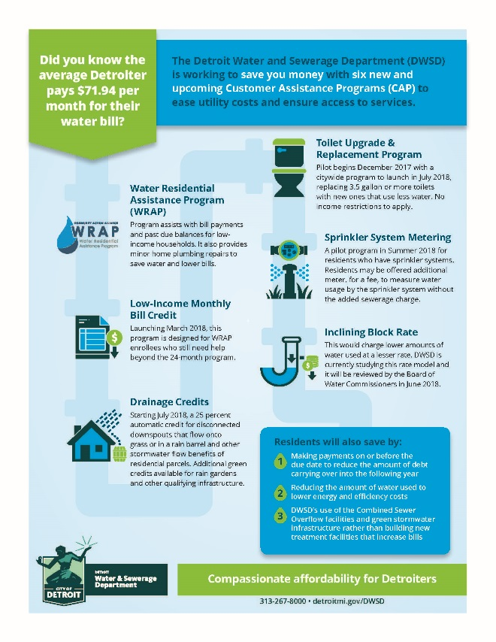
Calendar Year-End Director‘s Report: 2017
Looking Ahead at DWSD*
DWSD will build upon the past few months of good news stories to rebrand the organization with a message of responsiveness and compassion, along with environmental integrity in delivering services to Detroiters, with the engagement of a public relations firm.
In April 2018, DWSD will offer WRAP enrolled households which have been in the program for two years an extension of the $25 monthly bill credit if the resident continues to meet the income guidelines.
Beginning January 15, 2018, DWSD will roll-out the CAP 4.0 Toilet Upgrade pilot to replace 3.5 gallon or more toilets in 500 homes with new 1.3 gallon toilets to help reduce their water bills as an affordability tool.
Participants for the pilot include WRAP enrolled households, weatherization program households and 100 homes in the Jefferson Chalmers neighborhood.
A citywide roll-out of the program is expected after the data from the pilot is evaluated; There will be no income restrictions to receive the toilet upgrade.
The Capital Improvement Program is expected to begin construction work based on the engineering analysis.
A pilot program for full lead service line replacement will begin in January 2018 that is part of the scheduled water main replacement project.
Includes a 8-10 week customer outreach initiative for each project site.
Nonprofits will be able to use their resources to communicate to their members and the public about DWSD programs and services and will receive credit through the Community Outreach and Service Credits Program.
DRAFT
*This list does not include all upcoming projects during the 2018 calendar year.
DWSD Director’s Report: December 20, 2017
5

