Slide 1
DIRECTOR’S REPORT
December 19, 2018
detroitmi.gov/dwsd

Slide 2
CONTENTS*
Director’s Message for December 2018 3
Metrics by Function:
• Customer Care 4
• Field Services 7
• Finance 12
• Investigations 15
• Human Resources 17
• Public Affairs 21
• Information Technology 25

Slide 3
DIRECTOR’S MESSAGE TO THE BOARD
On December 11, the Detroit Water & Sewerage Department (DWSD) joined the Oakland County Water Resources Commissioner, the City of Livonia and the Great Lakes Water Authority to challenge the Michigan Department of Environmental Quality over its revisions to the Lead and Copper Rule, which accelerates the work of replacing lead service lines without providing financial resources.
While the coalition agrees with the Rule’s intent to protect public health, it cannot support the unfunded mandate.
The revised Rule would likely have a statewide impact of $2.5 billion over 20 years, potentially causing double-digit rate increases for water customers and diverting capital improvement program dollars.
The complaint was filed with the Court of Claims with the goal to discuss revisions to the Rule to better fund and to satisfy the universal interest of continuing to provide clean, safe drinking water.
The Capital Improvement Program Management Office is in the design phase for its first two projects based on the recent water and sewer assessments: The work will be in North Rosedale Park and Cornerstone Village.
Community meetings are scheduled for January 2019 to provide residents an update and gather their input on the design of the green stormwater infrastructure portion of the CIP.
Construction is scheduled to begin on the water main portion in April 2018.
Since the Community Outreach Credit Program was launched in December 2017, 11 organizations have DIRECTLY reached at least 5,605 Detroit residents with DWSD programs and services, in addition to communicating about DWSD through social media and literature at their facilities.
The organizations received account credits totaling $29,132 for their efforts, to date.

Slide 4
Customer Care

Slide 5
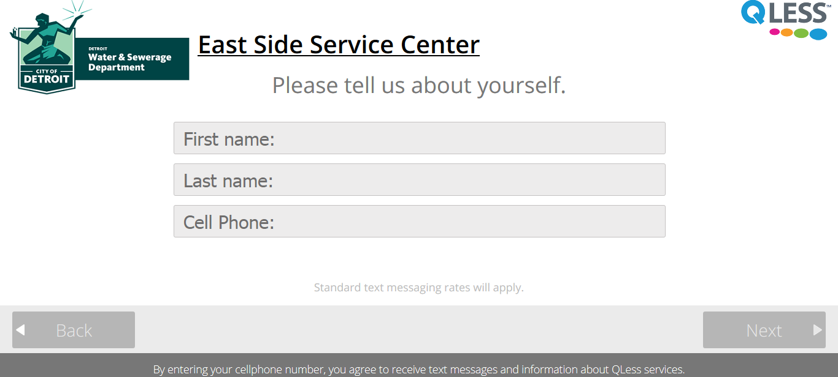
CUSTOMER CARE: Account Status
All Customers
Residential Only
Non-Residential Only
n Active customer accounts in good standing n Delinquent accounts
The charts represent data from October 2018. The November 2018 data is expected to be available in January 2019.
If you need to visit a DWSD Customer Care Center, skip the line. Go to detroitmi.gov/DWSDCustomerCare, click on the location, and place yourself in line before you leave your home/work.

Slide 6
CUSTOMER CARE: Transactions
Number of Transactions
Millions of Dollars
Payment Transactions by Type
Revenue Collected by Type

Slide 7
Field Services

Slide 8
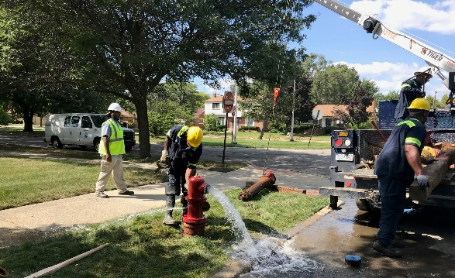
FIELD SERVICES: Fire Hydrant Maintenance
n Operating Fire Hydrants n Operating Hydrants with Issues n Non-Operating Hydrants
The Detroit Fire Department uses a mobile collector app where firefighters report on the status of each hydrant. This data integrates into DWSD’s work order system. In turn, DWSD maintenance and repair staff update the hydrant mobile app to indicate when a repair is completed.

Slide 9
FIELD SERVICES: Running Water
n Reported by Customers n Resolved within Two Days
Running water reports include water flowing on a street, issues at vacant properties, and calls by residents who see gushing or flowing water that is out of the ordinary.

Slide 10
FIELD SERVICES: Water Main Breaks
n Reported by Customers n Resolved within Four Days
DWSD has a service level agreement with contractors to have reported water main breaks repaired within four days.

Slide 11
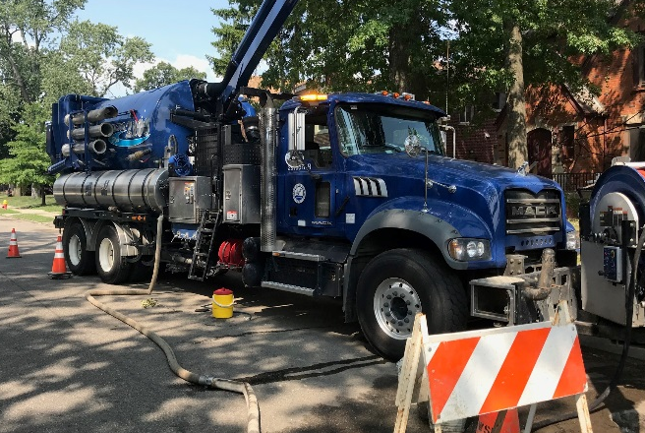
FIELD SERVICES: Catch Basin Inspection & Cleaning
The catch basin inspections and cleaning had a late start in 2018 due to weather, equipment maintenance and two large rainstorms which had DWSD crews re-assigned to water-in-the-basement complaints for two weeks on two separate occasions in the Spring.

Slide 12
Finance

Slide 13
FINANCE: Bill Collection Rate
12-Month Rolling Average Collection Rate
Every percentage increase in the collection rate above 80 percent is an additional $4-$7 million which can be applied to the maintenance and rehabilitation of the water and sewer infrastructure.

Slide 14
FINANCE: Cash Balance
$105,034,492
Water cash balance as of October 31, 2018
$174,522,094
Sewer cash balance as of October 31, 2018
As of October 31, 2018, DWSD had 233 days of cash on hand. The target is 120 days.

Slide 15
Investigations

Slide 16
INVESTIGATIONS: Results
930
[62 per month, on average]
Property addresses investigated for delinquency, possible meter tampering and no meter.
$5,616,727
Money owed to DWSD
Water theft
Unauthorized fire hydrant usage
The DWSD Revenue Recovery Unit, in collaboration with customer service/billing, has identified nearly $6 million in services owed by primarily commercial customers. They uncovered severe delinquencies, non-working meters, unauthorized use of fire hydrants, tampering with the meters, or connected to the city’s water main without a meter and/or permit. The team works closely with the DWSD collections and legal staff.

Slide 17
Human Resources

Slide 18
HUMAN RESOURCES: Detroit Residents and Hiring
Fifty-eight percent of the DWSD workforce lives in Detroit. Twenty-four new hires in November 2018 (twelve in October). This includes 18 Field Service Technicians, one engineer, two Maintenance Technicians, one Human Resources Director and two Field Services Coordinator Specialists.
Forty-three contract employees to augment staffing.

Slide 19
HUMAN RESOURCES: Retirement Eligible

Slide 20
HUMAN RESOURCES: Family Medical Leave Act

Slide 21
Public Affairs

Slide 22
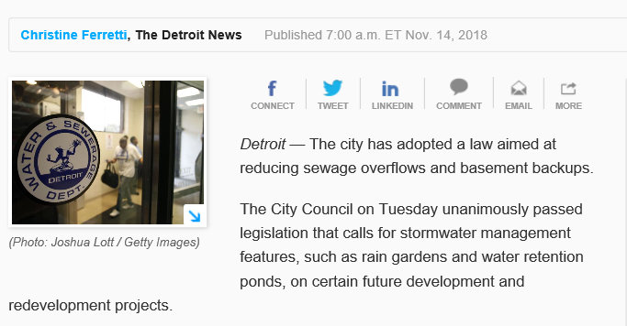
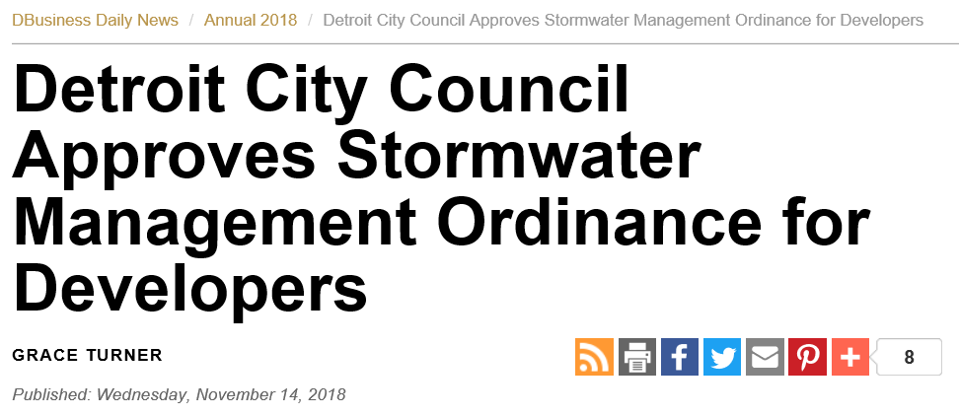
PUBLIC AFFAIRS: Good News
This month, the team garnered 1 positive news story. The story was about City Council passing the Stormwater Management Ordinance.
PLEASE NOTE: For this metric, news stories are only counted once per topic, not by the number of media outlets picking up the story.

Slide 23
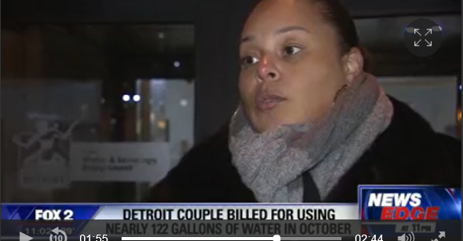
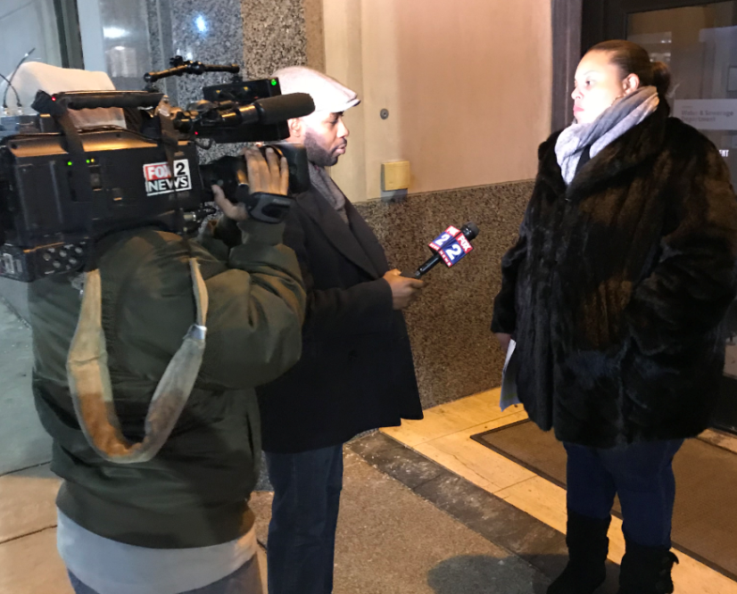
PUBLIC AFFAIRS: Positive vs. Negative News Stories
DWSD News Coverage: November 1 – November 30, 2018
This month the DWSD Public Affairs team saw a total of 14 media stories. The majority of the coverage was regarding a high water bill concern. Deputy Director Palencia Mobley was interviewed. The other stories included an article in Bridge Magazine and passing of the Stormwater Management Ordinance. Of the 14 stories, 3 were broadcast, 11 were print/online and none were radio.
PLEASE NOTE: For this metric, each story/interview published or aired is counted.

Slide 24
PUBLIC AFFAIRS: Social Media Activity
74
New Facebook Followers
7,525
Total Followers on Facebook
4,446
Engagement on Facebook
4
New Twitter Followers
1,372
Total Followers on Twitter
226
Engagement on Twitter
8
New Instagram Followers
1,010
Total Followers on Instagram
13
Engagement on Instagram
The DWSD Public Affairs team gained 86 new followers on social media in November 2018, bringing the total number of followers to 9,907. In addition to the metrics above, Facebook saw a total of 1.1M impressions and 7,034 link clicks. The top performing post on Facebook was on November 28 about clogged catch basins. The post highlighted the five crews doing preventative maintenance on the storm drains before winter. On this post alone, there were 89,209 impressions, 171 comments and 655 reactions. The post regarding the Stormwater Management Ordinance was the top performing Twitter post (15,436 impressions, 2 responses and 2 retweets).

Slide 25
Information Technology

Slide 26
Information Technology: Application Availability
In the Informational Technology (IT) Group, the major projects underway are the transition from Great Lakes Water Authority (GLWA) IT shared services which includes new network, active director, BOX.com, print/fax services, IVR upgrade to the cloud, and GIS (Geographic Information System) to City of Detroit migration; launch of fleet management programs AssetWorks, FleetFocus and FuelFocus; CityWorks to replace WAM work order system; and Customer Care Web Portal phase two.

