Slide 1
DIRECTOR’S REPORT
December 16, 2020
detroitmi.gov/dwsd

Slide 2
CONTENTS*
Metrics by Function:
• Director’s Message 3
• Customer Care 4
• Field Services 7
• Finance 12
• Legal Services 15
• Investigations 17
• Human Resources 19
• Public Affairs 21
• Information Technology 25

Slide 3
DIRECTOR’S MESSAGE TO THE BOARD
Mayor Mike Duggan and the Detroit Water and Sewerage Department (DWSD) announced on December 8, 2020 a voluntary extension of the moratorium on water service interruptions for nonpayment through 2022 for residents who cannot pay their water bills. We were joined by Dr. Abdul El-Sayed, Detroit’s former health director and a water access advocate, who will fight for state and federal legislation on water affordability.
The water shutoff moratorium, issued by the Michigan Department of Health & Human Services and the Detroit Health Department in response to the COVID-19 Pandemic ends on December 31.
Since March 9, 2020, DWSD has not interrupted water service at any home for nonpayment after Governor Gretchen Whitmer and Mayor Duggan launched the COVID-19 $25 Water Restart Plan. This included restoring water service at nearly 1,300 occupied homes, many of which needed plumbing repairs to get water on. Nearly $22 million in state and federal funds, primarily through the CARES Act have enabled us to comply with Governor Whitmer’s and the city and state health departments’ moratoriums on water service interruptions, and we will continue to honor the moratorium through 2022.
Coalition committed to find a permanent solution to prevent water shutoffs. Detroit will be a leader at the state level and nationally, led by Mayor Duggan, Dr. El-Sayed and DWSD Director Brown. Detroit has joined a coalition of cities from around the country, including Seattle, San Francisco, Philadelphia, Alexandria, Baltimore, Louisville, Sacramento and Washington, DC to create a policy platform on national water affordability initiatives focusing primarily on LIWAP (Low-Income Water Assistance Program) and include plumbing repairs.
Moratorium intended for residents who don’t have the ability to pay.
The moratorium is not payment amnesty – once someone turns on the faucet, the cost to the system is incurred. Residential households will continue to generate their full water and sewer charges based on monthly usage, and the drainage charge, using current rates. Those who can pay their monthly bills, should continue to pay.

Slide 4
Customer Care

Slide 5
CUSTOMER CARE: Number of Active Accounts
Active Residential Accounts Active Non-Residential Accounts
Vacant parcels, parking lots and other properties with no need for water service, receive stormwater charges only (drainage).

Slide 6
CUSTOMER CARE: Transactions
Number of Transactions
Millions of Dollars
DWSD continues to adapt during the COVID-19 Pandemic and is offering more services remotely, including contact via email at mydwsd@detroitmi.gov. DWSD is also communicating the convenient, safe ways to pay and how customers can access their account(s).

Slide 7
Field Services

Slide 8
FIELD SERVICES: Fire Hydrant Maintenance
n Operating Fire Hydrants n Operating Hydrants with Issues n Non-Operating Hydrants
DWSD prioritizes fire hydrant maintenance as a key component of providing essential and exceptional service delivery led by the Maintenance & Repair Service Line in our Operations Group. During the Fall season, the number of hydrants needing repair typically increases significantly as the Detroit Fire Department staff do annual hydrant inspections.

Slide 9
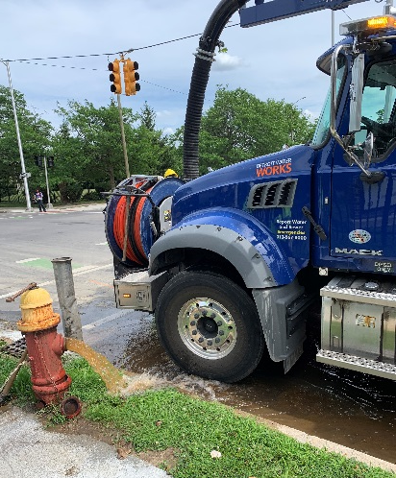
FIELD SERVICES: Running Water
n Reported by Customers n Resolved within Two Days
DWSD Operations continues to prioritize work orders based on level of impact, including number of customers affected, with water main repairs, street flooding and water-in-basement complaints taking priority.

Slide 10
FIELD SERVICES: Water Main Breaks
n Reported by Customers n Resolved within Four Days
DWSD Operations continues to prioritize work orders based on level of impact, including number of customers affected, with water main repairs, street flooding and water-in-basement complaints taking priority.

Slide 11
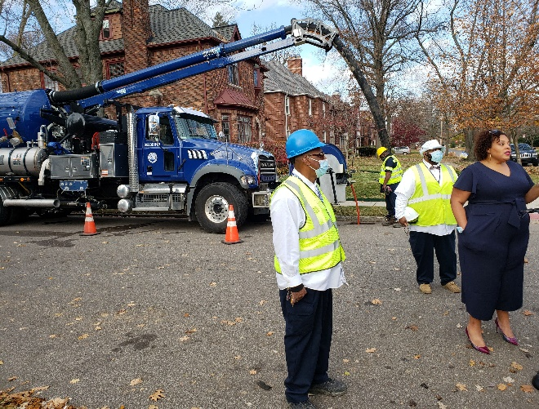
FIELD SERVICES: Catch Basin Inspection & Cleaning
DWSD held a media event on November 10 with Deputy Director & Chief Engineer Palencia Mobley, P.E. and the sewer team leaders.
The catch basin inspection and cleaning program launched in 2017. DWSD crews have touched more than 30,000 of the estimated 90,000 catch basins, including tracking them through a mapping app for asset inventory. The 30,000 goal was achieved in the three-year commitment as announced by DWSD and Mayor Duggan in 2017.

Slide 12
Finance

Slide 13
FINANCE: Bill Collection Rate
August September October
3-Month Rolling Average Collection Rate
n Water Revenue n Sewer Revenue
The Finance data is provided based on the most recent month reported to the Finance Committee of the Board of Water Commissioners.

Slide 14
FINANCE: Cash Balance
$167,693
(thousands)
Water cash balance as of October 31, 2020
$111,389
(thousands)
Sewer cash balance as of October 31, 2020
The Finance data is provided based on the most recent month reported to the Finance Committee of the Board of Water Commissioners.

Slide 15
Legal Services

Slide 16
LEGAL: Claims, Hearings and Cases
21
Cases handled by in-house staff
8
Cases handled by outside counsel
0
Lawsuits dismissed
5
Lawsuits dismissed in FY2020
18
Dispute hearings
10
Number of cases DWSD prevailed
N/A
Property damage claims
N/A
Amount in property damage claims
N/A
Amount of total claims recommended to be paid
$22,309
Amount in dispute
$17,361
Credited to customers based on hearing outcomes
$4,948
Owed to DWSD after hearings
DWSD uses a mix of in-house and contracted legal counsel to handle damage claims, civil action for commercial delinquencies and lawsuits filed against the department.

Slide 17
Investigations

Slide 18
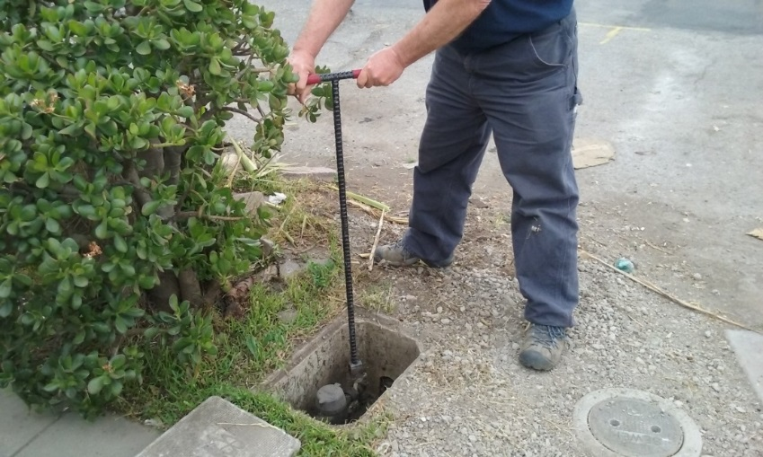
INVESTIGATIONS: Results
Money Owed to DWSD identified by Investigators
$1,089,182
Total since July 1, 2020
$128,457
Back billed
$533,107
Future owed in 12 months
$427,618
Water loss
231
Parcels investigated for delinquency, possible meter tampering and no meter since July 1, 2020
Revenue Identified Since Investigation Unit Began
$14,222,201
Total since August 14, 2017
Since August 2017, the unit, in collaboration with customer service/billing, has identified more than $14 million in services owed by primarily commercial customers. They uncover severe delinquencies, non-working meters, unauthorized use of fire hydrants, meter tampering, or connected to the city’s water main without a meter and/or permit. The unit works closely with the Finance/Collections and Legal Groups.

Slide 19
Human Resources

Slide 20
HUMAN RESOURCES: Detroit Residents and Hiring
Fifty-five percent of the DWSD workforce lives in Detroit.*
*DWSD and the City of Detroit do not require residency to be employed, per Michigan law.

Slide 21
Public Affairs

Slide 22
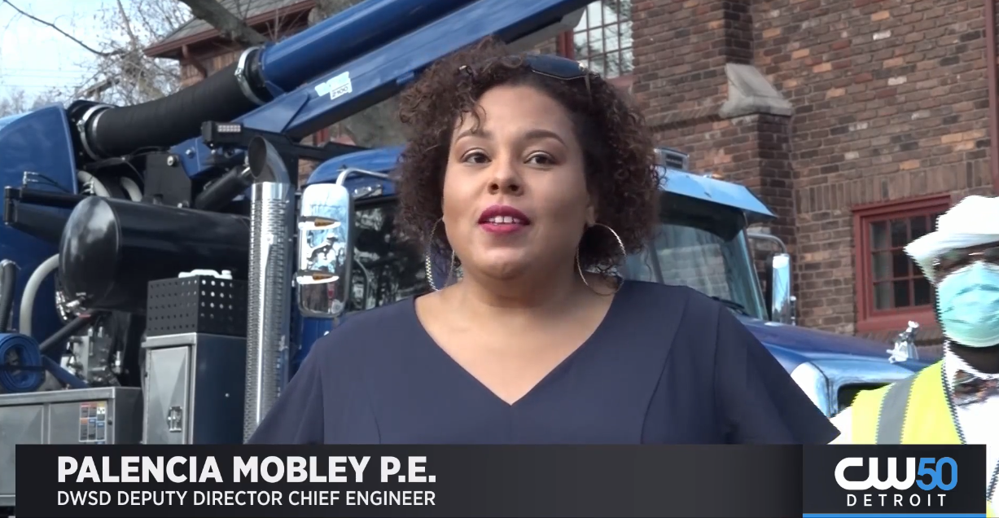
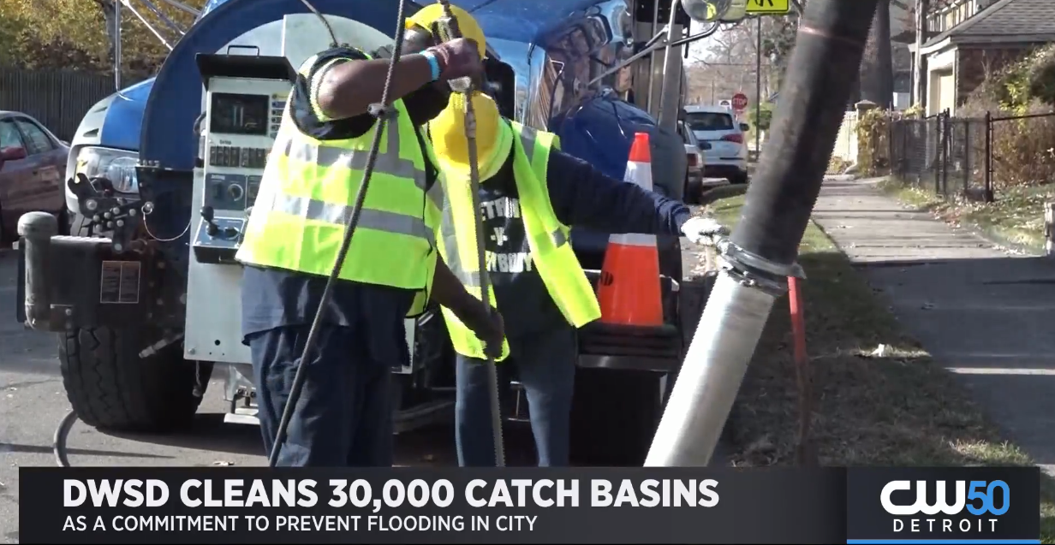
PUBLIC AFFAIRS: Good News
This month, the team garnered 1 positive pitched news story. The story was about DWSD cleaning its 30,000th catch basin. The program was launched in 2017 and was a commitment by DWSD to help reduce flooding on residential streets and basement backups.
PLEASE NOTE: For this metric, news stories are only counted once per topic, not by the number of media outlets picking up the story.

Slide 23
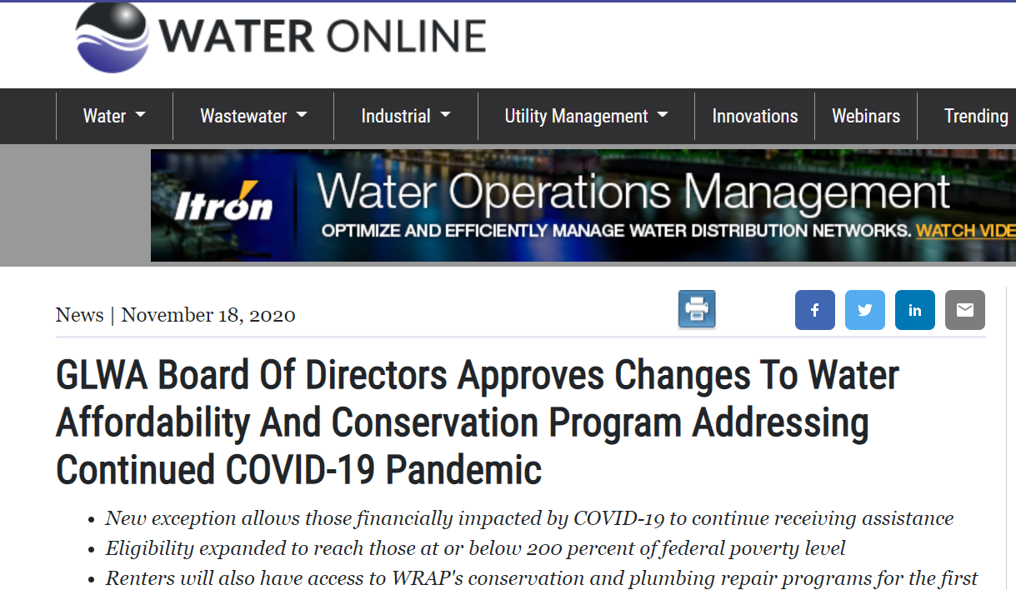
PUBLIC AFFAIRS: Positive vs. Negative News Stories
DWSD News Coverage: November 1 – November 30, 2020
In November, the DWSD Public Affairs team saw a total of 40 media stories. The positive stories were about DWSD’s catch basin inspection and cleaning program, which was published in the U.S. News & World Report. The majority of the neutral stories were the Great Lakes Water Authority (GLWA) approving changes to the Water Residential Assistance Program (WRAP). The updated program allows those financially impacted by COVID-19 to continue receiving assistance.
PLEASE NOTE: For this metric, each story/interview published or aired is counted.

Slide 24
PUBLIC AFFAIRS: Social Media Activity
-2
New Facebook Followers
8,569
Total Followers on Facebook
816
Engagement on Facebook
14
New Twitter Followers
1,712
Total Followers on Twitter
148
Engagement on Twitter
7
New Instagram Followers
1,497
Total Followers on Instagram
77
Engagement on Instagram
The DWSD Public Affairs team gained 21 new followers on social media in November 2020, bringing the total number to 11,778. In addition to the metrics above, Facebook saw a total of 107K impressions and 374 link clicks for the month. The top performing Facebook, Twitter and Instagram post was about DWSD’s catch basin inspection and cleaning program successfully reaching the goal of cleaning 30,000 catch basins in three years.

Slide 25
Information Technology

Slide 26
TECHNOLOGY: Top Ten Projects Scorecard
Exec. Priority Score | Sorted by Adjusted Priority Score | PM | Total Investment | Revised Target Date | Status/ Issues | Current Phase
1 | Customer Service-2:enQuesta 6.0 Upgrade | E Taiariol | $ 1,400,000 | 5/1/2022 | 8 BPA's signed, 12 in progress and 3 pending | Active Design
2 | Operations (M&R, MTR OPS, Fleet)-1:CityWorks | C Penoza | $ 970,000 | 12/31/2020 | Facility Maintenance on track for December 2020 | Active Implementation
3 | Customer Service-1:IVR / Call Center Replacement | G Burrell | $ 800,000 | 4/1/2021 | Issue with Tax Clearances – Project at Risk! | Procurement
4 | Administrative and Compliance-1:GLWA Separation - Network (Not WiFi) | R Burke | $ 1,000,000 | 3/31/2021 | Hardware 95% complete, deployment delayed due to COVID-19 team | Active Implementation
5 | Administrative and Compliance-2:GLWA Separation - Computers / Active Directory | R Burke | $ 300,000 | 3/31/2021 | Applications testing complete; SCCM servers installed in IDFs; deployment delayed due to COVID-19 team | Active Design
6 | Customer Service-7:enQuestaLink (ServiceLink Replacement) | C Penoza | $ 500,000 | 6/30/2021 | Going to board in January | Procurement
7 | Engineering-1:eBuilder | C Penoza | $ 300,000 | 7/31/2020 | Data warehouse config underway; Pilot metrics completed; SFTP technology implemented; data prep underway on eBuilder | Active Implementation
8 | Office of CFO-1: Oracle Supply Chain | C. Penoza | $ 1,434,657 | TBD | Pre-Procurement; Meeting with integrators to see if we can reduce cost with limited installation | Pre-Procurement
9 | eSignature Standard for Contracts and Forms | G Burrell | $ 300,000 | 6/30/2021 | Working w/ City to establish DWSD DocuSign subaccount / envelopes. Business stakeholders aligned. SME/technical resources have not been assigned. | Active Implementation
10 | Operations (M&R, MTR OPS, Fleet)-3:GPS/AVL For Vehicles | C Penoza | $ 90,000 | 12/31/2020 | Installations occurring now. Should complete by January 2020. | Procurement
A+

Slide 27
TECHNOLOGY: Application Availability
100% SYSTEMS AVAILABILITY
99.9% = TARGET
Systems Availability
Last 90 Days
Tickets Created 393 | Tickets Closed 425 | Backlog 123 | SLA Compliance 77%
Service Desk Performance

