Slide 1
DIRECTOR’S REPORT
November 18, 2020
detroitmi.gov/dwsd

Slide 2
CONTENTS*
Metrics by Function:
• Director’s Message 3
• Customer Care 4
• Field Services 7
• Finance 12
• Legal Services 15
• Investigations 17
• Human Resources 19
• Public Affairs 22
• Information Technology 26

Slide 3
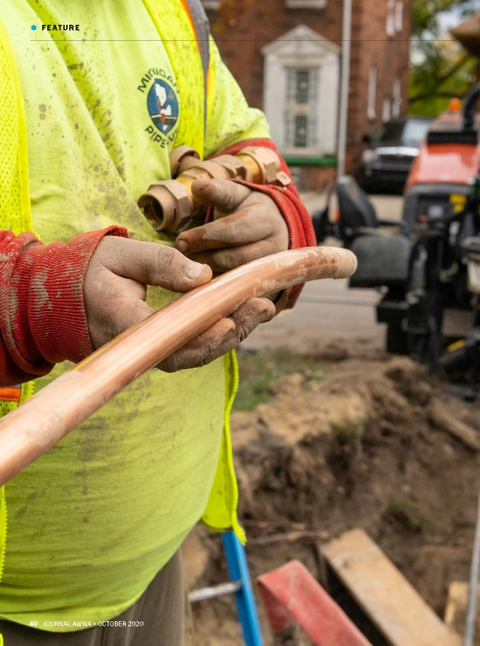
DIRECTOR’S MESSAGE TO THE BOARD
The Journal of the American Water Works Association featured the Detroit Water and Sewerage Department (DWSD) Lead Service Line Replacement Program in its October 2020 issue as a best practice for other water utilities across the country.
The Lead Service Line Replacement Program project is a significant team effort across the department -- staff from Engineering, Maintenance & Repair, Finance, Public Affairs, Information Technology and the Deputy Director’s Office have been critical to the design and implementation.
The journal article highlights the integration of full lead service line replacement with DWSD’s Asset Management Program, and the development and implementation of Standard Operating Procedures.
The article also lays out the extensive customer outreach in advance of construction, including the Lead Service Line Replacement Program packet with the owner/occupant agreement.
Lastly, the article also includes the use of technology, including a mobile app to track service line inventory and replacement.

Slide 4
Customer Care

Slide 5
CUSTOMER CARE: Number of Active Accounts
Active Residential Accounts Active Non-Residential Accounts
Vacant parcels, parking lots and other properties with no need for water service, receive stormwater charges only (drainage).

Slide 6
CUSTOMER CARE: Transactions
Number of Transactions
Millions of Dollars
DWSD continues to adapt during the COVID-19 Pandemic and is offering more services remotely, including contact via email at mydwsd@detroitmi.gov. DWSD is also communicating the convenient, safe ways to pay and how customers can access their account(s).

Slide 7
Field Services

Slide 8
FIELD SERVICES: Fire Hydrant Maintenance
n Operating Fire Hydrants n Operating Hydrants with Issues n Non-Operating Hydrants
DWSD prioritizes fire hydrant maintenance as a key component of providing essential and exceptional service delivery led by the Maintenance & Repair Service Line in our Operations Group. During the Fall season, the number of hydrants needing repair typically increases significantly as the Detroit Fire Department staff do annual hydrant inspections.

Slide 9
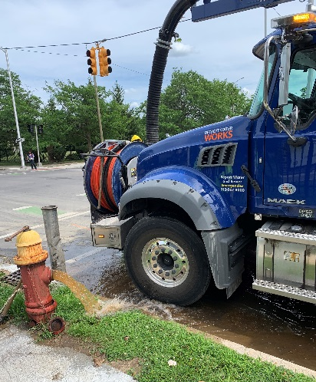
FIELD SERVICES: Running Water
n Reported by Customers n Resolved within Two Days
DWSD Operations continues to prioritize work orders based on level of impact, including number of customers affected, with water main repairs, street flooding and water-in-basement complaints taking priority.

Slide 10
FIELD SERVICES: Water Main Breaks
n Reported by Customers n Resolved within Four Days
The number of water main breaks significantly rose in the summer and began to decline in September. Detroit experienced several days of above 90-degree weather. When there is dramatic change in temperature --- hot or cold --- the ground can shift and cause tension on the pipes potentially resulting in water main breaks.

Slide 11
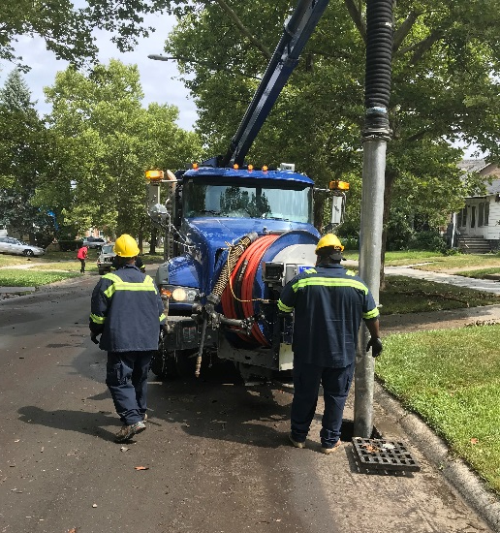
FIELD SERVICES: Catch Basin Inspection & Cleaning
The catch basin inspection and cleaning program launched in 2017. DWSD crews have touched more than 29,800 of the estimated 90,000 catch basins. The goal was 30,000 by August 2020, which is expected to be achieved before winter (delayed due to pandemic stay-at-home orders in March-May and the pandemic furloughs).

Slide 12
Finance

Slide 13
FINANCE: Bill Collection Rate
July August September
3-Month Rolling Average Collection Rate
n Water Revenue n Sewer Revenue
The Finance data is provided based on the most recent month reported to the Finance Committee of the Board of Water Commissioners.

Slide 14
FINANCE: Cash Balance
$172,696
(thousands)
Water cash balance as of September 30, 2020
$118,260
(thousands)
Sewer cash balance as of September 30, 2020
The Finance data is provided based on the most recent month reported to the Finance Committee of the Board of Water Commissioners.

Slide 15
Legal Services

Slide 16
LEGAL: Claims, Hearings and Cases
21
Cases handled by in-house staff
8
Cases handled by outside counsel
0
Lawsuits dismissed
5
Lawsuits dismissed in FY2020
12
Dispute hearings
3
Number of cases DWSD prevailed
11
Property damage claims
$267,529
Amount in property damage claims
$20,523
Amount of total claims recommended to be paid
$6,794
Amount in dispute
$1,832
Credited to customers based on hearing outcomes
$4,962
Owed to DWSD after hearings
DWSD uses a mix of in-house and contracted legal counsel to handle damage claims, civil action for commercial delinquencies and lawsuits filed against the department.

Slide 17
Investigations

Slide 18
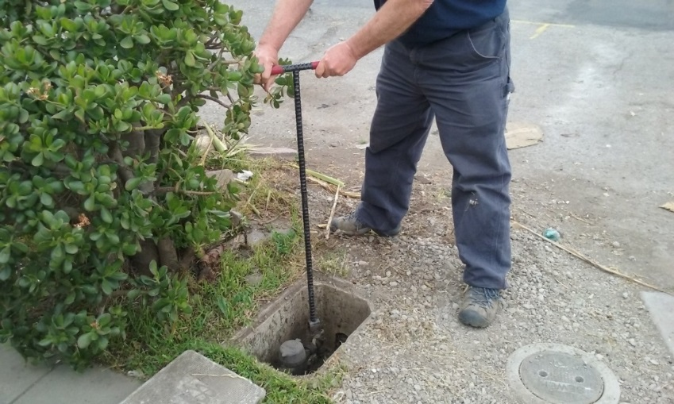
INVESTIGATIONS: Results
Money Owed to DWSD identified by Investigators
$1,039,148
Total since July 1, 2020
$119,327
Back billed
$492,203
Future owed in 12 months
$427,618
Water loss
134
Parcels investigated for delinquency, possible meter tampering and no meter since July 1, 2020
Revenue Identified Since Investigation Unit Began
$14,170,353
Total since August 14, 2017
Since August 2017, the unit, in collaboration with customer service/billing, has identified more than $14 million in services owed by primarily commercial customers. They uncover severe delinquencies, non-working meters, unauthorized use of fire hydrants, meter tampering, or connected to the city’s water main without a meter and/or permit. The unit works closely with the Finance/Collections and Legal Groups.

Slide 19
Human Resources

Slide 20
HUMAN RESOURCES: Detroit Residents and Hiring
Fifty-five percent of the DWSD workforce lives in Detroit.*
*DWSD and the City of Detroit do not require residency to be employed, per Michigan law.

Slide 21
HUMAN RESOURCES: Retirement Eligible
With a current population of 553 employees, there are 107 DWSD employees eligible for retirement.

Slide 22
Public Affairs

Slide 23
PUBLIC AFFAIRS: Good News
This month, the team garnered 2 positive pitched news stories. The first story was about the completion of DWSD’s $8.6M Oakman Blvd. Stormwater Project. The second story was about Detroit’s Lead Service
Line Replacement Program that was featured in The Journal of the American Water Works Association.
PLEASE NOTE: For this metric, news stories are only counted once per topic, not by the number of media outlets picking up the story.

Slide 24
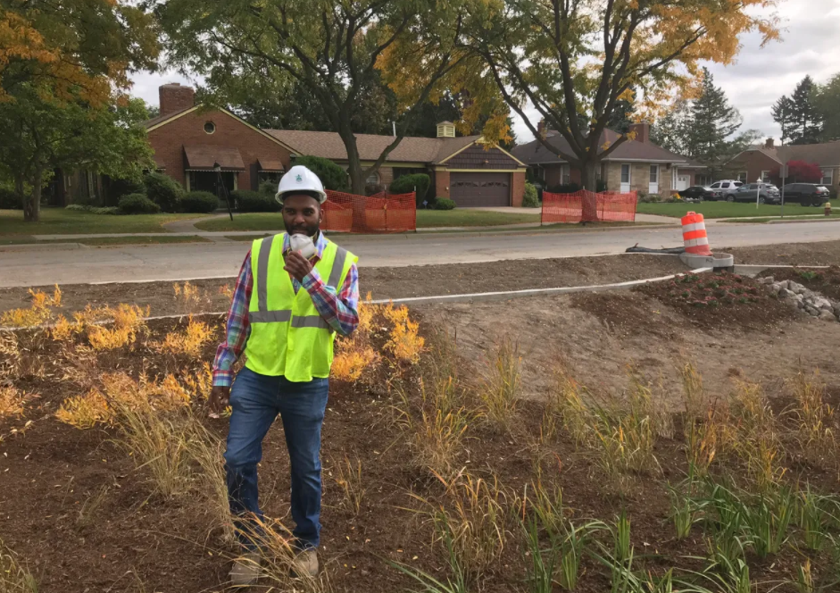
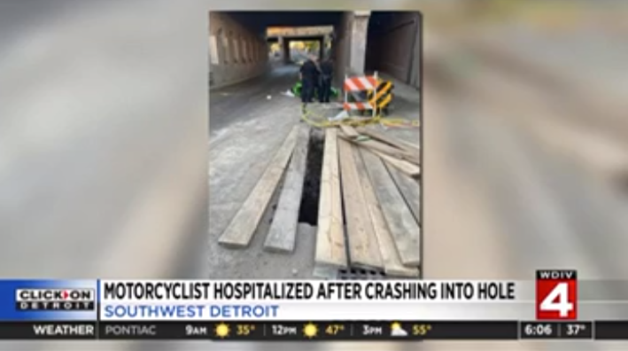
PUBLIC AFFAIRS: Positive vs. Negative News Stories
DWSD News Coverage: October 1 – October 31, 2020
In October, the DWSD Public Affairs team saw a total of 84 media stories. The positive stories featured the $8.6M Oakman Blvd. Stormwater Project and the Lead Service Line Program article in The Journal of the American Water Works Association. The negative story was about a motorcyclist claiming he was injured after crashing into a hole left by DWSD. Majority of the neutral stories were regarding Flint residents suing investment banks over the water crisis. DWSD was just mentioned in name as being the original water source.
PLEASE NOTE: For this metric, each story/interview published or aired is counted.

Slide 25
PUBLIC AFFAIRS: Social Media Activity
22
New Facebook Followers
8,572
Total Followers on Facebook
901
Engagement on Facebook
3
New Twitter Followers
1,701
Total Followers on Twitter
341
Engagement on Twitter
10
New Instagram Followers
1,490
Total Followers on Instagram
64
Engagement on Instagram
The DWSD Public Affairs team gained 35 new followers on social media in October 2020, bringing the total number of followers to 11,763. In addition to the metrics above, Facebook saw a total of 150K impressions and 749 link clicks for the month. The top performing Twitter post was on Oct. 14 about the Oakman Blvd. Green Stormwater Infrastructure project.

Slide 26
Information Technology

Slide 27
TECHNOLOGY: Top Ten Projects Scorecard
Exec. Priority Score | Sorted by Adjusted Priority Score | PM | Total Investment | Revised Target Date | Status/ Issues | Current Phase
1 | Customer Service-2:enQuesta 6.0 Upgrade | E Taiariol | $ 1,400,000 | 5/1/2022 | 8 BPA's signed, 12 in progress and 3 pending | Active Design
2 | Operations (M&R, MTR OPS,Fleet)-1:CityWorks | C Penoza | $ 970,000 | 12/31/2020 | Facility Maintenance on track for December 2020 | Active Implementation
3 | Customer Service-1:IVR / Call Center Replacement | G Burrell | $ 800,000 | 4/1/2021 | Vendor selected; Going to Board in November | Procurement
4 | Administrative and Compliance-1:GLWA Separation - Network (Not WiFi) | R Burke | $ 1,000,000 | 12/31/2020 | Hardware 95% complete, deployment delayed due to COVID-19 team | Active Implementation
5 | Administrative and Compliance-2:GLWA Separation - Computers / Active Directory | R Burke | $ 300,000 | 12/31/2020 | Applications testing complete; SCCM servers installed in IDFs; deployment delayed due to COVID-19 team | Active Design
6 | Customer Service-7:enQuestaLink (ServiceLink Replacement) | C Penoza | $ 500,000 | 6/30/2021 | Going to board in December | Procurement
7 | Engineering-1:eBuilder | C Penoza | $ 300,000 | 7/31/2020 | Data warehouse config underway; Pilot metrics completed; SFTP technology implemented; data prep underway on eBuilder | Active Implementation
8 | Office of CFO-1: Oracle Supply Chain | C. Penoza | $ 1,434,657 | TBD | Pre-Procurement; Meeting with integrators to see if we can reduce cost with limited installation | Pre-Procurement
9 | eSignature Standard for Contracts and Forms | G Burrell | $ 300,000 | 6/30/2021 | Working w/ City to establish DWSD DocuSign subaccount / envelopes. Business stakeholders aligned. SME/technical resources have not been assigned. | Active Kick-Off
10 | Operations (M&R, MTR OPS,Fleet)-3:GPS/AVL For Vehicles | C Penoza | $ 90,000 | 12/31/2020 | Installations occurring now. Should complete by January 2020. | Procurement
A+

Slide 28
TECHNOLOGY: Application Availability
100% SYSTEMS AVAILABILITY
99.9% = TARGET
Systems Availability
Last 90 Days
Tickets Created 686 | Tickets Closed 524 | Backlog 123 | SLA Compliance 75% 80% = goal
Service Desk Performance

