Slide 1
DIRECTOR’S REPORT
November 17, 2021

Slide 2
CONTENTS*
Metrics by Function:
• Director’s Message 3
• Customer Care 4
• Field Services 7
• Capital Improvement Program 12
• Finance 14
• Legal Services 17
• Investigations 19
• Human Resources 21
• Public Affairs 24
• Information Technology 28

Slide 3
DIRECTOR’S MESSAGE TO THE BOARD
Congress passed the Infrastructure Investment and Jobs Act which includes nearly $50 Billion for water and wastewater infrastructure. Mayor Mike Duggan and the Detroit Water & Sewerage Department executive team will advocate for Detroit to get significant funds from this Act over the next five years. The Infrastructure Investment and Jobs Act, which President Joe Biden is expected to sign, include the following:
$23.4 billion for the Drinking Water State Revolving Fund (DWSRF) and the Clean Water State Revolving Fund (CWSRF);
$15 billion for lead service line replacement;
$200 million to address lead contamination in school drinking water;
$250 million for the Midsize and Large Drinking Water System Infrastructure Resilience and Sustainability Program;
$1.4 billion for sewer overflow and stormwater reuse municipal grants;
$10 billion to address per- and polyfluoroalkyl substances (PFAS);
$250 million for the Water Infrastructure Finance and Innovation program;
$175 million for technical assistance and grants for emergencies affecting public water systems;
$100 million to establish a wastewater efficiency grant pilot program;
$125 million to establish a grant program for alternative water source projects;
$125 million for clean water infrastructure resiliency and sustainability;
$250 million for construction and refurbishing of individual household decentralized wastewater systems; and
$200 million for grants for publicly-owned treatment facilities in low-income communities.

Slide 4
Customer Service

Slide 5
CUSTOMER Service: Number of Active Accounts
Active Residential Accounts Active Non-Residential Accounts
Vacant parcels, parking lots and other properties with no need for water service, receive stormwater charges only (drainage).

Slide 6
CUSTOMER Service: Transactions
Number of Transactions
Millions of Dollars
DWSD continues to adapt during the COVID-19 Pandemic and is offering more services remotely, including contact via email at mydwsd@detroitmi.gov. DWSD is also communicating the convenient, safe ways to pay and how customers can access their account(s).

Slide 7
Field Services

Slide 8
FIELD SERVICES: Fire Hydrant Maintenance
n Operating Fire Hydrants n Operating Hydrants with Issues n Non-Operating Hydrants
DWSD prioritizes fire hydrant maintenance as a key component of providing essential and exceptional service delivery led by the Maintenance & Repair Service Line in our Operations Group. During the Fall season, Detroit Fire Department staff conduct inspections and share the data through a dashboard with DWSD if hydrants need to be repaired or replaced. The community can report hydrant issues via the Improve Detroit mobile app.

Slide 9
FIELD SERVICES: Running Water
n Reported by Customers n Resolved within Two Days
DWSD Operations continues to prioritize these work orders based on level of severity, including number of customers affected, to determine priority.

Slide 10
FIELD SERVICES: Water Main Breaks
n Reported by Customers n Resolved within Four Days
DWSD Operations continues to prioritize these work orders based on level of severity, including number of customers affected, to determine priority.

Slide 11
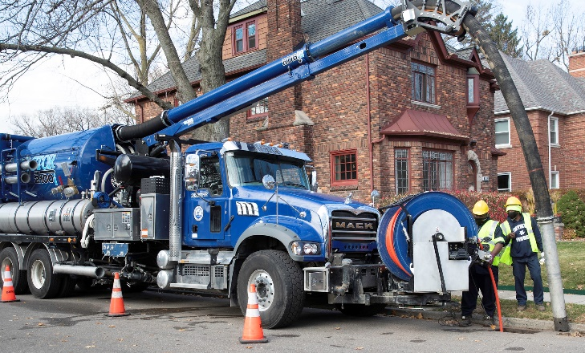
FIELD SERVICES: Catch Basin Inspection & Cleaning
DWSD is expanding sewer cleaning for preventative maintenance to help reduce street flooding and basement backups. As of this report, crews have cleaned 479 miles of city sewer pipe in calendar year 2021 compared with 59 miles in calendar year 2020.

Slide 12
Capital Improvement Program

Slide 13
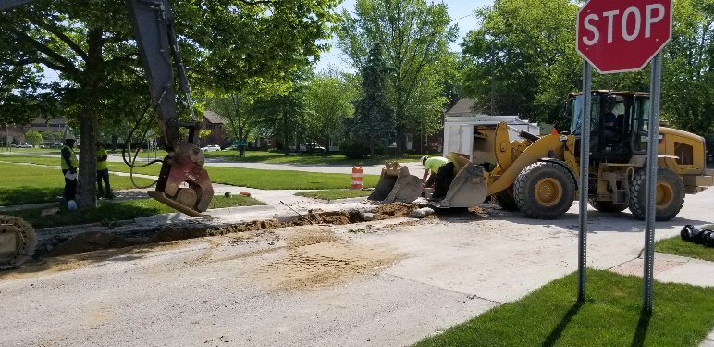
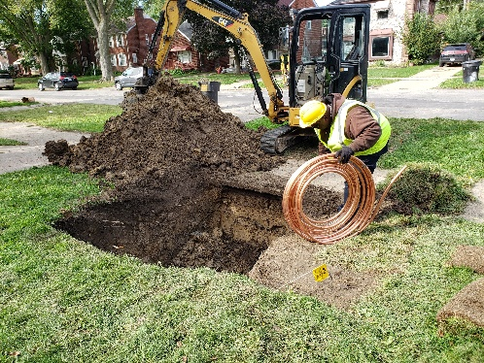
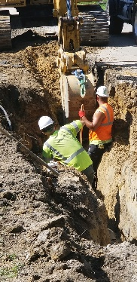
Capital Improvement Program: Application Availability
 | Water Main Assessed* | Water Main Replaced | Lead Service Line Replacement | Sewer Assessed* | Sewer Replaced or Lined
Total CIP 2002-2018 | N/A | 236 miles | None | N/A | 371 miles
CIP since FY2018-2019 which has been accelerated due to GLWA lease payment | 75 miles | 66 miles | 1,155 homes | 295 miles | 50 miles
Most recent month progress (October 2021 CIP work) | In progress | 1.16 miles | 27 homes | N/A | .27 miles
*The data-driven condition assessment program for water and sewer systems was implemented by DWSD in 2018 as part of the re-design of the Capital Improvement Program.

Slide 14
Finance

Slide 15
FINANCE: Bill Collection Rate
April May June
3-Month Rolling Average Collection Rate
n Water Revenue n Sewer Revenue
The Finance data is provided based on the most recent month reported to the Finance Committee of the Board of Water Commissioners.

Slide 16
FINANCE: Cash Balance
The Finance data is provided based on the most recent month reported to the Finance Committee of the Board of Water Commissioners.

Slide 17
Legal Services

Slide 18
LEGAL: Claims, Hearings and Cases
29
Cases handled by in-house staff
8
Cases handled by outside counsel
1
Lawsuits dismissed
8
Lawsuits dismissed in calendar year 2021
273
Pending Billing Disputes
77
Disputes Closed in
October 2021
$102,081
Total Amount Disputed
$20,959
Total Credits to Customers
61
Total Resolved Utilizing Leak Policy
N/A
Property damage claims
N/A
Damage claims approved
N/A
Amount in property damage claims
N/A
Amount of total claims recommended to be paid
DWSD uses a mix of in-house and contracted legal counsel to handle damage claims, civil action for commercial delinquencies and lawsuits filed against the department.

Slide 19
Investigations

Slide 20
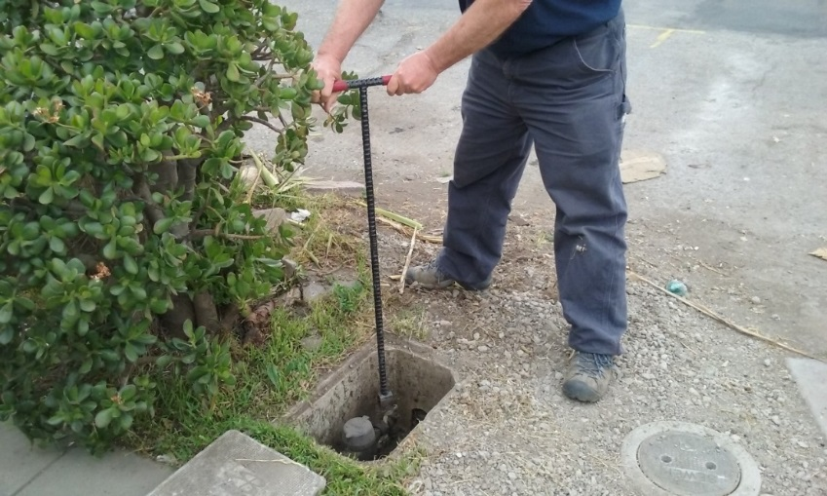
INVESTIGATIONS: Results
Money Owed to DWSD identified by Investigators
$1,027,646
Total since July 1, 2021
$153,416
Back billed
$271,999
Future owed in 12 months
$602,231
Water loss
189
Parcels investigated for delinquency, possible meter tampering and no meter since July 1, 2021
Revenue Identified Since Investigation Unit Began
$20,236,086
Total since August 14, 2017
Since August 2017, the unit, in collaboration with customer service/billing, has identified more than $20 million in services owed by primarily commercial customers. They uncover severe delinquencies, non-working meters, unauthorized use of fire hydrants, meter tampering, or connected to the city’s water main without a meter and/or permit. The unit works closely with the Finance/Collections and Legal Groups.

Slide 21
Human Resources

Slide 22
HUMAN RESOURCES: Detroit Residents and Hiring
Total of 549 DWSD employees, 54% of which live in Detroit.*
*DWSD and the City of Detroit do not require residency to be employed, per Michigan law.

Slide 23
HUMAN RESOURCES: Retirement Eligible
With a current population of 549 employees, there are 97 DWSD employees eligible for retirement.

Slide 24
Public Affairs

Slide 25
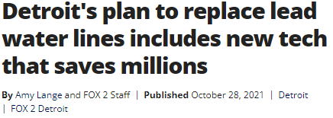
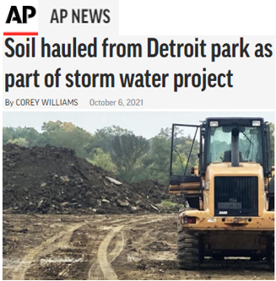
PUBLIC AFFAIRS: Good News
This month, the team garnered two positive pitched news stories. The first announcement was DWSD’s partnership with BlueConduit, an Ann Arbor based technology startup, to save an estimated $165M by using predicative modeling to determine lead service line inventory in Detroit to meet the Michigan Lead and Copper Rule. The second positive story was the soil swamp from DWSD’s Far West Stormwater Project to the City’s Riverside Park, saving DWSD $80,000.
PLEASE NOTE: For this metric, news stories are only counted once per topic, not by the number of media outlets picking up the story.

Slide 26
PUBLIC AFFAIRS: Positive vs. Negative News Stories
DWSD News Coverage: October 1 – October 31, 2021
In October, the DWSD Public Affairs team saw a total of 108 media stories. None were negative. Three of the positive stories highlighted how DWSD is using Green Stormwater Infrastructure to combat street and basement flooding. WXYZ Detroit interviewed Deputy Director and Chief Engineer Palencia Mobley, P.E. The story was shared on television and print news.
PLEASE NOTE: For this metric, each story/interview published or aired is counted.

Slide 27
PUBLIC AFFAIRS: Social Media Activity
10
New Facebook Followers
8,852
Total Followers on Facebook
2,488
Engagement on Facebook
11
New Twitter Followers
1,832
Total Followers on Twitter
395
Engagement on Twitter
4
New Instagram Followers
1,641
Total Followers on Instagram
15
Engagement on Instagram
The DWSD Public Affairs team gained 25 new followers on social media in October 2021, bringing the total number of followers to 12,325. In addition to the metrics above, Facebook saw a total of 116,528 impressions and 1,134 link clicks for the month. The top performing Facebook post was on October 6 when Deputy Director and Chief Engineer Palencia Mobley, P.E. spoke about the Far West Detroit soil swap. The post had 168 total engagements and 45 reactions. Twitter’s top performing post was also about the soil swap, gaining 98 engagements.

Slide 28
Information Technology

Slide 29
TECHNOLOGY: Top Ten Projects Scorecard
Exec. Priority Score | Sorted by Adjusted Priority Score | PM | Total Investment | Revised Target Date | Status/ Issues | Current Phase
1 | Customer Service-2:enQuesta 6.0 Upgrade | E Taiariol | $ 1,400,000 | 5/1/2022 | A change order is being prepared because additional time is needed for Functional Testing due to missing test cases. | Active Design
2 | Customer Service-7:enQuestaLink (Service Link Replacement) | C Penoza | $ 619,500 | 3/31/2022 | Development systems have been built and delivered. Development instance has been upgraded and discussions with the business units are being scheduled. | Active Design
4 | Office of CFO-1: Oracle Supply Chain | C. Penoza | $ 1,000,000 | 6/30/22 | All contracts have been setup and initial discussions have begun. Planning discussions with Oracle & AST have begun. | Active Design
4 | Operations (M&R, MTR OPS, Fleet)-2:Itron Meter Replacement | C Penoza | $ 1,000,000 | 12/31/2023 | Functional Design meetings scheduled for the week of December 6th, 2021 | Active Design
5 | eSignature Standard for Contracts and Forms | G Burrell | $ 300,000 | 4/30/2021 | Additional training is currently in progress for additional business units. | Live
6 | Engineering-1:eBuilder | C. Penoza | $ 300,000 | 7/04/21 | Project impacted due to flood response. Scope is being reviewed | Active Design
7 | Administrative and Compliance-7: 800 MHz Radio Upgrade | TBD | $ 330,000 | 6/30/2022 | Securing Funding for FY 22 – FY 24 | Pre-Procurement
8 | Administrative and Compliance-7: 800 MHz Radio Upgrade | TBD | $ 330,000 | 6/30/2022 | Securing Funding for FY 22 – FY 24 | Pre-Procurement
9 | Administrative and Compliance-6:Security Infrastructure Repair | G Burrell | $ 350,000 | 6/30/2022 | RFP Awarded to Johnson Controls Security Solutions. Assessment are complete at WBB, CSF and West Yard. | Active Design
10 | Administrative and Compliance-7 Oracle Database Cluster Migration | G Burrell | $0 | 3/27/2022 | Developing the Scope of Work | Active Design
A+

Slide 30
TECHNOLOGY: Application Availability
99.7% SYSTEMS AVAILABILITY
99.9% = TARGET
Systems Availability
Last 90 Days
Sept 2021 Cherwell Stats | Totals
Total Tickets | 746
New Tickets Received | 543
Total Tickets Resolved | 612
Average Time to Resolve in Days | 11
Total Tickets Resolved within SLA | 544
Total Tickets Resolved not in SLA | 68

