Slide 1
DIRECTOR’S REPORT
October 20, 2021

Slide 2
CONTENTS*
Metrics by Function:
• Director’s Message 3
• Customer Care 4
• Field Services 7
• Finance 12
• Legal Services 15
• Investigations 17
• Human Resources 19
• Public Affairs 22
• Information Technology 25

Slide 3
DIRECTOR’S MESSAGE TO THE BOARD
In a column with the Detroit Free Press on September 30, I joined with Abdul El-Sayed, MD, Dphil, current University of Michigan Ford School of Public Policy professor and former Detroit Health Department Director, to make a case for keeping three provisions in the Build Back Better Reconciliation Bill. Below is an excerpt. Read the full column online.
Water affordability, infrastructure, must be part of Biden bills | Opinion
The headlines this year speak volumes about what our families are facing.
Michigan has the third-highest childhood lead levels in the country. Climate change devastated thousands of families with unprecedented rainstorms this summer that backed up sewage lines into basements as the intense rain overwhelmed a sewer system built more than 100 years ago. Indeed, the first such storm prompted a national disaster declaration by President Joe Biden.
Despite being the Great Lakes state, water issues have emerged as front and center for the wellbeing of Detroit and Michigan residents. Across the region, households struggle to afford the water they need to care for their families, let alone combat the coronavirus pandemic and other illnesses.
The Infrastructure Investment and Jobs Act, a bipartisan bill that contains $55 billion for water infrastructure, would help address these issues. With its companion Build Back Better Reconciliation Bill, the bills would invest in broader solutions for climate change, reinvest in our eroding water infrastructure, and restore our social safety net with assistance for low-income water customers.
But we are growing concerned that these key provisions may be casualties of the budget reconciliation process.
It would be folly to pass one of these bills without the other.
There are three provisions in the reconciliation bill that are of vital necessity to preserve for southeast Michigan:
$30 billion for lead service line replacement and $700 million for grants to reduce lead in school drinking water;
$500 million for grants to improve climate resiliency of community water systems; and
$500 million for a permanent Low Income Water Customer Assistance Program (LIWCAP) administered through the Environmental Protection Agency, Office of Water.

Slide 4
Customer Care

Slide 5
CUSTOMER CARE: Number of Active Accounts
Active Residential Accounts Active Non-Residential Accounts
Vacant parcels, parking lots and other properties with no need for water service, receive stormwater charges only (drainage).

Slide 6
CUSTOMER CARE: Transactions
Number of Transactions
Millions of Dollars
DWSD continues to adapt during the COVID-19 Pandemic and is offering more services remotely, including contact via email at mydwsd@detroitmi.gov. DWSD is also communicating the convenient, safe ways to pay and how customers can access their account(s).

Slide 7
Field Services

Slide 8
FIELD SERVICES: Fire Hydrant Maintenance
n Operating Fire Hydrants n Operating Hydrants with Issues n Non-Operating Hydrants
DWSD prioritizes fire hydrant maintenance as a key component of providing essential and exceptional service delivery led by the Maintenance & Repair Service Line in our Operations Group. During the Fall season, Detroit Fire Department staff conduct inspections and share the data through a dashboard with DWSD if hydrants need to be repaired or replaced. The community can report hydrant issues via the Improve Detroit mobile app.

Slide 9
FIELD SERVICES: Running Water
n Reported by Customers n Resolved within Two Days
DWSD Operations continues to prioritize these work orders based on level of severity, including number of customers affected, to determine priority.

Slide 10
FIELD SERVICES: Water Main Breaks
n Reported by Customers n Resolved within Four Days
DWSD Operations continues to prioritize these work orders based on level of severity, including number of customers affected, to determine priority.

Slide 11
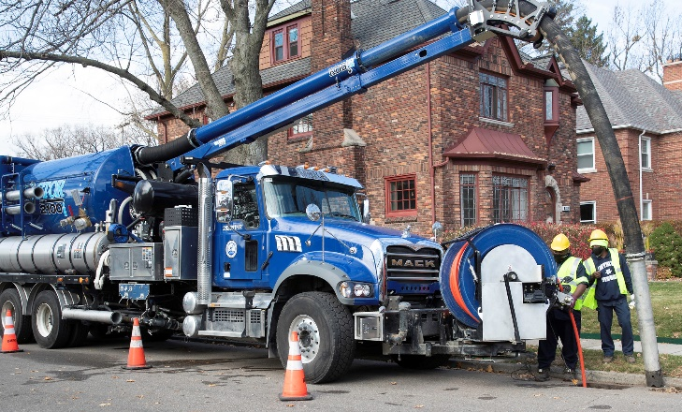
FIELD SERVICES: Catch Basin Inspection & Cleaning
DWSD is expanding sewer cleaning for preventative maintenance to help reduce street flooding and basement backups. As of this report, crews have cleaned 425 miles of city sewer pipe in calendar year 2021 compared with 59 miles in calendar year 2020.

Slide 12
Finance

Slide 13
FINANCE: Bill Collection Rate
April May June
3-Month Rolling Average Collection Rate
n Water Revenue n Sewer Revenue
The Finance data is provided based on the most recent month reported to the Finance Committee of the Board of Water Commissioners.

Slide 14
FINANCE: Cash Balance
The Finance data is provided based on the most recent month reported to the Finance Committee of the Board of Water Commissioners.

Slide 15
Legal Services

Slide 16
LEGAL: Claims, Hearings and Cases
30
Cases handled by in-house staff
8
Cases handled by outside counsel
0
Lawsuits dismissed
7
Lawsuits dismissed in calendar year 2021
293
Pending Billing Disputes
28
Disputes Closed in September 2021
$416,292
Total Amount Disputed
$22,223
Total Credits to Customers
21
Total Resolved Utilizing Leak Policy
290
Property damage claims
5
Damage claims approved
$249,688.09
Amount in property damage claims
$10,257.13
Amount of total claims recommended to be paid
DWSD uses a mix of in-house and contracted legal counsel to handle damage claims, civil action for commercial delinquencies and lawsuits filed against the department.
Damage claims data is for July 2021 and August 2021.

Slide 17
Investigations

Slide 18
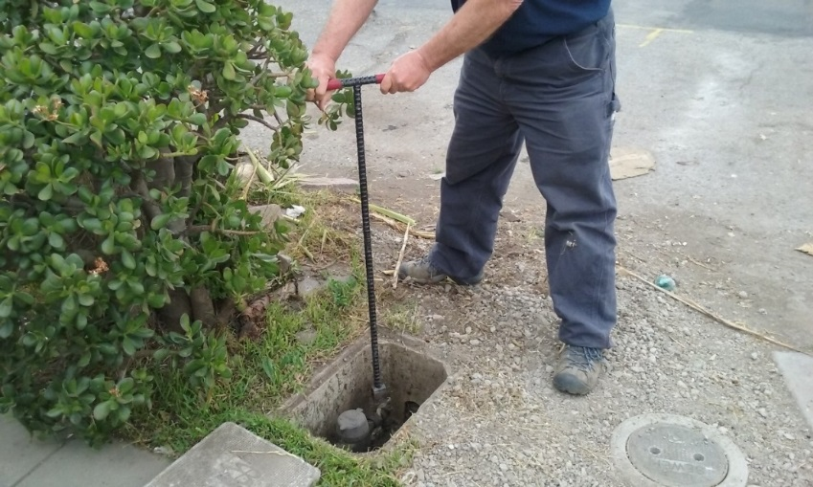
INVESTIGATIONS: Results
Money Owed to DWSD identified by Investigators
$910,985
Total since July 1, 2021
$136,405
Back billed
$221,689
Future owed in 12 months
$552,891
Water loss
146
Parcels investigated for delinquency, possible meter tampering and no meter since July 1, 2021
Revenue Identified Since Investigation Unit Began
$20,119,425
Total since August 14, 2017
Since August 2017, the unit, in collaboration with customer service/billing, has identified more than $20 million in services owed by primarily commercial customers. They uncover severe delinquencies, non-working meters, unauthorized use of fire hydrants, meter tampering, or connected to the city’s water main without a meter and/or permit. The unit works closely with the Finance/Collections and Legal Groups.

Slide 19
Human Resources

Slide 20
HUMAN RESOURCES: Detroit Residents and Hiring
Total of 542 DWSD employees, 54% of which live in Detroit.*
*DWSD and the City of Detroit do not require residency to be employed, per Michigan law.

Slide 21
HUMAN RESOURCES: Retirement Eligible
With a current population of 547 employees, there are 97 DWSD employees eligible for retirement.

Slide 22
Public Affairs

Slide 23
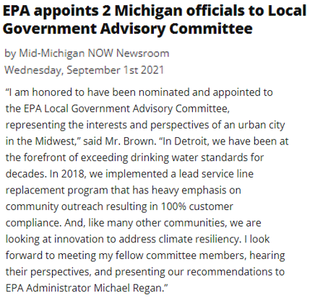
PUBLIC AFFAIRS: Positive vs. Negative News Stories
DWSD News Coverage: September 1 – September 30, 2021
In September, the DWSD Public Affairs team saw a total of 60 media stories. The one positive story covered Director Brown’s EPA appointment to the Local Government Advisory Committee. The most popular neutral story was an interview with Deputy Director and Chief Engineer Palencia Mobley, P.E. on NPR radio’s “All Things Considered” regarding the June flooding. The majority of the other neutral stories focused on weather reports, rain predictions and flood reduction tips.
PLEASE NOTE: For this metric, each story/interview published or aired is counted.

Slide 24
PUBLIC AFFAIRS: Social Media Activity
25
New Facebook Followers
8,867
Total Followers on Facebook
434
Engagement on Facebook
8
New Twitter Followers
1,821
Total Followers on Twitter
297
Engagement on Twitter
9
New Instagram Followers
1,637
Total Followers on Instagram
49
Engagement on Instagram
The DWSD Public Affairs team gained 42 new followers on social media in September 2021, bringing the total number of followers to 12,325. In addition to the metrics above, Facebook saw a total of 15,507 impressions and 48 link clicks for the month. The top performing Facebook post was on September 20 when DWSD posted tips on preparation for heavy rain over the week of September 19. The post had 75 total engagements and 15 reactions. September 21 was the top performing Twitter post sharing a flood watch for that evening.

Slide 25
Information Technology

Slide 26
TECHNOLOGY: Top Ten Projects Scorecard
Exec. Priority Score | Sorted by Adjusted Priority Score | PM | Total Investment | Revised Target Date | Status/ Issues | Current Phase
1 | Customer Service-2:enQuesta 6.0 Upgrade | E Taiariol | $ 1,400,000 | 5/1/2022 | Project Impacted due to Resources being allocated to Flood Response. Currently preparing for functional testing starting 9/20 | Active Design
2 | Customer Service-7:enQuestaLink (Service Link Replacement) | C Penoza | $ 619,500 | 3/31/2022 | Phase II is underway with planning and eQ6 impact analysis being performed by DWSD. S&S, and AECOM. Monthly milestones have been established as detail has been added to the plan. | Active Design
4 | Office of CFO-1: Oracle Supply Chain | C. Penoza | $ 1,000,000 | 6/30/22 | All contracts have been setup and initial discussions have begun. Planning discussions with Oracle & AST have begun. | Active Design
4 | Operations (M&R, MTR OPS, Fleet)-2:Itron Meter Replacement | C Penoza | $ 1,000,000 | 12/31/2023 | Development of work force management integration is delayed due to flood response. However, there is a long lead time due to hardware not being available until Feb 22. BSRD Discussions with iTron ongoing in order to begin rollout by Feb 22. | Active Design
5 | eSignature Standard for Contracts and Forms | G Burrell | $ 300,000 | 4/30/2021 | Additional training is currently in progress for additional business units. | Live
6 | Engineering-1:eBuilder | C. Penoza | $ 300,000 | 7/04/21 | Project impacted due to flood response. Scope is being reviewed | Active Design
3 | Customer Service-1:IVR Call Center Replacement | G Burrell | $ 800,000 | 6/30/2021 | Outbound Dialing complete. Work Force Management is the remaining component but due to short staff, this is being rescheduled. Will require a change order. | Active Implementation
8 | Customer Service-3: Customer Service Portal v2.0 | C Penoza | $ 455,000 | 10/31/2021 | Went live October 10th, 2021. | Complete
A+

Slide 27
TECHNOLOGY: Application Availability
99.2% SYSTEMS AVAILABILITY
99.9% = TARGET
Systems Availability
Last 90 Days
Sept 2021 Cherwell Stats | Totals
Total Tickets | 786
New Tickets Received | 553
Total Tickets Resolved | 582
Average Time to Resolve in Days | 17
Total Tickets Resolved within SLA | 433
Total Tickets Resolved not in SLA | 149

