Slide 1
DIRECTOR’S REPORT
September 19, 2018
detroitmi.gov/dwsd

Slide 2
CONTENTS*
Director’s Message for September 2018 3
Metrics by Function:
• Customer Care 4
• Field Services 7
• Finance 12
• Legal Services 15
• Investigations 17
• Human Resources 19
• Public Affairs 23
• Information Technology 27

Slide 3
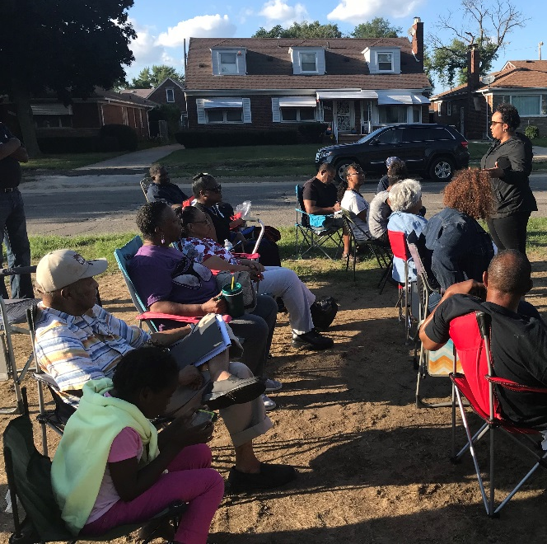
DIRECTOR’S MESSAGE TO THE BOARD
The cooperative effort between the Detroit Water and Sewerage Department (DWSD) and the Detroit Fire Department (DFD) to improve the maintenance of fire hydrants has been successful at greatly reducing inoperable hydrants.
DWSD and DFD use shared mapping technology to pinpoint and track maintenance issues.
Firefighters are able to know the condition and pressure capacity of the nearby hydrants while heading to the scene of an incident.
As this report shows, only 0.12 percent of hydrants are inoperable.
DWSD expanded its outreach to customers in the water main replacement construction zones, which most include a pilot program to replace the full lead service lines, where they exist.
DWSD mailed letters and distributed door hanger notifications in advance.
Customers also received a pitcher filter kit as a precautionary measure to use during and following construction.
Four block meetings were held with the residents, mostly on the public median where neighbors could see DWSD subject matter experts providing information and answering questions.
The department will go before City Council this Fall to request that they consider and adopt two new ordinances.
A Post-Construction Stormwater Management Ordinance for new development and redevelopment projects in the city.
The Gold Shovel Standard to reduce the instances of utility companies and contractors during excavations hitting other utility lines which cause service interruptions, cost increases and/or injuries.

Slide 4
Customer Care

Slide 5
CUSTOMER CARE: Account Status
All Customers
Residential Only
Non-Residential Only
n Active customer accounts in good standing n Delinquent accounts
DWSD has reduced the number of delinquent accounts this summer by 32 percent through customer outreach, the availability of WRAP, the Water Residential Assistance Program, community meetings and fairs at nonprofit partner organizations, and an advertising campaign.

Slide 6
CUSTOMER CARE: Transactions
Number of Transactions
Millions of Dollars
Payment Transactions by Type
Revenue Collected by Type

Slide 7
Field Services

Slide 8
FIELD SERVICES: Fire Hydrant Maintenance
n Operating Fire Hydrants n Operating Hydrants with Issues n Non-Operating Hydrants
The Detroit Fire Department uses a mobile collector app whereby firefighters report on the status of each hydrant. This data integrates into DWSD’s work order system. In turn, DWSD maintenance and repair staff update the hydrant mobile app to indicate when a repair is completed.

Slide 9
FIELD SERVICES: Running Water
n Reported by Customers n Resolved within Two Days
Running water reports include water flowing on a street, issues at vacant properties, and calls by residents who see gushing or flowing water that is out of the ordinary.

Slide 10
FIELD SERVICES: Water Main Breaks
n Reported by Customers n Resolved within Four Days
DWSD has a service level agreement with contractors to have reported water main breaks repaired within four days.

Slide 11
FIELD SERVICES: Catch Basin Inspection & Cleaning
The catch basin inspections and cleaning had a late start in 2018 due to weather, equipment maintenance and two large rainstorms which had DWSD crews re-assigned to water-in-the-basement complaints for two weeks on two separate occasions in the Spring.

Slide 12
Finance

Slide 13
FINANCE: Bill Collection Rate
Water Service Collection Rate Sewer Service Collection Rate
Every percentage increase in the collection rate above 80 percent is an additional $4 million which can be applied to the maintenance and rehabilitation of the water and sewer infrastructure.
The data in the chart is based upon the 330-360 day collection rate.

Slide 14
FINANCE: Cash Balance
$111,028,895
Water cash balance as of June 30, 2018
$80,929,561
Sewer cash balance as of June 30, 2018
As of June 30, 2018, DWSD had 185.58 days of cash on hand. The target is 100 days.

Slide 15
Legal Services

Slide 16
LEGAL: Claims, Hearings and Cases
47
Property damage claims
2
Basement backup damage claims appeals
6
Dispute hearings
2
Number of cases DWSD prevailed
18
Cases handled by in-house staff
8
Cases handled by outside counsel
$236,940
Amount in property damage claims
TBD
Basement backup damage claim appeals
$236,940 Total claims in August 2018
$3,463
Amount in dispute
$1,783
Credited to customers based on hearing outcomes
$1,681
Owed to DWSD after hearings
DWSD uses a mix of in-house and contracted legal counsel to handle damage claims, civil action for commercial delinquencies and lawsuits filed against the department.
Customers who have bill disputes may request a hearing at the City of Detroit Department of Appeals and Hearings. The cases are heard by an administrative hearing officer, which will restart in October after a recently vacated position is filled.

Slide 17
Investigations

Slide 18
INVESTIGATIONS: Results
849
[65 per month, on average]
Property addresses investigated for delinquency, possible meter tampering and no meter.
$4,846,118
Money owed to DWSD
Water theft
Unauthorized fire hydrant usage
The DWSD Revenue Recovery Unit, in collaboration with customer service/billing, has identified nearly $5 million in services owed by primarily commercial customers. They uncovered severe delinquencies, non-working meters, unauthorized use of fire hydrants, tampering with the meters, or connected to the city’s water main without a meter or permit. The team works closely with the DWSD collections and legal staff.

Slide 19
Human Resources

Slide 20
HUMAN RESOURCES: Detroit Residents and Hiring
Fifty-seven percent of the DWSD workforce lives in Detroit. Two new hires in August 2018 (five in July 2018).
Forty-three contract employees to augment staffing, plus six returning citizens working on the hydrant painting project.

Slide 21
HUMAN RESOURCES: Retirement Eligible
DWSD
Employees
Total Eligible
for
Retirement
25+ Years of Service
30+ Years of Service
60+ Years Old 10 or More Years of Service
65+ Years Old
8 or More Years of Service

Slide 22
HUMAN RESOURCES: Family Medical Leave Act
Applications
Timeframe Request

Slide 23
Public Affairs

Slide 24
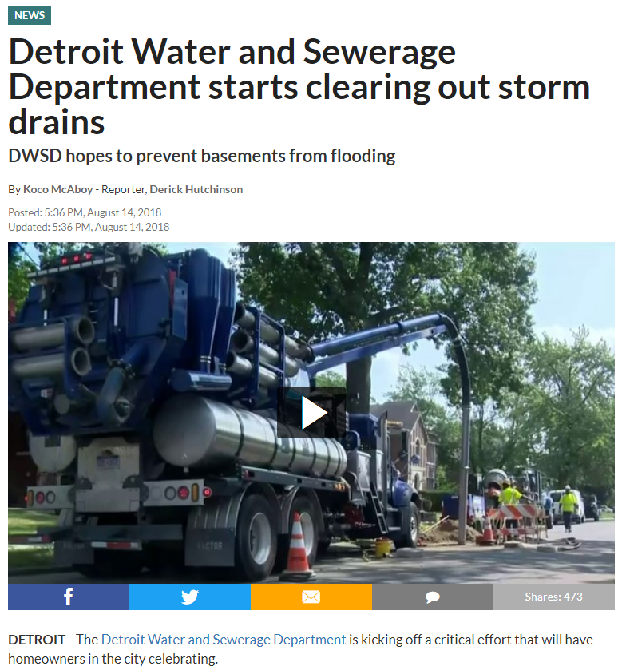
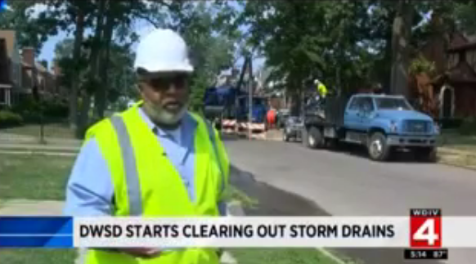
PUBLIC AFFAIRS: Good News
This month, the team garnered 2 positive news stories. The stories included DWSD’s update on our Catch Basin Cleaning and Inspection program and a story on the City’s fire hydrant repairs.
PLEASE NOTE: For this metric, news stories are only counted once per topic, not by the number of media outlets picking up the story.

Slide 25
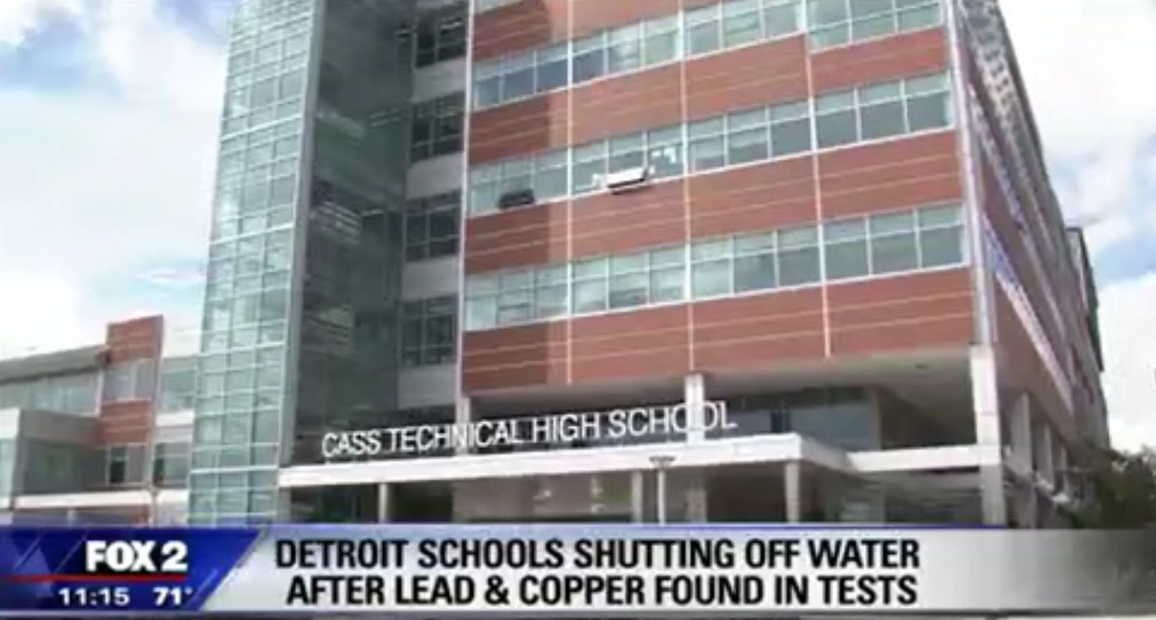
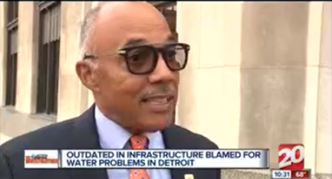
PUBLIC AFFAIRS: Positive vs. Negative News Stories
DWSD News Coverage: August 1 – August 31, 2018
The DWSD Public Affairs team saw a total of 295 media stories this month. The majority of the coverage was regarding the lead and copper issues at Detroit Public School Community District schools. Many of the stories were counted as neutral because they included DWSD and GLWA’s joint statement, assuring customers the water was safe and that the issue was because of aging plumbing in the schools. Of the 295 stories, 25 were broadcast, 246 were print/online and 24 were radio.
PLEASE NOTE: For this metric, each story/interview published or aired is counted.

Slide 26
PUBLIC AFFAIRS: Social Media Activity
280
New Facebook Followers
7,320
Total Followers on Facebook
5,414
Engagement on Facebook
-19
New Twitter Followers
1,312
Total Followers on Twitter
472
Engagement on Twitter
11
New Instagram Followers
1,002
Total Followers on Instagram
18
Engagement on Instagram
The DWSD Public Affairs team gained 291 new followers on social media in August 2018, bringing the total number of followers to 9,634. Unfortunately, we lost 19 Twitter followers. In addition to the metrics above, Facebook saw a total of 880,700 impressions and 6,799 link clicks. The top performing post on Facebook was on August 22 about DWSD’s efforts to clear storm drains to reduce street and basement flooding. On this post alone, there were 73,800 impressions, 90 comments and 396 reactions. The top performing Twitter post was on August 6 about DWSD’s WAVE Fund (54,700 impressions, 34 responses and 33 retweets.).

Slide 27
Information Technology

Slide 28
IT: Customer Service, Field Services and Finance Software Availability
In August, there were 206 outage hours mostly related to pay-by-phone (IVR) being unavailable, and a billing data pull glitch causing an auto-pay error. IT has been working with Public Affairs to communicate with the impacted customers.

