Slide 1
DIRECTOR’S REPORT
September 15, 2021

Slide 2
CONTENTS*
Metrics by Function:
• Director’s Message 3
• Customer Care 4
• Field Services 7
• Finance 12
• Legal Services 15
• Investigations 17
• Human Resources 19
• Public Affairs 22
• Information Technology 25

Slide 3
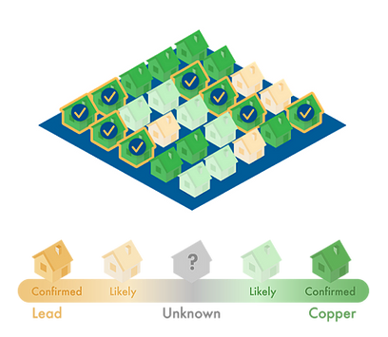
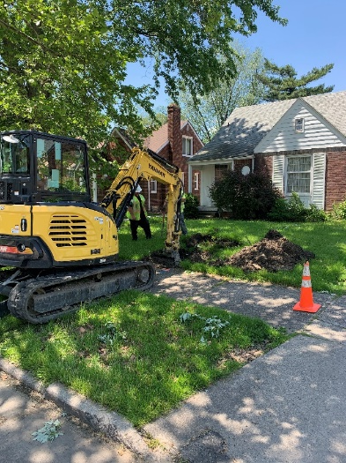
DIRECTOR’S MESSAGE TO THE BOARD
The Detroit Water and Sewerage Department (DWSD) is partnering with Ann Arbor-based technology company BlueConduit to determine service line inventory and meet state-required reporting regulations for January 2025 under the Michigan Lead & Copper Rule.
Stop box excavation data that visually verifies the service line material at 384 houses and City permit/parcel data will be inputted into a predictive modeling to map the probable locations of lead service lines.
Funding is from a $50,000 grant from the Rockefeller Foundation and a $50,000 grant from the Kresge Foundation to support BlueConduit’s analysis and predictive modeling, and a $154,000 grant from the Michigan Department of Environment, Great Lakes & Energy (EGLE) for the stop box excavations.
The project will save an estimated $165 million – the projected cost of excavating EVERY stop box in the city of Detroit to provide a report.
The model will also inform future planning for the DWSD Capital Improvement Program.

Slide 4
Customer Care

Slide 5
CUSTOMER CARE: Number of Active Accounts
Active Residential Accounts Active Non-Residential Accounts
Vacant parcels, parking lots and other properties with no need for water service, receive stormwater charges only (drainage).

Slide 6
CUSTOMER CARE: Transactions
Number of Transactions
Millions of Dollars
DWSD continues to adapt during the COVID-19 Pandemic and is offering more services remotely, including contact via email at mydwsd@detroitmi.gov. DWSD is also communicating the convenient, safe ways to pay and how customers can access their account(s).

Slide 7
Field Services

Slide 8
FIELD SERVICES: Fire Hydrant Maintenance
n Operating Fire Hydrants n Operating Hydrants with Issues n Non-Operating Hydrants
DWSD prioritizes fire hydrant maintenance as a key component of providing essential and exceptional service delivery led by the Maintenance & Repair Service Line in our Operations Group. During the Fall season, Detroit Fire Department staff conduct inspections and share the data through a dashboard with DWSD if hydrants need to be repaired or replaced. The community can report hydrant issues via the Improve Detroit mobile app.

Slide 9
FIELD SERVICES: Running Water
n Reported by Customers n Resolved within Two Days
DWSD Operations continues to prioritize these work orders based on level of severity, including number of customers affected, to determine priority.

Slide 10
FIELD SERVICES: Water Main Breaks
n Reported by Customers n Resolved within Four Days
DWSD Operations continues to prioritize these work orders based on level of severity, including number of customers affected, to determine priority.

Slide 11
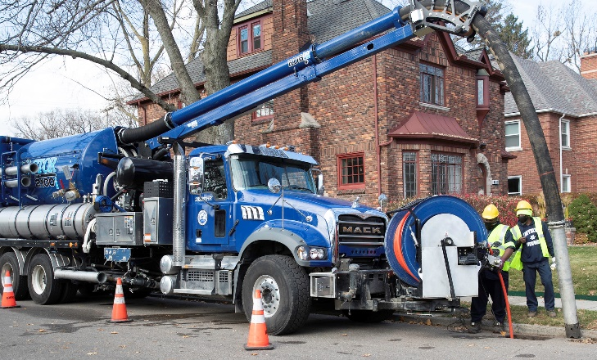
FIELD SERVICES: Catch Basin Inspection & Cleaning
DWSD is expanding sewer cleaning for preventative maintenance to help reduce street flooding and basement backups. As of this report, crews have cleaned 425 miles of city sewer pipe in calendar year 2021 compared with 59 miles in calendar year 2020.

Slide 12
Finance

Slide 13
FINANCE: Bill Collection Rate
March April May
3-Month Rolling Average Collection Rate
n Water Revenue n Sewer Revenue
The Finance data is provided based on the most recent month reported to the Finance Committee of the Board of Water Commissioners.

Slide 14
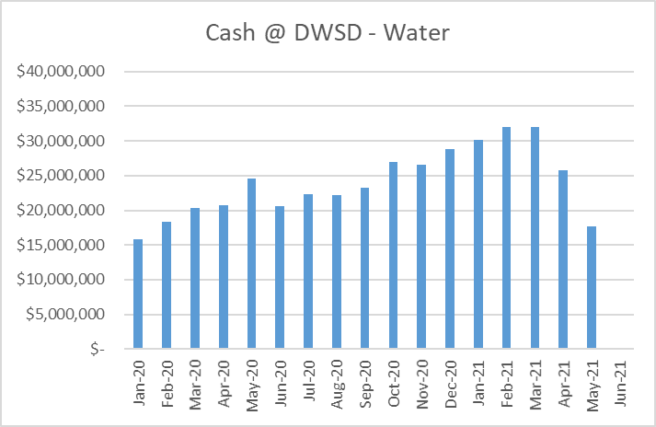
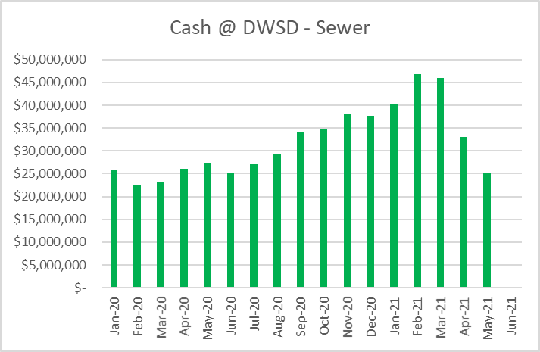
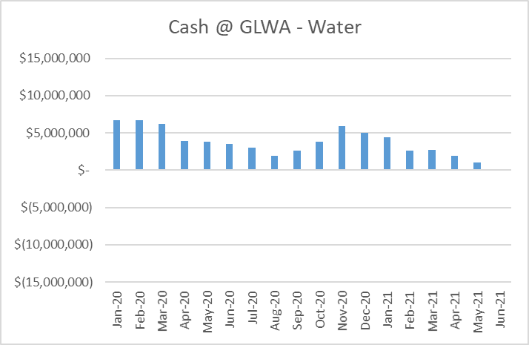
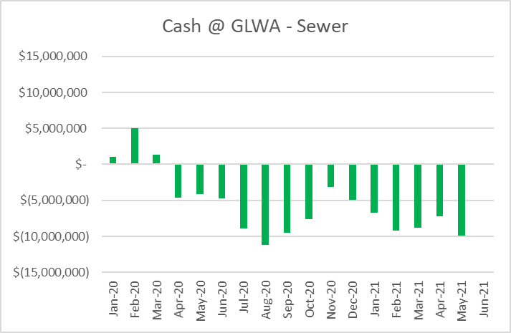
FINANCE: Cash Balance
The Finance data is provided based on the most recent month reported to the Finance Committee of the Board of Water Commissioners.

Slide 15
Legal Services

Slide 16
LEGAL: Claims, Hearings and Cases
27
Cases handled by in-house staff
8
Cases handled by outside counsel
0
Lawsuits dismissed
7
Lawsuits dismissed in calendar year 2021
N/A
Property damage claims
N/A
Damage claims approved
0
Dispute hearings*
0
Number of cases DWSD prevailed*
0
Number of accounts given adjustments*
*No hearings held in July 2021
N/A
Amount in property damage claims
N/A
Amount of total claims recommended to be paid
DWSD uses a mix of in-house and contracted legal counsel to handle damage claims, civil action for commercial delinquencies and lawsuits filed against the department.

Slide 17
Investigations

Slide 18
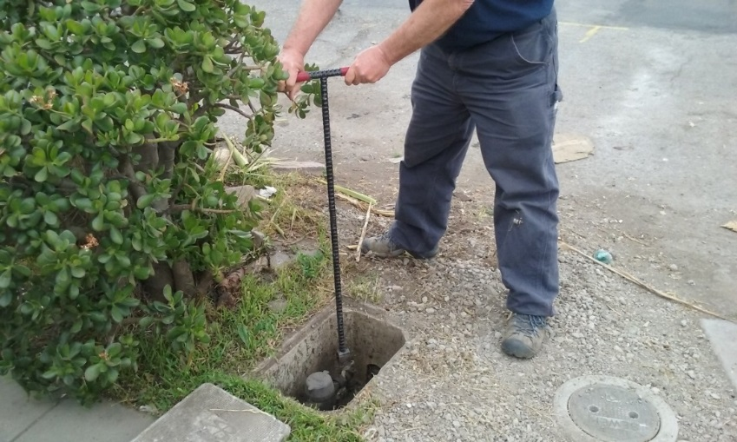
INVESTIGATIONS: Results
Money Owed to DWSD identified by Investigators
$711,354
Total since July 1, 2021
$128,782
Back billed
$177,896
Future owed in 12 months
$404,676
Water loss
95
Parcels investigated for delinquency, possible meter tampering and no meter since July 1, 2021
Revenue Identified Since Investigation Unit Began
$19,919,794
Total since August 14, 2017
Since August 2017, the unit, in collaboration with customer service/billing, has identified nearly $20 million in services owed by primarily commercial customers. They uncover severe delinquencies, non-working meters, unauthorized use of fire hydrants, meter tampering, or connected to the city’s water main without a meter and/or permit. The unit works closely with the Finance/Collections and Legal Groups.

Slide 19
Human Resources

Slide 20
HUMAN RESOURCES: Detroit Residents and Hiring
Total of 543 DWSD employees, 54% of which live in Detroit.*
*DWSD and the City of Detroit do not require residency to be employed, per Michigan law.

Slide 21
HUMAN RESOURCES: Retirement Eligible
With a current population of 547 employees, there are 97 DWSD employees eligible for retirement.

Slide 22
Public Affairs

Slide 23
PUBLIC AFFAIRS: Positive vs. Negative News Stories
DWSD News Coverage: August 1 – August 31, 2021
In August, the DWSD Public Affairs team saw a total of 93 media stories. The four positive stories were on the East Jefferson streetscape project in which DWSD will be doing water main upgrades starting in 2023. Most of the neutral stories were regarding the Mayoral primary in August, mentioning candidate Anthony Adam’s time as interim director of DWSD. Other neutral stories focused on flood relief from FEMA.
PLEASE NOTE: For this metric, each story/interview published or aired is counted.

Slide 24
PUBLIC AFFAIRS: Social Media Activity
34
New Facebook Followers
8,864
Total Followers on Facebook
5,069
Engagement on Facebook
3
New Twitter Followers
1,814
Total Followers on Twitter
433
Engagement on Twitter
8
New Instagram Followers
1,628
Total Followers on Instagram
N/A
Engagement on Instagram
The DWSD Public Affairs team gained 45 new followers on social media in August 2021, bringing the total number of followers to 12,306. In addition to the metrics above, Facebook saw a total of 96,511 impressions and 2,039 link clicks for the month. The top performing Facebook and Twitter post was on August 27 when DWSD posted a flier from the City of Detroit Health Department on how to stay healthy and safe during flood events. The Facebook post had 167 total engagements and 30 reactions. The Twitter post had 88 engagements.

Slide 25
Information Technology

Slide 26
TECHNOLOGY: Top Ten Projects Scorecard
Exec. Priority Score | Sorted by Adjusted Priority Score | PM | Total Investment | Revised Target Date | Status/ Issues | Current Phase
1 | Customer Service-2:enQuesta 6.0 Upgrade | E Taiariol | $ 1,400,000 | 5/1/2022 | Project Impacted due to Resources being allocated to Flood Response. Currently preparing for functional testing starting 9/20 | Active Design
2 | Customer Service-7:enQuestaLink (Service Link Replacement) | C Penoza | $ 619,500 | 3/31/2022 | Servers have been provisioned and have been turned over to the vendor. | Active Design
3 | Operations (M&R, MTR OPS, Fleet)-2:Itron Meter Replacement | C Penoza | $ 1,000,000 | 12/31/2023 | Development of work force management integration is delayed due to flood response. However, there is a long lead time due to hardware not being available until Feb 22. | Active Design
4 | Engineering-2:GIS Maintenance/As-Builts into Box | R Burke | $ 2500,000 | 6/30/21 | Data has migrated to Box. All data connections between GLWA and DWSD have been shut down. | COMPLETE
5 | Customer Service-3: Customer Service Portal v2.0 | C Penoza | $ 455,000 | 10/31/2021 | Executing new plan for implementation. Testing of delivered components is scheduled for the end of September for an October Go Live | Active Implementation
6 | Administrative and Comliance-2:GLWA Separation - Computers | R Burke | $ 300,000 | 5/31/2021 | Complete | COMPLETE
7 | eSignature Standard for Contracts and Forms | G Burrell | $ 300,000 | 4/30/2021 | Training is currently in progress for additional business units. | Active Implementation
8 | Engineering-1:eBuilder | C. Penoza | $ 300,000 | 7/04/21 | Project impacted due to flood response. Prototype is currently being developed | Active Implementation
9 | Office of CFO-1: Oracle Supply Chain | C. Penoza | $ 1,000,000 | TBD | License contract approved in August, Implementation contracts going to BOWC in September | Procurement
10 | Customer Service-1:IVR Call Center Replacement | G Burrell | $ 800,000 | 6/30/2021 | Outbound Dialing changed in order to assist June Flood Response. Additional Outbound Dialing Campaigns being implemented. Work Force Management has been delayed due to Flood Response bust estimated to complete by 9/30. | Active Implementation
A+

Slide 27
TECHNOLOGY: Application Availability
100% SYSTEMS AVAILABILITY
99.9% = TARGET
Systems Availability
Last 90 Days
August 2021 Cherwell Stats | Totals
Total Tickets | 858
New Tickets Received | 602
Total Tickets Resolved | 626
Average Time to Resolve in Days | 10
Total Tickets Resolved within SLA | 472
Total Tickets Resolved not in SLA | 154

