Slide 1
DIRECTOR’S REPORT
August 18, 2021

Slide 2
CONTENTS*
Metrics by Function:
• Director’s Message 3
• Customer Care 4
• Field Services 7
• Finance 12
• Legal Services 15
• Investigations 17
• Human Resources 19
• Public Affairs 22
• Information Technology 25

Slide 3
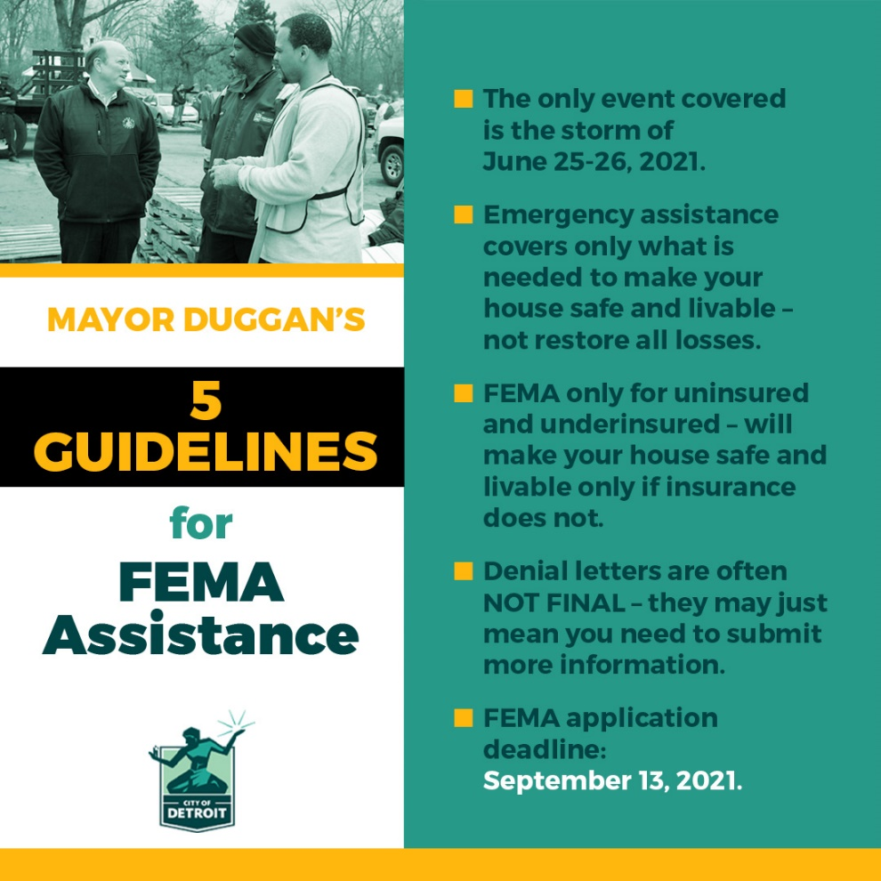
DIRECTOR’S MESSAGE TO THE BOARD
The Detroit Water and Sewerage Department (DWSD) is encouraging our customers who experienced flooding on June 25-26 to apply with FEMA and follow the appeal process if they were denied.
DWSD crews and contractors continue to work through the initial investigations of the “water in basement complaints, and review of the sewer backup claims will begin soon.

Slide 4
Customer Care

Slide 5
CUSTOMER CARE: Number of Active Accounts
Active Residential Accounts Active Non-Residential Accounts
Vacant parcels, parking lots and other properties with no need for water service, receive stormwater charges only (drainage).

Slide 6
CUSTOMER CARE: Transactions
Number of Transactions
Millions of Dollars
DWSD continues to adapt during the COVID-19 Pandemic and is offering more services remotely, including contact via email at mydwsd@detroitmi.gov. DWSD is also communicating the convenient, safe ways to pay and how customers can access their account(s).

Slide 7
Field Services

Slide 8
FIELD SERVICES: Fire Hydrant Maintenance
n Operating Fire Hydrants n Operating Hydrants with Issues n Non-Operating Hydrants
DWSD prioritizes fire hydrant maintenance as a key component of providing essential and exceptional service delivery led by the Maintenance & Repair Service Line in our Operations Group. During the Fall season, Detroit Fire Department staff conduct inspections and share the data through a dashboard with DWSD if hydrants need to be repaired or replaced. The community can report hydrant issues via the Improve Detroit mobile app.

Slide 9
FIELD SERVICES: Running Water
n Reported by Customers n Resolved within Two Days
DWSD Operations continues to prioritize these work orders based on level of severity, including number of customers affected, to determine priority.

Slide 10
FIELD SERVICES: Water Main Breaks
n Reported by Customers n Resolved within Four Days
DWSD Operations continues to prioritize these work orders based on level of severity, including number of customers affected, to determine priority.

Slide 11
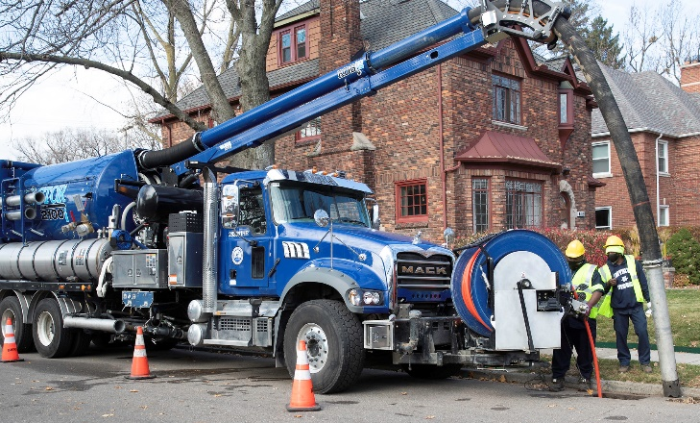
FIELD SERVICES: Catch Basin Inspection & Cleaning
DWSD is expanding sewer cleaning for preventative maintenance to help reduce street flooding and basement backups. As of this report, crews have cleaned 225 miles of city sewer pipe compared with 59 miles in calendar year 2020.
This program launched in 2017. DWSD crews have touched more than 30,000 of the estimated 90,000 catch basins, including tracking them through a mapping app for asset inventory. The 30,000 goal was achieved in the three-year commitment as announced by DWSD and Mayor Duggan in 2017.

Slide 12
Finance

Slide 13
FINANCE: Bill Collection Rate
March April May
3-Month Rolling Average Collection Rate
n Water Revenue n Sewer Revenue
The Finance data is provided based on the most recent month reported to the Finance Committee of the Board of Water Commissioners.

Slide 14
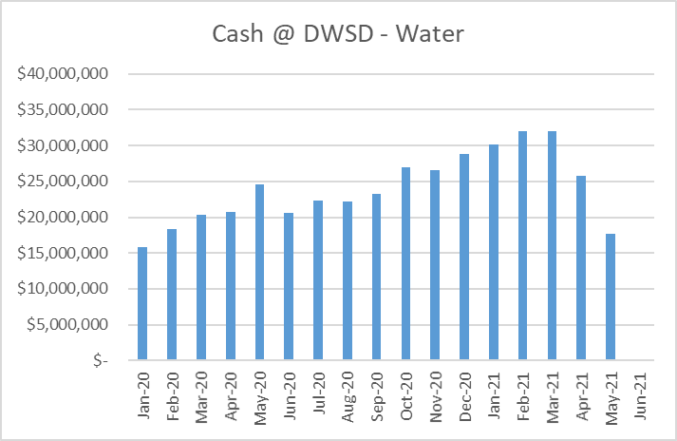
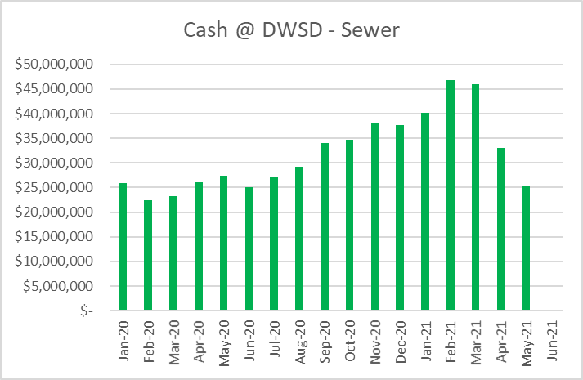
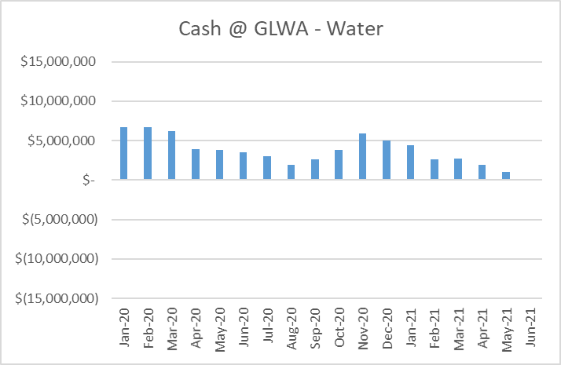
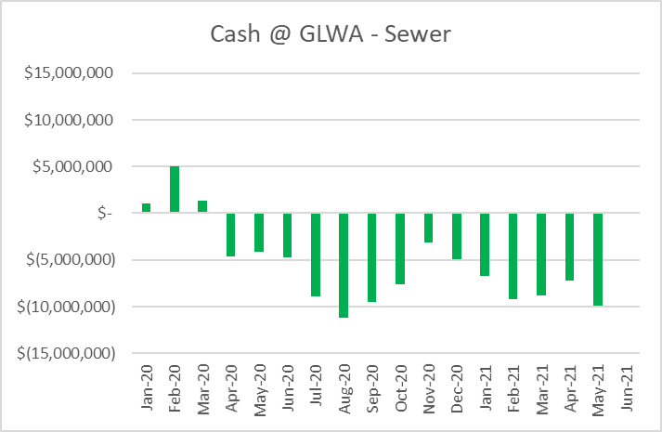
FINANCE: Cash Balance
The Finance data is provided based on the most recent month reported to the Finance Committee of the Board of Water Commissioners.

Slide 15
Legal Services

Slide 16
LEGAL: Claims, Hearings and Cases
27
Cases handled by in-house staff
8
Cases handled by outside counsel
1
Lawsuits dismissed
7
Lawsuits dismissed in calendar year 2021
39
Property damage claims
5
Damage claims approved
0
Dispute hearings*
0
Number of cases DWSD prevailed*
0
Number of accounts given adjustments*
*No hearings held in July 2021
$209,286
Amount in property damage claims
$8,566
Amount of total claims recommended to be paid
DWSD uses a mix of in-house and contracted legal counsel to handle damage claims, civil action for commercial delinquencies and lawsuits filed against the department.

Slide 17
Investigations

Slide 18
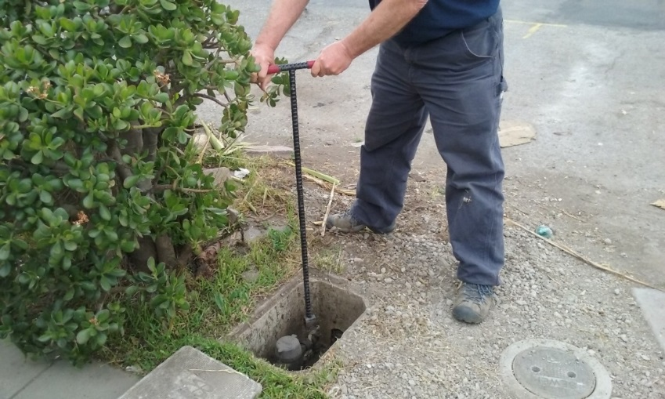
INVESTIGATIONS: Results
Money Owed to DWSD identified by Investigators
$352,899
Total since July 1, 2021
$113,010
Back billed
$93,327
Future owed in 12 months
$146,562
Water loss
54
Parcels investigated for delinquency, possible meter tampering and no meter since July 1, 2021
Revenue Identified Since Investigation Unit Began
$19,561,339
Total since August 14, 2017
Since August 2017, the unit, in collaboration with customer service/billing, has identified more than $19 million in services owed by primarily commercial customers. They uncover severe delinquencies, non-working meters, unauthorized use of fire hydrants, meter tampering, or connected to the city’s water main without a meter and/or permit. The unit works closely with the Finance/Collections and Legal Groups.

Slide 19
Human Resources

Slide 20
HUMAN RESOURCES: Detroit Residents and Hiring
Total of 547 DWSD employees, 55% of which live in Detroit.*
*DWSD and the City of Detroit do not require residency to be employed, per Michigan law.

Slide 21
HUMAN RESOURCES: Retirement Eligible
Retirement Criteria | Total
30 YOS/Any Age (Legacy and Hybrid) | 52
10 YOS/60 years old (Legacy) | 45
10 YOS/62 years old (Hybrid) | 0
8 YOS/65 years old (Legacy) | 0
TOTAL | 97
97
LEGACY = HIRED BEFORE 2014
HYBRID = HIRED AFTER JANUARY 1, 2014
With a current population of 547 employees, there are 97 DWSD employees eligible for retirement.

Slide 22
Public Affairs

Slide 23
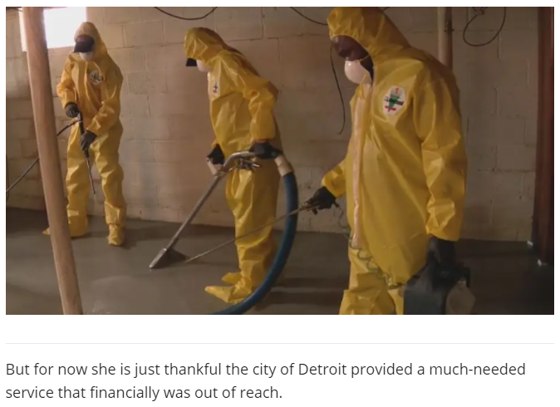
PUBLIC AFFAIRS: Positive vs. Negative News Stories
DWSD News Coverage: July 1 – July 31, 2021
In July, the DWSD Public Affairs team saw a total of 241 media stories. Most of the neutral stories were focused on the City of Detroit, DWSD and FEMA updates in response to the June 25-26 and July 16 Flood Events. There was 1 positive story that multiple media sources covered regarding the City of Detroit and DWSD’s cleaning assistance program.
PLEASE NOTE: For this metric, each story/interview published or aired is counted.

Slide 24
PUBLIC AFFAIRS: Social Media Activity
102
New Facebook Followers
8,835
Total Followers on Facebook
12,036
Engagement on Facebook
220
New Twitter Followers
2,487
Total Followers on Twitter
840
Engagement on Twitter
37
New Instagram Followers
1,620
Total Followers on Instagram
N/A
Engagement on Instagram
The DWSD Public Affairs team gained 359 new followers on social media in July 2021, bringing the total number of followers to 12,942. In addition to the metrics above, Facebook saw a total of 185,911 impressions and 1,895 link clicks for the month. The top performing Facebook and Twitter post was on July 7 when DWSD posted a flier on how to start the flood claim process. The Facebook post had 9,343 total engagements and 746 reactions. The Twitter post had 130 engagements.

Slide 25
Information Technology

Slide 26
TECHNOLOGY: Top Ten Projects Scorecard
Exec. Priority Score | Sorted by Adjusted Priority Score | PM | Total Investment | Revised Target Date | Status/ Issues | Current Phase
1 | Customer Service-2:enQuesta 6.0 Upgrade | E Taiariol | $ 1,400,000 | 5/1/2022 | Core Team Training is complete. Currently performing Bill Parallel on Data Conversion #2. | Active Design
2 | Customer Service-7:enQuestaLink (Service Link Replacement) | C Penoza | $ 619,500 | 3/31/2022 | Phase 2 Kickoff was completed and new servers are currently being provisioned. | Active Design
3 | Operations (M&R, MTR OPS, Fleet)-2:Itron Meter Replacement | C Penoza | $ 1,000,000 | 12/31/2023 | Development of work force management integration is delayed due to flood response. However, there is a long lead time due to hardware not being available until Feb 22. | Active Design
4 | Engineering-2:GIS Maintenance/As-Builts into Box | R Burke | $ 2500,000 | 6/30/21 | Data has migrated to Box. All data connections between GLWA and DWSD have been shut down. | COMPLETE
5 | Customer Service-3: Customer Service Portal v2.0 | C Penoza | $ 455,000 | 10/31/2021 | Executing new plan for implementation. | Active Implementation
6 | Administrative and Comliance-2:GLWA Separation - Computers | R Burke | $ 300,000 | 5/31/2021 | Complete | COMPLETE
7 | eSignature Standard for Contracts and Forms | G Burrell | $ 300,000 | 4/30/2021 | Training is currently in progress for additional business units. | Active Implementation
8 | Engineering-1:eBuilder | C. Penoza | $ 300,000 | 7/04/21 | Prototype is currently being developed | Active Implementation
9 | Office of CFO-1: Oracle Supply Chain | C. Penoza | $ 1,000,000 | TBD | City contract issues resolved. License contract going to BOWC in August, Implementation contracts going to BOWC in September | Procurement
10 | Customer Service-1:IVR Call Center Replacement | G Burrell | $ 800,000 | 6/30/2021 | Outbound Dialing changed in order to assist June Flood Response. Work Force Management has been delayed due to Flood Response. New Go lives planned for September 2021 | Active Implementation
A+

Slide 27
TECHNOLOGY: Application Availability
100% SYSTEMS AVAILABILITY
99.9% = TARGET
Systems Availability
Last 90 Days
July 2021 Cherwell Stats | Totals
Total Tickets | 1061
New Tickets Received | 661
Total Tickets Resolved | 805
Average Time to Resolve in Days | 5
Total Tickets Resolved within SLA | 410
Total Tickets Resolved not in SLA | 395

