Slide 1
DIRECTOR’S REPORT
July 21, 2021

Slide 2
CONTENTS*
Metrics by Function:
• Director’s Message 3
• Customer Care 4
• Field Services 7
• Finance 12
• Investigations 15
• Human Resources 18
• Public Affairs 20
• Information Technology 23

Slide 3
DIRECTOR’S MESSAGE TO THE BOARD
Since June 26, the Detroit Water and Sewerage Department (DWSD) has been focused on responding to the nearly seven inches of rain received within several hours, which overwhelmed the design standards of the combined sewer system.
The response has focused on:
Creating more than 24,000 work orders for the “water in basement” reports (individual addresses) from Detroiters including adding Rocket Connections for additional call takers;
Starting the claim process to ensure residents meet the 45-day deadline, and assisting in the FEMA assessments for a possible presidential disaster declaration;
Inspecting the sewer system near the flooded homes, and cleaning where necessary, with the priority on the most severely impacted neighborhoods (with DWSD and contractor crews); and
Assisting the most vulnerable residents with clean-out services with GSD, DPW, contractors and volunteers.

Slide 4
Customer Care

Slide 5
CUSTOMER CARE: Number of Active Accounts
Active Residential Accounts Active Non-Residential Accounts
Vacant parcels, parking lots and other properties with no need for water service, receive stormwater charges only (drainage).

Slide 6
CUSTOMER CARE: Transactions
Number of Transactions
Millions of Dollars
DWSD continues to adapt during the COVID-19 Pandemic and is offering more services remotely, including contact via email at mydwsd@detroitmi.gov. DWSD is also communicating the convenient, safe ways to pay and how customers can access their account(s).

Slide 7
Field Services

Slide 8
FIELD SERVICES: Fire Hydrant Maintenance
n Operating Fire Hydrants n Operating Hydrants with Issues n Non-Operating Hydrants
DWSD prioritizes fire hydrant maintenance as a key component of providing essential and exceptional service delivery led by the Maintenance & Repair Service Line in our Operations Group. During the Fall season, Detroit Fire Department staff conduct inspections and share the data through a dashboard with DWSD if hydrants need to be repaired or replaced. The community can report hydrant issues via the Improve Detroit mobile app.

Slide 9
FIELD SERVICES: Running Water
n Reported by Customers n Resolved within Two Days
DWSD Operations continues to prioritize these work orders based on level of severity, including number of customers affected, to determine priority.

Slide 10
FIELD SERVICES: Water Main Breaks
n Reported by Customers n Resolved within Four Days
DWSD Operations continues to prioritize these work orders based on level of severity, including number of customers affected, to determine priority.

Slide 11
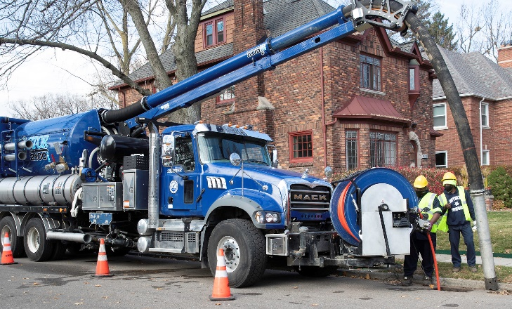
FIELD SERVICES: Catch Basin Inspection & Cleaning
DWSD is expanding sewer cleaning for preventative maintenance to help reduce street flooding and basement backups. As of this report, crews have cleaned 225 miles of city sewer pipe compared with 59 miles in calendar year 2020.
This program launched in 2017. DWSD crews have touched more than 30,000 of the estimated 90,000 catch basins, including tracking them through a mapping app for asset inventory. The 30,000 goal was achieved in the three-year commitment as announced by DWSD and Mayor Duggan in 2017.

Slide 12
Finance

Slide 13
FINANCE: Bill Collection Rate
March April May
3-Month Rolling Average Collection Rate
n Water Revenue n Sewer Revenue
The Finance data is provided based on the most recent month reported to the Finance Committee of the Board of Water Commissioners.

Slide 14
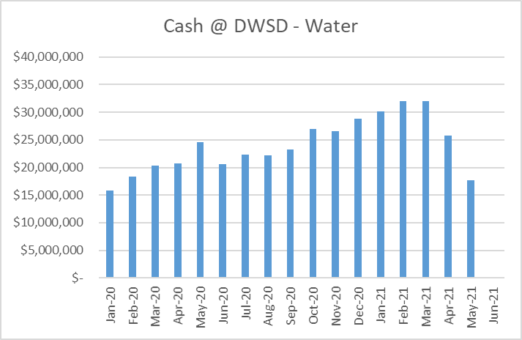
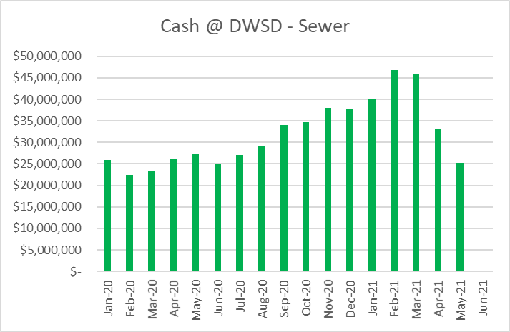
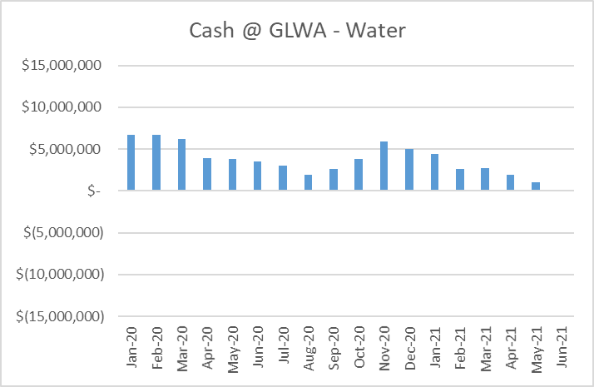
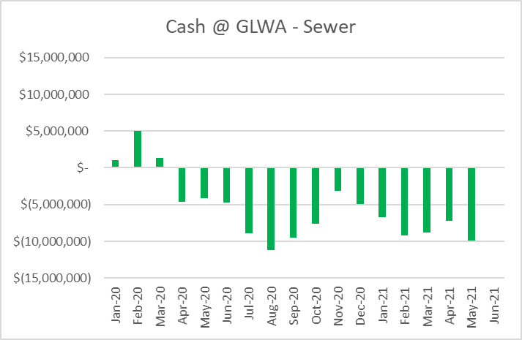
FINANCE: Cash Balance
The Finance data is provided based on the most recent month reported to the Finance Committee of the Board of Water Commissioners.

Slide 15
Investigations

Slide 16
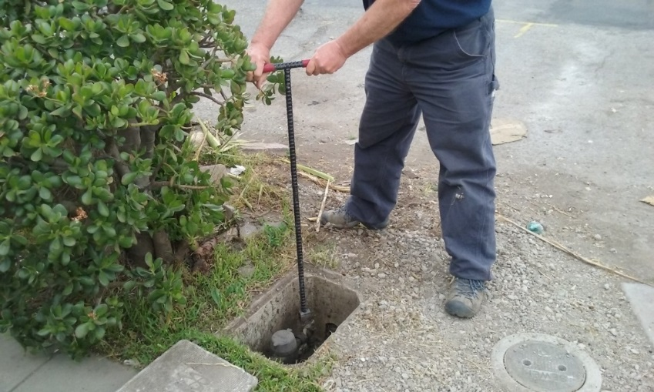
INVESTIGATIONS: Results
Money Owed to DWSD identified by Investigators
$6,075,491
Total since July 1, 2020
$387,809
Back billed
$1,221,625
Future owed in 12 months
$4,466,057
Water loss
1,024
Parcels investigated for delinquency, possible meter tampering and no meter since July 1, 2020
Revenue Identified Since Investigation Unit Began
$19,208,440
Total since August 14, 2017
Since August 2017, the unit, in collaboration with customer service/billing, has identified more than $19 million in services owed by primarily commercial customers. They uncover severe delinquencies, non-working meters, unauthorized use of fire hydrants, meter tampering, or connected to the city’s water main without a meter and/or permit. The unit works closely with the Finance/Collections and Legal Groups.

Slide 17
Human Resources

Slide 18
HUMAN RESOURCES: Detroit Residents and Hiring
Fifty-five percent of the DWSD workforce lives in Detroit.*
*DWSD and the City of Detroit do not require residency to be employed, per Michigan law.

Slide 19
HUMAN RESOURCES: Retirement Eligible
With a current population of 545 employees, there are 100 DWSD employees eligible for retirement.

Slide 20
Public Affairs

Slide 21
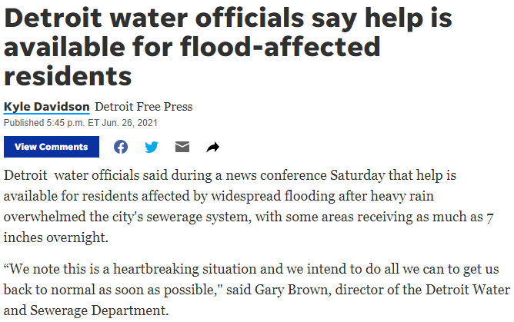
PUBLIC AFFAIRS: Positive vs. Negative News Stories
DWSD News Coverage: June 1 – June 30, 2021
In June, the DWSD Public Affairs team saw a total of 178 media stories. The majority of the neutral stories were focused on the City of Detroit, DWSD and State of Michigan updates in response to the June 25-26 Flood Event. A series of other neutral stories were about Metro Detroit water rate hikes. DWSD’s 2021-2022 rate increase is lower than a majority of the suburban communities.
PLEASE NOTE: For this metric, each story/interview published or aired is counted.

Slide 22
PUBLIC AFFAIRS: Social Media Activity
159
New Facebook Followers
8,779
Total Followers on Facebook
11,590
Engagement on Facebook
8
New Twitter Followers
1,771
Total Followers on Twitter
617
Engagement on Twitter
44
New Instagram Followers
1,585
Total Followers on Instagram
N/A
Engagement on Instagram
The DWSD Public Affairs team gained 211 new followers on social media in June 2021, bringing the total number of followers to 12,135. In addition to the metrics above, Facebook saw a total of 653,413 impressions and 4,366 link clicks for the month. The top performing Facebook and Twitter post was on June 30 when DWSD posted a brown water advisory for eastside neighborhoods. The Facebook post had 888 total engagements and 7 reactions. The Twitter post had 29 engagements.

Slide 23
Information Technology

Slide 24
TECHNOLOGY: Top Ten Projects Scorecard
Exec. Priority Score | Sorted by Adjusted Priority Score | PM | Total Investment | Revised Target Date | Status/ Issues | Current Phase
1 | Customer Service-2:enQuesta 6.0 Upgrade | E Taiariol | $ 1,400,000 | 5/1/2022 | Test Case review and step development begins June 8th. Training Plan development is in progress. | Active Design
2 | Customer Service-7:enQuestaLink (Service Link Replacement) | C Penoza | $ 619,500 | 6/30/2021 | Phase 1 Complete. Project planning has begun for upgrade from v4 to v6. This priority will change for June BOWC Report | COMPLETE
3 | Operations (M&R, MTR OPS,Fleet)-2:Itron Meter Replacement | C Penoza | $ 1,000,000 | 12/31/2022 | Development of work force management integration is in progress with testing to begin in June and July of 2021. | Active Design
4 | Engineering-2:GIS Maintenance/As-Builts into Box | R Burke | $ 2500,000 | 6/30/21 | Data is actively copying to BOX. | COMPLETE
5 | Customer Service-3: Customer Service Portal v2.0 | C Penoza | $ 455,000 | 5/31/2021 | Demo of new UI changes has been reviewed and approved. Go live and new features being planned for August/September due to delays in development. | Active Implementation
6 | Administrative and Comliance-2:GLWA Separation - Computers | R Burke | $ 300,000 | 5/31/2021 | All onsite systems have been migrated at WBB, ECS, WSCS & West Yard. CSF to be complete 6/17/21. Remote Staff computers currently being upgraded. | COMPLETE
7 | eSignature Standard for Contracts and Forms | G Burrell | $ 300,000 | 4/30/2021 | Training is currently in progress for additional business units. | Active Implementation
8 | Engineering-1:eBuilder | C. Penoza | $ 300,000 | 5/01/21 | Resolved technical issues allowing the project to move forward with data exchange and dashboard development. | Active Implementation
9 | Office of CFO-1: Oracle Supply Chain | C. Penoza | $ 1,000,000 | TBD | Working to resolve issues with City contract. City states that contract issues will be resolved week of 6/14/21. | Procurement
10 | Customer Service-1:IVR Call Center Replacement | G Burrell | $ 800,000 | 6/30/2021 | Phase 1 complete. DWSD received audit report and SOW for Outbound calling for appointment reminders will be ready June 30th. Work Force Management is progressing through design phases with training of Customer Service & IT staff | Active Implementation
A+

Slide 25
TECHNOLOGY: Application Availability
100% SYSTEMS AVAILABILITY
99.9% = TARGET
Systems Availability
Last 90 Days
June 2021 Cherwell Stats | Totals
Total Tickets | UNAVAILABLE
New Tickets Received | UNAVAILABLE
Total Tickets Resolved | UNAVAILABL
Average Time to Resolve in Days | UNAVAILABLE
Total Tickets Resolved within SLA | UNAVAILABLE
Total Tickets Resolved not in SLA | UNAVAILABLE

