Slide 1
DIRECTOR’S REPORT
April 17, 2019
detroitmi.gov/dwsd

Slide 2
CONTENTS*
Director’s Message for January 2019 3
Metrics by Function:
• Customer Care 4
• Field Services 7
• Finance 12
• Legal Services 15
• Investigations 17
• Human Resources 19
• Public Affairs 22
• Information Technology 25

Slide 3
DIRECTOR’S MESSAGE TO THE BOARD
As the weather begins to break, the Detroit Water and Sewerage Department (DWSD) is embarking on its most aggressive construction season in decades – rehabilitating more than 50 miles of water main and sewer piping and installing several Green Stormwater Infrastructure (GSI) projects this year.
In addition to the first Capital Improvement Program Management Office construction projects to begin this spring in Cornerstone Village and North Rosedale Park, DWSD contractors will be on portions of these streets replacing water mains: Algonac, Beaverland, East Outer Drive, Grand River, Lahser, Mark Twain, Marlowe, Notingham, Oakman, Robson, Stansbury, Tireman, West Outer Drive, Whitehill, to name a few.
DWSD and its contractor IWPC is also continuing sewer relining in Jefferson Chalmers as part of the $20 million project which began last year.
The most significant GSI project will be the bioretention gardens to be constructed in the medians on Oakman Blvd between Tireman and Birwood to improve stormwater management and reduce flooding in that neighborhood.
The Customer Assurance Specialist Team (CAST) has increased the number of assigned customer service representatives to eight in order to attend more outreach events in the neighborhoods than years past (CAST began in late 2017); the team is partnering with DTE Energy, Wayne Metropolitan Community Action Agency, THAW and the Wayne County Treasurer on Wednesday, April 10 at 10 a.m. - 5 p.m. for a Customer Assistance Day at Eastern Market Shed 3, which is expected to draw more than 1,000 Detroit residents.
Wayne Metro will pre-register households in advance of the event and qualifying residents will have a scheduled onsite interview for WRAP, the Water Residential Assistance Program, on April 10 at Eastern Market.
DWSD CAST will assist customers who don’t meet the WRAP income guidelines or have other account needs.
Oakman Blvd. GSI Project

Slide 4
Customer Care

Slide 5
CUSTOMER CARE: Account Status
All Customers
Residential Only
n Active customer accounts in good standing n Delinquent accounts
Non-Residential Only
During the winter months there is a historic pattern of an increase in delinquent accounts for two primary reasons: DWSD does not interrupt service for nonpayment on residential accounts during freezing temperatures and households (and businesses) have significantly higher utility costs in the winter due to increase use of furnaces and other heating appliances which causes a budgeting issue for many families.

Slide 6
CUSTOMER CARE: Transactions
Number of Transactions
DWSD is presenting this payment transaction data in a three-month series to show trends..
Millions of Dollars

Slide 7
Field Services

Slide 8
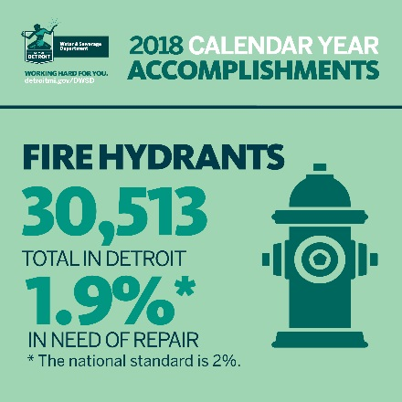
FIELD SERVICES: Fire Hydrant Maintenance
n Operating Fire Hydrants n Operating Hydrants with Issues n Non-Operating Hydrants
During the winter months, the Detroit Fire Department uses a mobile collector app to inspect the hydrants. As a result there is typically a change in hydrant maintenance status during the winter months. For instance, during the summer approximately 1% of the hydrants need some level of repair, while during this winter the figure is 1.9%.

Slide 9
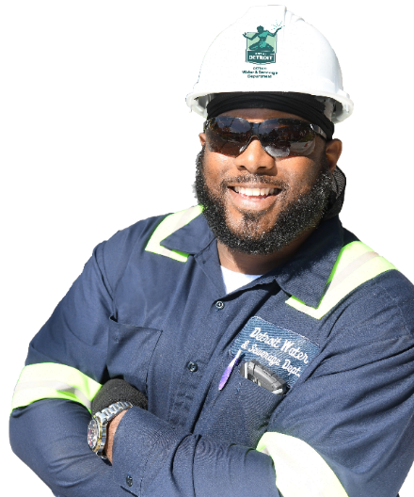
FIELD SERVICES: Running Water
n Reported by Customers n Resolved within Two Days
Running water reports include water flowing on a street, issues at vacant properties, and calls by residents who see gushing/flowing water that is out of the ordinary. This can increase during the fall/winter months due to clogged basins from leaves and dramatic temperature changes.

Slide 10
FIELD SERVICES: Water Main Breaks
n Reported by Customers n Resolved within Four Days
The increase in water main breaks is due to freezing temperatures, including the Polar Vortex near the end of January and into February. When there is a significant temperature change – hot or cold – the condition of the soil alters and shifts the pipes. DWSD has a service level agreement with contractors to have reported water main breaks repaired within four days.

Slide 11
FIELD SERVICES: Catch Basin Inspection & Cleaning
The catch basin inspection and cleaning program is on target to reach it’s 30,000 basin goal within three years (launched August 2017). Due to the efforts of the crews, DWSD is seeing a decrease in the volume of catch basin complaints.

Slide 12
Finance

Slide 13
FINANCE: Bill Collection Rate
During the winter months when DWSD does not interrupt residential water service for nonpayment, the collection rate historical decreases as households choose to pay their heating bills and catch up later with water bills. Every percentage increase in the collection rate above 80 percent is an additional $4 million which can be applied to the maintenance and rehabilitation of the water and sewer infrastructure.

Slide 14
FINANCE: Bill Collection Rate
12-Month Rolling Average Collection Rate
Every percentage increase in the collection rate above 80 percent is an additional $4 million which can be applied to the maintenance and rehabilitation of the water and sewer infrastructure.

Slide 15
FINANCE: Cash Balance
$95,350,309
Water cash balance as of February 28, 2019
$166,966,258
Sewer cash balance as of February 28, 2019
As of February 28, 2019, DWSD had 234 days of cash on hand. The target is 120 days.

Slide 16
Legal Services

Slide 17
LEGAL: Claims, Hearings and Cases
5
Property damage claims
0
Basement backup damage claims appeals
23
Dispute hearings
8
Number of cases DWSD prevailed
15
Cases handled by in-house staff
9
Cases handled by outside counsel
1
Lawsuits dismissed
$56,814
Amount in property damage claims
D/N/A
Basement backup damage claim appeals
$18,228 Total claims recommended to be paid
$193,058
Amount in dispute
$41,189
Credited to customers based on hearing outcomes
$151,869
Owed to DWSD after hearings
DWSD uses a mix of in-house and contracted legal counsel to handle damage claims, civil action for commercial delinquencies and lawsuits filed against the department.
Customers who have bill disputes may request a hearing at the City of Detroit Department of Appeals and Hearings.

Slide 18
Investigations

Slide 19
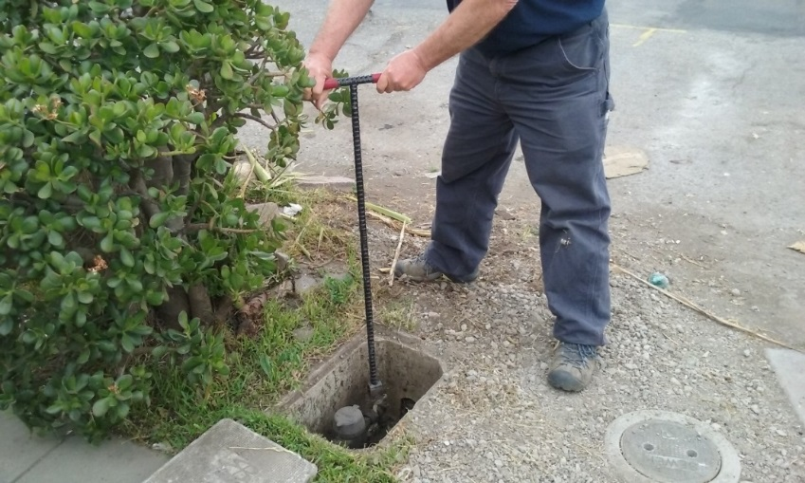
INVESTIGATIONS: Results
Money Owed to DWSD identified by Investigators
$4,611,655
Total since July 1, 2018
$1,453,184
Back billed
$1,922,856
Future owed in 12 months
$1,165,615
Water loss
1,312
[146 per month, on average]
Parcels investigated for delinquency, possible meter tampering and no meter since July 1, 2018
The DWSD Revenue Recovery Unit, in collaboration with customer service/billing, has identified more than $7 million in services owed by primarily commercial customers since its creation in August 2017. They uncovered severe delinquencies, non-working meters, unauthorized use of fire hydrants, tampering with the meters, or connected to the city’s water main without a meter and/or permit. The team works closely with the DWSD collections and legal staff.

Slide 20
Human Resources

Slide 21
HUMAN RESOURCES: Detroit Residents and Hiring
Fifty-seven percent of the DWSD workforce lives in Detroit.

Slide 22
HUMAN RESOURCES: Family Medical Leave Act

Slide 23
Public Affairs

Slide 24
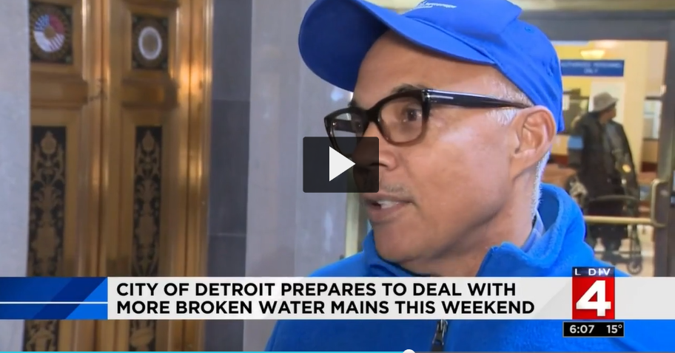
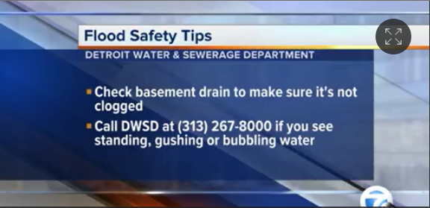
PUBLIC AFFAIRS: Positive vs. Negative News Stories
DWSD News Coverage: February 1 – February 28, 2019
This month the DWSD Public Affairs team saw a total of 503 media stories. The majority of the neutral coverage was related the Polar Vortex (a continuation from last month). One of the positive stories highlighted DWSD’s use of the DivDat kiosks. Of the stories, 9 were broadcast, 461 were print/online and 33 were radio.
PLEASE NOTE: For this metric, each story/interview published or aired is counted.

Slide 25
PUBLIC AFFAIRS: Social Media Activity
56
New Facebook Followers
7,728
Total Followers on Facebook
2,542
Engagement on Facebook
18
New Twitter Followers
1,486
Total Followers on Twitter
587
Engagement on Twitter
19
New Instagram Followers
1,093
Total Followers on Instagram
27
Engagement on Instagram
The DWSD Public Affairs team gained 93 new followers on social media in February 2019, bringing the total number of followers to 10,307. In addition to the metrics above, Facebook saw a total of 598,100 impressions and 2,886 link clicks. The top performing post on Facebook was on Feb. 21 when DWSD Auto Fleet Technician James A. was featured in the Employee Spotlight, with 217 reactions, 57 comments and a reach of 12,478. The Feb. 22 post announcing the City’s Seasonal Job Fair was the top performing post on Twitter, with 12 responses, 12 retweets and a reach of 25,481.

Slide 26
Information Technology

Slide 27
Information Technology: Application Availability
99.85%
MONTHLY AVAILABILITY 99.9% = TARGET
In the Informational Technology (IT) Group, the major projects underway are the transition from Great Lakes Water Authority (GLWA) IT shared services which includes new network, active director, BOX.com, print/fax services, IVR upgrade to the cloud, and GIS (Geographic Information System) to City of Detroit migration; launch of fleet management programs AssetWorks, FleetFocus and FuelFocus; CityWorks to replace WAM work order system; and Customer Care Web Portal phase two.

