Slide 1
Director’s Report
January 17, 2018
detroitmi.gov/dwsd

Slide 2
Table of Contents
Department Update from Director Gary Brown 3
Metrics by Function:
Customer Care 4
Field Services 18
Finance 26
Legal Services 31
Investigations 36
Human Resources 39
Public Affairs 42
Information Technology 46

Slide 3
Director‘s Update
Recent Actions and Events:
Customers can now use Amazon Alexa to ask for their water usage and account status as long as they have a registered Detroit Water and Sewerage Department (DWSD) account on the new Customer Care Web Portal (detroitmi.gov/paymywaterbill).
DWSD is the first municipal water utility in America to offer this feature.
Several positive news stories about Alexa have been aired or published in partnership with CityInsight which developed the Customer Care Web Portal.
The Capital Improvement Program pilot project in North Rosedale Park and Cornerstone Village to assess the condition of our infrastructure is well underway.
The Billing, Legal and Investigation groups continue to uncover commercial accounts that have been under-billed or have severe delinquencies; DWSD is using all available collection and legal tools.
Upcoming Actions and Events (November - December):
The Toilet Upgrade pilot, as part of DWSD’s overall Customer Assistance Programs to help address water affordability in Detroit, will launch in December with WRAP enrollees and qualifying residents of the Jefferson Chalmers neighborhood.
Direct outreach in Jefferson Chalmers will take place in December.
Wayne Metropolitan Community Action Agency is administering the pilot program.
The Community Outreach Credit program will launch, which is intended to leverage the unique position in the community of non-profit and faith-based organizations that can communicate with the public and host meetings about DWSD programs while earning bill credit for their efforts.
Public Affairs is working with the Stormwater Management Group to market and coordinate the program.
Gesu Catholic Church, which painted all the fire hydrants in the University District, is one example of a successful project that is earning bill credit.
The Board of Water Commissioners will have its next evening community meeting in January to review the proposed budget for Fiscal Year 2018-2019.
Customers Current on Bill
108,360 2.8%
Active in Payment Plans
20,583 11.7%
At-Risk for Service Interruption
6,214 188.8%
Collection Rate
Sept 30– 88.75% 0.1%
WRAP
711 Appt Backlog 17.9%
Fire Hydrant Repairs
7,683 Repaired
1,753 Backlogged 584.8%
Reports of Running Water
2,094 Reported
98% Cases Closed 2.0%
Water Main Breaks
1,067 Reported
93% Cases Closed 1.1%
Catch Basin Inspections
1,108 Active Work Orders
6,291 Cleaned & Inspected
Information Technology
3
97.24% App Availability 9.4 %

Slide 4
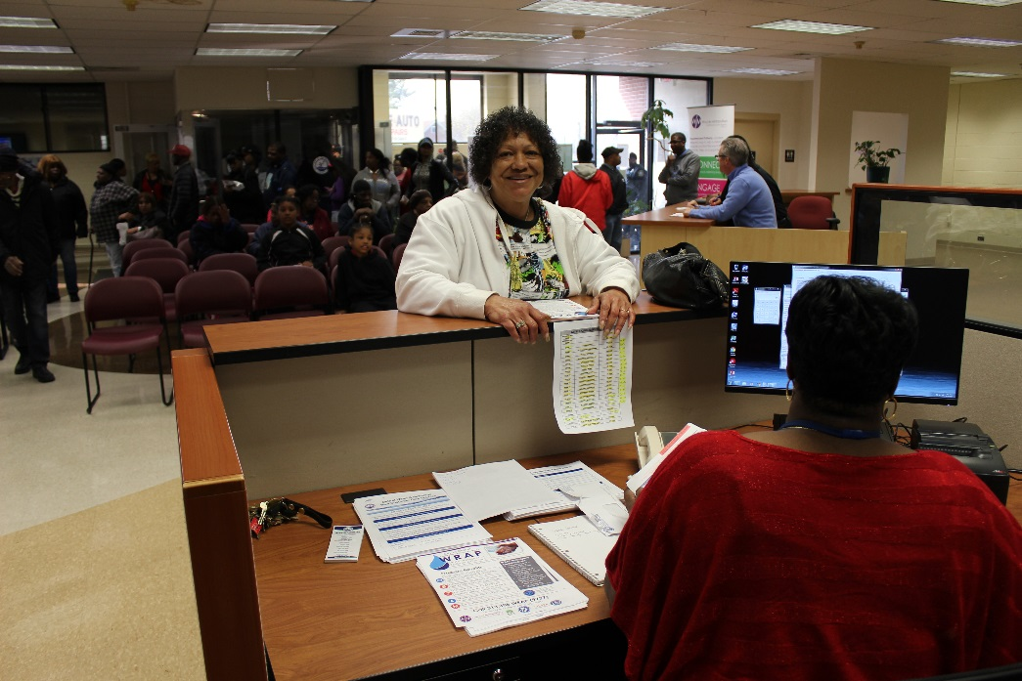
Attaching Names to Accounts
Customers Staying Connected
The Detroit Water and Sewerage Department (DWSD) recognizes that approximately 30 percent of customers encounter financial struggles. The Customer Care and Public Affairs staff has made strides this year to help residents stay connected by improving customer relations, launching assistance programs and educating Detroit residents on how to get help with their water and sewer bills.
The “Stay Connected” outreach effort publicly launched when DWSD held a press conference on April 27, followed by a Water Assistance Fair on Saturday, April 30. More than 1,400 customers came to the Eastside and Downtown locations. This was the last Saturday before shut-offs were scheduled to begin. DWSD also purchased print, radio and social media advertisements to inform customers of the fair and available options.
As a result of DWSD staff efforts, close to 5,000 residential customers who faced shut-off avoided a disconnection by entering a payment plan arrangement in May.
This report includes an update on the status of DWSD customers as of June 9, 2016.
A significant step to improve DWSD’s business practices is to attach names to water and sewer accounts. Currently, DWSD has a parcel-based billing system whereby the account remains with the property. This causes several customer relations and billing issues. The least of which is pursuing the customer for past due balances after they vacated the property. Under the new system, the account will follow the resident rather than staying with the property.
The Blue Ribbon Panel on Affordability recommended DWSD begin the process to attach names to the accounts. Attaching names to accounts is a standard utility practice used across the country.
On April 4, DWSD Customer Care staff began the process with a new policy (shown below) for establishing service. This includes residents who move into Detroit, residents who move to a new location within the city, and residents who are restoring their service.
Close to 5,000 customer accounts have names attached since the policy was launched.
Currently, the new policy does not impact the majority of DWSD customers who pay on time every month and have no intention of moving.
3

Slide 5
Customer Care
4

Slide 6
Customer Care: Account Status (all)*
*Approximately 20,000 never-been-billed parcels were added to the DWSD billing system in October 2016 as part of the Drainage Charge Program.
5

Slide 7
Customer Care: Residential Account Status*
*Approximately 20,000 never-been-billed parcels were added to the DWSD billing system in October 2016 as part of the Drainage Charge Program.
6

Slide 8
Customer Care: Residential Current on Bill*
*Approximately 20,000 never-been-billed parcels were added to the DWSD billing system in October 2016 as part of the Drainage Charge Program.
7

Slide 9
Customer Care: Appointments for Water Residential Assistance Program (WRAP)
8

Slide 10
Customer Care: Residential Payment Plans
9

Slide 11
Customer Care: Residential On the Bubble*
*Past due more than 60 days and less than $150.
10

Slide 12
Customer Care: Residential At-Risk for Service Interruption
11

Slide 13
Customer Care: Nonresidential Account Status*
*Approximately 20,000 never-been-billed parcels were added to the DWSD billing system in October 2016 as part of the Drainage Charge Program.
12

Slide 14
Customer Care: Nonresidential Current on Bill*
*Approximately 20,000 never-been-billed parcels were added to the DWSD billing system in October 2016 as part of the Drainage Charge Program.
13

Slide 15
Customer Care: Nonresidential Payment Plans
14

Slide 16
Customer Care: Nonresidential On the Bubble*
*Past due more than 60 days and less than $150.
15

Slide 17
Customer Care: Nonresidential At-Risk for
Service Interruption
16

Slide 18
Customer Care: Nonresidential At-Risk for Service Interruption*
*Customers in the “do not shut” category include nursing homes and apartment buildings.
17

Slide 19
Field Services
18

Slide 20
Field Services: Fire Hydrant Repairs
19

Slide 21
Field Services: Backlog of Inoperable Fire Hydrants
20

Slide 22
Field Services: Reports of Running Water
21

Slide 23
Field Services: Reports of Running Water
Completion Rate within TWO Days
22

Slide 24
Field Services: Water Main Repairs
23

Slide 25
Field Services: Water Main Repairs
Completion Rate within FOUR Days
24

Slide 26
Field Services: Catch Basin Inspections*
*Figures are for the 2017 calendar year through October 31, 2017.
25

Slide 27
Finance
26

Slide 28
Finance: Collection Rate*
*The long-term collection rate below the 90% target is temporary as it dips in non-shutoff months and the months immediately following.
27

Slide 29
Finance: Cash Flow Status
28

Slide 30
Finance: Water Revenue
29

Slide 31
Finance: Sewer Revenue
30

Slide 32
Legal Services
31

Slide 33
Legal: FOIA Requests
32

Slide 34
Legal: Lawsuits Filed for Delinquent Debt*
*A total of three cases have been filed.
33

Slide 35
Legal: Cases
34

Slide 36
Legal: Claims
35

Slide 37
Investigations
36

Slide 38
Investigations: Cases
37

Slide 39
Investigations: Unpaid Revenue Identified
*A total of three cases have been filed.
38

Slide 40
Human Resources
39

Slide 41
HR: Family Medical Leave Act
Applications
Timeframe Request
DWSD Unit
40

Slide 42
HR: Retirement Eligible
DWSD
Employees
Total Eligible
for
Retirement
25+ Years of
Service
60+ Years Old
60+ Years Old &
10 or More Years of Service
41

Slide 43
Public Affairs
42

Slide 44
Public Affairs: News Media Placements
43

Slide 45
Public Affairs: Social Media Followers
44

Slide 46
Public Affairs: Community Engagement Activities
45

Slide 47
Information Technology
46

Slide 48
Information Technology: Software Application Availability for Customer Care,
Field Services and Finance
47

