Slide 1
Director’s Report
Customers Current on DWSD Bills
TBD (data will be aggregated)
Active in Payment Plans
34,594 7.4%
Customers Shut-Off Eligible
11,862 51.2%
Customer AMR Meters
Repaired/Replaced TBD
Collection Rate
April 30 – 73.8% 1.9%
WRAP
815 277.2%
Fire Hydrant Repairs
5,333 Repaired
288 Backlogged 14.1%
Reports of Running Water
1,390 Reported
98% Cases Closed 2.0%
Water Main Breaks
559 Reported
91% Cases Closed 9.0%
Catch Basin Repairs
July 20, 2016
1,096 Reported
77% Cases Closed 146.0%
Customer Dispute Resolutions
% of Cases Closed TBD
Information Technology
App Availability 0.42%

Slide 2
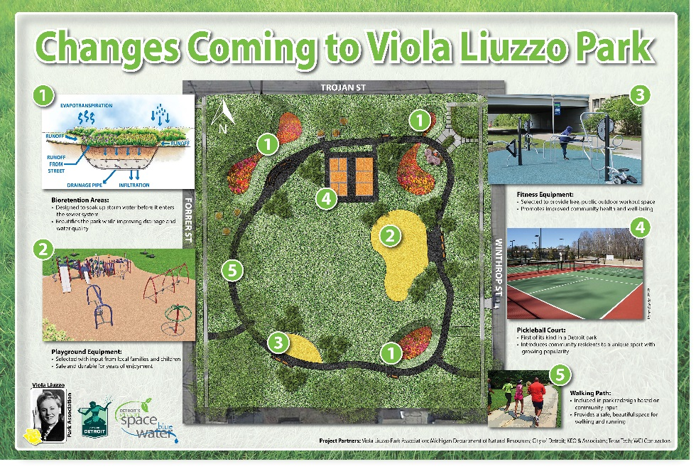
Viola Liuzzo Park Revitalization to Include Three Bioretention Gardens
Drainage Outreach Efforts Begin; First Phase is Never-Been-Billed Customers
Beginning in October, the Detroit Water and Sewerage Department (DWSD) will start billing more than 25,000 previously unbilled properties a monthly drainage charge. This effort is the first phase of an 18-month initiative designed to transition all customer properties to a common rate basis, and ensure more fair and accurate billing across property classes.
Since 1975, DWSD has charged most customers for drainage services as part of their water and sewer bills. Customers and parcels not currently billed for drainage will be charged based on a common rate of $750 per impervious acre per month and each parcel’s amount of impervious cover. Impervious surfaces are roofs, pavement and similar hard surfaces that prevent or limit the ability of stormwater to soak into the ground. Newly billed customers and parcels will not be back-billed for Drainage services provided to date. Over the next 18 months, all existing properties will be transitioned to the common rate - impervious acreage basis. Existing customers will continue to be billed at current rates until their property class migrates to the new rate basis.
A Detroit neighborhood park named in honor of a fallen Detroit civil rights champion is being completely redone this summer. The City will spend nearly $1 million as part of Mayor Mike Duggan’s $12 million “40 Neighborhood Parks Initiative” to redesign Viola Liuzzo Park on the City’s northwest side and install an array of new features and equipment. DWSD will create beautiful bio-retention gardens to enhance the appearance of the park and reduce storm water runoff in the surrounding neighborhood.
The groundbreaking was held on Tuesday, July 12, 2016, led by Mayor Mike Duggan with participation from the Viola Liuzzo Park Association, the Parks and Recreation Department, the General Services Department, and DWSD.
Liuzzo, a Detroiter and mother of five, was shot and killed in March 1965 as she and fellow civil rights activists returned from a rally in Montgomery, Alabama. The City of Detroit dedicated Liuzzo Park in her honor in 1982.
DWSD Dashboard: July 20, 2016

Slide 3
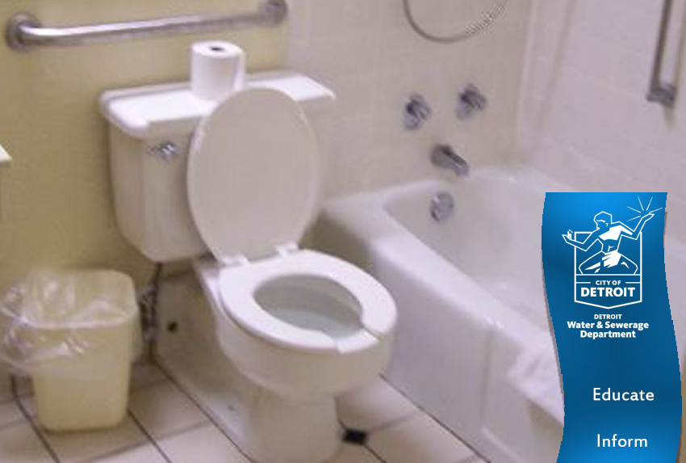
Educating Detroiters on Monitoring Household Water Usage
Lead and Copper Testing Outreach Began this Month
The Detroit Water and Sewerage Department (DWSD) recognizes that approximately 30 percent of customers encounter financial struggles. The Customer Care and Public Affairs staff has made strides this year to help residents stay connected by improving customer relations, launching assistance programs and educating Detroit residents on how to get help with their water and sewer bills.
The “Stay Connected” outreach effort publicly launched when DWSD held a press conference on April 27, followed by a Water Assistance Fair on Saturday, April 30. More than 1,400 customers came to the Eastside and Downtown locations. This was the last Saturday before shut-offs were scheduled to begin. DWSD also purchased print, radio and social media advertisements to inform customers of the fair and available options.
As a result of DWSD staff efforts, close to 5,000 residential customers who faced shut-off avoided a disconnection by entering a payment plan arrangement in May.
This report includes an update on the status of DWSD customers as of June 9, 2016.
The US Water Alliance held the #OneWater16 Summit in Atlanta, Georgia on June 8-10. The Alliance is a trade association for water utilities and related businesses, foundations and non-profits which “advances policies and programs that build a sustainable water future for all.” Director Gary Brown and Deputy Director/Chief Engineer Palencia Mobley participated.
Director Brown spoke about water and affordability during a workshop. His presentation was on how DWSD is improving customer service to reduce service disconnections for delinquent accounts and alter the water shut-off narrative in Detroit by placing more residents into payment plan arrangements. He challenged the summit attendees to find a more generous assistance plan in America than the Water Residential Assistance Program (WRAP) which was launched on March 1.
Deputy Director Mobley participated in a green infrastructure workshop. DWSD and the City will place more emphasis on green infrastructure to reduce the amount of storm water in the combined sewer system. The City of Detroit is well positioned to be a national leader in this area.
Water utility conferences, such as the US Water Alliance Summit, are beneficial to learning innovation from others and sharing DWSD success stories.
DWSD Dashboard: July 20, 2016

Slide 4
Customer Care
DWSD Dashboard: July 20, 2016

Slide 5
Customer Care: Account Status (all customers)
DWSD Dashboard: July 20, 2016

Slide 6
Customer Care: Account Status (residential)
DWSD Dashboard: July 20, 2016

Slide 7
Customer Care: Current (residential)
DWSD Dashboard: July 20, 2016

Slide 8
Customer Care: WRAP
DWSD Dashboard: July 20, 2016

Slide 9
Customer Care: Payment Plan Arrangements (residential)
DWSD Dashboard: July 20, 2016

Slide 10
Customer Care: On the Bubble (residential 60 days & $150 past due)
DWSD Dashboard: July 20, 2016

Slide 11
Customer Care: Shut-Off Eligible (residential)
DWSD Dashboard: July 20, 2016

Slide 12
Customer Care: Meter Operations* (residential)
*These figures are from the April 2016 report and will be updated in the July report. The number of AMR meters which are malfunctioning and the number which have been repaired will be included in future reports as well.
DWSD Dashboard: July 20, 2016

Slide 13
Customer Care: Account Status* (commercial)
DWSD Dashboard: July 20, 2016

Slide 14
Customer Care: Current (commercial)
DWSD Dashboard: July 20, 2016

Slide 15
Customer Care: Payment Plan Arrangements (commercial)
DWSD Dashboard: July 20, 2016

Slide 16
Customer Care: On the Bubble (commercial 60 days & $150 past due)
DWSD Dashboard: July 20, 2016

Slide 17
Customer Care: Shut-Off Eligible (commercial)
DWSD Dashboard: July 20, 2016

Slide 18
Customer Care: Meter Operations* (commercial)
*These figures are from the April 2016 report and will be updated in the July report. The number of AMR meters which are malfunctioning and the number which have been repaired will be included in future reports as well.
DWSD Dashboard: July 20, 2016

Slide 19
Finance
DWSD Dashboard: July 20, 2016

Slide 20
Finance: Collection Rate*
*The long-term collection rate below the 90% target is likely temporary as it dips in non-shutoff months and the months immediately following. Customer Care has improved collections as indicated in the customer account data shown on previous pages.
DWSD Dashboard: July 20, 2016

Slide 21
Finance: Cash Flow Status*
*Cash flow statement is pro forma. DWSD lacks certain data to perform a full reconciliation. Unreconciled balance as of April 30, 2016 approximates $4 million (actual cash approximates $49 million versus $45 million combined cash from cash flow statement).
DWSD Dashboard: July 20, 2016

Slide 22
Finance: Commodity Volumes
DWSD Dashboard: July 20, 2016

Slide 23
Finance: Equivalent Accounts
DWSD Dashboard: July 20, 2016

Slide 24
Field Services
DWSD Dashboard: July 20, 2016

Slide 25
Field Services: Fire Hydrant Repairs
DWSD Dashboard: July 20, 2016

Slide 26
Field Services: Backlog of Inoperable Fire Hydrants
DWSD Dashboard: July 20, 2016

Slide 27
Field Services: Reports of Running Water
DWSD Dashboard: July 20, 2016

Slide 28
Field Services: Reports of Running Water
Completion Rate within TWO Days
DWSD Dashboard: July 20, 2016

Slide 29
Field Services: Water Main Repairs
DWSD Dashboard: July 20, 2016

Slide 30
Field Services: Water Main Repairs
Completion Rate within FOUR Days
DWSD Dashboard: July 20, 2016

Slide 31
Field Services: Catch Basins
Close to 95,000 catch basins in the city
Five trucks to clean catch basins – same trucks used to clean sewers
Priority 1: Water in basement complaint investigation; cleaning/repair
Priority 2: Clogged catch basin investigation; cleaning/repair
DWSD Dashboard: July 20, 2016

Slide 32
Field Services: Catch Basins
DWSD Dashboard: July 20, 2016

Slide 33
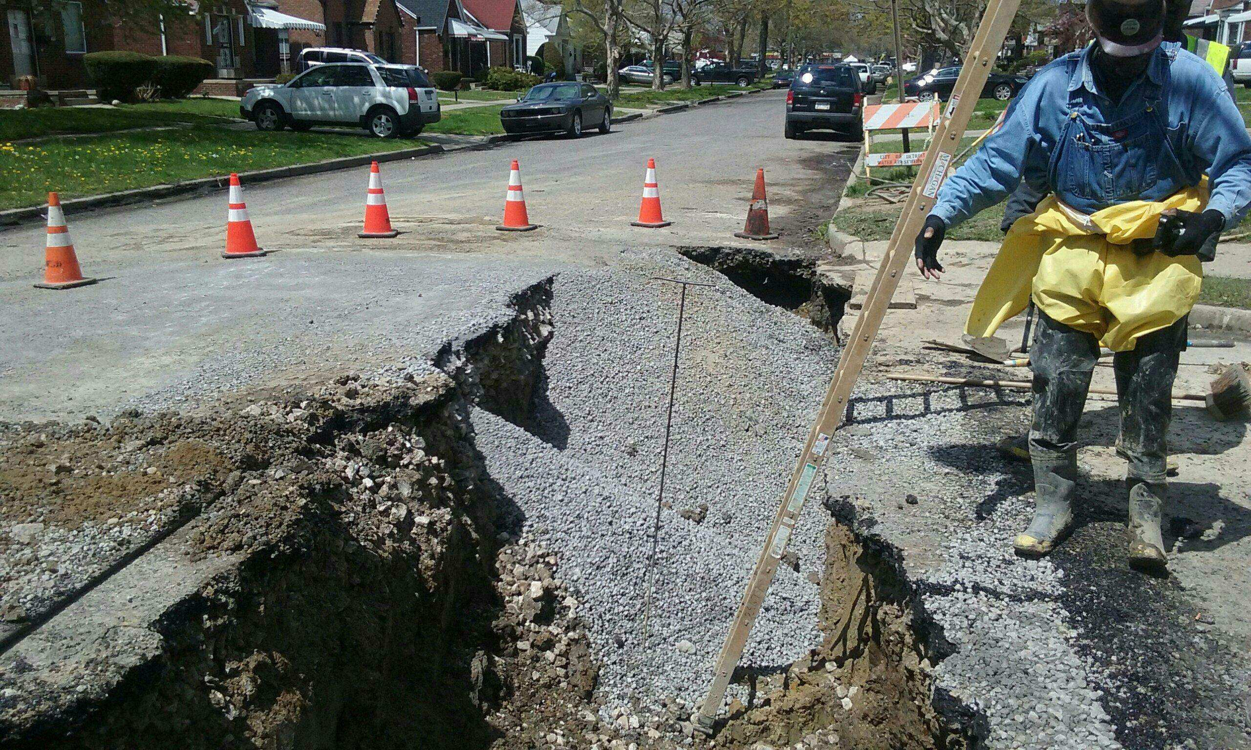
Field Services: Catch Basin Repair (Beginning)
DWSD Dashboard: July 20, 2016

Slide 34
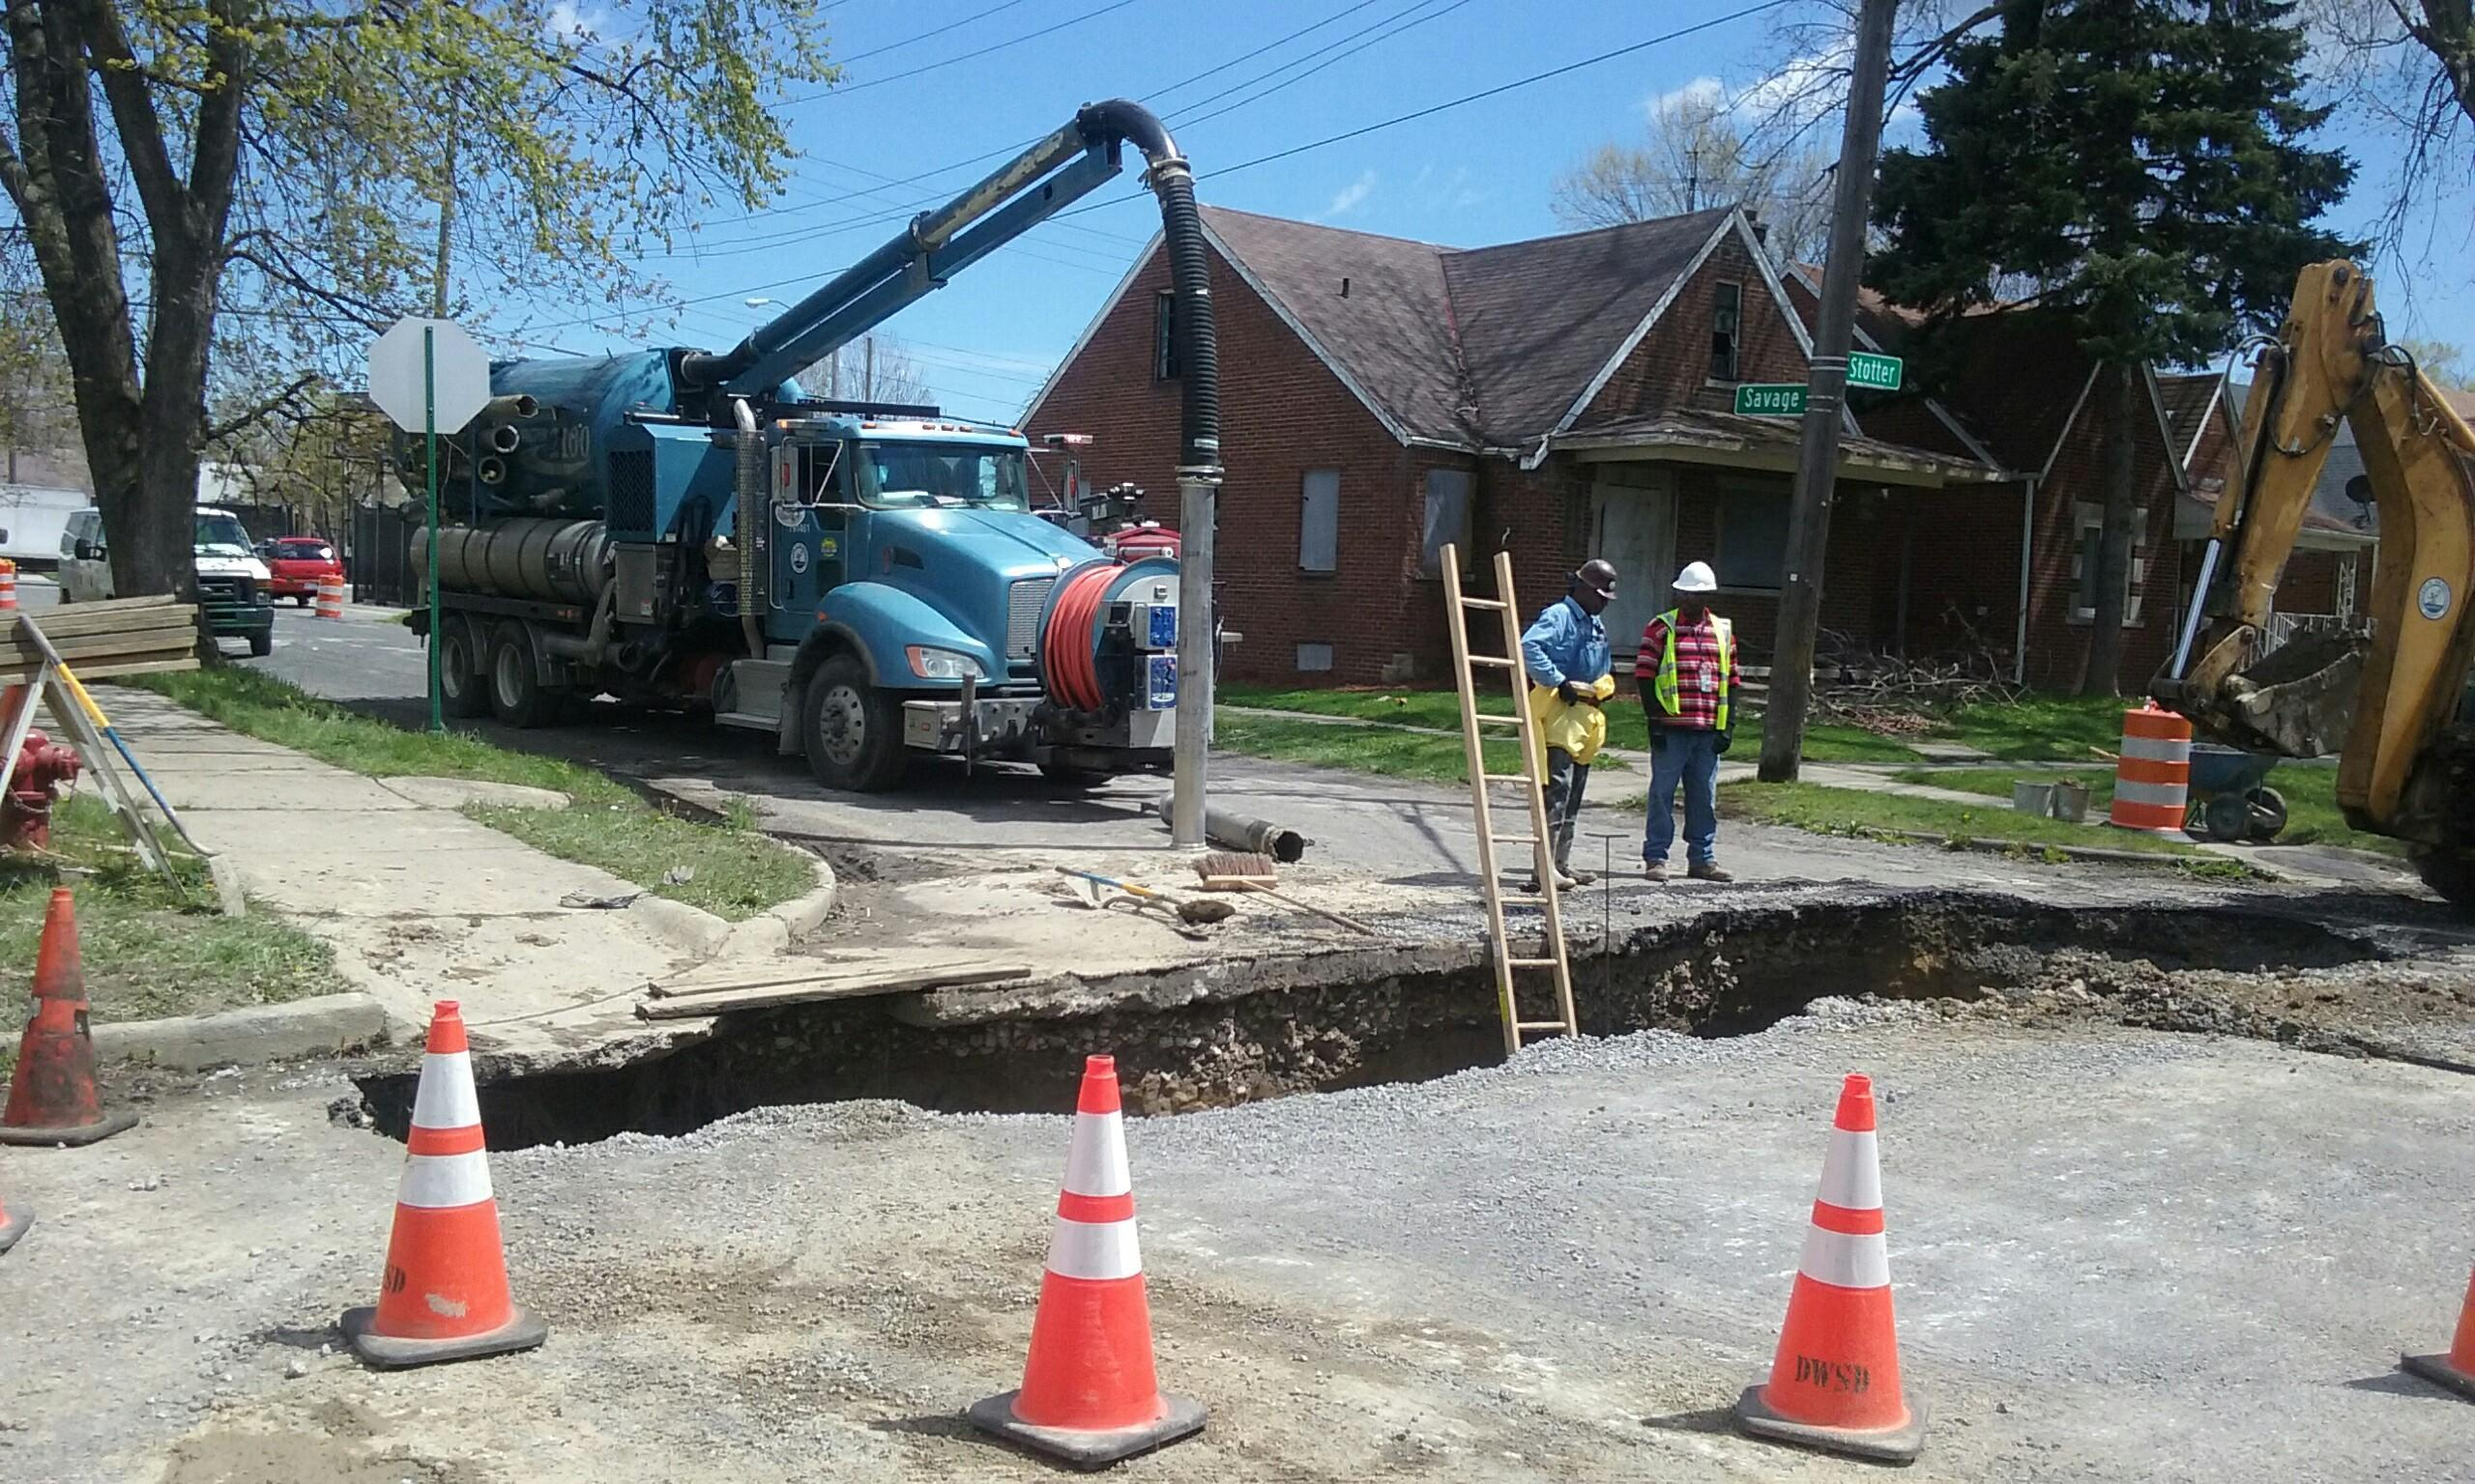
Field Services: Catch Basin Repair (During)
DWSD Dashboard: July 20, 2016

Slide 35
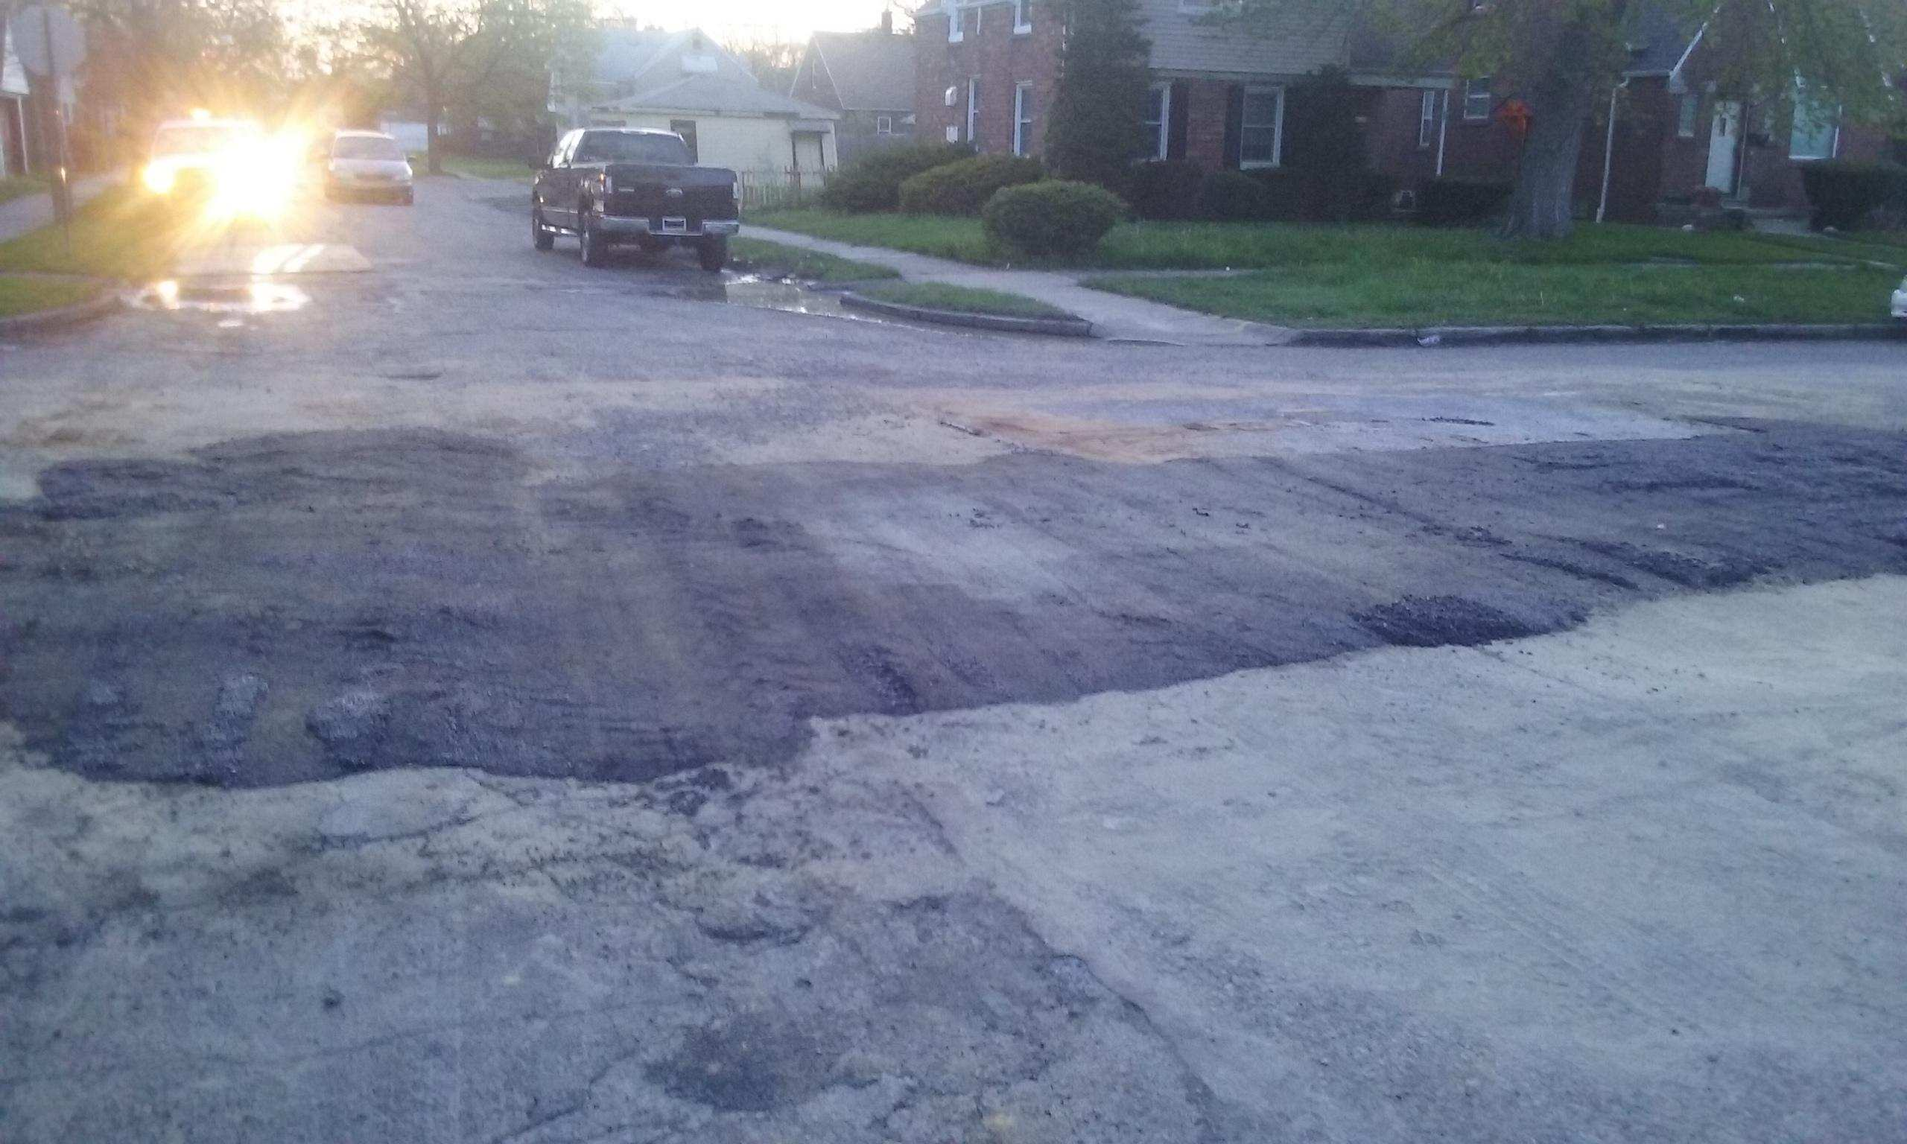
Field Services: Catch Basin Repair (Completed)
DWSD Dashboard: July 20, 2016

Slide 36
Legal Services
DWSD Dashboard: July 20, 2016

Slide 37
Legal: Customer Dispute Resolutions
The DWSD legal team is going through reorganization – data will be shared in future reports.
DWSD Dashboard: July 20, 2016

Slide 38
Public Affairs
DWSD Dashboard: July 20, 2016

Slide 39
Public Affairs: News Media Placements
DWSD Dashboard: July 20, 2016

Slide 40
Public Affairs: Social Media Reach
DWSD Dashboard: July 20, 2016

Slide 41
Public Affairs: Community Engagement Activities
DWSD Dashboard: July 20, 2016

Slide 42
Information Technology
DWSD Dashboard: July 20, 2016

Slide 43
IT: Software Application Availability for Customer Care, Field Services and Finance
DWSD Dashboard: July 20, 2016

