Slide 1
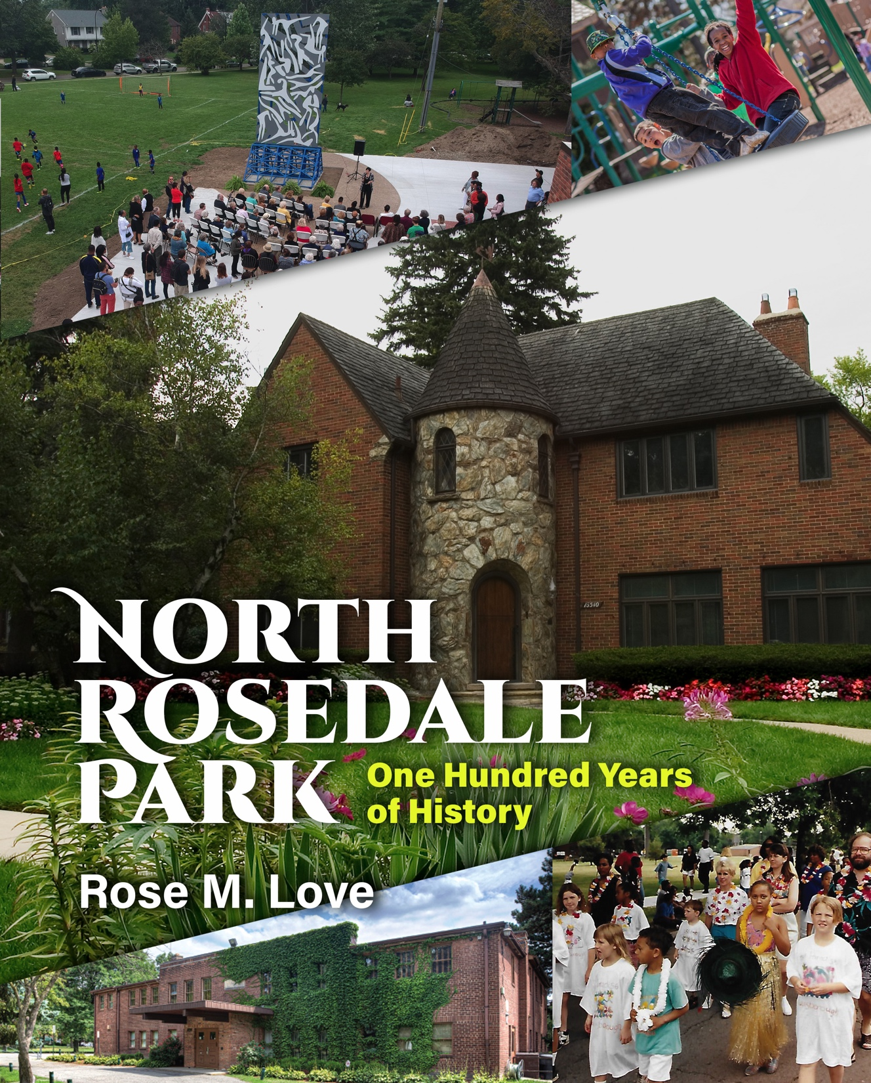
North Rosedale Park, One Hundred Years of History
The book takes the reader on an amazing journey of how North Rosedale Park, one of Detroit’s premier neighborhoods, came to be and all that’s happened since 1919. Starting with the early days of the pioneers, the book traces the people, organizations and activities that shaped North Rosedale Park over a century and made it the preferred neighborhood for many of Detroit’s leaders and one of the top ten neighborhoods in southeastern Michigan.

Slide 2
Subdivision platted in 1919, an extension of Rosedale Park (1916), by H.D. Shelden Sons.
Boundaries – Southfield (east), Grand River (south), Evergreen (west) and McNichols (north)
Roughly 1700 homes
Part of Grandmont Rosedale area
North Rosedale Park Facts

Slide 3
How the Book Came to Be
Learned North Rosedale Park turned 100 in 2019
Proposed centennial celebration including history book based on a similar book written for Sherwood Forest’s centennial
Organized Book Committee to assist with research and verifying information
Developed list of current and former residents to interview
Began research (Sources: Redford Historical Society, Rosedale Tattler, newspapers.com, resident interviews etc.).
Found treasure trove of information at the Community House

Slide 4
Things I Learned or Were Reminded Of
Whatever time you allot for a project, double it. I need a deadline.
Life is cyclical. There are no new things under the sun.
Detroit is a city of strong neighborhoods.
Progress is made when individuals work together to achieve a goal.
North Rosedale residents refused to take no for an answer.
Kids can be a mess.
North Rosedale was not immune from crime, vacant homes and decreased engagement, but committed residents kept the ship upright.

Slide 5
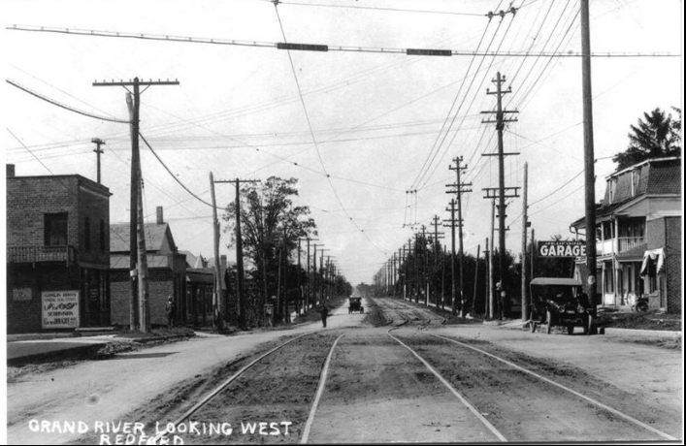
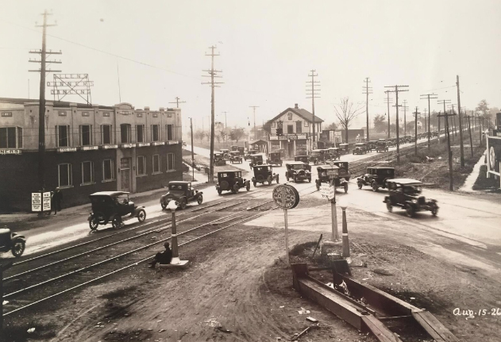
North Rosedale Park was once part of Redford Township. In 1925, residents in Rosedale Park, Brightmoor and Five Points voted in favor of annexation to Detroit.
Early North Rosedale Park
Grand River & Seven Mile Road, 1926
Grand River Avenue looking west

Slide 6
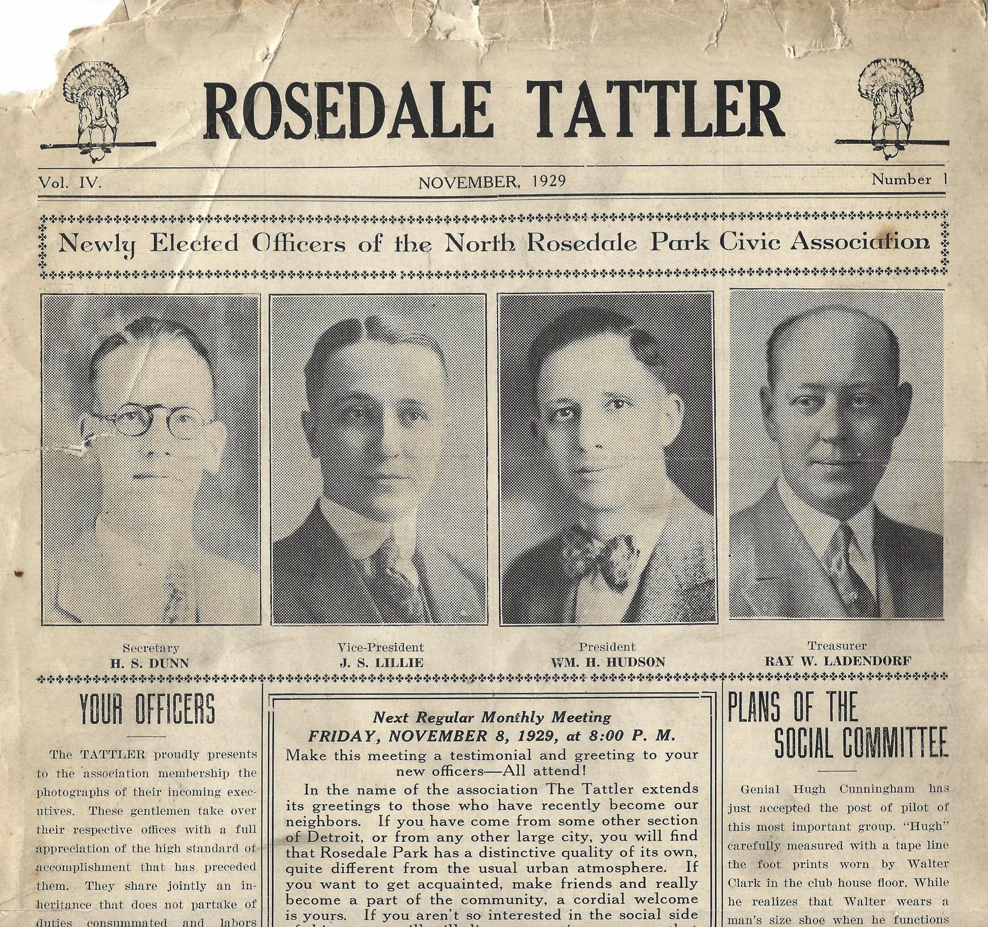
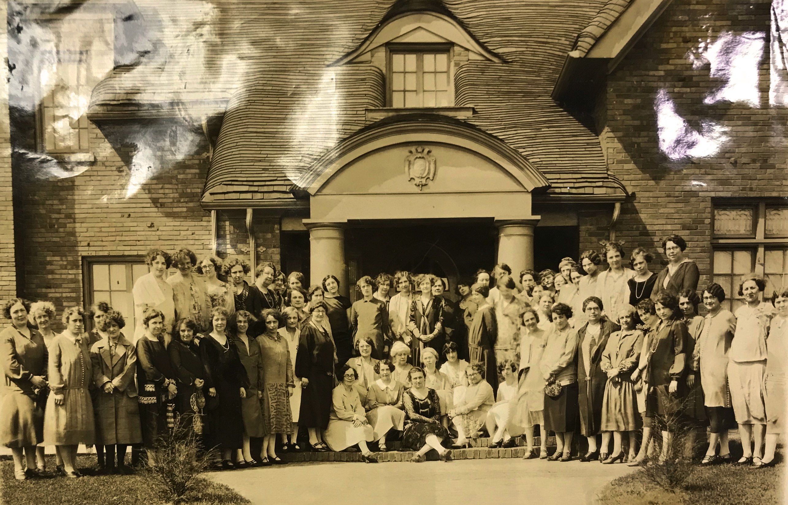
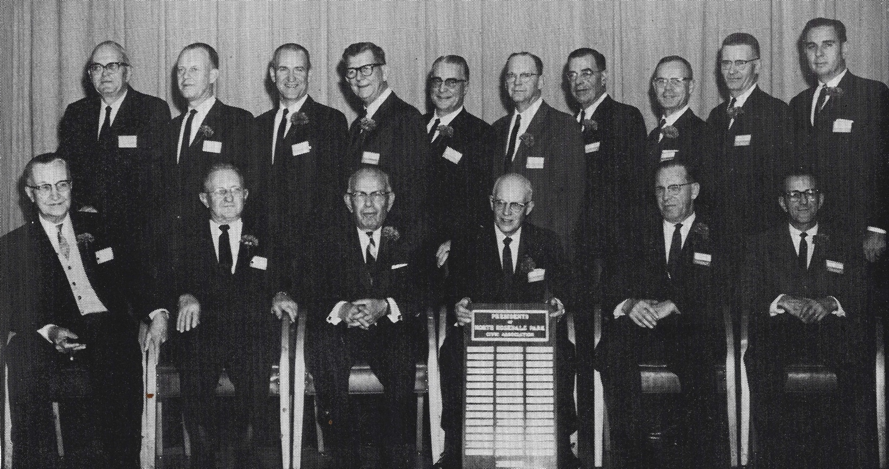
North Rosedale Park
Rosedale Park Woman’s Club was incorporated in 1923
Monthly newspaper started in 1926
North Rosedale Park Civic Association, started in 1923, was an all-male organization until women were admitted in 1972.

Slide 7
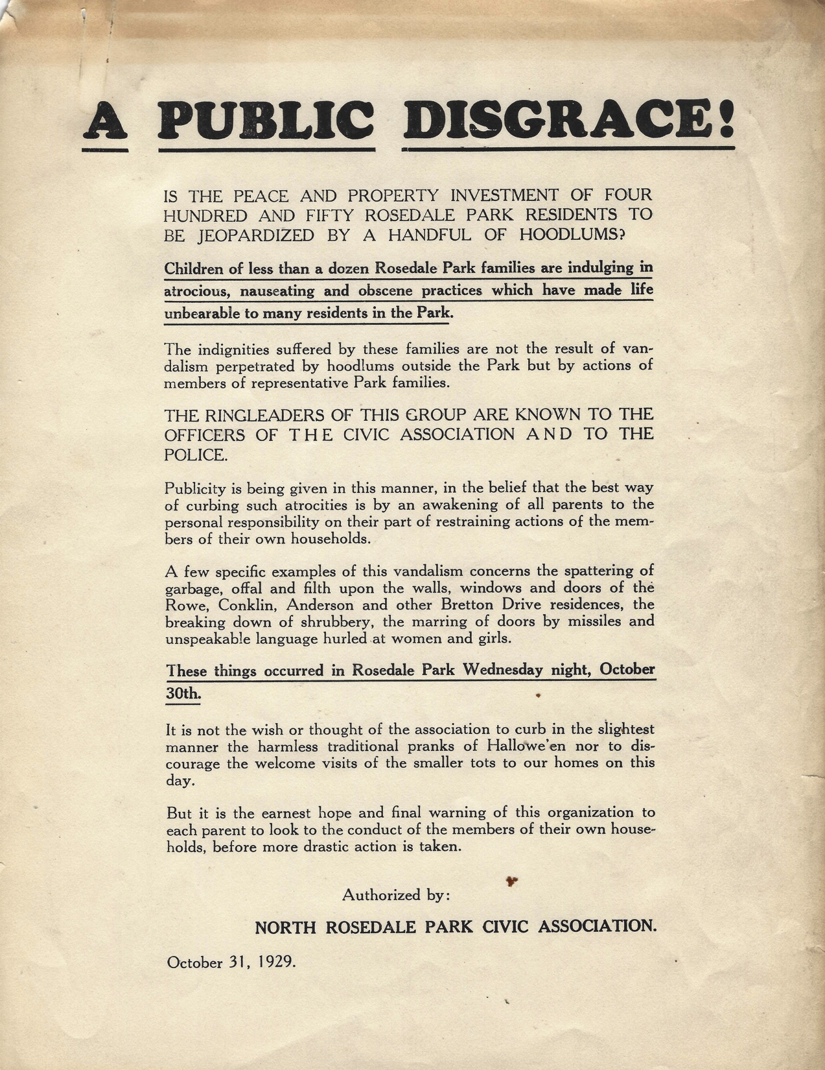
The Good Ol’ Days???
Like many all-white communities across the United States, North Rosedale Park fought to keep things just the way they were – allowing only certain types of people to move in and urging residents to keep race restrictions in place.
There was vandalism and a lot of it.

Slide 8
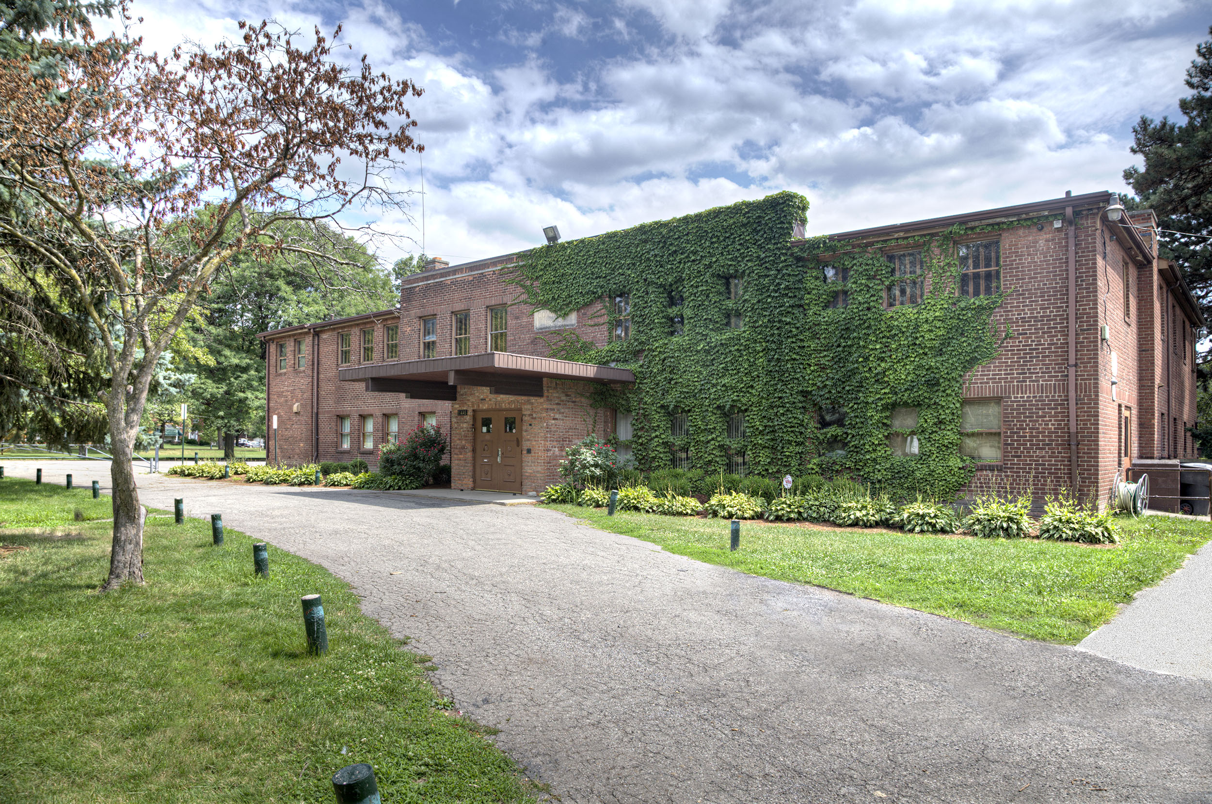
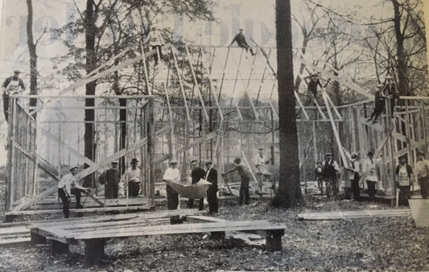
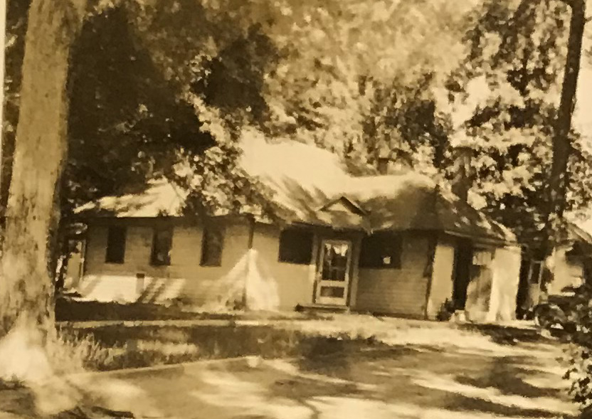
The only neighborhood in Detroit with its own Community House and park – the center of activity in the neighborhood.
What Makes North Rosedale Park Unique?
Replaced by the Community House built in 1939
Clubhouse built in 1924

Slide 9
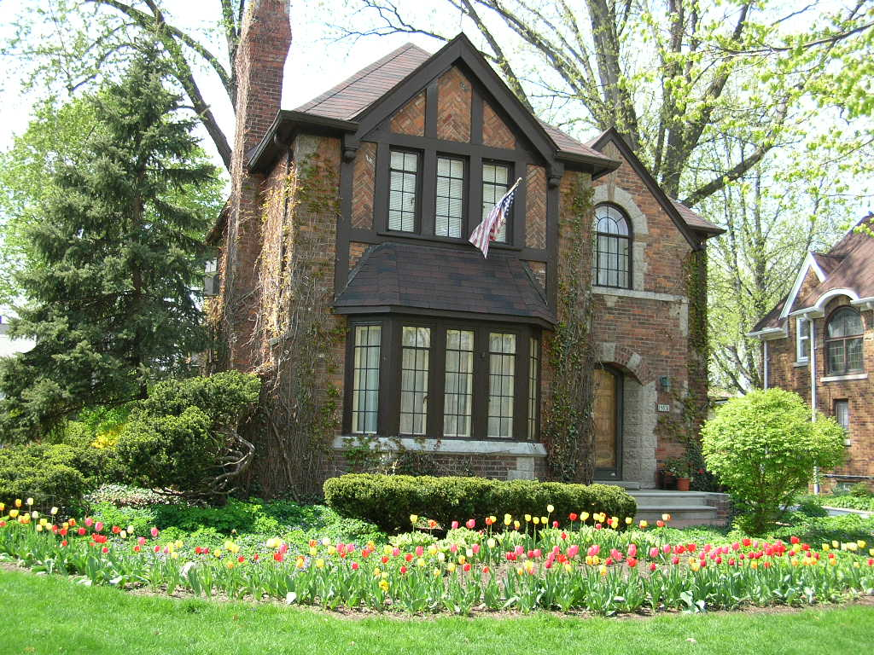
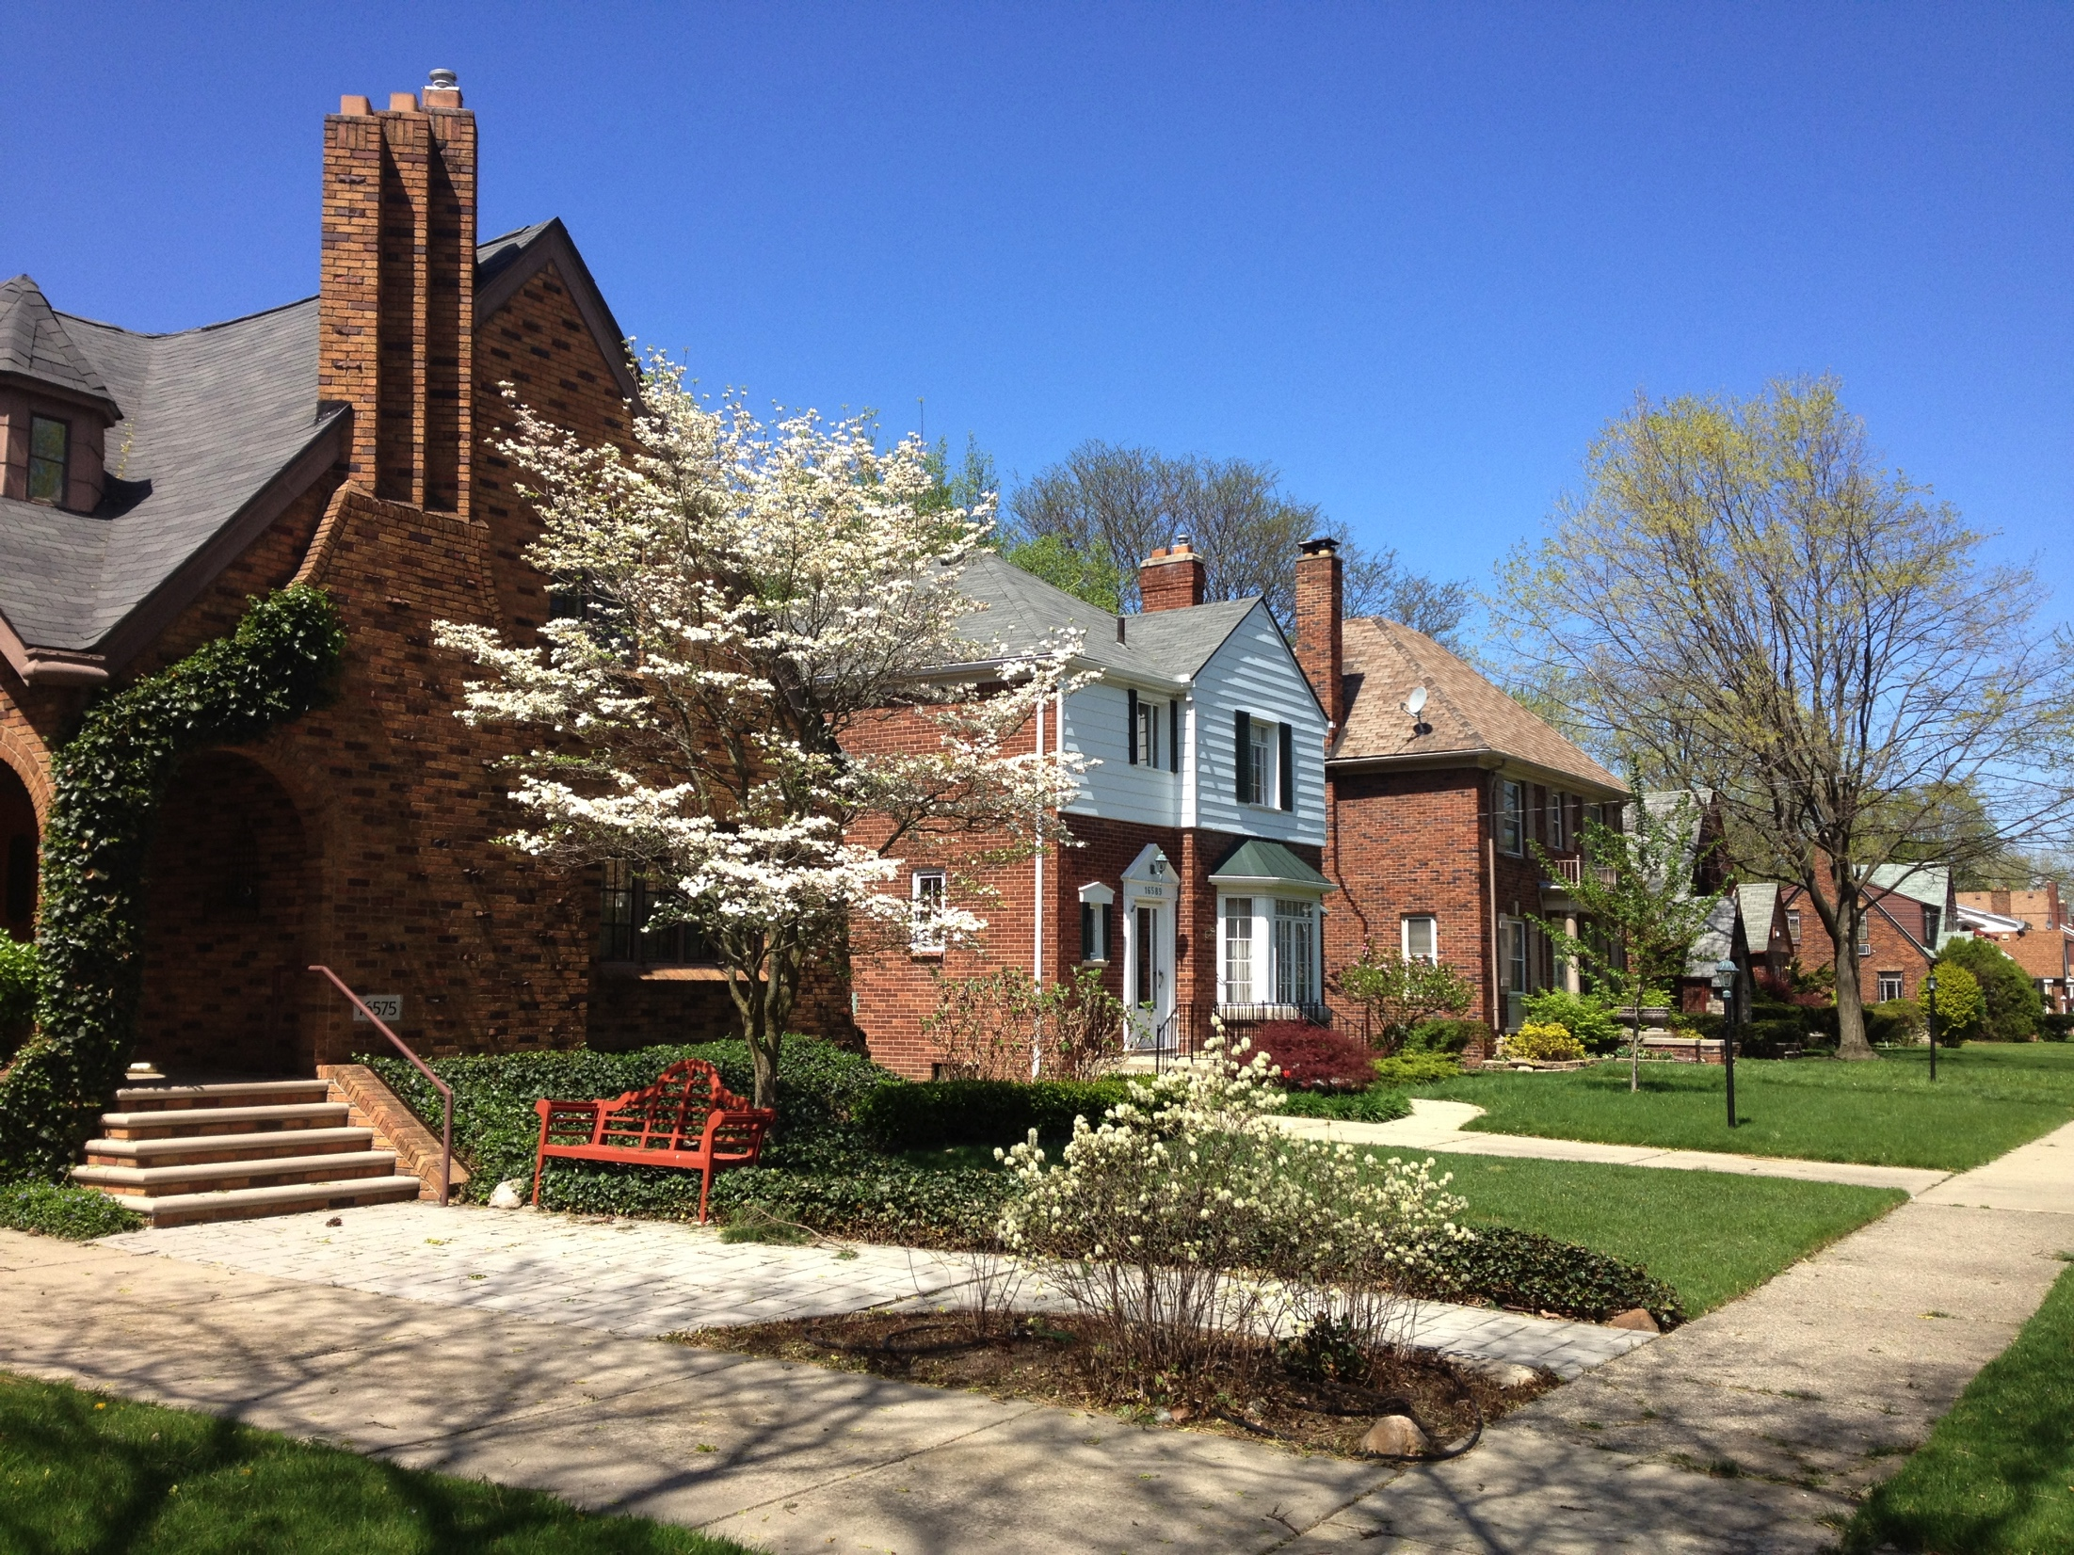
Homes with Beautiful Architecture
What is North Rosedale Park Known For?

Slide 10
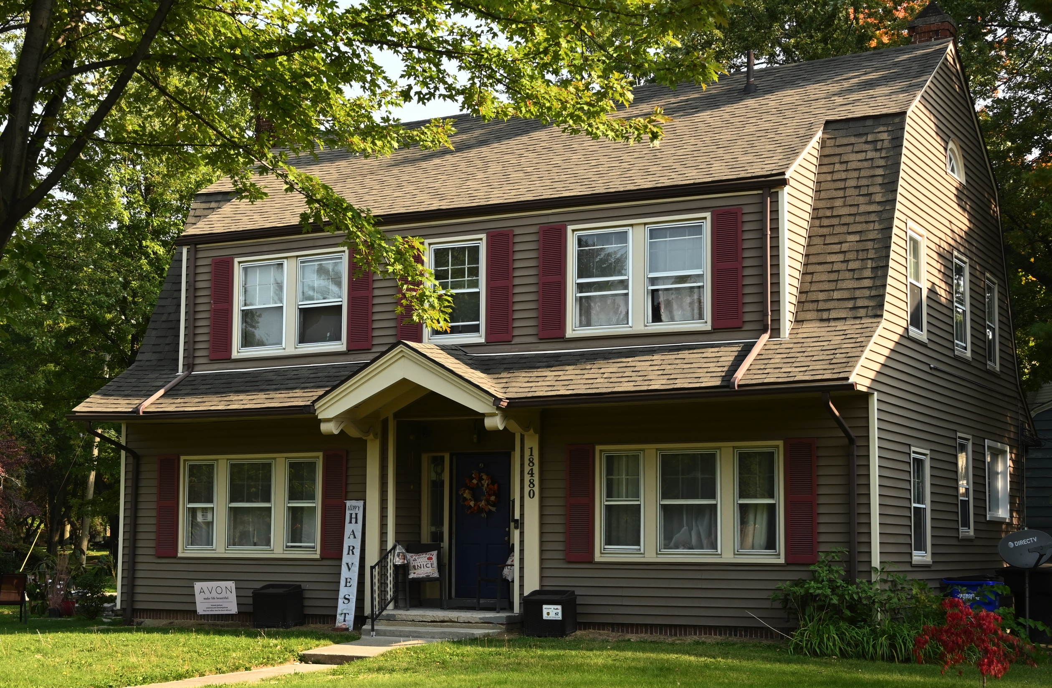
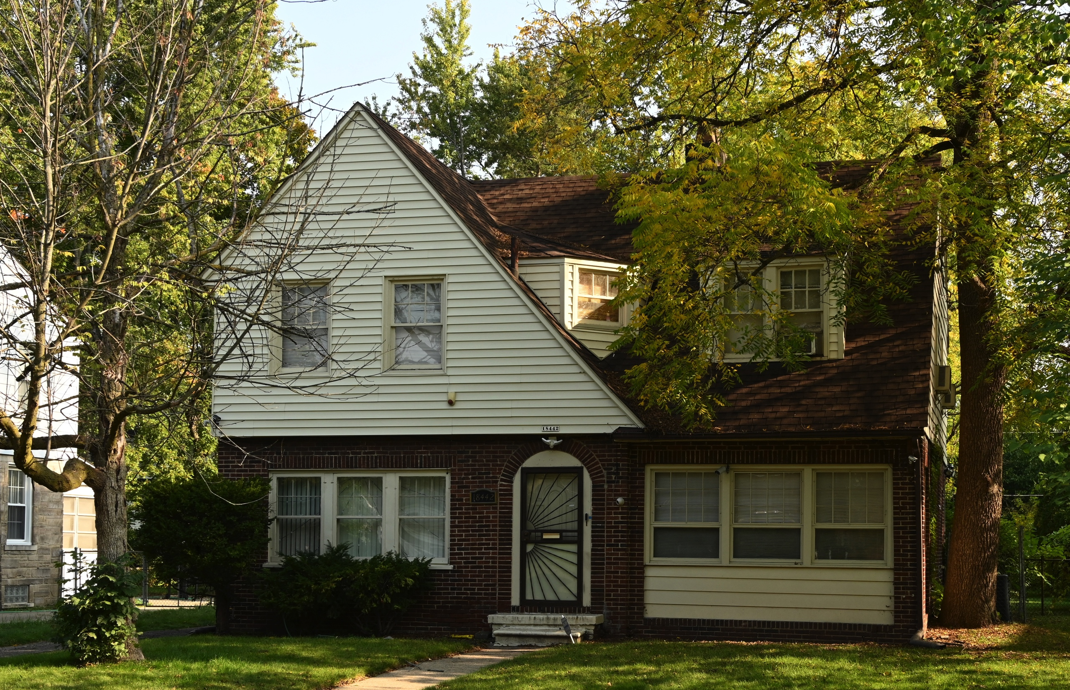
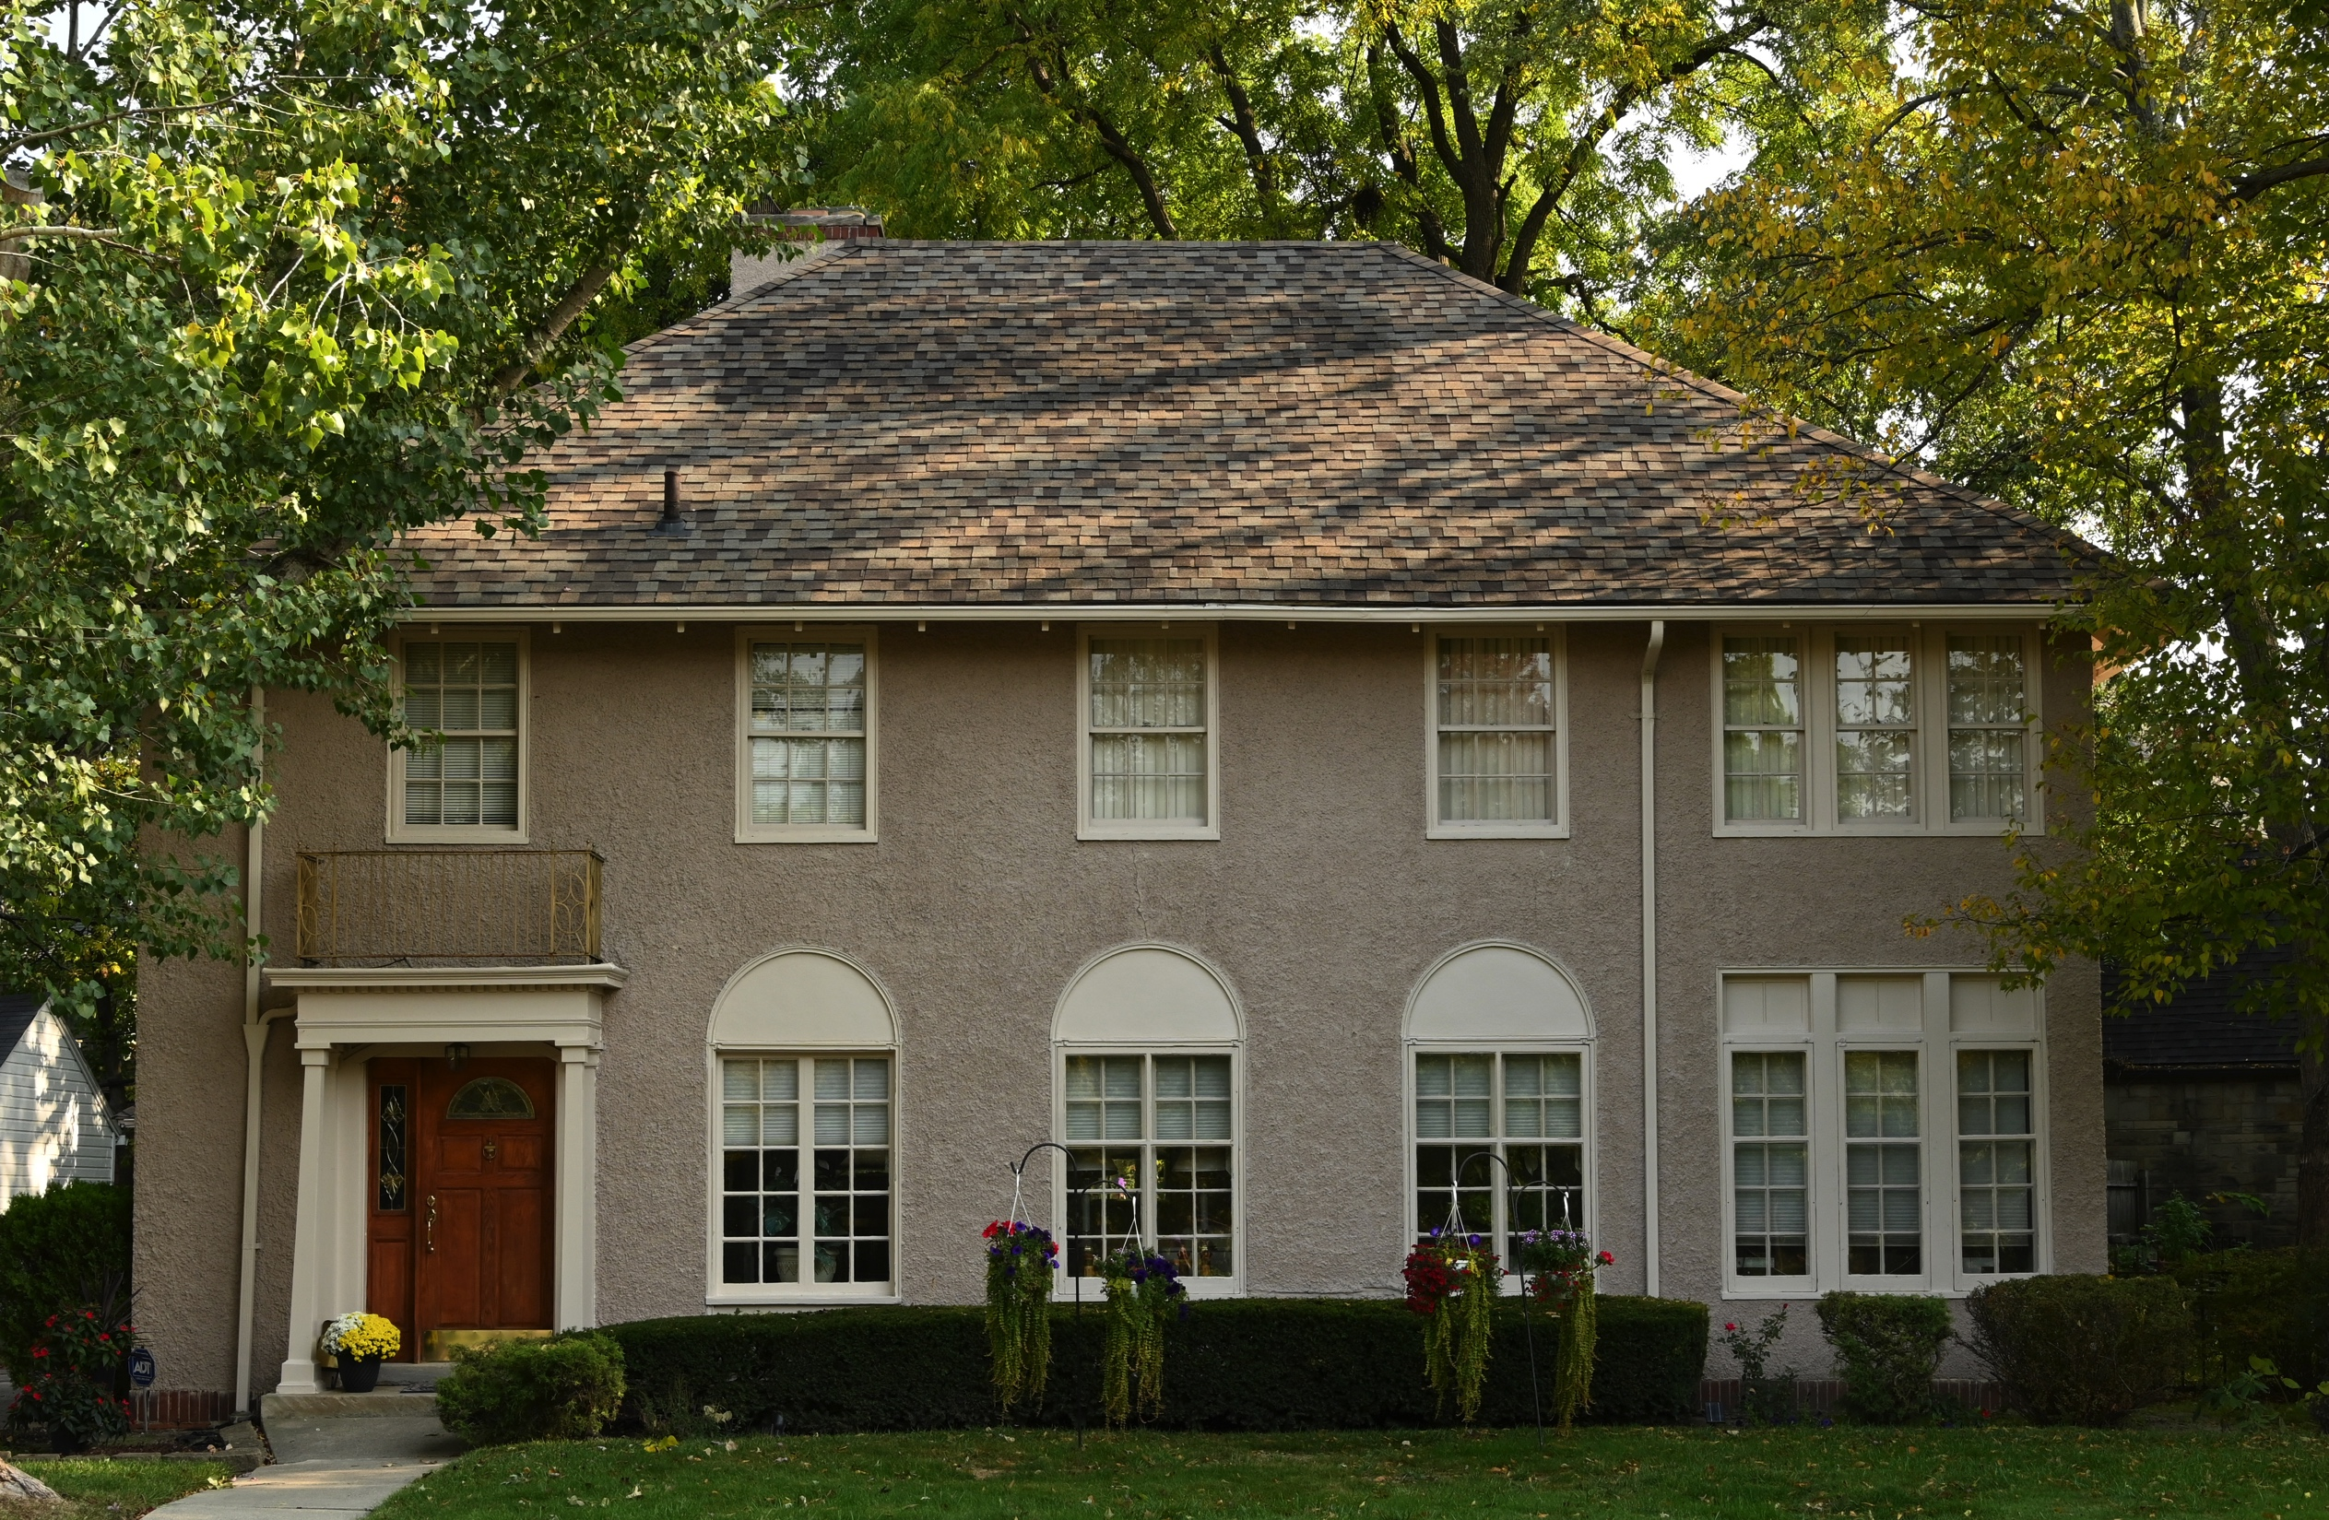
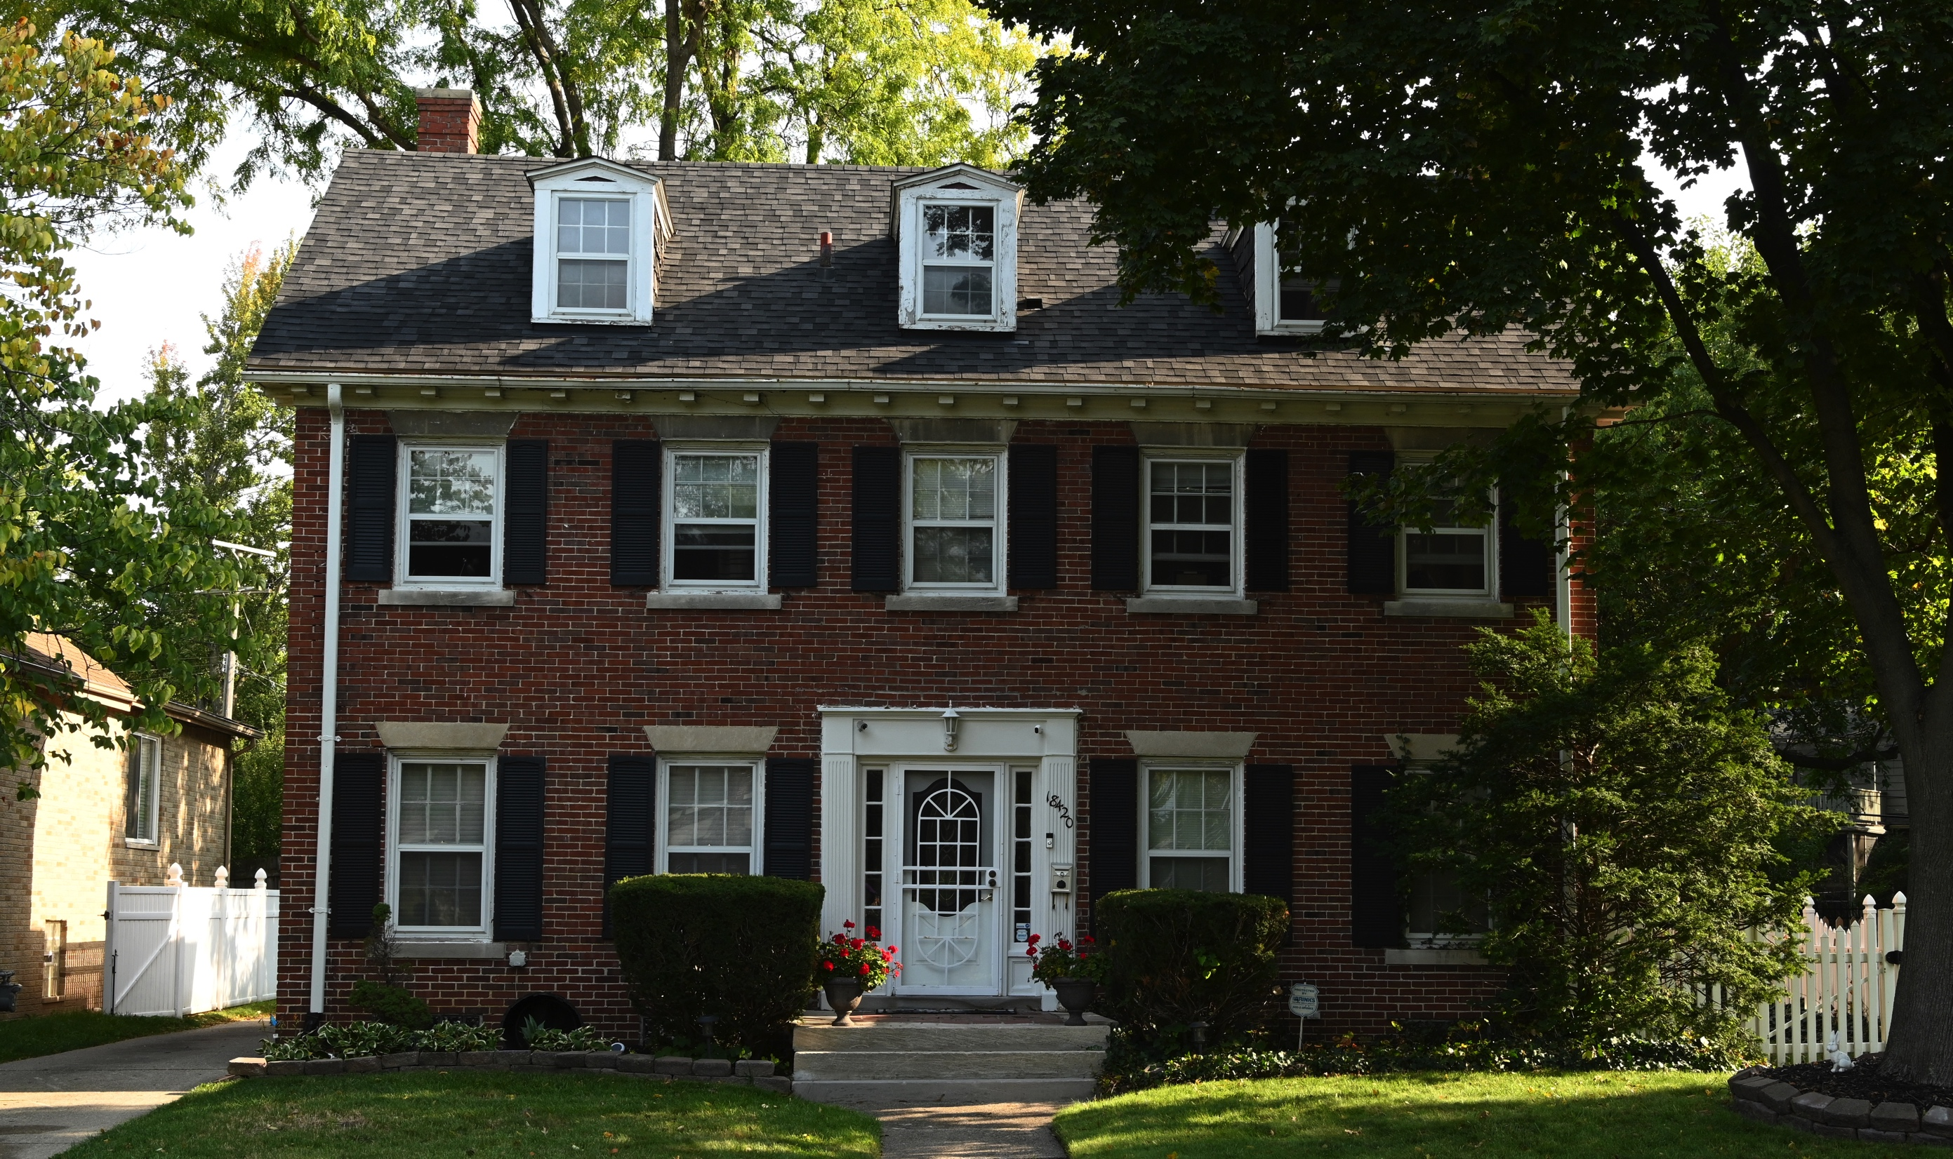
First Four Homes Built in the Park circa 1919
North Rosedale Park
All four homes on Bretton Drive

Slide 11
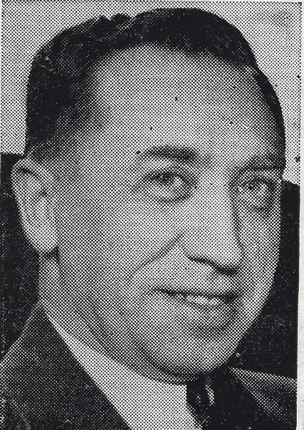
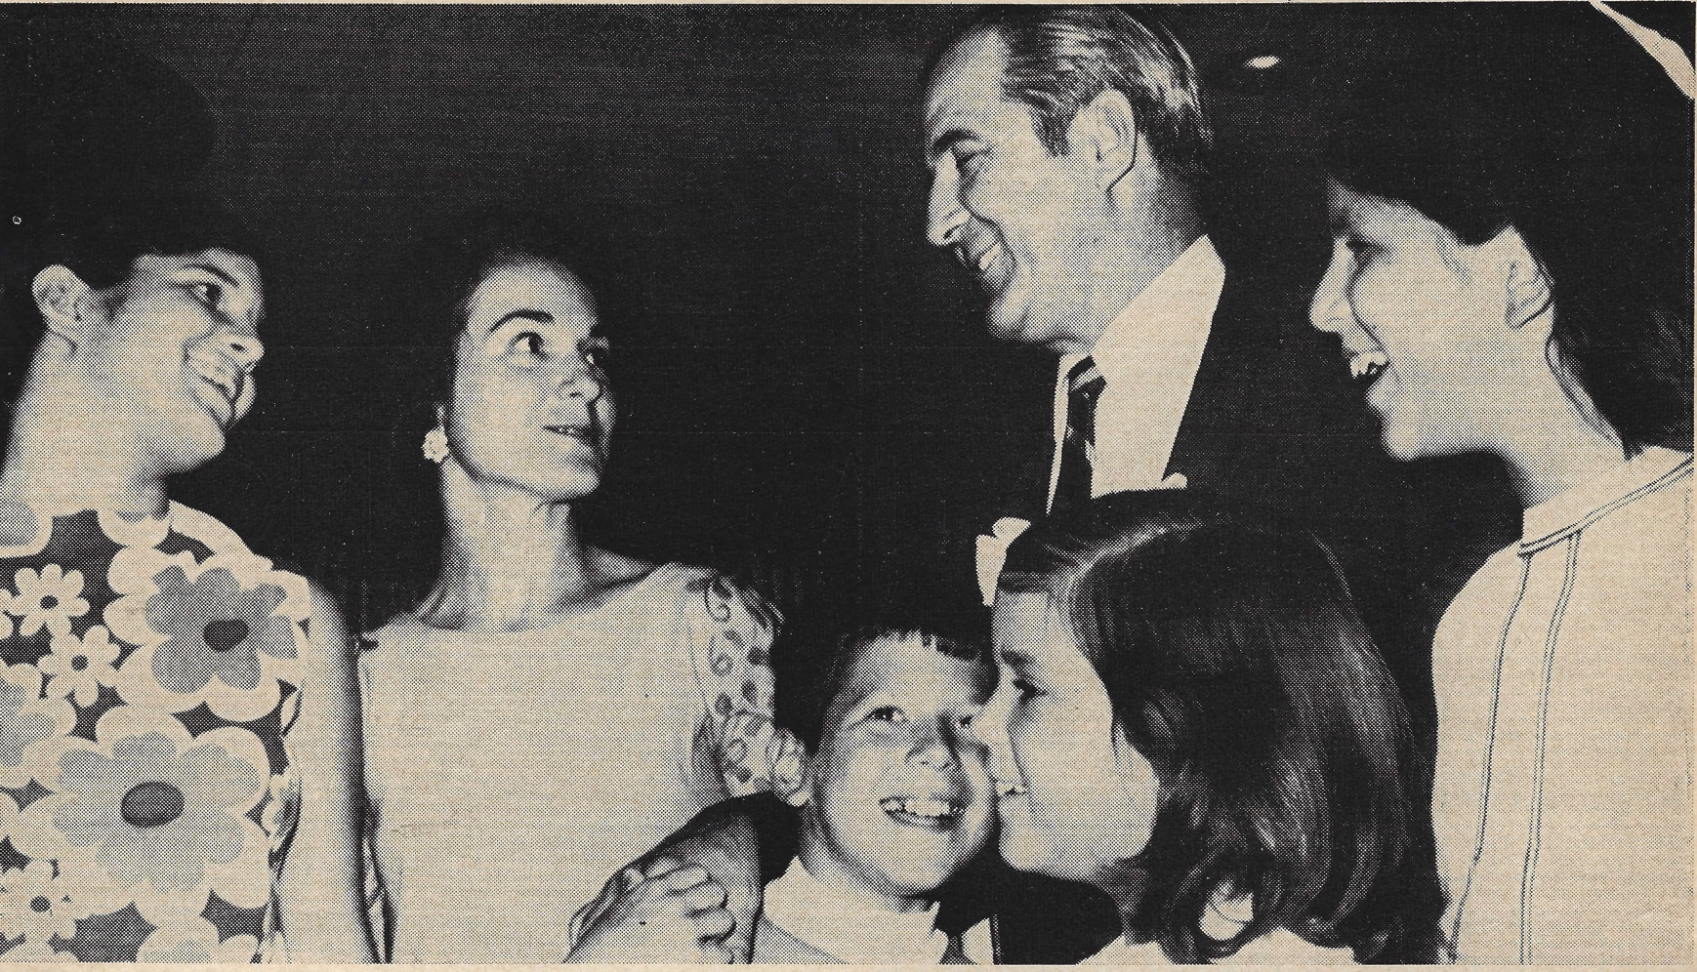
The home of many of Detroit’s leaders then and now (civic, business, religious and government)
Two Detroit mayors lived in North Rosedale Park Albert Cobo & Roman S. Gribbs Several City Council members were Park residents North Rosedale Park residents gained a reputation for being civic-minded and politically engaged. .
What is North Rosedale Park Known For?

Slide 12
Wendell Anthony, Detroit NAACP President and Fellowship Chapel Pastor Keith Butler, Detroit City Council Member and Bishop of Word of Faith Elbernita “Twinkie” Clark, Member of Gospel Group Clark Sisters Frankie Darcell, Radio Personality Hilary Golston, Fox 2 Reporter and Anchor Jennifer Granholm, Michigan Governor 2003 to 2011 Martha Griffiths, Michigan Lt. Governor (Gov. James Blanchard) Thomas Hearns (The Hitman), Professional Boxer Ted Nugent (Motor City Madman), Singer and Songwriter L. Brooks Patterson, Oakland County Executive 1993-2019 Emanuel Steward (Manny), Professional Boxer and Trainer James Tate, Detroit City Council Member Reginald Turner, Attorney and ABA President
Noted North Rosedale Park Residents

Slide 14
Thank you for your support!! Have a good day!!

