Slide 1
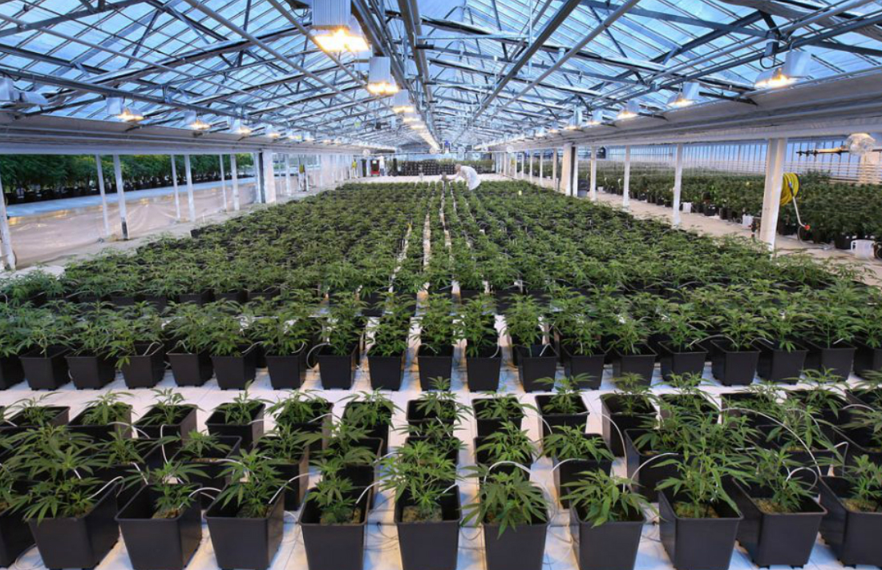
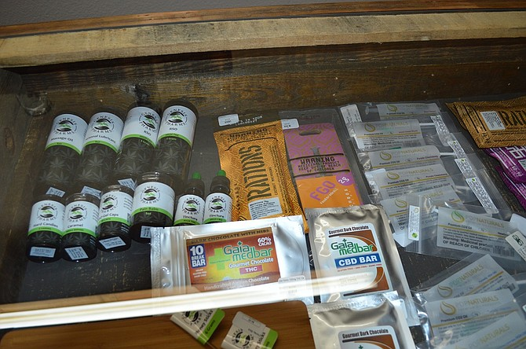
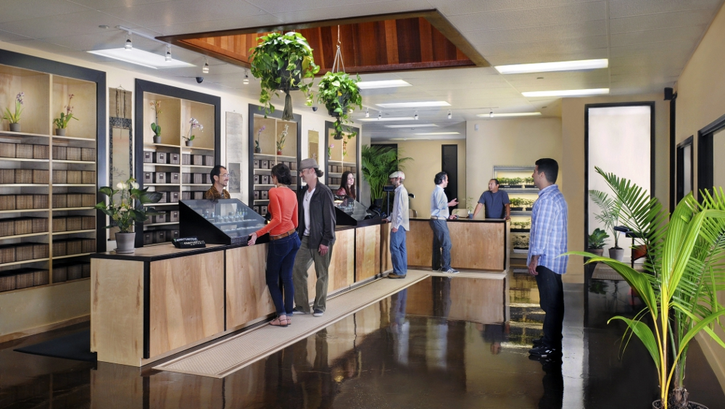
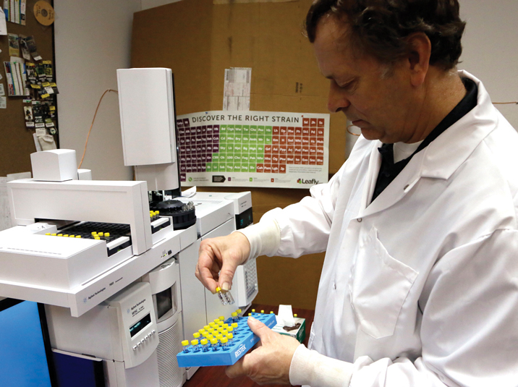
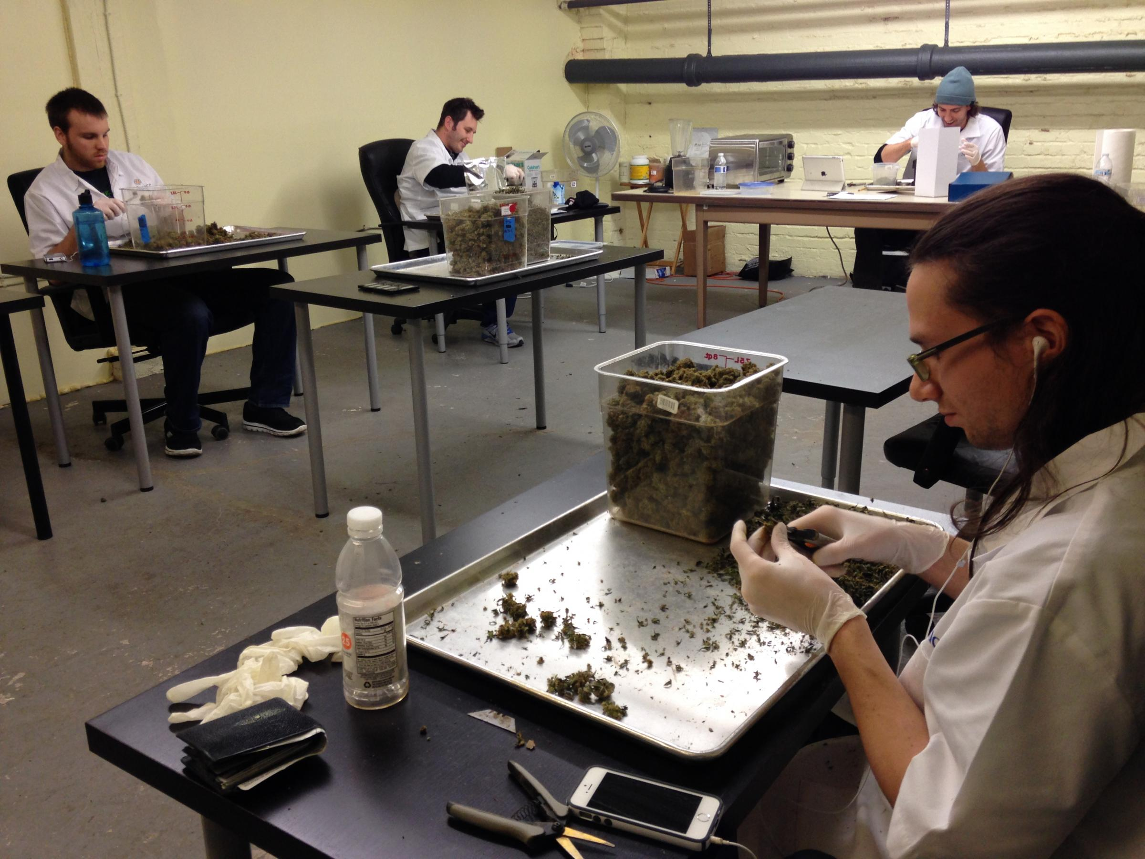
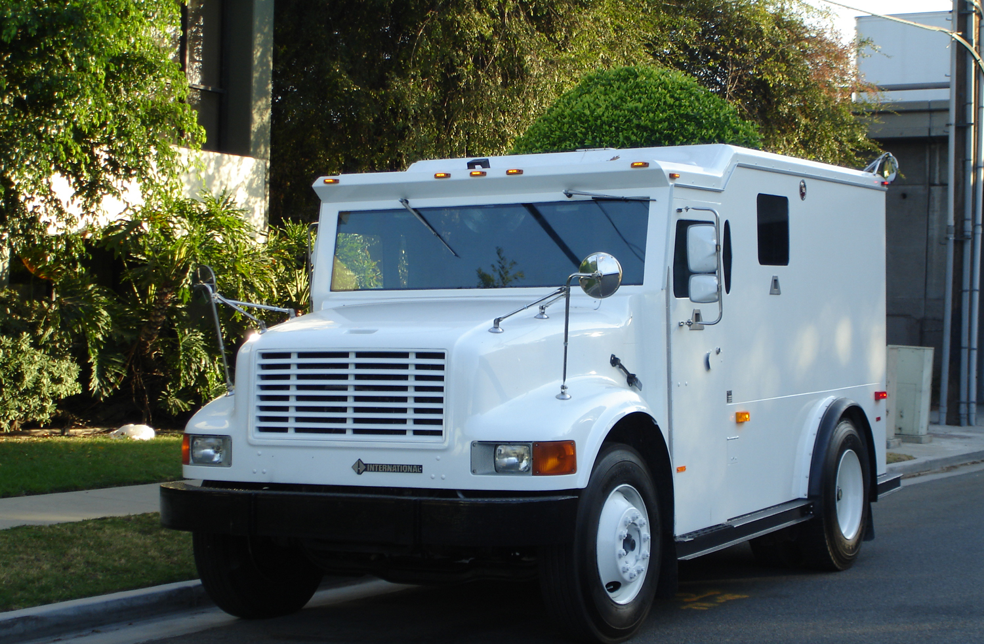
Medical Marijuana Facilities & Adult-Use Marijuana Establishments
D3 Townhall March 17, 2021

Slide 2
HISTORY
Medical Marihuana Act Initiated Law 1 of 2008
2012 Citizen Voter Legal Possession and Consumption (only Detroit)
2015 Medical Marihuana Caregiver Center provisions (only Detroit)
2016 Medical Marihuana Facilities Licensing Act (MMFLA)
May 2018 – Medical Marihuana Facilities Ordinance (only Detroit)
2018 Michigan Regulation and Taxation of Marijuana Act (MRTMA)
Notes:
In November 2008, Michigan voters passed a ballot initiative allowing the lawful sale and use of marihuana for medical purposes referred to as the Medical Marihuana Act Initiated Law 1 of 2008. This ballot initiative had widespread support amongst voters with a 63% approval of Michigan voters statewide and 75.6% of Detroit voters.
The passage of this act resulted in the proliferation of unlicensed and unregulated medical marihuana dispensaries and facilities throughout the city of Detroit, largely due to the lack of statutory regulation and oversight by the state, county and local government.
In November 2012, the electorate of the City of Detroit voted to enact a citizen-initiated ballot initiative which would allow for the legal possession and consumption of one ounce of marijuana or less on private property by an adult, aged 21 or older. This initiative passed with 65% voting yes.
In 2015 the Detroit City Council voted on the “Medical Marihuana Caregiver Center” ordinance (Ord. No. 31-15, effective 3/1/2016), which was enacted to amend the text of Chapter 61 of the 1984 Detroit City Code, “Zoning,” by defining “Medical Marihuana Caregiver Center” and creating regulations to stem the proliferation of and otherwise regulate such establishments in the City of Detroit. At the time of enactment, approximately 214 unlicensed and unregulated medical marihuana facilities had been established within the boundaries of the City of Detroit.
In 2016, the Michigan legislature enacted Public Acts, 281, 282, and 283 which allowed for the licensure of five Medical Marihuana Facility types, the production and sale of marihuana infused products, and the creation of a tracking system to monitor the products from “seed to sale.” This series of legislation has collectively been referred to as the Medical Marihuana Facilities Licensing Act (MMFLA).
In accordance with Public Act 281 (MMFLA), in order for a resident to obtain a state license, the municipality in which they wish to operate must opt into the state’s licensing scheme. The opt-in provisions have been implemented through what was previously Chapter 24 (now Chapter 20-Licensing), of the Detroit City Code, as a result of the November 7, 2017 ballot initiative – Proposal A. Proposal B was a citizen lead ballot initiative which sought to regulate the various land uses allowed through the MMFLA through zoning regulation, was ultimately struck down by Chief Judge Colombo of the 3rd Circuit Court and found to be in violation of the Michigan Zoning Enabling Act.
At the request of City Planning Commissioner Gregory Pawlowski (Feb. 2017- Feb. 2020), CPC staff convened two working group meetings including members of City Council staff, City department representatives, as well as members of the medical marihuana industry regarding developing the regulatory scheme for medical marihuana within the City of Detroit. Ordinance No. 20-18 was enacted on October 14, 2018 to regulate medical marijuana facilities in the City of Detroit.
In November 2018, the Michigan electorate enacted Proposal 1 – The Michigan Regulation and Taxation of Marijuana Act to legalize recreational marijuana possession, cultivation, and consumption by adults 21 years of age or older in the State of Michigan. The initiative was approved with 56% of the statewide vote, and was approved by the electorate of the City of Detroit with 69% voting yes.

Slide 3
PROPOSED ZONING PROVISIONS
Article II, Division 6 – Review and Decision-Making Bodies
Article III, Division 12 – Medical and Adult-Use Provisions
Article XII, Use Table
Article XII, General Use Standards & Specific Use Standards
Article XIV, Parking
Article XVI, Words and Terms
Notes:
PROPOSED ZONING PROVISIONS
In order to fully effectuate adult-use marijuana facilities and accommodate the newly passed licensing provisions, new terms are being added to Chapter 50 to delineate adult-use facilities from medical marijuana facilities, as well as adding terms and permissibility for new adult-uses.
Below is an analysis and summary of the provisions of the proposed text amendments to Chapter 50, which will be the subject of your February 4th public hearing.

Slide 4
Article III, Division 12 –
Medical and Adult-Use Provisions
Medical Marihuana Caregiver Centers (2015)
Medical Marihuana Facilities (2018)
Adult-Use Marijuana Establishments (2021)
Notes:
The ordinance as proposed amends Article III, Division 12 - Medical Marihuana Caregiver Centers and Medical Marihuana Facilities. The title of the division shall be changed to Medical Marijuana Facilities and Adult-Use Marijuana Establishments. With the passage of the 2020 Licensing Ordinance provisions, the land use of Medical Marihuana Caregiver Center has become a non-conforming use. Upon approval of the 2017 Medical Marihuana Facilities licensing provisions, the Buildings, Safety Engineering, and Environmental Department no longer accepts applications for Medical Marihuana Caregiver Centers nor issue renewals for such facilities. The intent is to phase out the land use in support of State-regulated Medical Marijuana establishments.
The general purpose of the revision of Article III is to regulate both medical marijuana facilities and adult-use marijuana establishments, to prevent concentration of these uses in order to better ensure the diversification of commercial and retail offerings along major and secondary corridors.
Additionally, references to the Michigan Medical Marihuana Facilities Licensing Act (Public Act 281 of 2016, MCL 333.27101 et seq.) and, the Michigan Regulation and Taxation of Marijuana Act (Initiated Law 1 of 2018, MCL 333.27951 et seq.) have been added to this section.
With the drafting of this ordinance a uniformed spelling of “Marijuana” has been adopted for utilization in all future ordinances and correspondence.
In regards to Sec. 50-3-531(c)(2)(d), the language requiring the Buildings, Safety Engineering and Environmental Department to maintain a list of locations of medical marihuana facilities that are licensed by the State of Michigan on the City of Detroit website is recommended to be stricken.

Slide 5
Sec. 50-3-533 – “Definitions.”
Notes:
In Sec. 50-3-533 – “Definitions.” The meaning of terms has been expanded and several definitions added to this section related to newly permissible business uses. Below is a summary of the revisions and/or additions proposed for this section:

Slide 6
Article XVI, Words and Terms
Marijuana retailer establishment,
Marijuana retail/provisioning facility,
Marijuana safety compliance facility,
Marijuana secure transporter facility,
Medical marijuana facility,
Medical marijuana Provisioning Center Facility,
Michigan Medical Marihuana Facilities Licensing Act or “MMFLA,” and
Michigan Regulation and Taxation of Marijuana Act or “MRTMA”
Adult-use marijuana establishment,
Co-location (marijuana),
Cultivation or cultivate (marijuana),
Designated marijuana consumption establishment,
Drug-free zone, Equivalent licenses (marijuana),
Licensee (marijuana),
Marijuana grower facility,
Marijuana microbusiness,
Marijuana processor facility,
Notes:
Finally, Article XVI, Division 2 – “Words and Terms Defined,” is proposed to be revised by amending and adding several definitions. The existing terms, including the word “Marihuana,” have been revised to read “Marijuana,” and Adult-use marijuana establishment, Co-location (marijuana), Cultivation or cultivate (marijuana), Designated marijuana consumption establishment, Drug-free zone, Equivalent licenses (marijuana), Licensee (marijuana), Marijuana grower facility, Marijuana microbusiness, Marijuana processor facility, Marijuana retailer establishment, Marijuana retail/provisioning facility, Marijuana safety compliance facility, Marijauana secure transporter facility, Medical marijuana facility, Medical marijuana Provisioning Center Facility, Michigan Medical Marihuana Facilities Licensing Act or “MMFLA,” and Michigan Regulation and Taxation of Marijuana Act or “MRTMA” definitions are newly added to this section.
The proposed revisions to the Zoning Ordinance are anticipated to move in tandem with an amendatory ordinance for the Chapter 20 – “Business Licensing” provision so the definitions of Adult-Use Marijuana Consumption Establishment coincide with one another.

Slide 7
Sec. 50-3-533 – “Definitions.”
The definition of an Adult-use designated marijuana consumption establishment has been newly added; as a location where a business that is licensed under the Michigan Regulation and Taxation of Marihuana Act (MRTMA) and Chapter 20 of this Code is operated which permits adults 21 years of age and older to consume marijuana products at a commercial location designated on the state operating license, and approved in accordance with Chapter 50.

Slide 8
Sec. 50-3-533 – “Definitions.”
The definition of Drug-free zone in Sec. 50-3-533(d)(4) has been revised to reference “outdoor recreation facilities as defined in Sec. 50-16-324 of this Code, other than parkways and parklots.”

Slide 9
Sec. 50-3-533 – “Definitions.”
The definition of Marijuana microbusiness has been newly added meaning, a location where a licensee that is licensed as a marijuana microbusiness under the MRTMA and Chapter 20, Article VI of this Code operates a commercial entity that cultivates not more than 150 marijuana plants, or more as allowed by the State of Michigan, processes and packages marijuana, and sells or otherwise transfers marijuana to individuals who are 21 years of age or older or to a marijuana safety compliance facility, but not to other adult-use marijuana establishments or medical marijuana facilities.

Slide 10
Sec. 50-3-533 – “Definitions.”
The definition of Marijuana retailer establishment has been newly added meaning, a location where a licensee that is licensed as a marijuana retailer under the MRTMA and Chapter 20, Article VI of this Code operates a commercial entity that obtains marijuana from adult-use marijuana establishments and sells or transfers marijuana to individuals who are 21 years of age or older and to other adult-use marijuana establishments.

Slide 11
Sec. 50-3-534 – “Medical marijuana caregiver center” procedures
Notes:
Sec. 50-3-534 – “Medical marijuana caregiver center procedures,” has been revised to reiterate that applications for medical marijuana caregiver centers will not be accepted after the effective date of the revised ordinance. Language pertaining to procedures for processing medical marijuana caregiver center applications have been stricken from this section.

Slide 12
Sec. 50-3-535 – “Permitted districts for medical marijuana facilities and adult-use marijuana establishments; Conditional use; Restrictions,”
Notes:
Newly added to Subsection (a) of this section are the land uses of Designated marijuana consumption establishment which may be permitted on a conditional basis in B2, B4, B5, B6, M1, M2, M3, M4, and SD2 zoning districts, and Marijuana microbusinesses which may be permitted on a conditional basis in the B2, B4, B5, B6, M1, M2, M3, M4, and SD2 zoning districts. The land use of Medical marijuana provisioning center has been replaced with Marijuana retail/provisioning facilties. Additionally the language which limits the number of provisioning center facilitity licenses to 75 has been stricken from this section, noting that the licensing limitation is now included in Chapter 20, Article VI of the City Code.

Slide 13
Locational Prohibition
(1) within a drug-free zone,
(2) within a Gateway Radial Thoroughfare overlay area or Traditional Main Street overlay area, or
(3) on a zoning lot that is located less than “1,000 radial feet from a zoning lot occupied by any religious institution identified as exempt by the City Assessor,” any zoning lot “with an unexpired conditional land use approval, building permit, or certificate of occupancy for medical marijuana provisioning center facility, an adult-use marijuana retailer establishment, or a marijuana microbusiness,” or within “1,000 feet of any zoning lot occupied by a Controlled Use,”
Notes:
Also in Subsection (b) of this section, the three-part prohibition against locating (1) within a drug-free zone, (2) within a Gateway Radial Thoroughfare overlay area or Traditional Main Street overlay area, or (3) on a zoning lot that is located less than “1,000 radial feet from a zoning lot occupied by any religious institution identified as exempt by the City Assessor,” any zoning lot “with an unexpired conditional land use approval, building permit, or certificate of occupancy for a marijuana retail/provisioning facility or a marijuana microbusiness,” or within “1,000 feet of any zoning lot occupied by a Controlled Use,” has been extended to designated consumption establishments, marijuana retail/provisioning facilities and marijuana microbusinesses.

Slide 14
Sec. 50-3-357 – “Accessory Uses; Public Nuisance”
Notes:
Sec. 50-3-357 – “Accessory Uses; Public Nuisance” - provides that marijuana establishments are not permitted as accessory uses, and must not include accessory uses. However, multiple types of medical marijuana facilities and adult-use marijuana establishments may co-locate in the same building as separate principal uses of the premises.

Slide 15
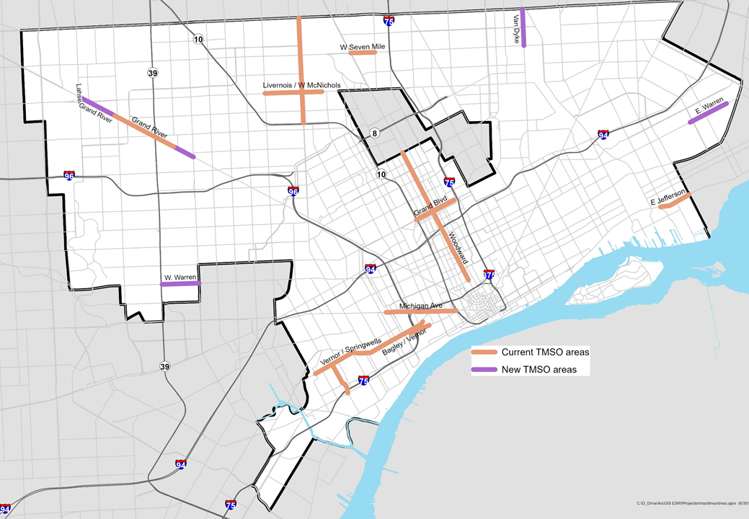
Sec. 50-11-386 – “Traditional Main Street Overlay Areas.”
Notes:
Sec. 50-11-386 – “Traditional Main Street Overlay Areas.” This section prohibits designated marijuana consumption establishments, marijuana microbusinesses, or marijuana retail/provisioning facilities from locating within any Traditional Main Street Overlay Area.
West Seven Mile. All zoning lots abutting West Seven Mile Road between the zoning lots at the four (4) corners of John R Avenue and the center line of Woodward Avenue.
(2) Grand River. All zoning lots abutting Grand River Avenue between the center line of Woodmont Avenue and the zoning lots at the four (4) corners of Evergreen Road.
(3) Bagley/Vernor. All zoning lots abutting Bagley Avenue between the center line of 16th Street and the center line of 24th Street; and all zoning lots abutting West Vernor Highway between the center line of Newark Avenue and the center line of Clark Street.
(4) Livernois/West McNichols. All zoning lots abutting Livernois Avenue between the center line of the John C. Lodge Freeway and the center line of West Eight Mile Road; and all zoning lots abutting West McNichols Road between the center line of Lawton Avenue and the zoning lots at the four (4) corners of Wyoming Avenue.
(5) East Jefferson. All zoning lots abutting East Jefferson Avenue between the center lines of Dickerson Avenue/Gray Avenue and the city limits of Grosse Pointe Park.
(6) Woodward. All zoning lots abutting Woodward Avenue between the center line of Temple Avenue/Alfred Street and the city limits of Highland Park.
(7) Grand Boulevard. All zoning lots abutting West Grand Boulevard/East Grand Boulevard between the John C. Lodge freeway (M-10) and the eastern edge of Cameron Street (extended). Standards for West Grand Boulevard between John C. Lodge freeway (M-10) and West Grand River in the Grand Boulevard Overlay Area are available in Subdivision D of this division.
(8) Michigan Avenue. All zoning lots abutting Michigan Avenue between the John C. Lodge freeway (M-10) and the zoning lots at the four (4) corners of Vinewood Avenue.
(9) Vernor/Springwells. All zoning lots abutting West Vernor Highway between the center line of Clark Street and the zoning lots at the four (4) corners of Woodmere Avenue; and all zoning lots abutting Springwells Avenue between the four (4) corners of West Vernor Highway and the four (4) corners of the Fisher Freeway (I-75) service drives. (

Slide 16
Article XII, Use Table
Notes:
The proposed ordinance amends Article XII, Division 1, Use Table, by adding the newly revised and/or added land uses to their respective category of Medical Marijuana Facilities and Adult-Use Marijuana Establishments as denoted in Sec. 50-12-110.

Slide 17
Article XII, General Use Standards & Specific Use Standards
Notes:
The proposed amendments to Article XII, Division 2 – General Use Standards, amend Sec. 50-12-132 – Other uses – Spacing, by striking the section pertaining to Medical marihuana caregiver center and specifying the spacing requirements for the other associated marijuana related uses.
Additionally, Sections 50-12-135 – “Waiver of general spacing requirements,” and 50-12-136 – “Waiver of spacing from schools,” state explicitly that spacing requirements may not be waived.
The proposed amendments to Article XII, Division 3 – “Specific Use Standards,” amend the language reflecting “Medical marihuana caregiver center” to reflect “Marijuana” where appropriate and to incorporate “adult-use marijuana establishment” where appropriate.

Slide 18
Sec. 50-12-413 – “Medical marijuana facilities and adult-use marijuana establishments”
Notes:
Newly added to Sec. 50-12-413 – “Medical marijuana facilities and adult-use marijuana establishments” are subsections (3),(4), and (5).
Subsection 3 specifies that a marijuana grower facility may operate only in a commercial or industrial building that has a building footprint that does not exceed 30,000 square feet and that is located on a parcel no larger than three acres; a marijuana grower facility may operate in a multi-story building, subject to applicale height limitations. A marijuana grower facility may operate in a building that has a building footprint that exceeds 30,0000 square feet but does not exceed 50,000 square feet, regardless of height, and is located on a parcel no larger than five acres only if that marijuana grower facility is co-located with another medical marijuana facility or another adult-use marijauan establishment.
Subsection 4 states that marijuana grower facilities may not grow outdoors.
Subsection 5 states that marijuana microbusinesses and marijuana retail/provisioning facilities may include drive-thru or curbside pickup operation if such operations are in compliance with applicable rules set forth by the state of Michigan. This section is incorporated to ensure that social distancing safeguards to combat the Covid-19 pandemic are in place.

Slide 19
Article XII, Division 6 – “Temporary Uses and Structures,”
Notes:
Article XII, Division 6 – “Temporary Uses and Structures,” strikes the references to Medical marihuana caregiver centers and medical marihuana facilities and replaces them with Medical marijuana facilities and adult-use marijuana establishments.

Slide 20
Article XIV, Parking
Notes:
Article XIV, Subdivision B – Off-Street Parking Schedule A, is revised as follows:

Slide 21
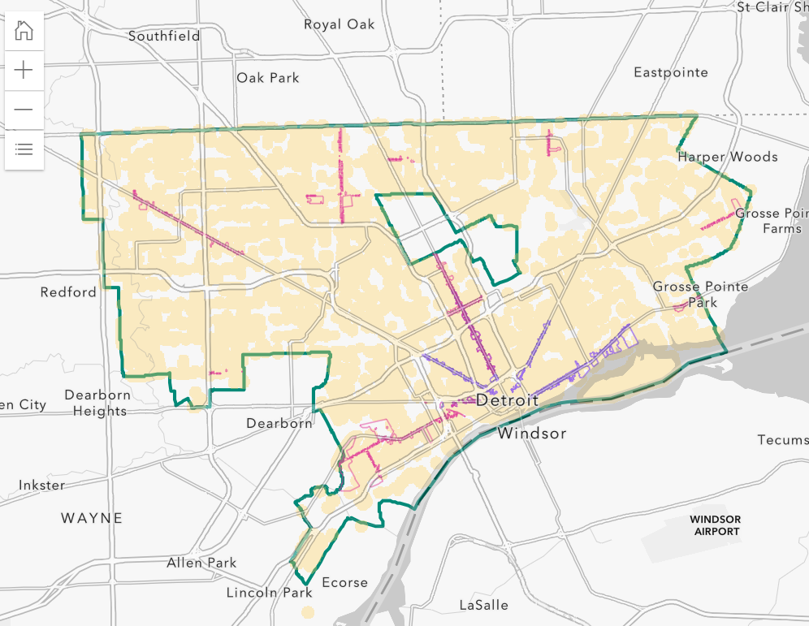
Current Drug Free Zone (1000 radial feet)
56,464 total parcels unaffected, of them
2,538 appear to be in zoning permissible areas
Notes:
Staff will note that there are currently 2,538 parcels which meet the zoning and spacing requirements for marijuana related industries, however, unfortunately many of these vacant parcels have been priced out of the range of many legacy Detroiters. DEFER TO COUNCILMAN TATE
This issue is further highlighted by the fact that after the City of Detroit evaluated its entire inventory we were only able to produce 17 properties that met the zoning and spacing requirements.

Slide 22
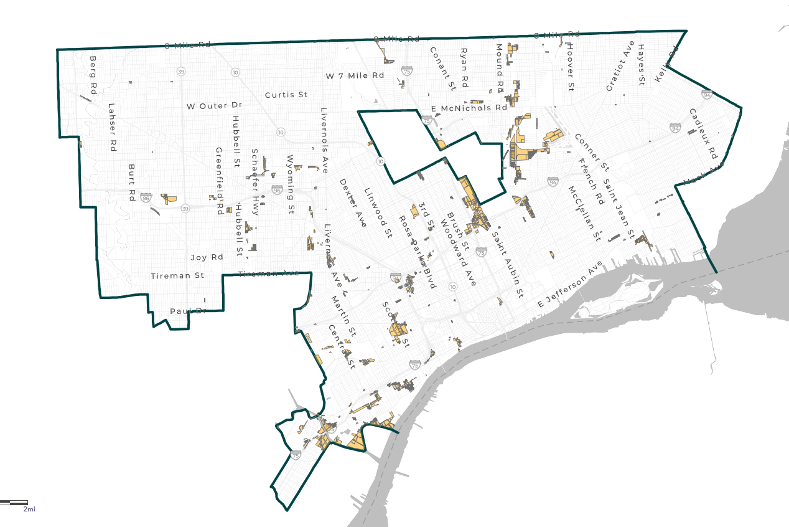
Proposed Drug Free Zone with reduced spacing from Controlled Uses (750 radial feet)
70,867 total parcels unaffected, of them
3,880 or so appear to be in zoning permissible areas
Notes:
By shrinking the buffer around drug-free zones from 1,000’ to 750’ there would be an increase of 1,342 more parcels able to be considered for a marijuana establishment—a 53% increase in the number of parcels.
There are additional maps that are in the process of being created. One decreases the spacing buffer around both liquor stores and marijuana facilities by 750 ft. The other decreases the spacing buffer around both liquor stores and marijuana facilities by 700 ft.

Slide 25
QUESTIONS?

