Slide 1
Advertising and Signs Ordinance
Ordinance Summary
November 18, 2020

Slide 2
Historical Context
Effective Regulation of Signage is CHALLENGING:
Constitutional Limitations
on Protected Speech
Property Rights of
Building/Land Owners
Preservation of Architectural Resources and
Neighborhood Aesthetics
Any Effective Signage Regulation Must Accommodate Multiple Distinct Priorities
Interest in Business Promotion/
Promotion of Local Commerce
Protection of Public Safety for
Motorists, Pedestrians, etc.
Advances in Signage Technology
Interests of Residents and Local Community Groups
Prevention of Proliferation of Excessive Signage

Slide 3
Sign Ordinance Overview
Under the revised draft sign ordinance, sign regulations are consolidated in Chapter 4, “Advertising and Signs”
Article I: Generally
Article II: Distribution of Handbills, Circulars, and Advertising Cards
Article III: Protection of Minors Against Advertisement and Promotion of Alcoholic Liquor and Tobacco Products
Article IV: Regulation of Business and Advertising Signs
Division 1: Generally
Division 2: General Sign Standards
Division 3: Regulation of Business Signs
Division 4: Regulation of Advertising Signs Outside the CBD
Division 5: Regulation of Advertising Signs Inside the CBD
Division 6: Regulation of Signs in the Right of Way
Division 7: Temporary Signs
Article V: Development Notification Signs

Slide 4
Sign Ordinance Overview
Article IV, Division 1: Generally
Significant Government Interests in Sign Regulation:
General protection of public welfare
Public safety, including traffic safety for pedestrians and motorists
Neighborhood aesthetics and environment
Facilitation of protected speech
Reduction of conflict among signs, buildings, and other structures
Business identification and promotion of local commerce
Noncompliance with Sign Regulations Constitute Blight Violations.
Blight violations is permissible pursuant to HCRA § 4q(4), MCL 117.4q(4)
Heightened Property Maintenance Standards for Signs
Signs must be maintained in good repair
Obsolete signs must be removed
Signs on vacant buildings must be removed
Unused sign supports must be removed
City has right of entry to abate sign violations

Slide 5
Sign Ordinance Overview
Amortization of Existing Nonconforming Signs
By codifying sign regulations under its police powers, the City can phase out (amortize) nonconforming signs over a reasonable 10-year period.
Heritage Signs
Older signs may contribute positively to the City’s aesthetics, even if they are obsolete. Ordinance recognizes unilluminated painted signs have been obsolete for a period of at least 50 years as “Heritage Signs” which are exempted from otherwise applicable property maintenance requirements and other standards.
Process for Waiver and Adjustment of Sign Standards
New opportunity for adjustments/waivers of dimensional or operational parameters for all types of signs.
Adjustment/waiver process conducted by the PDD Director via public hearing, subject to public notice/comment and Open Meetings Act standards.
PDD decisions are subject to appeal to the Department of Appeals and Hearings.
Sign Guidebook
BSEED to publish a guidebook containing pictures, graphics, workflows, sample applications and forms, and other information to make sign regulations and procedures accessible to the public.

Slide 6
Sign Ordinance Overview
Article IV, Division 2: General Sign Standards
Provides general requirements for any single sign, based on:
(1) Type of Sign Construction
(2) Master Plan Designation
Types of Sign Construction:
Arcade Signs
Awning Signs
Marquee Signs
Mechanical Signs
Monument Signs
Pole Signs
Portable Signs
Projecting Signs
Raceway Signs
Roof Signs
Wall Signs
Window Signs
Also:
Illuminated Signs
Animated Signs
Dynamic Signs
Double-Face Signs

Slide 7
Sign Ordinance Overview
Master Plan Designations
Sign District | Low-Density Residential | High-Density Residential/ Mixed Use | Low-Density Commercial/ Institutional | High-Density Commercial/ Industrial | Recreation/ Open Space
Master Plan District | Low-Density Residential (RL) Low/Medium-Density Residential (RLM) | Medium-Density Residential (RM) High-Density Residential (RH) Neighborhood Commercial (CN) Mixed Residential-Commercial (MRC) | Mixed-Town Centers (MTC) Institutional (INST) Thoroughfare Commercial (CT) Retail Centers (CRC) Mixed Residential-Industrial (MRI) IF Outside of CBD | Major Commercial (CM) Special Commercial (CS) Light Industrial (IL) General Industrial (IG) Distribution/Port Industrial (IDP) Airport (AP) ALSO Entire CBD | Regional Parks (PR) Recreation (PRC) Private Marinas (PMR) Cemetery (CEM)

Slide 8
Sign Ordinance Overview
 | Low-Density Residential | High-Density Residential/Mixed Use | Low-Density Commercial/ Institutional | High-Density Commercial/ Industrial | Recreation/ Open Space
Arcade |  | X | X | X
Awning |  | X | X | X | X
Marquee |  |  | X | X
Mechanical |  |  | X | X
Monument |  | X | X | X | X
Pole |  |  | X | X
Portable | X | X | X | X | X
Projecting |  | X | X | X | X
Raceway |  | X | X | X | X
Roof |  |  | X | X
Wall | X | X | X | X | X
Window | X | X | X | X | X
Illuminated | X | X | X | X | X
Dynamic/ Animated |  |  | X | X
Double-Face | X | X | X | X | X

Slide 9
Sign Ordinance Overview
Article IV, Division 3: Regulation of Business Signs
The total area of all business signage per premises is limited based on the type of sign district where the premises is located:
Sign District | Maximum Total Business Signage (Per Premises)
Low-Density Residential | 6 square feet
High-Density Residential/Mixed Use Low-Density Commercial/Institutional Recreation/Open Space | Greater of: 2.6 square feet per linear foot building frontage, or 1 square foot per linear foot premises frontage, Limited to 500 square feet.
High-Density Commercial/ Industrial | 3 square feet per linear foot building frontage. If outside CBD, limited to 500 square feet.
Casino Properties | 4 square feet per linear foot building frontage.

Slide 10
Sign Ordinance Overview
Additional business signage area is allowed under certain specific purposes:
High-rise Identification Signs
Painted Side Wall Signs
Signs Identifying the Sponsorship of Public Art
Directional
Signage

Slide 11
Sign Ordinance Overview
Additional business signage area is allowed for premises located in the Entertainment District
Zone 1: most intense, allows approximately 5x more business signage than elsewhere and 100% dynamic if screened by buildings.
Theater District: allows 2x the business signage otherwise allowed. Dynamic signs are allowed but cannot be animated.
Woodward North Corridor: Dynamic signs may not be above 25’ in height, may not be animated, and must operate as static signs from 2:00 am to 6:00 am.
Buffer Area: designed to screen the intense signage of Zone 1 from adjacent areas. 50% more business signage is allowed.

Slide 12
Sign Ordinance Overview
Article IV, Division 4: Advertising Signs OUTSIDE THE CBD
Prohibition
Advertising signs prohibited in low-density residential and recreation/open space sign districts
Adjustment/Waiver Process
Every advertising sign located outside the CBD is subject to approval through adjustment/waiver process
Departmental Findings
DPW finding that advertising sign will not impair traffic safety
PDD finding that advertising sign will not be detrimental to environmental aesthetics
CFO finding that neither applicant nor property owner owe City taxes or assessments
BSEED finding that neither applicant nor property owner is subject to outstanding violations
BSEED finding that all other governmental approvals have been secured for the proposed sign
Spacing Requirements
1,000 feet between any two externally illuminated advertising signs
1,750 feet between an internally illuminated/dynamic advertising sign and another advertising sign
500 feet from any hospital, school, museum, park, playground, outdoor rec. facility, or historic district
125 feet from freeway travel lanes and 25 feet from freeway boundary
125 feet from any premises containing a residential dwelling unit.
200 feet from Detroit River

Slide 13
Sign Ordinance Overview
Dimensional Limitations
Height: 45 feet if adjacent to freeway,
35 feet for all other locations.
Clearance: 15 feet
Area: 672 square feet if adjacent to freeway,
378 square feet if adjacent to road >80 feet wide
250 square feet if adjacent to road <80 feet wide
Landscaping
If a premises is occupied solely by an advertising sign and no other building or structure, it must contain perimeter landscaping to a depth of five feet, which must be maintained in good health and quality.

Slide 14
Sign Ordinance Overview
 | Current Zoning Regulation | Revised Draft Sign Ordinance
Permissibility | In Grand Boulevard Overlay Area: new signs prohibited, nonconforming signs permissible indefinitely. By-Right in B5, B6, M3, M4, M5 Conditional in B2, B3, B4, M1, M2, W1 | In Grand Boulevard Overlay Area (outside CBD): new signs permissible, nonconforming signs subject to 10 year amortization. All signs permissible only “conditionally" Prohibited in low-density residential, recreation districts
Spacing | 1,000’ between advertising signs 500’ from schools, playgrounds, parks 500’ from historic districts 125’/25’ from freeway lanes/boundaries 40’ from residential districts | 1,000’ between externally illuminated ad signs 1,750’ from any internally illuminated/dynamic ad sign 500’ from hospitals, schools, playgrounds, parks 500’ from historic districts 125’/25’ from freeway lanes/boundaries 125’ from residential districts 200’ from Detroit River
Area | Freeway-adjacent: 672+ sf Adjacent to street >80’: 378+ sf Adjacent to street <80’: 250+ sf **Limits are automatically increased w/o limit based on distance from residential | Freeway-adjacent: 672 sf Adjacent to street >80’: 378 sf Adjacent to street <80’: 250 sf **Limits can be increased no more than 10%, subject to adjustment/waiver process
Height | All signs: 35+ feet. **Limit is automatically increased w/o limit based on distance from residential | Freeway-adjacent: 45 feet All other locations: 35 feet **Limits can be increased no more than 10%, through adjustment/waiver process
Landscaping | Landscaping at base of freestanding sign may be required on case-by-case basis. | 5’ deep perimeter landscaping required if sign is only structure on premises.

Slide 15
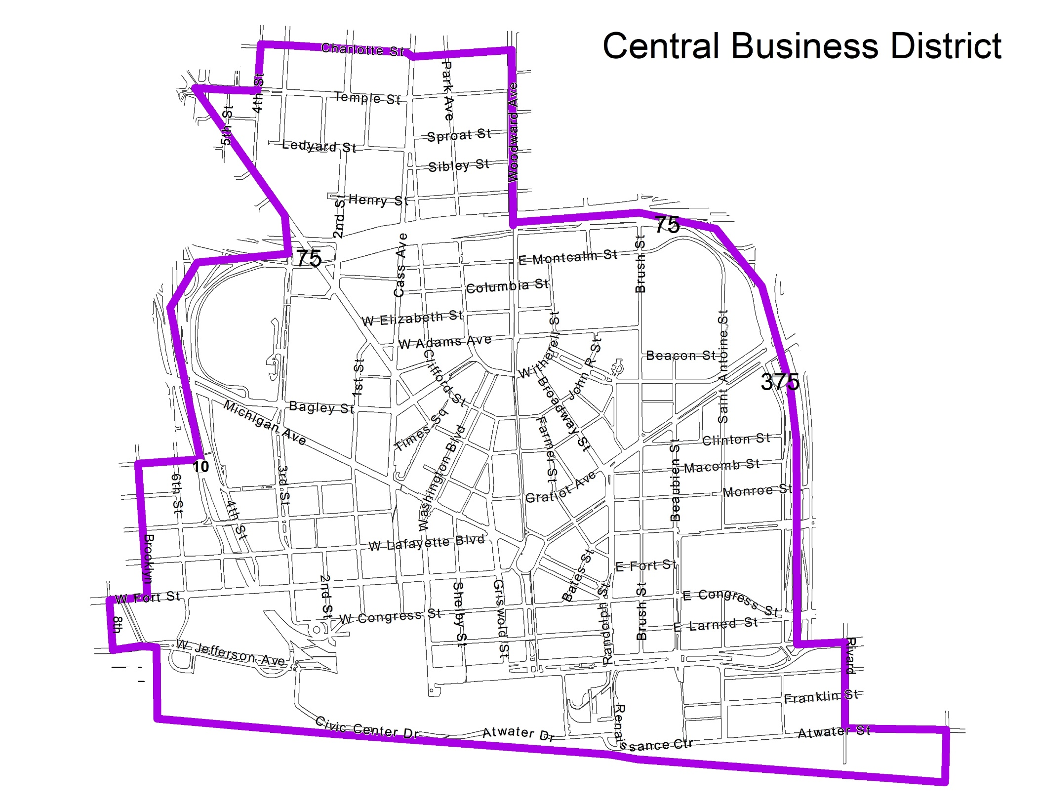
Sign Ordinance Overview
Article IV, Division 5: Advertising Signs INSIDE THE CBD
Number:
Max 25 permits for local advertising signs.
Max 45 permits for super advertising signs
Issued on a first-in-time basis
Term:
Permits are valid for a limited term of 10 years.
Permits are renewable only under limited circumstances. Otherwise, all properties must reapply prior to the beginning of each new permit cycle.

Slide 16
Sign Ordinance Overview
Dimensional Limitations:
 | Local Advertising Signs | Super Advertising Signs
Construction Type | Wall Sign or Painted Sign
Illumination | Outside Ent. District: External illumination only, no dynamic operation. Inside Ent. District: Internal illumination and dynamic operation allowed in certain zones.
Number | Not more than one advertising sign (local or super) per premises.
Area | Wall Signs: 700 square feet Painted Signs: 875 square feet | Wall Signs: 5,000 square feet Painted Signs: 6,250 square feet
Height | 60 feet | Height of roofline
Clearance | None | 10 feet
Coverage | 80% of façade area | 60% of façade area

Slide 17
Sign Ordinance Overview
Mitigation of Harmful Visual Aesthetics of Super Advertising Signs:
Super advertising signs are far larger and more impactful than any other type of sign allowed under the Sign Ordinance.
The City may evaluate proposed super advertising sign as to their expected negative visual aesthetics.
If it determines that a super advertising sign’s negative visual aesthetics are expected to be excessive, then the City can require a monetary contribution to support the creation of new art murals and other public art to mitigate the negative visual aesthetics.

Slide 18
Sign Ordinance Overview
Article IV, Division 6: Regulation of Signs in the Right of Way (ROW)
Business Signage in the ROW:
Signs located in the ROW that are intended to direct attention to adjacent businesses are considered on-premises business signage.
Directional/Wayfinding Signage in the ROW:
Directional and wayfinding signage is permissible in the ROW, subject to dimensional limitations.
Traffic control signals and signage that are installed and operated by a governmental authority are not subject to these regulations.
Advertising Signage in the ROW:
Limited advertising signage is permissible in ROWs that are outside of low-density residential sign districts.
Area limited to 18 square feet if illuminated or 24 square feet if unilluminated.
Must be incorporated into a larger structure that provides non-advertising public benefit to pedestrians, such as a news stand, bus shelter, or bicycle docking station.

Slide 19
Sign Ordinance Overview
Article IV, Division 7: Temporary Signs
Limitations on Number, Area, Term:
One temporary sign is allowed per premises or ground-floor tenant space.
Maximum allowable temporary sign area for a premises can be between 6 and 32 square feet, depending on the sign district where the premises is located.
Temporary signs may be permitted for not more than 90 days.
Additional Temporary Sign Allowances:
Limited additional temporary signage may be allowed in specific circumstances:
Temporary signage on premises listed as for sale or lease
Temporary signage on premises with open building or construction permits
Portable temporary signage on residential premises during specified periods of the year.

Slide 20
Conforming Amendments to Zoning Ordinance
Unaffected Sign-Related Zoning Provisions Include:
Sign-related standards for Traditional Main Street Overlay (TMSO) Areas that are stricter than applicable Chapter 4 regulations (Sec. 50-14-450).
Sign-related standards for Planned Development (PD) Districts that are stricter than applicable Chapter 4 regulations (Sec. 50-11-15(l)).
Signs remain subject to Special District Review (SDR) in PC and PCA Districts (Secs. 50-11-66, 50-11-96).
Signs remain subject to existing design review procedures applicable to other special zoning districts, including:
SD3 Districts (PDD review)
SD4 Districts (BSEED and Council review)
SD5 Districts (CPC, PDD, and Council review)

