Slide 1

PROPERTY MAINTENANCE
SIGN ORDINANCE ENFORCEMENT
NOVEMBER 2020

Slide 2
Property Maintenance is responsible for enforcing the Property Maintenance Building code on non-compliant properties for the life of the building. Property owners are held accountable for the conditions of their property according to the building requirements by building type and use. The Property Maintenance Division is comprised of 5 enforcement offices that have been charged with ensuring continued compliance for commercial & residential properties.
The sign enforcement will be handled by our commercial annual office as part of the scheduled biennial building inspections and will be enforced under the amended Chapter 4 sign ordinance. The sign license along with the biennial inspection will coincide with each other to save both the property owner and inspector time and the cost of a second inspection fee.
PROPERTY MAINTENANCE DIVISION

Slide 3
SIGN ENFORCEMENT CATEGORIES
NEW SIGNS
NON-CONFORMING SIGNS
MISCELLANEOUS SIGNS
CONSTRUCTION
Issues Certificate of Acceptance Creates sign license case Schedules the 2 year inspection
PROPERTY MAINTENANCE
Inspector is scheduled to complete the sign license and biennial building inspection at the same time. Once inspection is complete inspector will either issue a correction order for any existing violations or certificate of compliance for the building and issue new sign license with a two year expiration date and all applicable fees will also be issued to the property owner. If correction order is issued PMB will follow our normal ticketing process if owner does not come into compliance for either sign license or building violations.
PROPERTY MAINTENANCE
Upon completing biennial inspection if sign is on premises inspector will research to see if sign has previous approvals/permits/grants. If existing sign complies with the new ordinance those signs will not be impacted and PMB will note the sign case. If sign was previously in compliance but does not comply with the new ordinance inspector will issue correction order that expires in 2030. Building is still eligible for receiving certificate of compliance if all building code violations are complied. The property owner will have until 2030 to either remove the sign, alter the sign to comply with the new ordinance or seek a waiver/adjustment from PDD to resolve their specific issues.
PROPERTY MAINTENANCE
Upon completing the biennial inspection on a building if a sign is on the premises inspector will research if Certificate of Acceptance and sign license exist. If a Certificate of Acceptance and sign license does not exist inspector will issue correction order and property owner has 30 days to start the permit process or remove the sign. If owner does not comply inspector will issue at least 3 rounds of ticketing if applicable and property owner is subject to a misdemeanor.

Slide 4
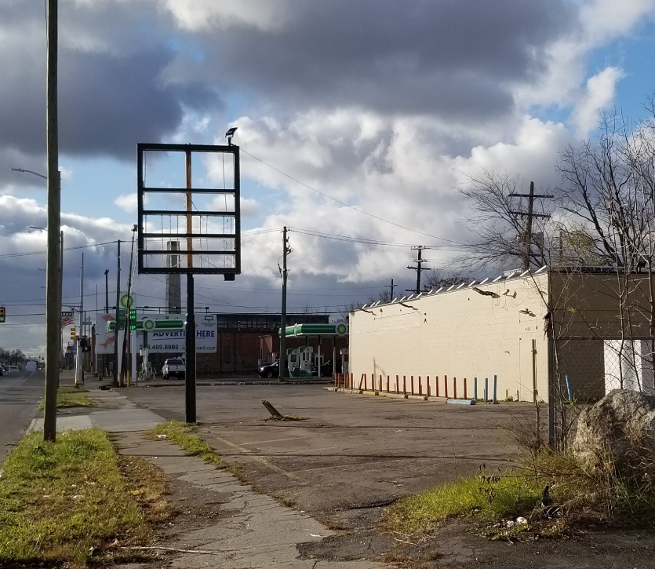
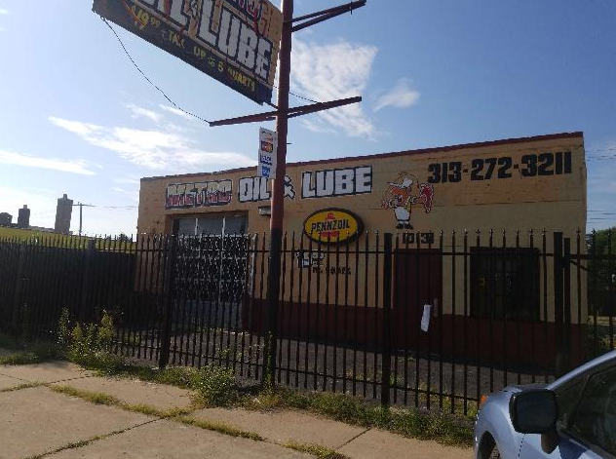
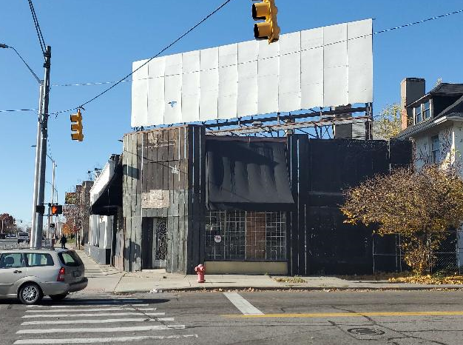
SIGN ENFORCEMENT BLIGHT VIOLATIONS

Slide 5
CIVIL FINES FOR ANY VIOLATION OF THIS ORDINANCE SHALL BE AS FOLLOWS:
SIGN ENFORCEMENT VIOLATION FINES
Nonpayment of the above blight violations are subject to additional civil or misdemeanor penalties under City Code Section 3-2-5.”
Noncompliance with the sign ordinance but property owner pays the blight violations in a timely basis, then the individual would be subject to misdemeanor penalties under City Code Section 3-2-5.
BUSINESS SIGNS ADVERTISING SIGNS
OFFENSE TYPE | FINE AMOUNTS
FIRST | $400
SECOND | $800
THIRD | $2000
OFFENSE TYPE | FINE AMOUNTS
FIRST | $600
SECOND | $1200
THIRD | $3000

