Slide 1

Jos Campau Streetscape Project
Pre-Construction Update Meeting
July 31, 2019

Slide 3
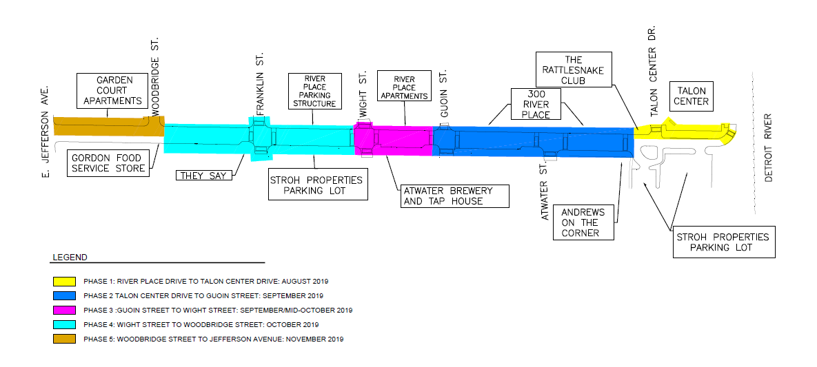
Proposed Construction Schedule

Slide 4
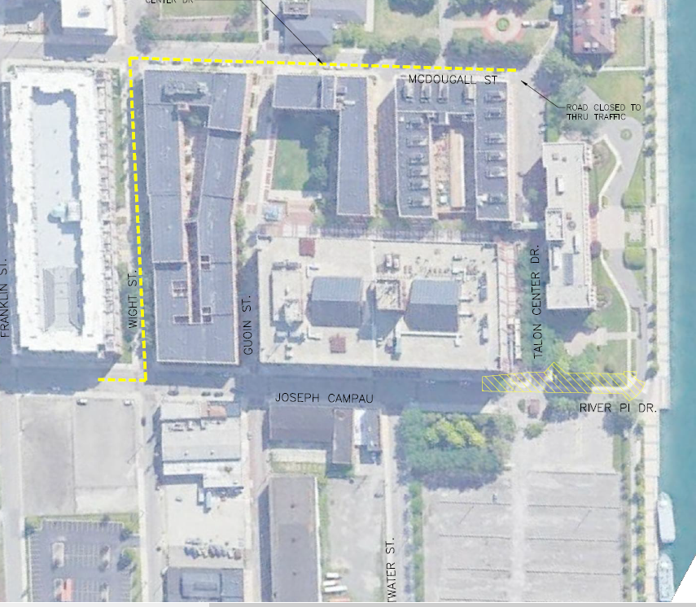
Detour Phase 1
Phase 1 Construction
Detour Route

Slide 5
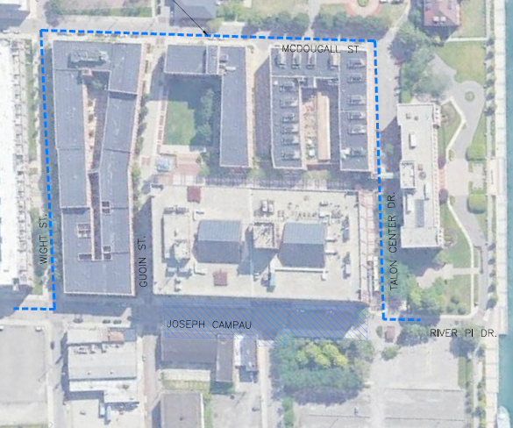
Detour Phase 2
Phase 2 Construction
Posted Detour Route

Slide 6
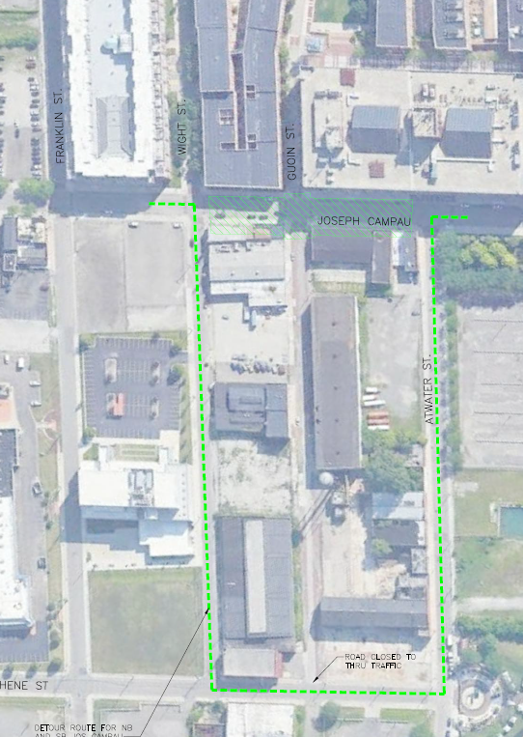
Detour Phase 3
Phase 3 Construction
Posted Detour Route

Slide 7
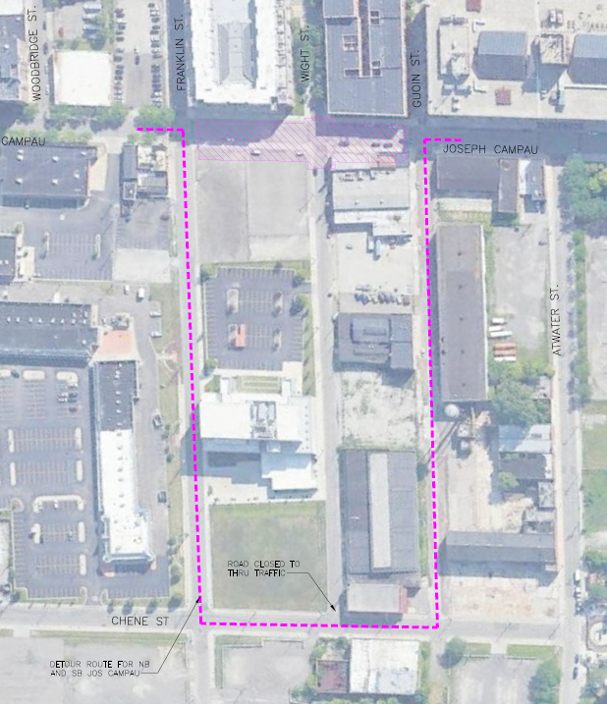
Detour Phase 4A
Phase 4 Construction
Detour Route

Slide 8
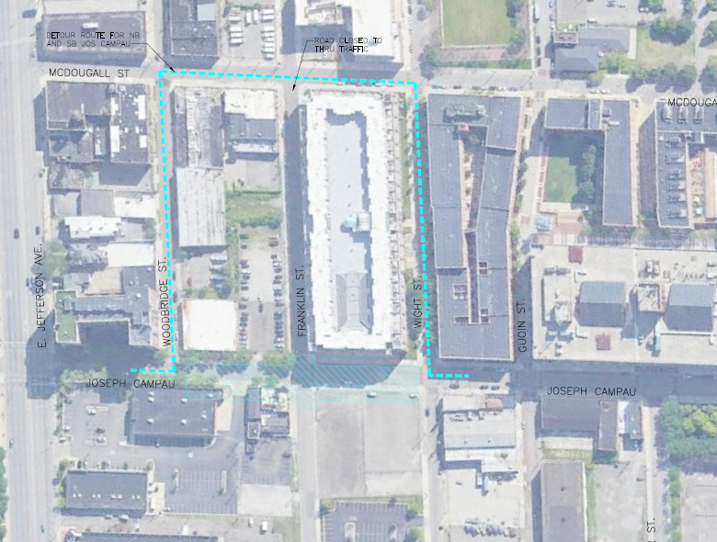
Detour Phase 4B
Phase 4 Construction
Posted Detour Route

Slide 9
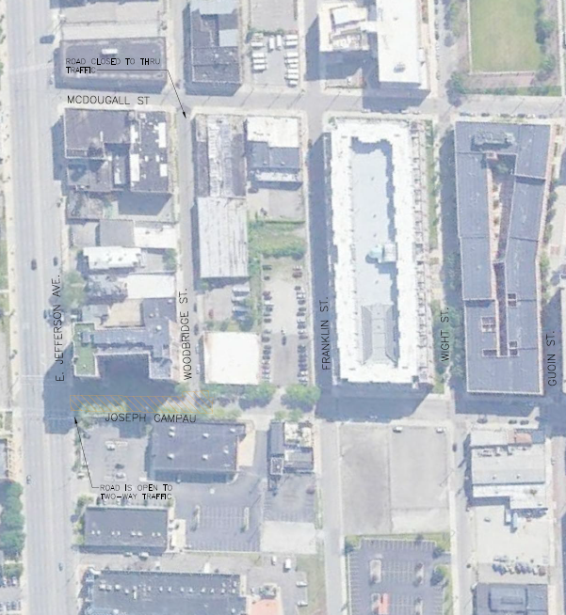
Detour Phase 5
Phase 5 Construction
Detour Route

Slide 10
Project Contact
Gustavo Serratos
Project Manager of Complete Streets
serratosg@detroitmi.gov
313-236-9522

