Slide 1
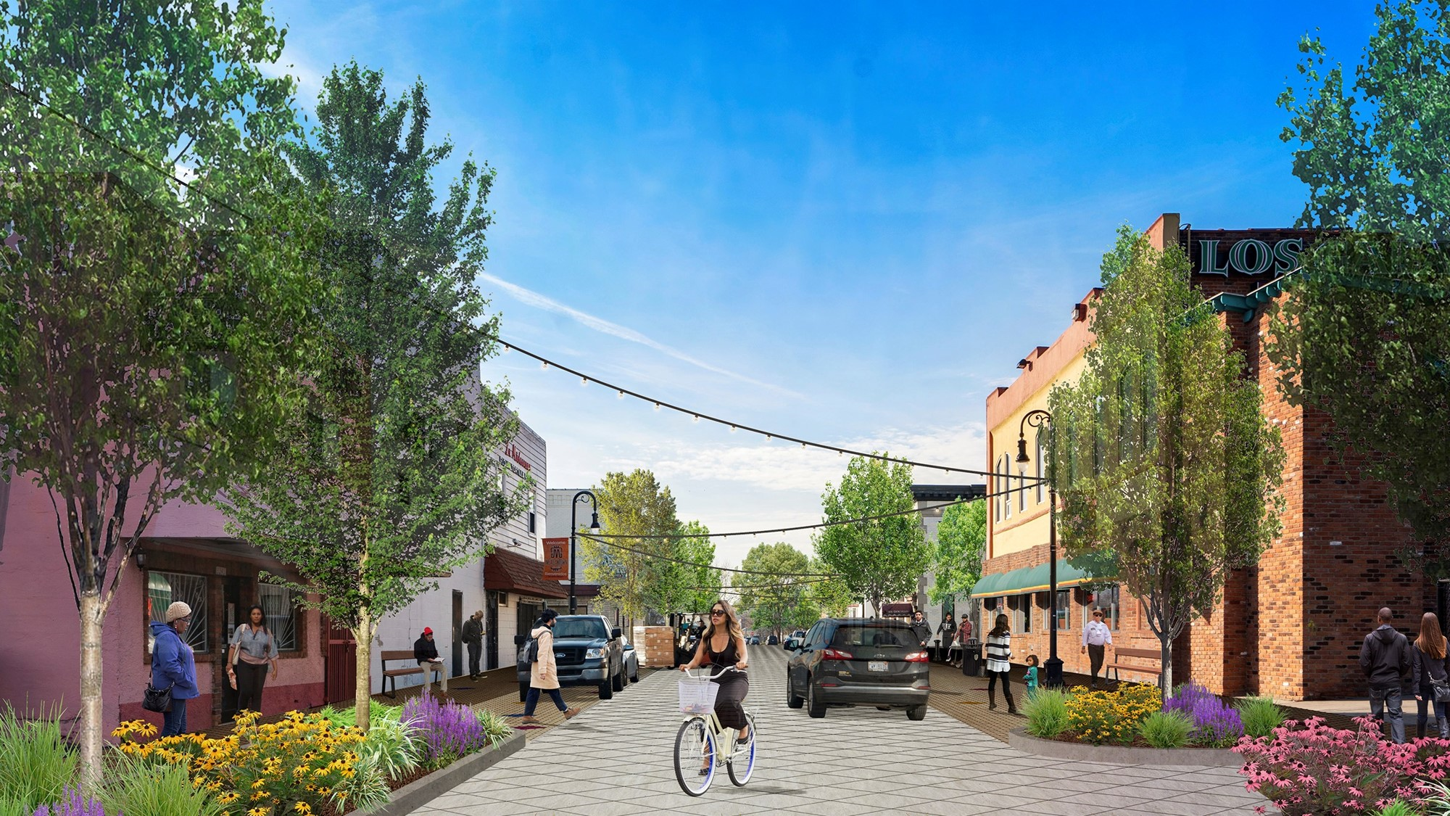
Bagley Streetscape Project
Pre-Construction Update Meeting
July 11, 2019

Slide 2
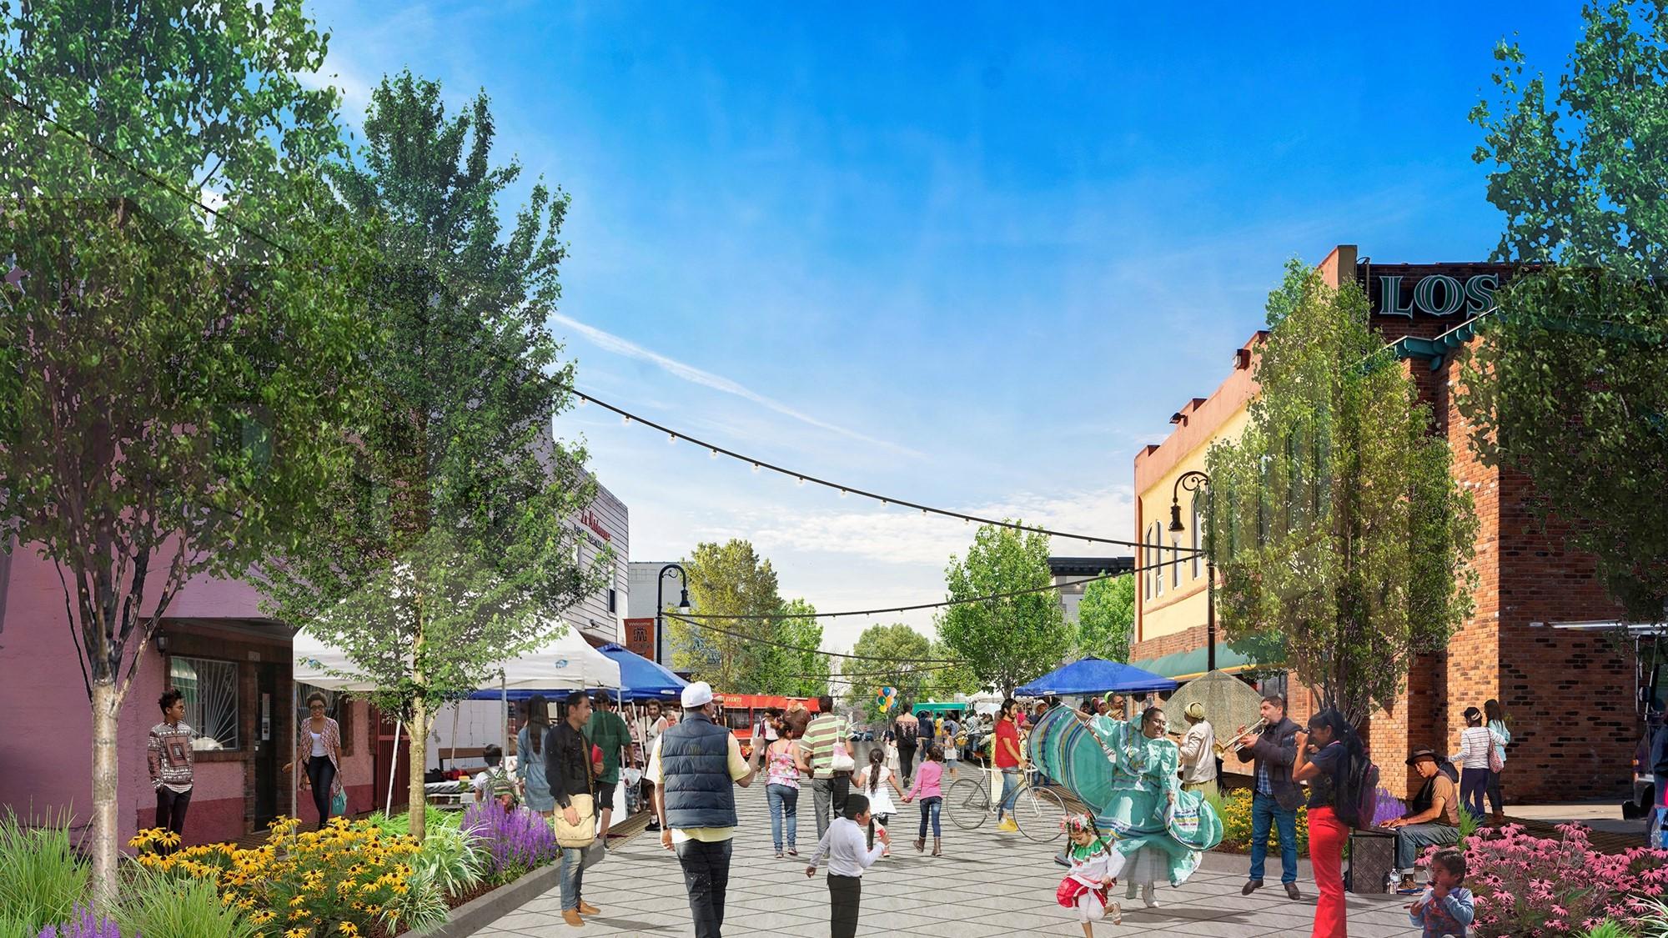

Slide 3
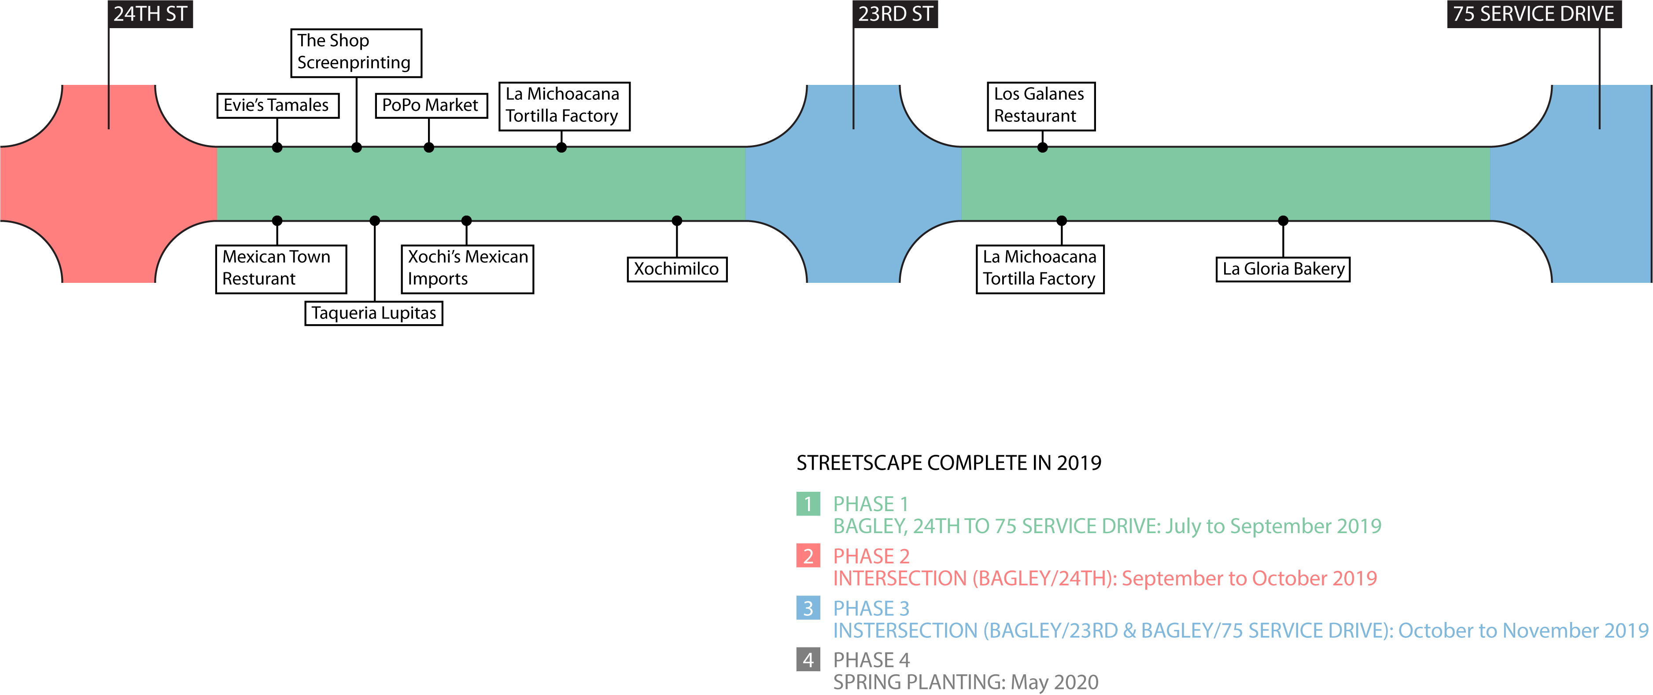

Slide 4
Project Contact
Gustavo Serratos
Project Manager of Complete Streets
serratosg@detroitmi.gov
313-236-9522

